Slide 1
Yeast Breads

Slide 2
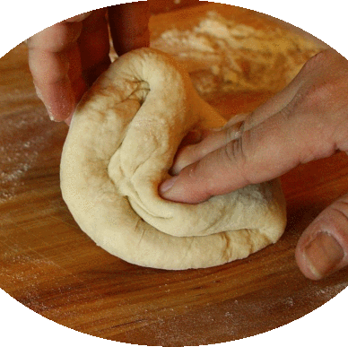
Homemade Yeast Bread
It has a distinctively appealing sweet smell and delicious taste.
Bread machine – measure the ingredients, and the machine does the rest

Slide 3
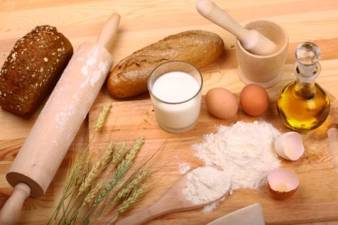
Yeast Bread Ingredients
Flour
Liquid
All-purpose flour
When mixed with liquid and kneaded, the flour develops gluten to support the carbon dioxide
Bread flour
Contains larger amounts of gliadin and glutenin
Produces the strongest and most elastic gluten
Whole wheat and nonwheat flours
Have a lower protein content
Produce a denser loaf
Plain water, potato water, or milk
Milk produces a softer crust and helps bread stay fresh longer
Buttermilk, fruit juices, yogurt, applesauce, and cottage cheese
Temperature affects yeast cells
Room temperature

Slide 4
Yeast Bread Ingredients, cont.
Salt
Yeast
A microscopic, single-celled plant used as a leavening agent
Compressed yeast – made from fresh, moist yeast cells that are pressed into cakes
Perishable
Active dry yeast – made from an active yeast strain that has been dried and made into granules
Fast-rising yeast – highly active yeast strains
Regulates the action of the yeast and inhibits the action of certain enzymes in the flour
Without = sticky and hard to handle

Slide 5
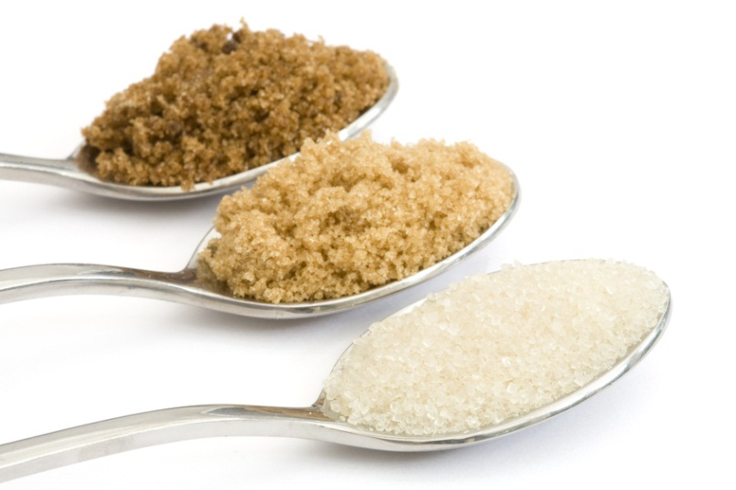
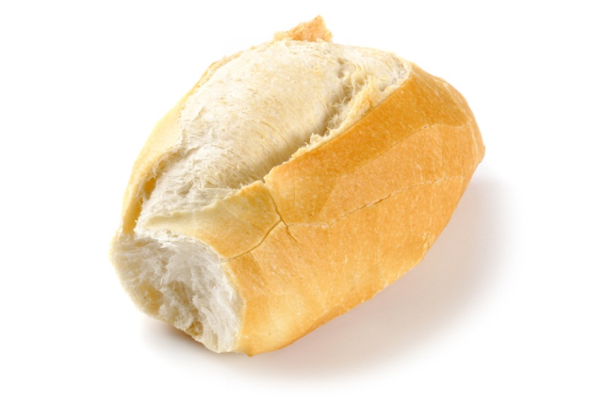
Yeast Bread Ingredients, cont.
Sugar
Fat
Influence browning, flavor, and texture
Provide extra food for the yeast so the dough will rise faster
Increases the tenderness of yeast breads
Optional in some traditional recipes, but it is required in bread machine recipes

Slide 6
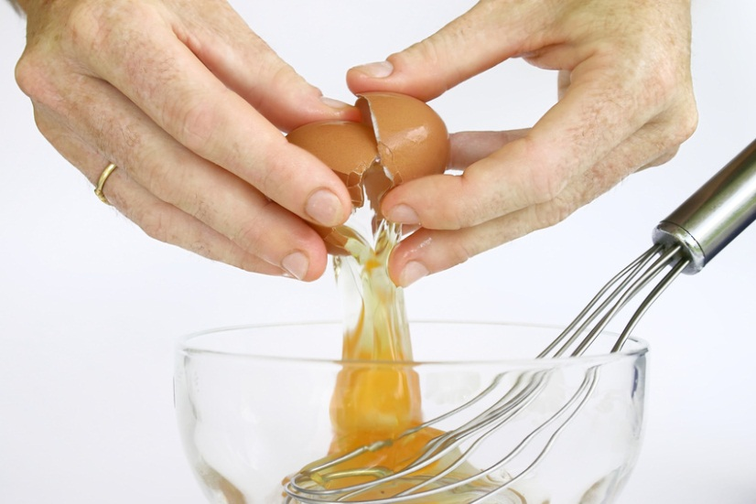
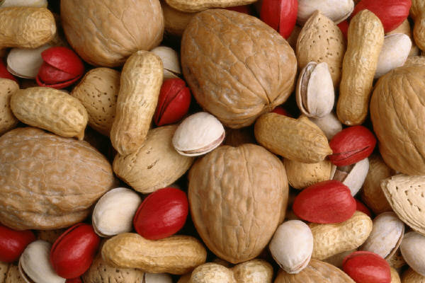
Yeast Bread Ingredients, cont.
Eggs
Other ingredients
Add flavor and richness
Add color and improve the structure
Raisins, nuts, cheese, herbs, and spices
Add flavor and variety
Lengthen the rising time

Slide 7
Mixing Methods For Yeast Breads
As a group and using the internet/book, make a poster explaining one of the assigned methods:
Traditional Method
One-Rise Method
Mixer Method
Batter Method
Fermentation / Punching Down
Shaping & Baking
Characteristics of Yeast Bread

Slide 8
Kneading
Video Clip

Slide 9
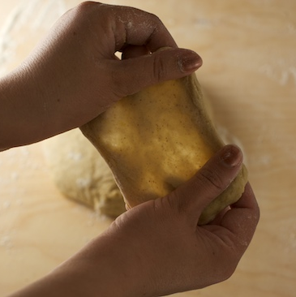
Food Science Principles of Preparing Yeast Breads
During mixing and kneading, the gluten develops
It will trap the carbon dioxide produced by the yeast as the dough rises

Slide 10
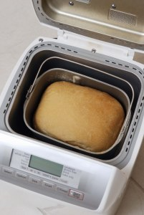
Timesaving Yeast Bread Techniques
Cool-Rise Doughs
*specifically designed to rise
slowly in the fridge
*kneaded, brief rest, and
shape
Refrigerator Doughs
*designed to rise slow in fridge
*uses the batter method,
shaped
Freezer Doughs
*mix and knead, freeze before
or after shaping
Bread Machines
*foolproof
*follow manufacturers
directions
*weather conditions effect dough that is prepared in a bread machine

Slide 11
Microwaving Yeast Breads
Can help with some STEPS throughout the yeast bread preparation process
*defrost frozen dough
-microwave 1 cup water for 3-5 minutes, until
boiling
-creates a moist atmosphere, place dough in
greased bowl & microwave on defrost setting for 3
minutes, turnover and repeat until dough is soft to
touch.
*raise the dough
-place in greased bowl, cover with wax paper, and place in a bowl of warm water, microwave on low for 1 minute, rotate and repeat until doubled in size.
*some recipes are designed to be baked in microwave

Slide 12
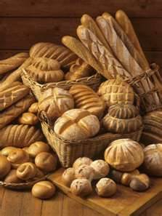
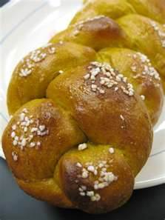
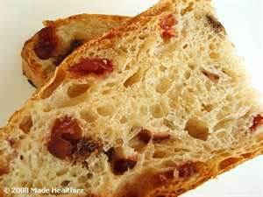
Yeast Bread Variations
Switching the flour type your using
Adding dried fruits, herbs, nuts, cheese, etc.
Brush tops with butter and add poppy
seeds, sesame, etc.
Shape into loaves, rolls, crescent rolls, bows, etc.

