Slide 1
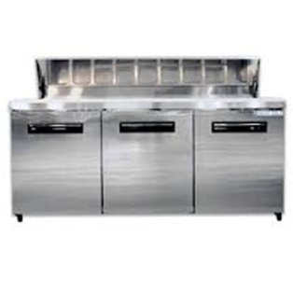
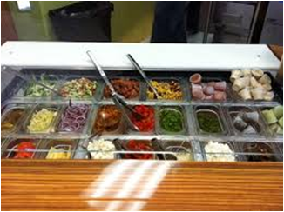
Sandwich Stations
1.3
Chapter 1: Breakfast Foods & Sandwiches

Slide 2
Review TWO Categories of Sandwiches
HOT
COLD

Slide 3
“Hello! My name is (name of sandwich) and I am a (description).”
Monte Cristo
Club Sandwich
Reuben
BLT
Patty Melt
Grilled Cheese
Cuban Sandwich
Open Faced Turkey Sandwich
French Dip
Calzone
Egg Salad
Po’Boy
Sloppy Joe
Philadelphia Cheese Steak

Slide 4
Assignment from last lesson:
Read pg. 59-65.
Be prepared to answer questions in class regarding sandwich stations.

Slide 5
Sandwich Stations
Sandwich ingredients must be prepared ahead of time.
Mise en place means that everything needed to prepare a particular item or for a particular service period is ready and at hand.
1.3

Slide 6
List 3 pieces of equipment that should be included in an efficient sandwich station:
Most stations should include
Work table
Storage facilities
Storage materials
Hand tools
Portion control equipment
Cooking equipment for hot sandwiches

Slide 7
Why should sandwich station ingredients be prepared ahead of time?
Efficiency
An efficient sandwich station makes it easier to prepare sandwiches in large quantities.
Portion control
Portion sliced items by count and by weight
Portion fillings by weight
Service-to-order
Arrange and store the ingredients to reduce hand movement.

Slide 8
Sandwich Station Flow Chart
Identify components of sandwich
Initial prepping of main ingredients
Temperature control of each ingredient
Progression to the final assembly of the sandwich on the plate (including order/arrangement of sandwich components)
Amount of space required
** Prepared ahead-of-time sandwiches should
be stored covered & refrigerated**

Slide 9
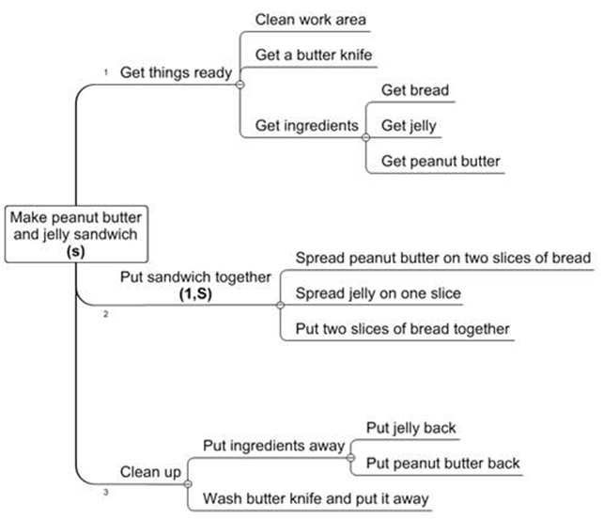
What needs improvement on this flow chart?

Slide 10
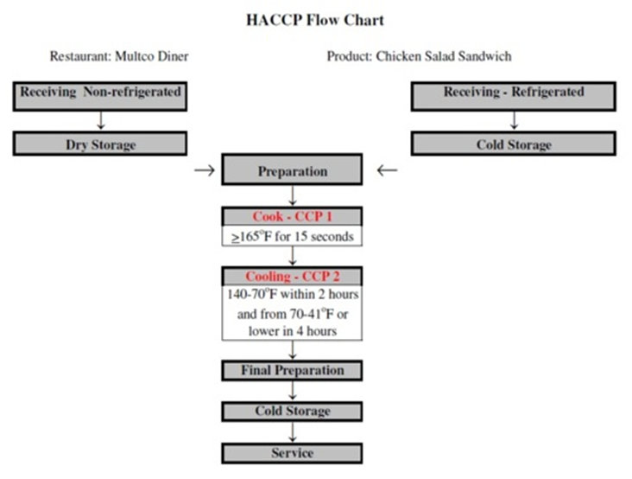
Compare with this…

Slide 11
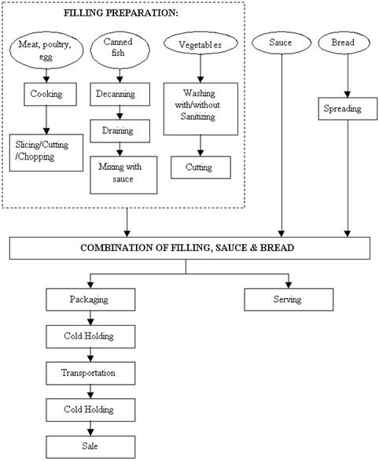
Another Example…

Slide 12
Make your flow chart WORK for you
HACCP: Hazard Analysis Critical Control Points
Remember:
Components of sandwich
Initial prepping of main ingredients
Temperature control of each ingredient
Progression to the final assembly of the sandwich on the plate (including order/arrangement of sandwich components)
Amount of space required

Slide 13
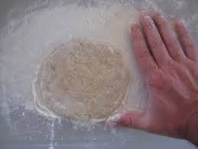
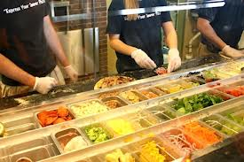
Alternative “Sandwich Stations”
Why is it important that the pizza station be separate from the traditional sandwich station?
Flour is used in the pizza station, which can contaminate other sandwich fillings.

Slide 14
Section 1.3 Summary
There are two basic kinds of sandwiches—hot and cold.
The primary components for all sandwiches are bread, spread, and filling:
The bread serves as an edible container for the food inside and also provides bulk and nutrients.
The spread prevents the bread from soaking up the filling and also adds flavor and moisture.
The filling is the primary flavor of the sandwich.
Every sandwich station needs ingredients and equipment:
Ingredients should be prepared ahead of time, if possible, to cut down on preparation time and hand movement.
Equipment should include a work table, a storage facility, hand tools, portion-control equipment, and heating equipment.
1.3

Slide 15
PART 1: MENU DEVELOPMENT PART 2: FLOW CHART PART 3: PRESENTATION
Sandwich Shop Group Project

