Slide 1
ProStart 1 – Chapter 12
Building a Successful Career in the Industry

Slide 2
Skills Needed for a Successful Career
Communication & Teamwork
Positive Attitude
Willingness to Learn
Technology Skills
Math Skills
Analyzing and Problem Solving
Knife and Equipment Skills
Food Safety Knowledge
Product Knowledge

Slide 3
The Job Search
Personal Contacts
School Placement Offices
Employment Agencies
Community Agencies
Internet Resources
Networking
Job Fairs

Slide 4
Portfolio – paper or digital
Cover page
List and samples of skills
Samples of work
Examples of problems solved
Examples of teamwork
Examples of leadership
Certificates of recognition
Newsletter or announcements
Essays, reports & papers
Letters of thanks
Resume
Test scores
Original recipes
Letters of recommendation

Slide 5
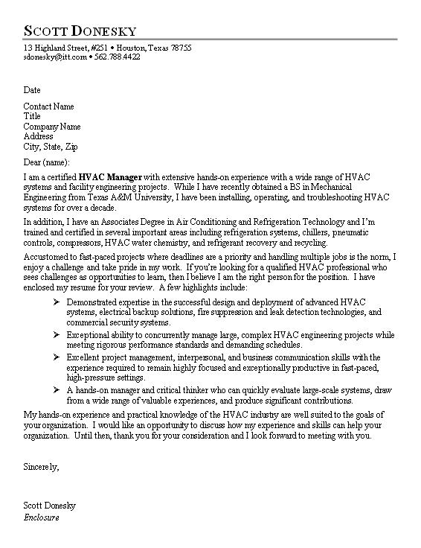
Cover Letter
Send with a resume
Keep it brief
Spell check
Tips
Attention
Interest
Desire
Action

Slide 6
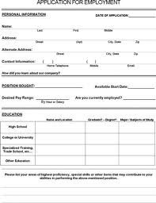
Job Applications
Write or print clearly
Use blue or black pen
Grammar, spelling, punctuation, organization
N/A or please see me
Questions about money?? Write “Open”

Slide 7
Interview Tips
Punctuality
Appearance
Good personal hygiene
Positive attitude
Good manners “etiquette”
Smile, extend your hand
Learn facts about companies

Slide 8
At the interview
Bring a portfolio/resume, names addresses, phone numbers of references, identification
Questions – open-ended – talk about yourself
Be prepared to ask questions to the interviewer – don’t ask about money, vacation, etc…

Slide 9
Follow Up After the Interview
Thank you note
Phone call

Slide 10
Health and Wellness
Eat right
Get exercise
Don’t smoke
Find something else to love
Don’t take drugs/limit alcohol
Take advantage of the resources offered
Have a plan for saving money
Find a job that makes you happy

Slide 11
Stress and Time Management
Feeling overwhelmed
Time, grades, college, relationships, loss of family member, divorce, change, workplace challenges, lack of planning
Internal or external factors
Find the source – identify a stress-reduction plan
Plan and evaluate, delegate, evaluate progress, set daily goals, get regular sleep, exercise, eat healthy, etc…

Slide 12
Time Management
Planning
Goal setting
Setting priorities
Delegating

Slide 13
Resigning from a Job
Two weeks notice
In person or in writing – not e-mail
Tell reasons for leaving, but be polite

Slide 14
Staying Educated and Involved
Continuous improvement – classes
Professional organizations
Other resources - publications, internet
Networking

