Slide 1
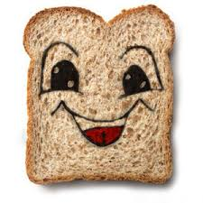
Snow Wheat and the Five Dwarfs
Erika

Slide 2
Once upon a time there was a queen that had the most beautiful step-daughter. Her skin was as light as snow, her cheeks were rosy red, and her name was Snow Wheat. She was the healthiest princess in all the lands.

Slide 3
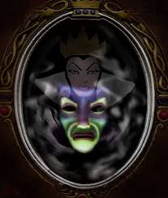
Snow Wheat’s stepmother was very jealous at how healthy Snow Wheat was. One day she went to her magic mirror, who could never tell a lie, and asked, “Mirror, mirror on the wall, am I the healthiest of them all?”
The mirror then replied, “Oh queen, thou are no longer the healthiest of all.
Snow Wheat is the healthiest in the land.”
This made stepmother quite angry.

Slide 4
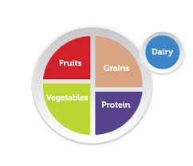
Snow Wheat was such a healthy princess because she used MyPlate every day. MyPlate made it easy for Snow Wheat to choose what foods she should eat and how much of them she should eat. Using MyPlate ensured that Snow Wheat was eating all the essential nutrients.

Slide 5
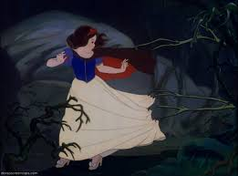
Because Snow Wheat’s stepmother was jealous she was so healthy, she only kept bad foods in the house. Every night for dinner she left Snow Wheat cake and pop. This made Snow Wheat very upset because she wanted to be healthy. So one day Snow Wheat ran away.

Slide 6
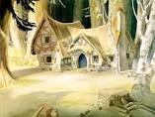
Snow Wheat wandered far into the woods where she found a small shack. Inside the shack she found five dwarfs. They were named Fruity, Veggie, Grainy, Dairy-ella, and Proteina. They were the healthiest dwarfs Snow Wheat had ever met.

Slide 7
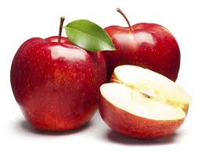
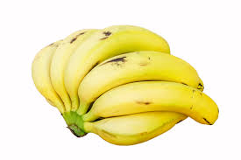
Fruity made sure Snow Wheat ate her fruits everyday such as apples, bananas, and orange slices. Fruits were Snow Wheats favorite and she usually ate the one cup that MyPlate recommended for her.

Slide 8
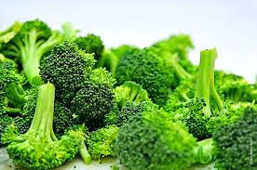
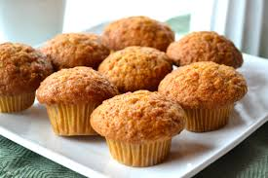
After picking fresh vegetables from the garden, Veggie would give Snow Wheat a cup of vegetables. Sometimes it was broccoli and sometimes it was corn, Snow Wheat’s favorite. Grainy made sure Snow Wheat got the recommended amount of 3 ounce equivalents of grains every day by having her eat things such as muffins, crackers, and oatmeal.

Slide 9
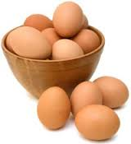
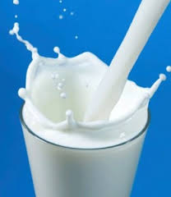
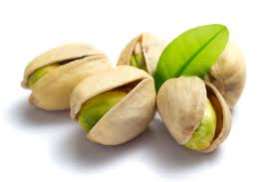
Snow Wheat was very picky when it came to protein but Proteina made sure she got the necessary 2 ounces of protein every day. She usually had her eat eggs, almonds, and pistachios. Dairy-ella never had a problem getting Snow Wheat to consume 2 cups of dairy every day because Snow Wheat loved milk. Low-fat milk of course. She also loved yogurt and cheese.

Slide 10
Even though Snow Wheat ate healthy every day she still had to exercise. Instead of watching tv she would go outside and play with the dwarves. Her favorite activity was jumping rope with Fruity and Veggie.

Slide 11
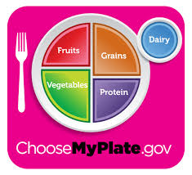
As Snow Wheat continues to grow she will continue to follow the MyPlate guidelines in order to receive the essential nutrients every day. Starting this at a young age created a good habit for Snow Wheat that she will have for the rest of her life. Snow Wheat escaped her very unhealthy evil stepmother and lived a happy healthy life with the dwarves. The end.

