Slide 1
The Snacking & Sleeping Beauty
By: Keri
Sleeping Beauty follows the MyPlate health recommendations until her 15th birthday…

Slide 2
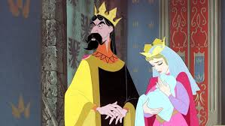
Once upon a time… there was a beautiful princess born in the kingdom named Sleeping Beauty. The King was so excited to have a child that he planned a big dinner for the entire kingdom. They planned the menu based on the MyPlate recommendations and had baked chicken for protein, plain yogurt with fresh fruit for dairy and fruits, whole wheat bread for grains, and carrots for vegetables. He invited everyone but the woman who always ate junk food.

Slide 3
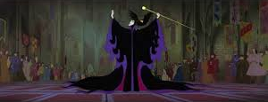
When the junk food woman showed up without being invited, everyone was surprised. She stood up on the table and shouted, “Cookies, cake, and ice cream every day! Why isn’t the most delicious meal being served at this party instead of that healthy baked chicken, yogurt, and whole wheat bread?” Soon after she got done yelling she had to sit down almost immediately because she was so tired.

Slide 4
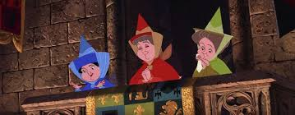
Luckily, there happened to be three healthy fairies there. They went over to the junk food woman and said, “Eating healthy foods like fruits and veggies give you a lot of energy so you won’t get tired throughout the day.” The junk food woman thought about this for a minute, but then she got angry and said, “You all might not think that junk food is the best, but I do!” Then suddenly she went over to the baby princess and put a curse on her that said on her 15th birthday she would fall dead. Everyone gasped and began to cry.

Slide 5
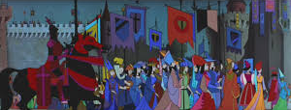
Then, one of the healthy fairies came over and said that Sleeping Beauty would not die, but just get sick and go to sleep. The healthy fairies told the king and queen to always make sure the princess ate healthy foods and exercised for at least 30 minutes every day. With that, they left the kingdom and the party was over.

Slide 6
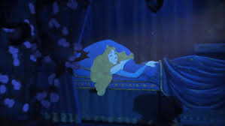
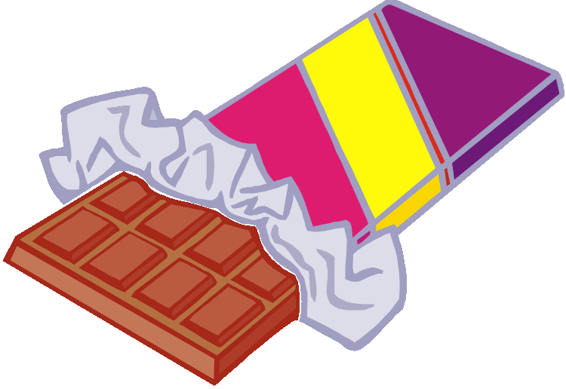
15 years later, on Sleeping Beauty’s birthday, there was another big dinner party thrown for her. They again based the menu off of the MyPlate recommendations. After the party, the princess went up to her room. When she got there she found mountains of candy piled all around her bed. Sleeping Beauty had always made sure to eat healthy, but this time she couldn’t resist. She began to eat them and soon she realized that she had eaten all but two. Just about then, Sleeping Beauty’s stomach began to hurt and she got really tired. She went to her bed and layed down and soon fell fast asleep.

Slide 7
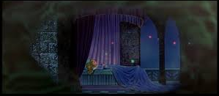
While she was asleep, all the princess could dream about was how bad she felt about eating all that candy. She knew that she should’ve listened to her parents and the healthy fairies. She wondered who could have put all that candy in her room. She knew that her parents were probably very worried about her, but she just didn’t have the energy to get out of bed.

Slide 8
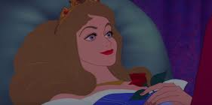
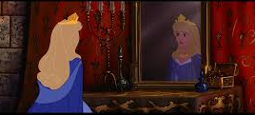
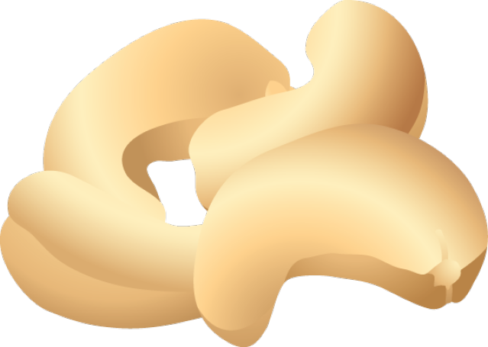
After a whole year, Sleeping Beauty finally gained enough strength to at least sit up in her bed. She looked over and saw her desk covered in fruits, veggies, unsalted nuts, and ice cold water. She began to eat when she was able to, and after just a few days, Sleeping Beauty could feel her energy and strength coming back.

Slide 9
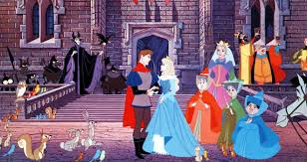
When the princess was feeling better, she went down from her room to see her parents. They gave her a big hug and asked her if she was okay. “Now that I have my energy back from eating healthy foods, I feel a lot better,” Sleeping Beauty replied. The king and queen called the healthy fairies to let them know that Sleeping Beauty was back to feeling okay and they told them to make sure she kept eating at least 1 cup of fruit, 1 cup of veggies, 3 ounces of grains, 2 ounces of protein, and 2 cups of milk each day. They all lived happily ever after...

Slide 10
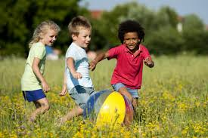
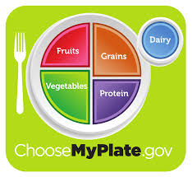
Conclusion
Eating healthy is a very important habit to start when you are young so that you will continue it all throughout your life. It is important to make sure you are eating healthy foods like fruits and vegetables so that you can grow. Exercising is also important because it helps make your muscles and bones stronger.

