Slide 1
Menu Costing
ProStart Chapter 3

Slide 2
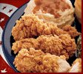
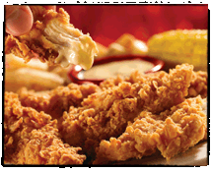
Pricing of Food
Why is one more expensive than the other?
KFC Fried Chicken Dinner $2.99
and
Chili’s Chicken Crisper Dinner $9.39 + tip

Slide 3
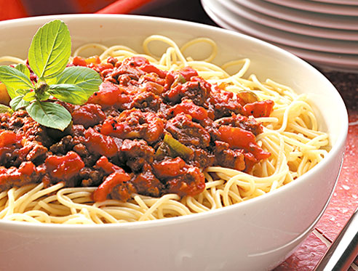
Why so much?
On the menu a meal is $10.00 – the food to prepare that meal costs $2.00. What is the other $8.00 for?
What % of the total meal is the food cost? $2.00/$10.00

Slide 4
The Real Story
Read through the story on your Controlling Food Service Costs worksheet.
What are the labor costs?? Multiply students by hours by wage.
Sub total by adding food cost and labor costs.
What is 12% of that total?
Add the sub total with the 12% for the cost to keep the restaurant open.
Divide the total by $18.00 (price charged for the meal)
How many people have to come to break even??
Homework – answer the question about how to increase their income.

Slide 5
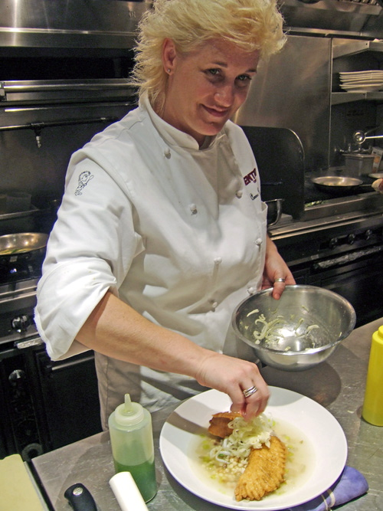
Food Cost Average
The Average Food Cost is 28-42% and depends on the food establishment, location, and so many other factors. Most restaurants have a specific percent and manager and chefs must work hard to meet that percent and not exceed it.
Some meals like pasta might be less than 28% and some with lots of protein like steak might be higher than 42%, but it will average out.

Slide 6
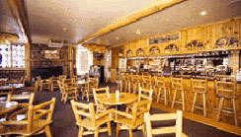
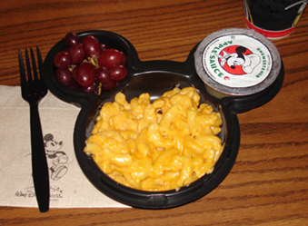
Where are food costs low?
Places you are “captive” – they can make a fortune!!
Disneyland
Recreation locations (Yellowstone, Lake Powell, etc… high food cost might be because of location)
Movie Theaters
College and Professional Athletic Events

Slide 7
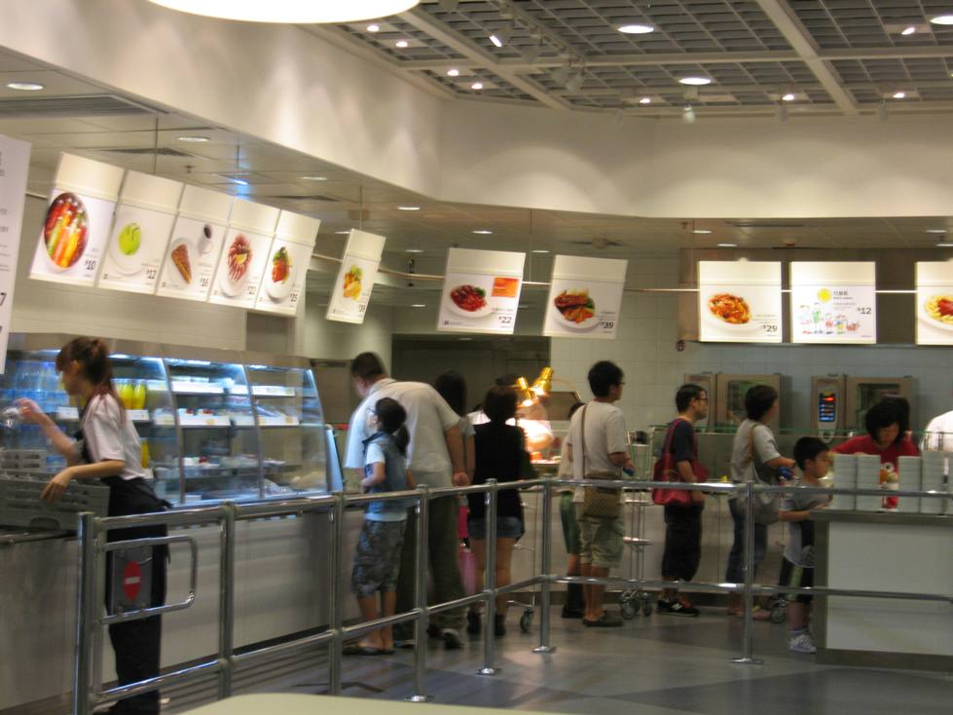
Where are food costs high?
Places where they make more money other ways but they need to get you to come – so the food is cheap. They make little no money from the food, but when you’re there you’ll spend money in other ways.
Las Vegas
Ikea

Slide 8
What is a Percent?
What is a percentage?
Where have you used percentages before?
If you’re downloading a program onto your phone or computer and you’ve downloaded for 1 minute and it says you are 30% complete, what is the total download time?

Slide 9
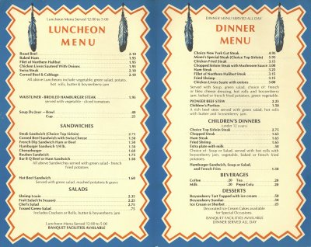
Menu Pricing
Four Methods
Contribution Margin Method
Straight Markup Method
Average Check Method
Food Cost Percentage

Slide 10
Contribution Margin Method
A portion of the money from a menu item contributes to overall profits.
Gross Food Sale – Cost of Food Sold = Gross Profit (Contribution Margin)
Gross Profit / Number of Customers = Average Amount Contributed to Overhead/Fixed Costs and Profit (Add this amount to the cost of the food)
$100,000 (Gross Food Sale) - $40,000 Cost of Food = $60,000 (Gross Profit)
$60,000 (Gross Profit)/ 30,000 Customers = $2.00 Contributed per food item
Work through problem A in the packet.

Slide 11
Straight Markup Method
Multiply raw food costs by a predetermined fraction then add that back to the raw food cost
.63 (Raw Food Cost) x 2/3 = .42 (Gross Profit)
.42 + .63 = $1.05 (Menu Price)
Work through problem B in the packet.

Slide 12
Average Check Method
Total revenue is divided by the number of seats, average turn over and days open in one year.
The average check gives managers an idea of the price range of items on the menu.
Use this range, with approximate food cost percentage to determine each item’s selling price
Not really specific, needs years of experience to make correct pricing decisions.

Slide 13
Food Cost Percentage
Most common method
Foods cost divided by food sales
$18,000 (Food Costs)/$62,000 (Food Sales) = 29% (Food Cost %)
Item Cost / Food Cost % = Menu Price
1.12 (Item Cost) / .29 (Food Cost %) = $3.86 (Menu Price)
Round up menu price – to a 0, 5 or 9 (3.90, 3.95, 3.99, 4.00
Work through problem C in the packet.

Slide 14
Other ideas
When multiplying with a percent – make sure you move the decimal point two places to the left.
If a store advertises 35% off an item that costs $6.79 what would you pay for that item? 6.79 x .35 = 2.38 off the original price or 6.79 – 2.38 = 4.41
Try this 6.79 x .65 = 4.41 (where did the 65 come from?)
If someone purchases food totaling $13.67 and tax is 7.75% on restaurant food. What would the total food bill be? 13.67 x .0775 = 1.059 (or 1.06) 13.67 + 1.06 = 14.73
Try this 13.67 x 1.0775 = 14.73
If you are making a recipe that yields 40 servings and you only need to serve 24 how do you figure that out? 24/40 = .60 (or you’re using 60% of the ingredients) So multiply each ingredient amount by .6

Slide 15
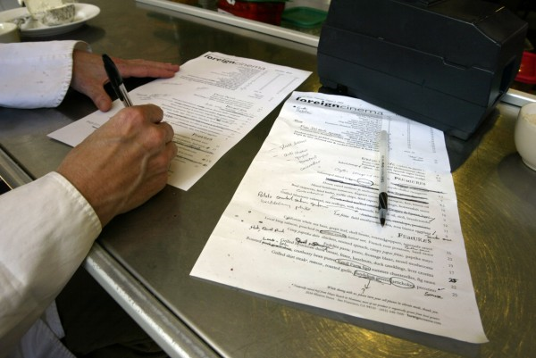
More math
Complete the packet as homework.
Read carefully!!

