Slide 1
November 4
Get out your…
Notes
Patterns, Fabric and Notions Review Questions

Slide 2
Patterns, Fabric & Notions
Fashion Construction 1
Pages 439-453

Slide 3
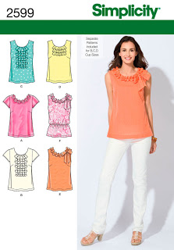
Patterns
Pattern: a set of tissue pattern pieces and instructions for creating an item from fabric
Categories: dresses, sportswear, easy-to-sew
Special categories: larger sizes, children and toddlers, men and boys, home decorating, crafts, gifts, and accessories.
Patterns often have more than
one view—see the front of this pattern envelope.
Another Example:
View A—shirt with long sleeves
View B—same shirt with short
sleeves

Slide 4
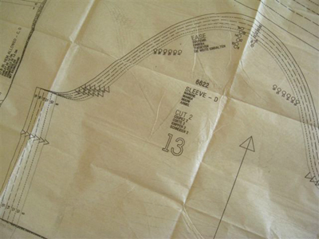
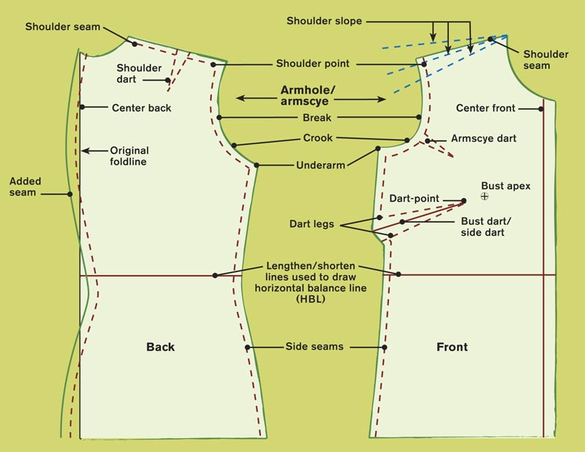

Slide 5
Patterns: Selecting the Right Style
How can you tell what a garment will look like on you?
Look at what you already own. Choose patterns with similar patterns and design.
Try on ready-to wear garments at the store.
Know your body type and what works!
5 dresses for 5 body types
3:30 min.

Slide 6
Clues on the pattern envelope
Pattern envelope shows how finished garment will look
Fitted or loose
Suggested fabric to use—help choose fabric
Finished garment measurements for proportion
Skill Level
Clues about sewing difficulty are on the sewing envelope
“Easy,” “Fast & Easy,” etc.—fewer pattern pieces, simple to follow layouts, and easier construction techniques

Slide 7
Patterns: Selecting the Correct Size
Take accurate body measurements
We will go into more detail with this later.
Figure Type
Size categories (i.e., juniors, misses) determined by height and body proportions
Compare body measurements to charts in the back of the pattern catalog.
Pattern Size
Compare body measurements listed in the chart to the back of the pattern envelope. Use measurements closest to yours.
Stop at 5 min.

Slide 8
**Need to Know!
Choose your size by actual measurements, NOT by the size you buy in ready-to-wear clothing.
Not all measurements will be exact.
If your measurements fall between 2 sizes…
Choose the larger size if the design is closely fitted.
Choose the smaller size if the design is loose fitting.
Almost all patterns are multi-sized—several sizes on one pattern.

Slide 9
Fabric
How do you know which fabrics would be best for a garment?
Read the back of the pattern envelope!
Choose from the suggested fabrics or a similar fabric.
Consider your sewing ability.
Beginning sewer??
AVOID:
Slippery fabrics
Loosely woven fabrics
Sheer or thick, bulky fabrics
Fabrics with a one-way design
Pile fabrics
Stripes and plaids

Slide 10
Choose fabric for you—Jo-Ann Fabrics
Color and texture that are flattering
Appropriate for activities/wearing plans
How much to buy?
Yardage chart—on the back of the pattern envelope
Pay attention to the width of the fabric when its on the bolt at the store.
Most fabrics are 45 inches or 60 inches.
Read yardage chart to determine how much you need based on fabric size.
6 min.

Slide 11
Notions
Notions: small items that become a permanent part of a garment.
Examples:
Thread
Buttons
Lining
Interfacing
Trims
Tapes
Zippers
Snaps
Hooks and eyes
Buckles
Elastic

Slide 12
Purchase notions at the same time you purchase fabric
Why??
They will match
Care requirements will be similar
You purchase the correct amount (yardage chart/back of pattern envelope)
You have everything you need when you begin sewing
Choosing Thread
If you can’t find the exact shade, choose a shade DARKER than your fabric
Thread looks lighter after sewing
All-purpose thread
Polyester or polyester/cotton
Can be used for most sewing projects
Strong and flexible
Shrinks less than other threads

Slide 13
Putting it all together…
From reading the pattern envelope to shopping for materials…
A brief review ☺
2 min.

Slide 14
Questions—For Review
What information can you learn from the front of the pattern envelope?
What a garment will look like
Different front views
Sewing difficulty
Pattern number
Size
What information is listed on the back of the pattern envelope?
Suggested fabrics
Yardage chart—determine how much fabric for the size you’re making
Back views—line drawings
Notions
Finished garment measurements

Slide 15
Name 3 characteristics of easy-to-sew patterns.
Fewer pattern pieces
Simple-to-follow layouts
Easier construction techniques
If body measurements differ from a pattern size, what should you do?
If measurements fall between 2 sizes, choose the size you make based on the design.
Loose-fitting design—choose smaller size.
Close-fitting design—choose larger size.

Slide 16
If two people are different sizes, could they share the same pattern?
Yes. Most patterns are multi-sized—several pattern pieces are printed on each pattern piece.
Cut larger one first (and fabric), then the smaller person cuts theirs.
Do you have to use the fabrics suggested on a pattern envelope? Explain.
No. However, you should take into consideration the design of the garment and your sewing abilities before using other fabrics.

Slide 17
List at least 5 fabrics a beginning sewer should avoid.
Slippery fabrics
Loosely woven fabrics
Sheer or thick, bulky fabrics
Fabrics with a one-way design
Pile fabrics
Stripes and plaids
How do you decide how much fabric to buy?
Based on your body measurements (taken accurately), how much the yardage chart recommends you need based on the size garment you are constructing, and the size of the fabric as it comes on the bolt (45” or 60”).

Slide 18
Why should notions be purchased at the same time as fabric?
So you have everything you need to construct your garment and do not need to make additional trips to the store.
So your notions match your garment and require the same care as your fabric.
So you buy the right amount of each notion (noted on the back of the pattern envelope).

