Slide 1
Nutrients Have Classes Too!
JustFACS

Slide 2
What is nutrition?
The study of how your body uses the food you eat.

Slide 3

What is a nutrient?
A nutrient is a chemical substance in the body that helps maintain the body.

Slide 4
The Six Classes of Nutrients
Your body needs over 50 different nutrients which can be divided into 6 classes:
  Carbohydrates
  Fats
  Proteins
  Vitamins
  Minerals
  Water

Slide 5

Carbohydrates
Functions
  Provides body main source of energy
  Provide bulk
  Helps the body digest fats
Types
  Simple –Sugars
  Complex
    Starches and Fiber
Sources:
  Sugars—honey, jam
  Fiber sources—fruits, vegetables, whole grains
  Starch sources—breads, cereals, pasta

Slide 6
Fats
Functions
  Provides energy
  Carries fat-soluble vitamins
  Protects vital organs and provides insulation
  Provides essential fatty acids
Types
  Fatty Acids
  Cholesterol
Types
  Fatty Acids
    Saturated –raises LDL
    Polyunsaturated-decreases LDL
    Monounsaturated-decreases LDL and increases HDL
  Cholesterol
    LDL-”bad cholesterol”
    HDL-”good cholesterol”

Slide 7

Sources of Fats
Cheese
Butter
Nuts
Meats
Dressings
Chocolate

Slide 8
Proteins
Functions
  Build and repair tissues
  Help body make important substances
  Regulate body processes
  Supply energy
Types
  Complete: contains adequate amounts of all essential amino acids
  Incomplete: Lacks some amino acids
Sources
  Meat-Complete
  Milk-Complete
  Eggs-Complete
  Fish-Complete
  Nuts-Incomplete
  Legumes-Incomplete

Slide 9
Vitamins
Can be divided into two main categories
Fat-soluble vitamins
  dissolve in fats
  can be stored in fatty tissues of the body
Water-soluble vitamins
  dissolve in water
  are not stored in the body

Slide 10
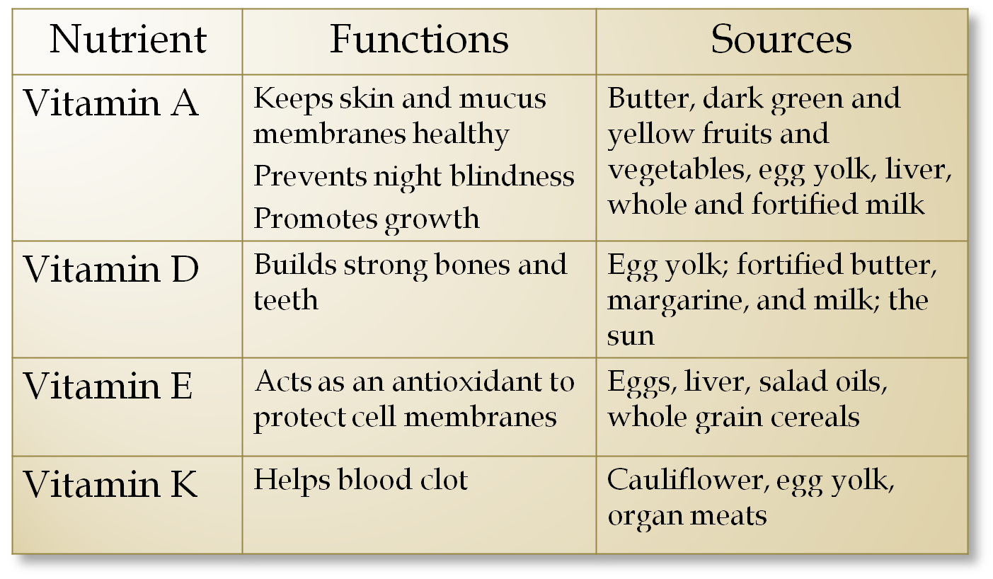
Fat-Soluble Vitamins

Slide 11
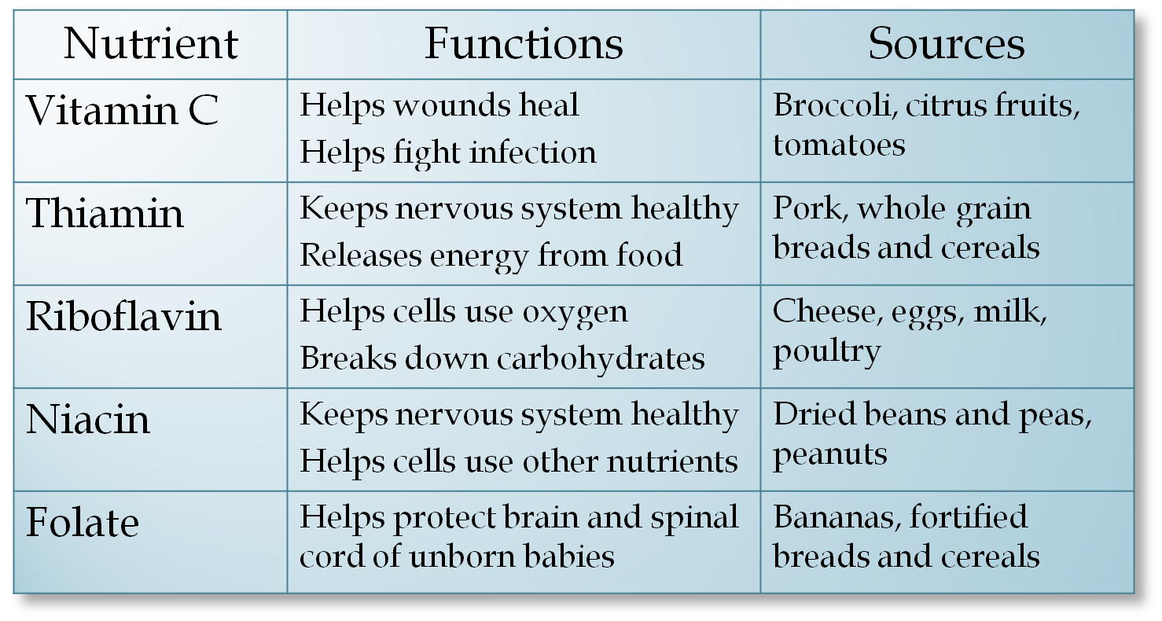
Water-Soluble Vitamins

Slide 12
Minerals
Minerals can also be divided into two categories:
Macrominerals are needed in amounts of 100 mg or more per day.
Trace elements are needed in amounts less than 100 mg per day.

Slide 13
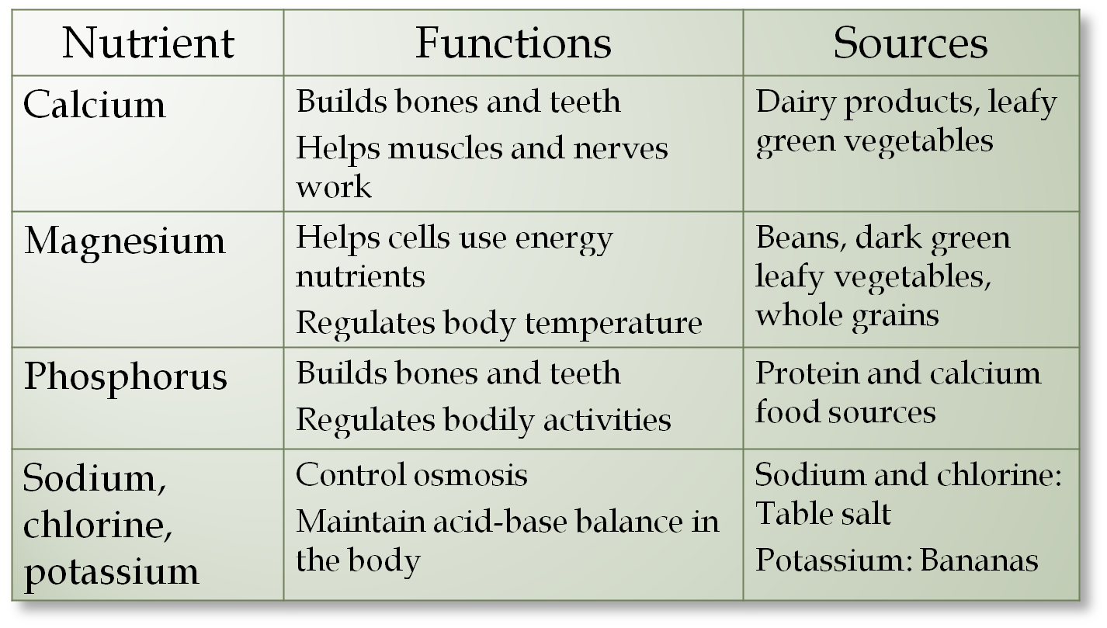
Macrominerals

Slide 14
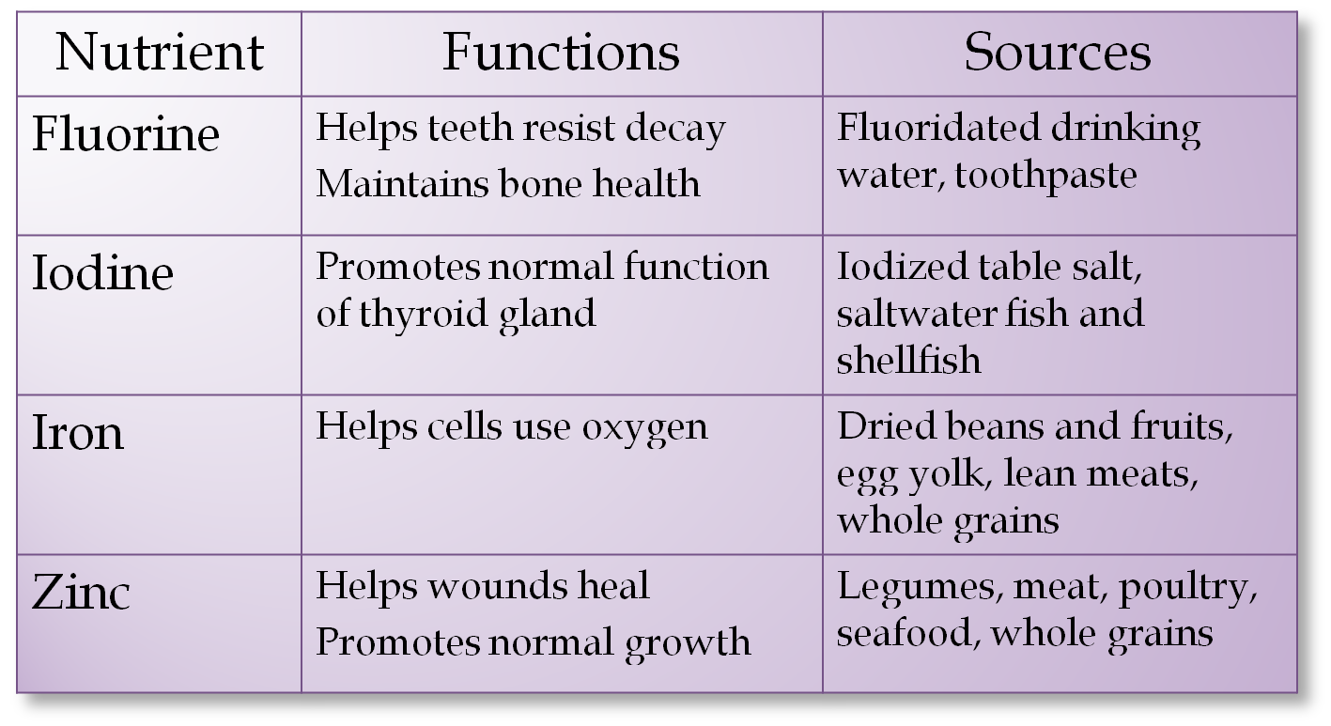
Trace Minerals

Slide 15


Water
Functions
  Aids digestion and cell growth and maintenance
  Facilitates chemical reactions
  Lubricates joints and cells
  Regulates body temperature
  Overall well-being
Sources
  Water
  Milk
  Fruits and Vegetables
  Other Liquids
  Some Foods

Slide 16
Nutrient Deficiencies
Not getting enough nutrients can lead to deficiency diseases.
Deficiency | Diseases | Symptoms
Protein-energy malnutrition | Kwashiorkor | Edema, irritability, anorexia, enlarged liver
Vitamin D and Calcium | Osteoporosis/Rickets | Brittle bones and bow legs
Iodine | Goiter | Swelling of the thyroid gland
Iron | Anemia | Fatigue, weakness, poor appetite, constipation
Thiamin | Beriberi | Affects nervous system, pain, vomiting, difficulty walking
Niacin | Pellagra | Diarrhea, dermatitis, dementia
Vitamin C | Scurvy | Spongy, bleeding gums
Vitamin A | Night blindness | Difficulty or inability to see in low light or darkness

Slide 17
Excess Nutrients
As with everything, too much of any one thing is not good for you and the same thing goes for nutrients.
Excess energy nutrients-carbohydrates, fats, and proteins-can lead to unhealthy weight gain
Excesses of some vitamins and minerals can lead to toxicity (poisoning) and other complications

Slide 18
Activity
Write down everything that you ate and drank yesterday.
  For each food you ate, list the nutrients that would be in it.

