Slide 1
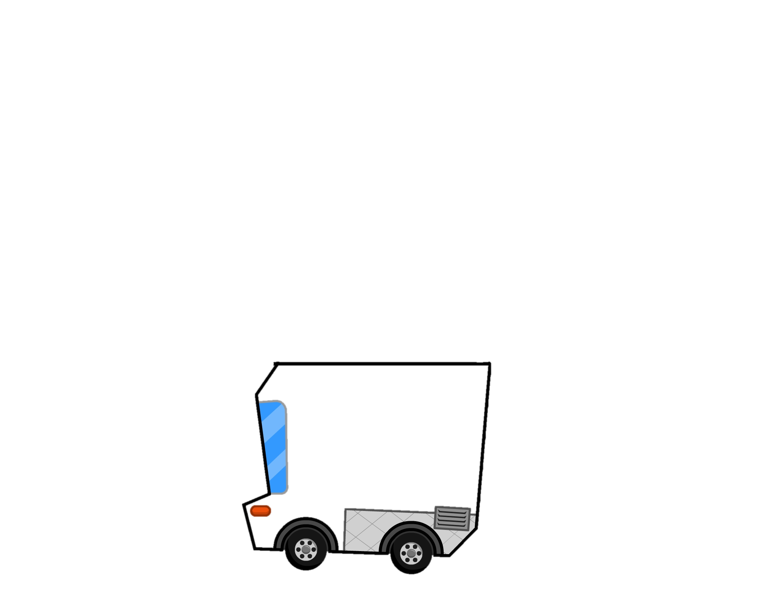

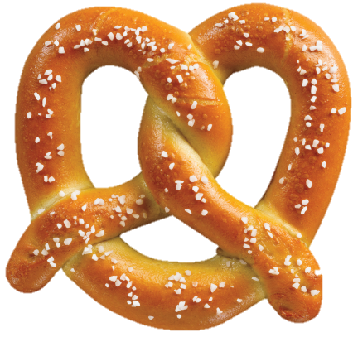

It’s

Slide 2
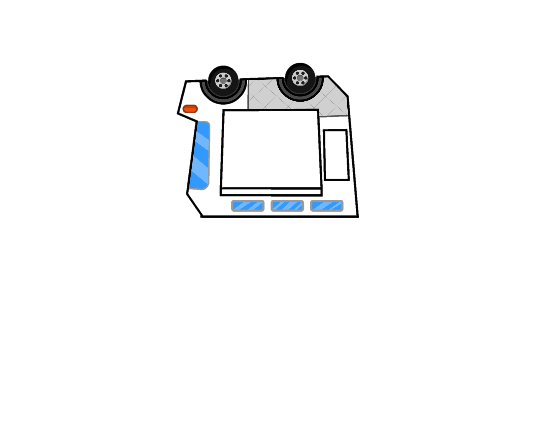
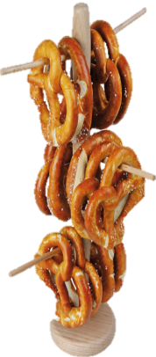






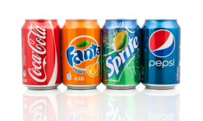



Pretzel: $2
Pretzel With Dip: $3
Drinks: $1
It’s
Menu:
Soft Pretzel
Dip: Nacho Cheese
Drinks: Water or
Sprite

Slide 3
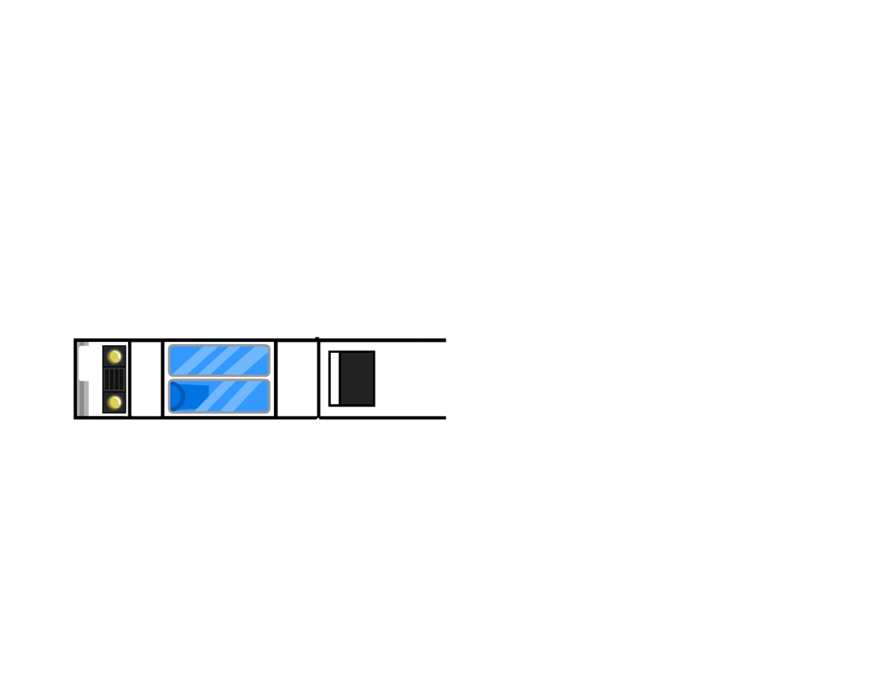



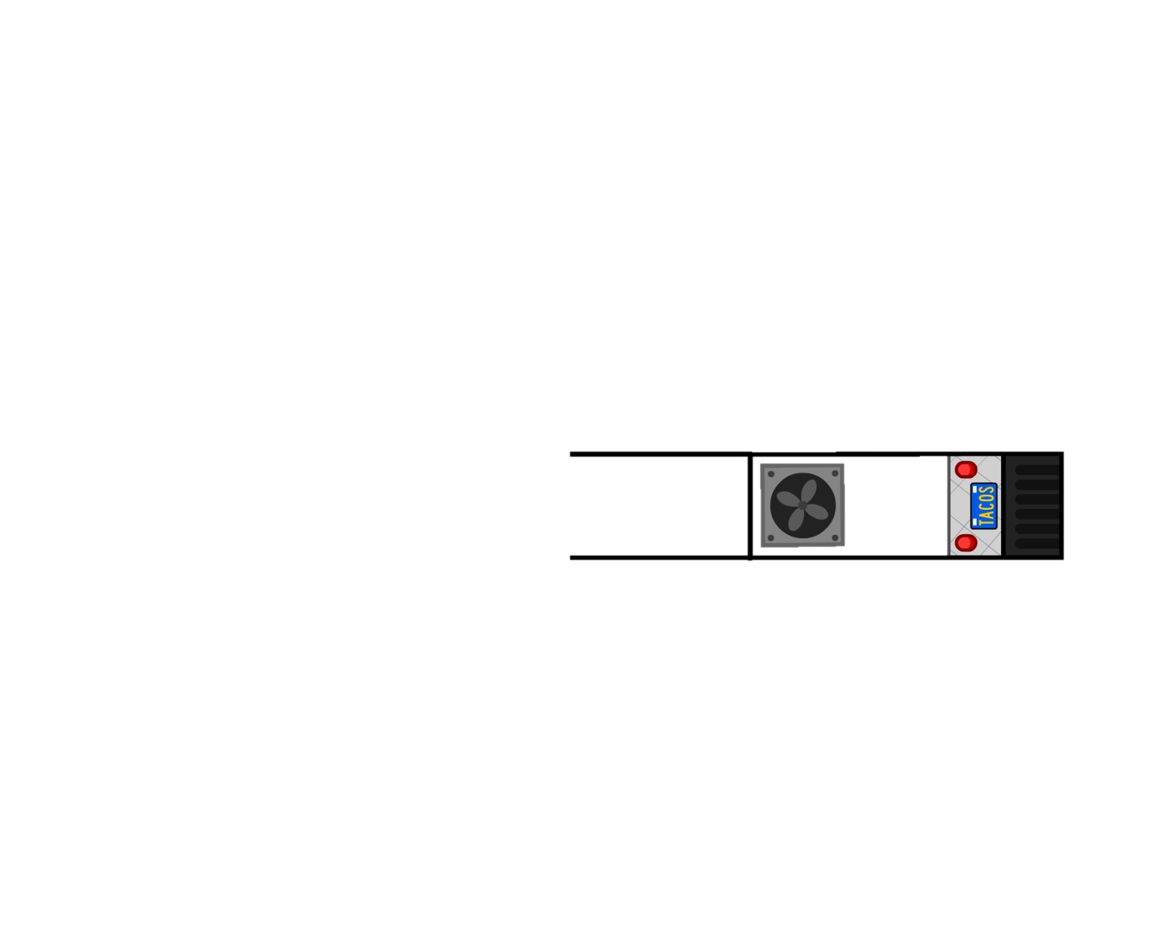



Truck Front
PRETZEL
It’s
Truck Back
PRETZEL
It’s

Slide 4
Truck Top
Cut this part out to create the “bank” for the money you will collect.
Truck Bottom

