Slide 1
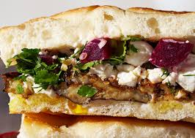
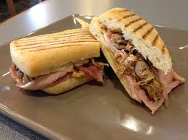
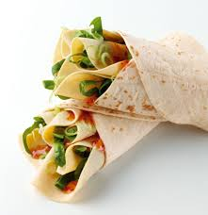
Sandwiches
Section 1.3
Chapter 1: Breakfast Foods & Sandwiches

Slide 2
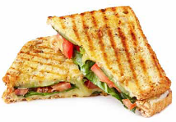
Basic Kinds of Sandwiches
When making sandwiches, consider:
The combinations of flavors and textures created by different breads
Condiments
Meat and vegetable additions.
As a table, come up with as many different kinds of sandwiches within the next 90 seconds.
Divide your list into 2 categories
1.3
Chapter 1 | Breakfast Food and Sandwiches

Slide 3
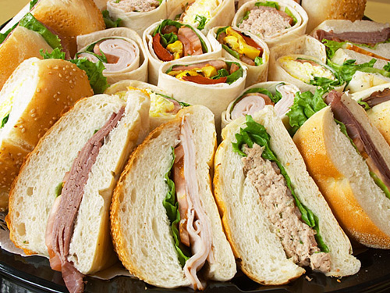
TWO Categories of Sandwiches
HOT
COLD

Slide 4
HOT SANDWICHES
A simple hot sandwich consists of hot fillings between two slices of bread or two halves of a roll.
May be served open-faced on one slice of bread, rolled up in a piece of bread, or even on a flat crust
Grilled cheese, grilled ham and cheese, and tuna melt are popular varieties of grilled sandwiches.

Slide 5
HOT SANDWICHES
Make panini sandwiches by grilling sandwiches on a panini press.
Make deep-fried sandwiches by dipping the sandwich in beaten egg and then deep-frying it.
Pizza, while not a typical sandwich, is a hot, open-faced Italian pie with a crisp, yeast-dough bottom.

Slide 6
COLD Sandwiches
A simple cold sandwich consists of two slices of bread or two halves of a roll, a spread, and a filling:
A submarine sandwich is a cold sandwich usually served on a long, sliced roll with several types of cheese, meat, lettuce, tomato, onion, and various other toppings.
A wrap sandwich is made on any type of flat bread and spread with a hot or cold sandwich filling. It is then rolled up.
A multi-decker sandwich has more than two slices of bread with several ingredients in the filling.
A club sandwich is three slices of toasted bread spread with mayonnaise and filled with an assortment of sliced chicken and/or turkey, ham, bacon, cheese, lettuce, and tomato. Serve club sandwiches cut into four triangles.
1.3

Slide 7
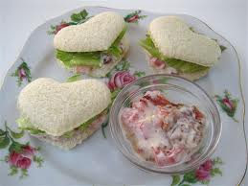
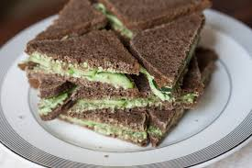
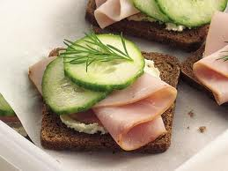
COLD Sandwiches
Cold Sandwiches as Appetizers
Tea sandwiches are small cold sandwiches usually served on bread or toast, trimmed of crusts, and cut into shapes.
A canapé is a version of a open-faced cold sandwich, served as hors d’oeuvres.
1.3

Slide 8
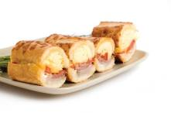
Primary Sandwich Components
Three Main Parts:
Bread
Spread
Filling
1.3

Slide 9
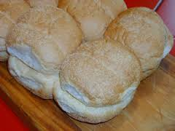
Primary Sandwich Components: Bread
Sliced bread
Hard rolls
Pita bread
French bread
Tortillas
Flatbreads
Multigrain bread
Cinnamon and/or raisin bread
1.3

Slide 10
Primary Sandwich Components: Spread
A spread serves three main purposes:
To prevent the bread from soaking up the filling
To add flavor
To add moisture
Butter and mayonnaise
are the most common spreads.
1.3

Slide 11
Primary Sandwich Components: Filling
The purpose of the filling is to provide the primary flavor to the sandwich.
Fillings can vary from sliced or grilled meat and cheeses to salad mixtures such as egg or tuna.
1.3

Slide 12
Additional Sandwich Component: Accompaniments
Sandwiches are often served with accompaniments such as:
Ketchup
Mustard
Horseradish sauce
Lettuce
Onion
Tomato
Sweet or dill pickles
1.3

Slide 13
Assignment:
Each person will pick randomly from the chef hat 1-2 sandwiches. Once picked, you will adopt the name of that certain sandwich to research its description.
Using ChatterPix, you will bring your sandwich to life for the rest of the class.
“Hello! My name is (name of sandwich)
and I am a (description).”
During PLT
Read pg. 59-65. Be prepared to answer questions in class regarding sandwich stations.

