Slide 1
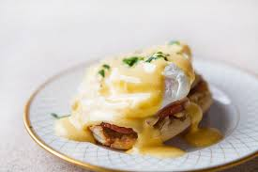
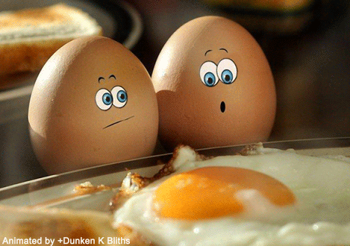
Dairy & Eggs Section 1.1
Chapter 1: Breakfast Foods and Sandwiches

Slide 2
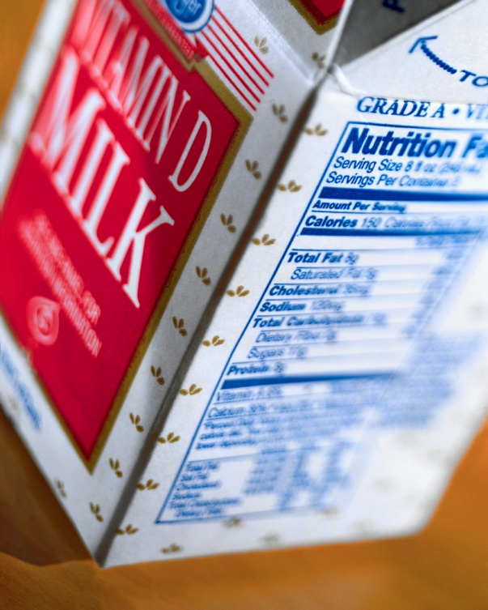
Dairy Products

Slide 3
Milk and Milk Products
Pasteurization:
Milk is heated to kill microorganisms that cause spoilage and disease without affecting its nutritional value.
Homogenization:
Milk is strained through very fine holes to break down fat and then blended into one fluid.
Some milk is available in raw form, but most milk products are processed to remove harmful bacteria that could make people sick.

Slide 4
Milk Receiving & Storage
Milk products should be received and stored at 41°F or lower.
Always use the FIFO (First In, First Out) method of stock rotation for milk.
All milk/milk products should be labeled “Grade A”
1.1

Slide 5
Milk Receiving & Storage
Milk should be rejected if it is too sweet or if it has a sour, bitter, or moldy taste.
Any milk that has passed its use-by or expiration date should be thrown away.

Slide 6
Cream
Cream contains far more fat than milk.
Chefs use it based mainly on its fat content, which provides richness.
Half and Half
½ cream, ½ milk
Substitute:
If you have heavy cream but need half and half, use half the amount of heavy cream and add milk for the remainder amount

Slide 7
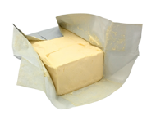
Butter
Butter is made by mixing cream containing between 30-45% milk fat at a high speed.
Most commercially-sold butter is lightly salted.
Salt acts as a preservative and sometimes to enhance flavor.
1.1

Slide 8
Butter and Butter Substitutes
Clarified butter has been heated, and the milk solids and water have been removed.
A butter substitute is any alternative used to replace butter in a recipe, such as margarine, olive oils, and soy-based oils.
Margarine is a manufactured food product that often contains no milk products.
Must contain 80% of calories coming from fat
1.1

Slide 9
Cooking with Butter & Fats
Smoke Point:
The point at which an oil or fat begins to burn
Clarified butter (ghee) has a higher smoke point
Less likely to burn when heated

Slide 10
Smoke Points of Common Fats

Slide 11
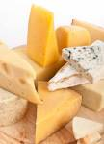
Cheese
All cheeses have three basic parts:
Water
Fat
Protein
Dairies make cheese by separating a milk’s solids from its liquid in a process called curdling.
1.1

Slide 12
Cheese Categories
Unripened:
Fresh cheeses, typically not aged
Ripened:
Bacteria either added or part of cheese
Processed:
Grinding, blending, and forming one or more natural cheeses
Emulsifiers added
Pasteurized to keep from aging
Example: American Cheese

Slide 13
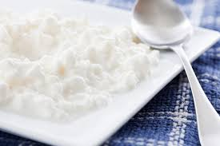
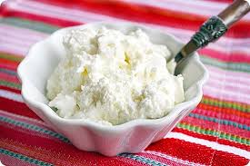
Cheese Categories
Unripened
Fresh cheeses:
Cream cheese
Cottage cheese
Ricotta cheese

Slide 14
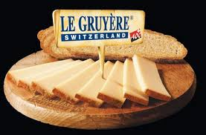
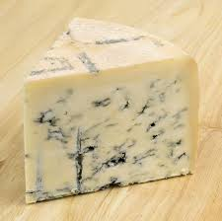
Cheese Categories: Ripened
Ripened by injecting mold into cheese to spread during aging
Bacteria cultures/Enzymes added
Bleu
Gorgonzola
Roquefort
Cheddar
Gruyere
Asiago
Parmigiano-Reggiano

Slide 15
Storing Cheese
Wrap in waxed or parchment paper
Optimal temperature: 35-45°F at high humidity
Best at near the bottom of the refrigerator
Double wrap pungent cheeses
Bleu cheese
Do not freeze
Discard dry, slimy, or cheeses with a strong odor

Slide 16
Lactose Allergy vs Intolerance
Lactose allergy cause allergic reactions such as hives, swelling, etc.
Lactose intolerance is a common digestive condition and is a reaction to many cultured dairy products, not just milk.
Dairy alternatives:
Soy milk
Rice milk
Almond milk
Coconut milk
Ripened cheeses are usually well tolerated because curdling separates the solids from the lactose portion

Slide 17
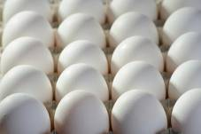
Eggs

Slide 18
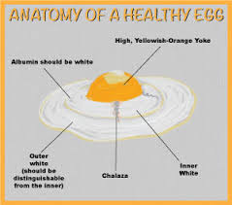
Eggs
An egg is composed of the outer shell, the white, and the yolk:
The white (albumen) consists of protein and water.
The yolk contains protein, fat, and lecithin, a natural emulsifier (thickener).
The membranes that hold the egg yolk in place are called chalazae.
1.1

Slide 19
Egg Grades
There are USDA grades for shell
USDA Grade AA:
Yolk is high and the white will not spread much when the shell is broken.
USDA Grade A:
Yolk is fairly high and the white will still not spread too much when the shell is broken.
Grade B:
Good for use in menu items that will hide their appearance, such as baked items.
1.1

Slide 20
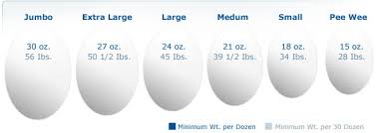
Egg Sizes
1.1

Slide 21
Egg Products
Shell
No odor
Clean and unbroken
Stored at 45°F or lower
Best for fresh products/immediate service
Liquid
Frozen
Dehydrated
USDA inspected
Must be pasteurized by law
Check packages for damage
Store according to package directions

Slide 22
EGG COOKING TECHNIQUES

Slide 23
Cooking with Eggs
Use pasteurized shell eggs or egg products when prepping egg dishes that need little to no cooking
Ex. Caesar salad dressing, tiramisu
Cook eggs for immediate service to 145°F for 15 seconds.
Cook eggs that will be hot-held to 155°F for 15 seconds.

Slide 24
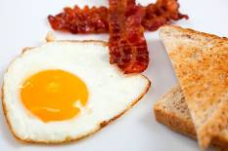
Cooking Eggs
Make hard-cooked eggs by simmering, then shocking, the eggs.
Add eggs to saucepan or stock pot completely immersed in cold water
Over medium heat, bring water up to a boil
Turn off heat, cover pan, and let sit for 10 minutes
Shock under cold water
1.1

Slide 25
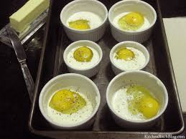
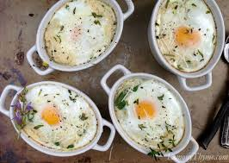
Cooking Eggs
To bake eggs, place the shelled eggs into individual ramekins.
1.1

Slide 26
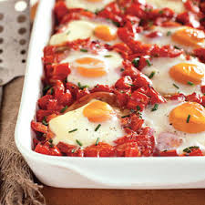
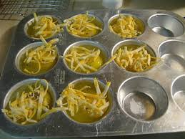
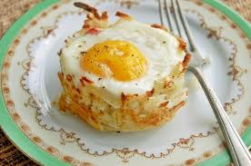
Cooking Eggs
Shirred eggs are a variety of baked egg cooked with other ingredients, such as cheese, vegetables, meats, and sauces.
1.1

Slide 27
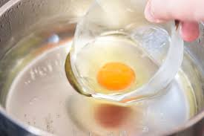
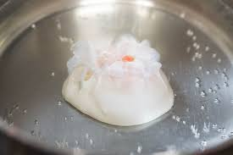
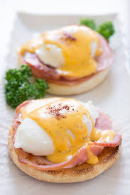
Cooking Eggs
To poach eggs, shell them and simmer the eggs in water.
1.1

Slide 28
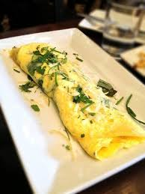
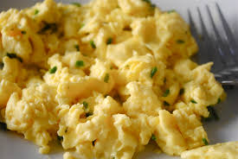
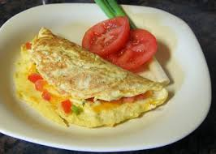
Cooking Eggs
Scrambled eggs should have a light texture, creamy consistency, and delicate flavor.
Stir continuously during cooking process.
Make omelets by slightly beating eggs, and then cooking them in a skillet with a filling, such as cheese, mushrooms, onions, or ham.
1.1

Slide 29
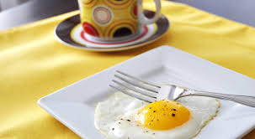
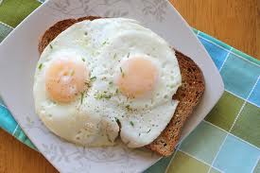
Cooking Eggs
Fried Eggs
Eggs fried up are fried only on the bottom (sunny-side up)
Eggs fried over easy are fried on the bottom, turned over, and fried lightly on their top sides.
1.1

Slide 30
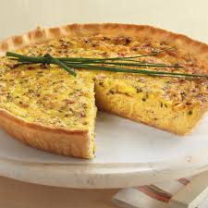
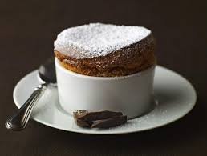
Cooking Eggs
Quiche is a savory egg custard baked in a crust.
Soufflés are made of eggs and can be both savory and sweet.
1.1

Slide 31
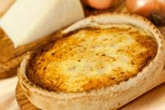
Section 1.1 Summary
There are many types of milk; the type of milk you use is often based on the nutritional value you want.
Cream must have at least 18 percent fat content to be considered light cream. Heavy whipping cream can be 40 percent fat or higher.
Butter is made by mixing heavy cream at a very high speed.
The pasteurization process is what kills bacteria in milk that could make people sick.
All cheese has three basic parts: water, fat, and protein. The amounts vary depending on the type of cheese.
Eggs are chosen by their grade (AA, A, or B) and size (ranging from peewee, the smallest, to jumbo, the largest).
Eggs can be cooked using many different methods, including simmering, frying, poaching, and baking.
1.1

Slide 32
Assignments
Egg Webquest- On
Upcoming Labs:
Egg Technique Practice
Hard Boiled
Fried Eggs: Sunny-side up & Over-easy
Poached
Eggs Benedict
Techniques: Clarifying Butter, Poaching Eggs & Hollandaise Sauce

