Slide 1
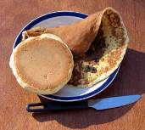
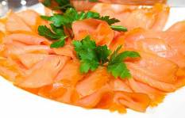
BREAKFAST FOODS & DRINKS 1.2
Chapter 1: Breakfast Foods & Sandwiches

Slide 2
Pancakes & Crêpes
Make pancakes with a medium-weight pour batter, and cook them on an open, lightly oiled griddle.
Crêpes are a very thin pancake-type item with a high egg content. Crêpes are traditionally cooked in a lightly oiled, very hot sauté pan.
Make Swedish pancakes with a slightly sweetened batter that is a bit heavier than a crêpe batter.
1.2

Slide 3
Waffles & French Toast
For waffles, use a medium-weight pour batter. Cook waffles in a waffle maker/iron.
French toast is sliced bread dipped in an egg-and-milk mixture. Cook French toast on a lightly-oiled griddle or flat pan, or pan-fry it in clarified butter in a hot sauté pan.
Serve pancakes, crêpes , waffles, and French toast with butter and syrup, powdered sugar, fresh fruit, or whipped cream.
1.2

Slide 4
Breakfast Meats
Cook bacon until it is crisp and then drain it of fat.
Bacon is about 70% fat so shrinkage will occur
Cook sausage completely through.
Canadian bacon is boneless pork loin that has been cured and smoked. Cook it the same way as ham.
Fish such as smoked salmon or trout is generally served cold on breakfast and brunch menus.
1.2

Slide 5
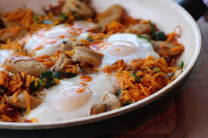
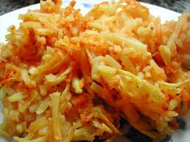
Breakfast Starches
Hash is a mixture of chopped meat (fresh, smoked, or cured), potatoes, and onions.
Prepare hash browns by steaming or simmering potatoes in lightly salted water, and then peeling, chilling, and shredding them. Cook the shredded potato on a lightly oiled griddle on medium heat to a light-golden brown on both sides.
1.2

Slide 6
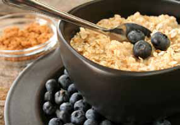
Breakfast Starches (cont.)
A wide variety of cold cereals featuring oat bran and granola are common breakfast requests.
There are two types of hot cereal: whole, cracked, or flaked and granular. When preparing hot cereal, be sure to measure the correct amount of water, salt, and cereal.
1.2

Slide 7
Breakfast Starches (cont.)
Breakfast breads range from simple sliced toast, bagels, biscuits, muffins, croissants, doughnuts, cornbread, coffeecake, English muffins, and sweet rolls, among many others.
Serve hot or warm, accompanied by butter, honey, cream cheese, or jam.
Store bread between 75-85°F
Use French bread or other hard-crusted bread
the day it is delivered or baked
1.2

Slide 8
Hot Breakfast Beverages:
Coffee
Tea
Cocoa
Both coffee and tea contain caffeine, which is a stimulant.
One cup of tea has about half the caffeine contained in a cup of coffee.
1.2

Slide 9
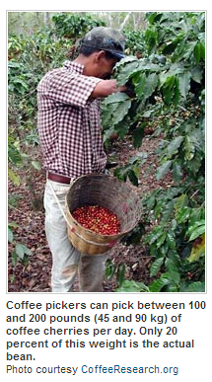
Hot Breakfast Beverages: Coffee
Coffee beans
Berries of a tropical shrub that are roasted to develop their flavor.
Coffee “berries” are called coffee cherries
1.2

Slide 10
Hot Breakfast Beverages: Coffee
Coffee beans
Degree of roasting determines flavor
Americans typically prefer medium-roast
Europeans- dark roast
Use right proportion of water to ground coffee beans
Start with fresh, cold water
Brewing temp of 195-200°
AVOID HOLDING FOR MORE THAN 1 HOUR
1.2

Slide 11
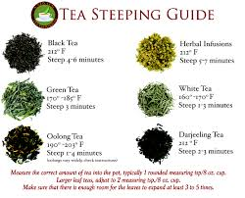
Hot Breakfast Beverages: Teas
Steep tea for approximately 5 minutes (dependent on type of tea) at 175°F
Black tea
Tea leaves that have been fermented
Green tea
Tea leaves that are not fermented
Herbal tea
Made from many different fruits and herbs
Naturally caffeine-free.
Tea has typically half or less of the caffeine than that of coffee
1.2

Slide 12
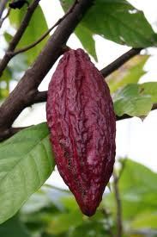
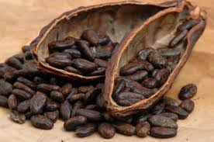
Hot Breakfast Beverages: Chocolate-Based
Hot chocolate is made from actual chocolate bars.
Hot cocoa is made from the powder of the cacao bean.
1.2

Slide 13
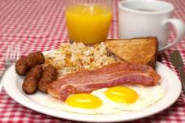
Section 1.2 Summary
Pancakes, waffles, crêpes, and French toast are the primary breakfast foods aside from eggs.
Bacon, sausage, ham, Canadian bacon, and fish make up the traditional breakfast meats.
Hash is traditionally a combination of meat, potatoes, and onion.
Potatoes have two traditional forms for breakfast: hashed brown and home-fried.
Both hot and cold cereals are popular breakfast foods. They are healthy and relatively easy to prepare.
Traditional hot beverages are coffee, tea, and cocoa.
1.2
Chapter 1 | Breakfast Food and Sandwiches

