Slide 1
Cooking Terms
The Language of the Recipe

Slide 2
The Language of the Recipe
Become familiar
Terms are important tools for the cook.
Each has its own meaning.
Achieve best results.

Slide 3
Techniques of: Preparation
Bread Grease
Brush Marinate
Dredge Sift
Flute Grease

Slide 4
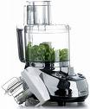
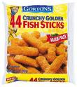
Bread
To cover a food with a coating of crumbs made from bread, crackers, or cereal. The food is often dipped in a liquid such as milk or egg before coating.

Slide 5
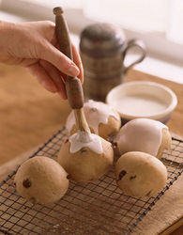
Brush
To spread a liquid coating on a food, using a pastry brush or paper towel.

Slide 6
Dredge
To cover a food with a dry ingredient such as flour or sugar. The food may be rolled in, sprinkled with, or shaken in a bag with the dry ingredient.

Slide 7
Flute
To form a standing edge on a pastry, such as pie crust, before baking. Press the dough with your fingers to create this scalloped edge, or use a fork to “crimp” the edge.

Slide 8
Grease
To rub shortening, fat, or oil, on the cooking surface of bake-ware. Use waxed paper or paper towel to spread a thin, even layer.

Slide 9
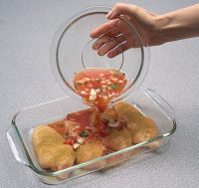
Marinate
To soak in a seasoned liquid, called a marinade, to add flavor and/or to tenderize.

Slide 10
Sift
To put dry ingredients through a sifter or a fine sieve to incorporate air.
If you don’t have a sifter you can use a strainer or a wire whisk.

Slide 11
Techniques of: Mixing
Beat Knead
Blend Mix
Combine Stir
Cream Whip
Cut in Fold in

Slide 12
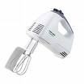
Beat
To mix with an over-and-over motion, using a spoon, rotary, or electric beater.

Slide 13
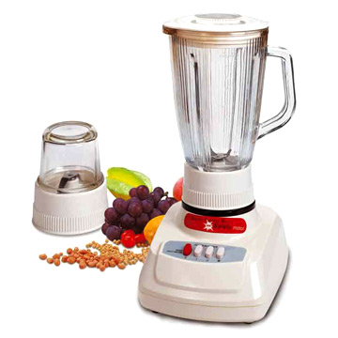
Blend
To combine thoroughly two or more ingredients.

Slide 14
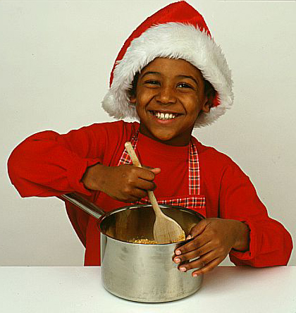
Combine
To mix together, usually by stirring, two or more ingredients.

Slide 15
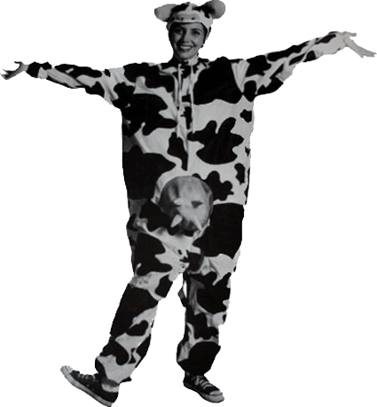
Cream
To soften and blend until smooth and light by mixing with a spoon or an electric mixer.

Slide 16
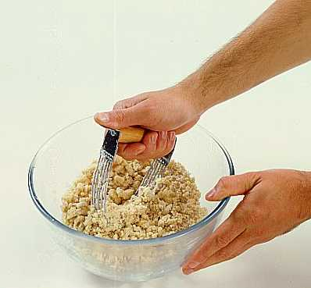
Cut in
To mix solid shortening with flour by cutting the shortening into small pieces and mixing until it is completely covered with the flour mixture. Use a pastry blender, two knives, or a fork.

Slide 17
Fold in
To combine a delicate mixture, such as beaten egg white or whipped cream, with a more solid material. Insert the edge of a spoon or rubber scraper vertically down through the middle of the mixture, slide it across the bottom of the bowl, bring it up with some of the mixture, and fold over on top of the rest. Continue slowly and gently, turning the bowl often, until all is evenly mixed.

Slide 18
Knead
To work dough by folding, pressing, and turning, until it is smooth and elastic. Place dough on a floured board, fold it in half, and press firmly with the heels of your hands. Turn the dough about a quarter turn, and repeat the folding and pressing.

Slide 19
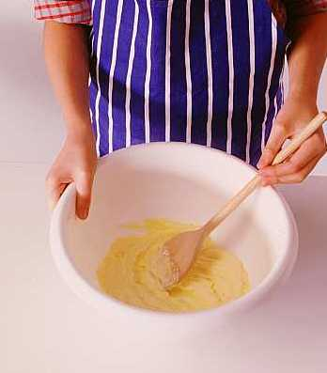
Mix
To combine two or more ingredients, usually by stirring.

Slide 20
Stir
To mix with a circular motion of a spoon or other utensil.

Slide 21
Whip
To beat rapidly with a rotary beater, an electric mixer, or wire whisk; to incorporate air and make light and fluffy, as whipped cream or egg white

Slide 22
Techniques of: Cutting
Chop Grind
Core Julienne
Cube Mash
Cut Mince
Dice Pare
Grate Score
Scrape Shred
Slice Sliver
Trim

Slide 23
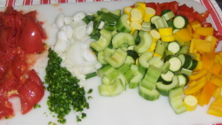
Chop
To cut into small pieces

Slide 24
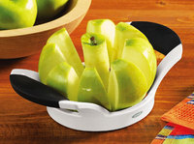
Core
To remove the core of a fruit with a corer or paring knife

Slide 25
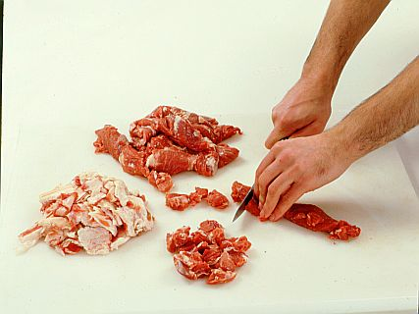
Cube
To cut into small squares

Slide 26
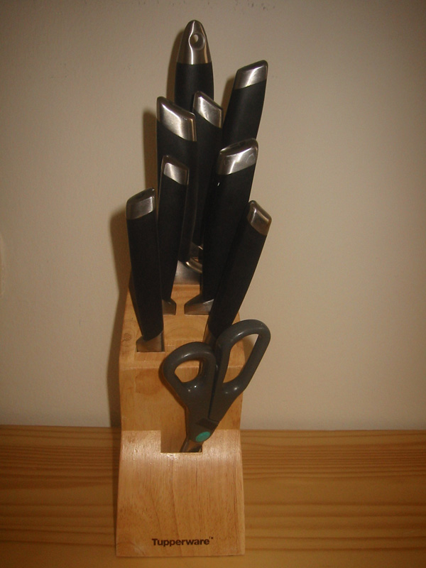
Cut
To divide foods into small pieces with a knife or scissors.

Slide 27
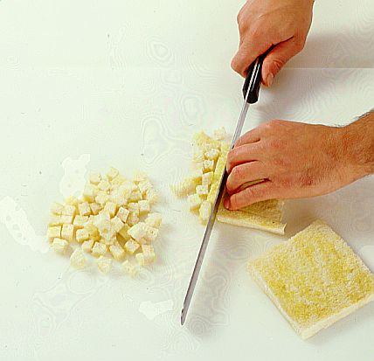
Dice
To cut into very small cubes

Slide 28
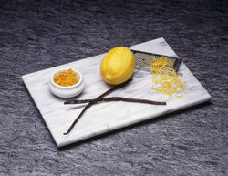
Grate
To rub food, such as lemon or orange peel, against a grater to obtain fine particles.

Slide 29
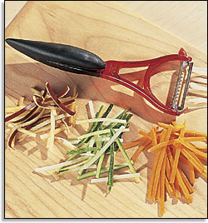
Julienne
To cut food into long, thin strips.

Slide 30
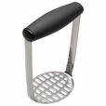
Mash
To crush food until it becomes smooth.

Slide 31
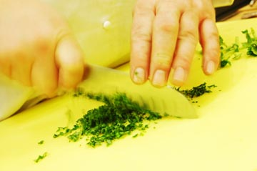
Mince
To cut into very small pieces with a sharp knife.

Slide 32
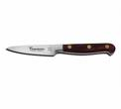
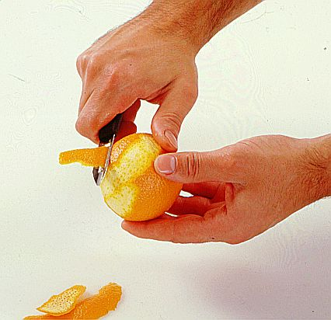
Pare
To cut away the skin or a very thin layer of the outside of fruits or vegetables. Use a vegetable peeler or a knife.

Slide 33
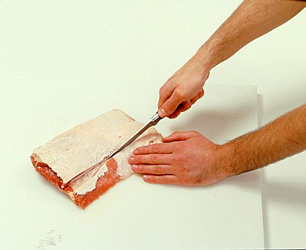
Score
To make thin, straight cuts through the outer edge of fat on meat to prevent the meat from curling during cooking.

Slide 34
Scrape
To rub a vegetable, such as a carrot, with the sharp edge of a knife in order to remove only the outer layer of skin.

Slide 35
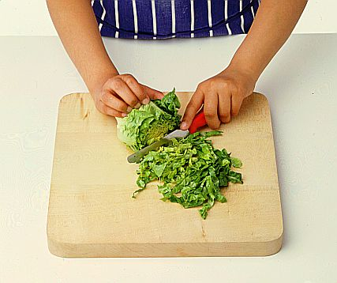
Shred
To tear or cut into thin pieces or strips.

Slide 36
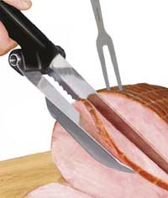
Slice
To cut food into flat pieces.

Slide 37
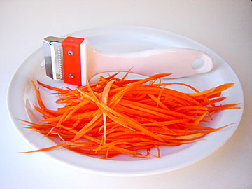
Sliver
To cut in long, thin pieces.

Slide 38
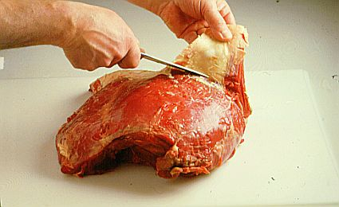
Trim
To cut away most of the fat from the edges of meat.

Slide 39
Techniques of: Cooking
Bake Barbeque
Baste Boil
Braise Broil
Brown Deep-fat fry
Dot Fry
Pan-broil Pan-fry
Poach Preheat
Roast Saute
Scald

Slide 40
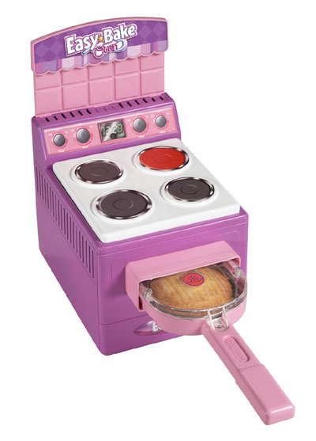
Bake
To cook in an oven or oven-type appliance in a covered or uncovered pan.

Slide 41
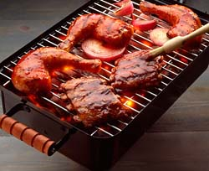
Barbeque
To cook meat or poultry slowly over coals on a spit or in the oven, basting it often with a highly seasoned sauce.

Slide 42
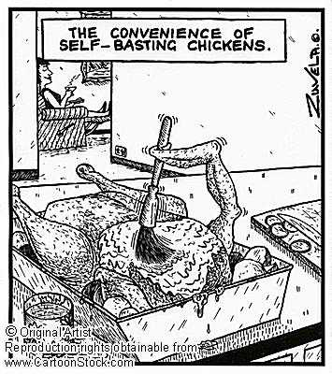
Baste
To spread, brush, or pour liquid (such as sauce, drippings, melted fat, or marinade) over food while it is cooking. Use a baster, brush, or spoon.

Slide 43
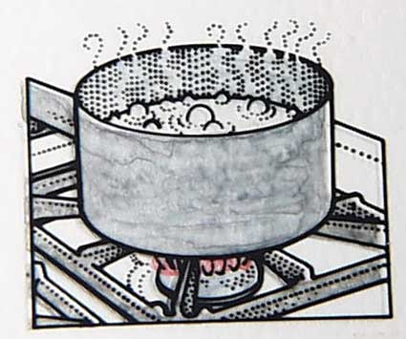
Boil
To cook in liquid, usually water, in which bubbles rise constantly and then break on the surface.

Slide 44
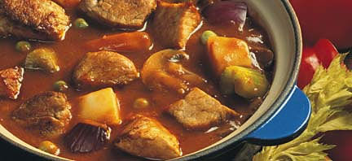
Braise
To cook meat slowly, covered and in a small amount of liquid or steam.

Slide 45
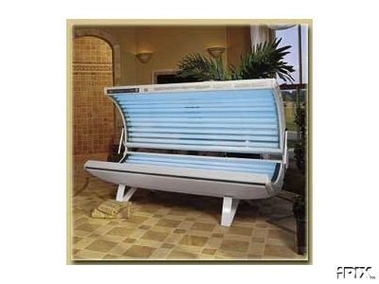
Broil
To cook under direct heat or over coals.

Slide 46
Brown
To make the surface of a food brown in color by frying, broiling, baking in the oven, or toasting.

Slide 47
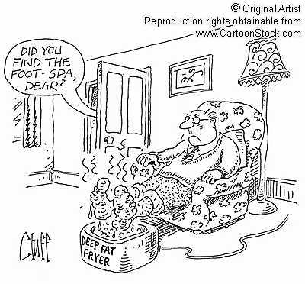
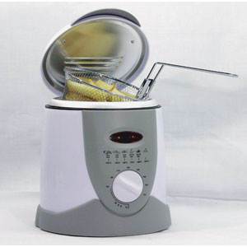
Deep-fat fry
To cook in hot fat that completely covers the food.

Slide 48
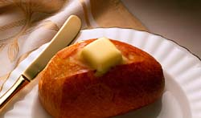
Dot
To place small particles of a solid, such as butter, on the surface of a food.

Slide 49
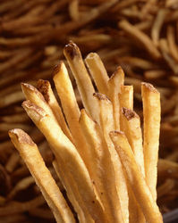
Fry
To cook in hot fat.

Slide 50
Pan-broil & Pan-fry
To cook uncovered in an un-greased or lightly greased skillet, pouring off excess fat as it accumulates.
To cook in an uncovered skillet with a small amount of fat.

Slide 51
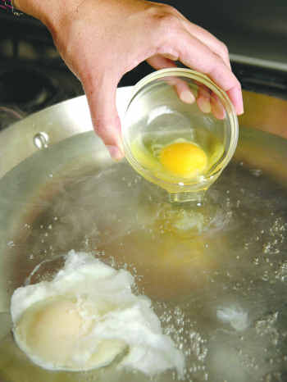
Poach
To cook gently in hot liquid below the boiling point.

Slide 52
Preheat
To set the oven to cooking temperature in advance so that it has time to reach the desired temperature by the start of cooking.

Slide 53
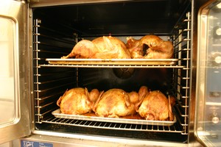
Roast
To cook by dry heat, uncovered, usually in the oven.

Slide 54
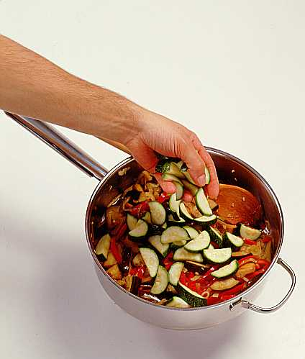
Saute
To cook uncovered in a small amount of fat in a pan.

Slide 55
Scald
To heat a liquid to just below the boiling point; or to pour boiling water over food or to dip food briefly into boiling water.

Slide 56
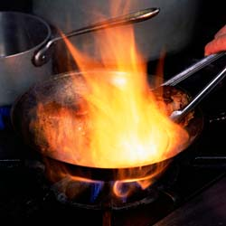
Sear
To cook meat quickly at a high temperature until it becomes brown. Use a skillet with a small amount of fat, or the oven at a high temperature.

Slide 57
Simmer
To cook in liquid just below the boiling point. The tiny bubbles that form should break before they reach the surface.

Slide 58
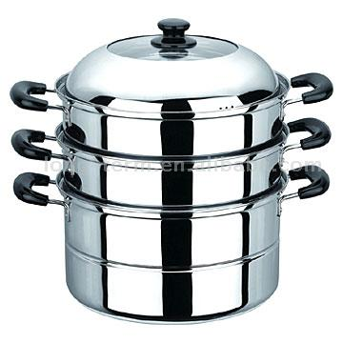
Steam
To cook over steam rising from boiling water.

Slide 59
Steep
To cover with boiling water and let stand without additional heating until flavor and color are extracted, as for tea.

Slide 60
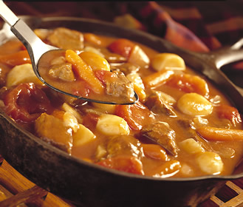
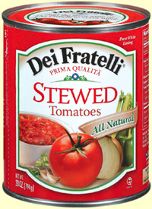
Stew
To cook slowly and for a long time in liquid

Slide 61
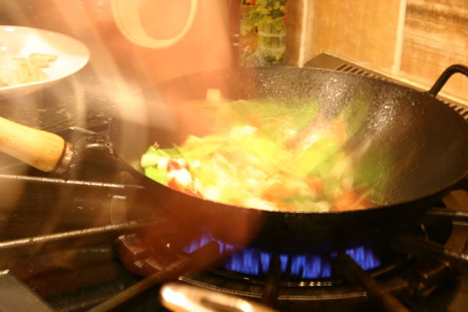
Stir-fry
To fry small pieces of food very quickly in a small amount of very hot oil while stirring constantly. Use a wok or skillet.

Slide 62
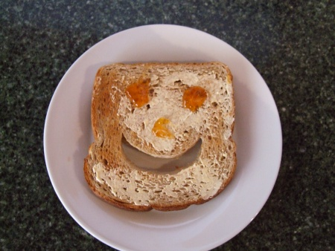
Toast
To brown by direct heat in a toaster or in the oven.

Slide 63
The End

