Slide 1
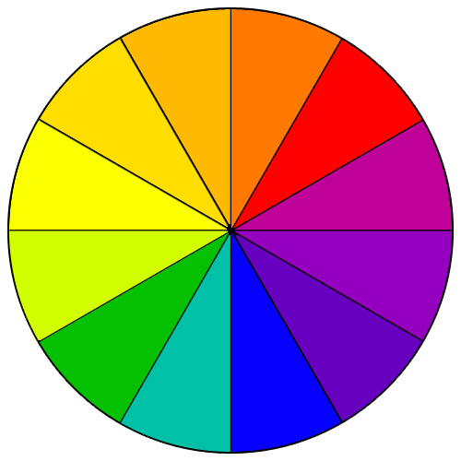
Understanding Color
Chapter 9

Slide 2
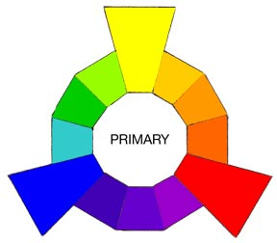
Primary Colors
Red, Yellow, Blue
Basic colors from which all other colors are made
Can NOT be made from combining any colors
Equally spaced on the color wheel

Slide 3
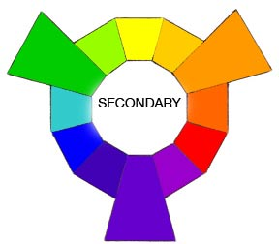
Secondary Colors
Green, Orange, Violet (Purple)
Equally spaced on the color wheel
Made by combining 2 primary colors
Blue + Yellow = Green
Red + Yellow = Orange
Red + Blue = Violet

Slide 4
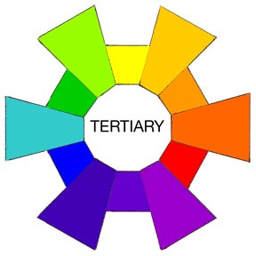
Tertiary Colors
Made by combining a primary color and a secondary color
Ex.—Red + Orange = Red-Orange
Ex.—Blue + Violet = Blue-Violet

Slide 5
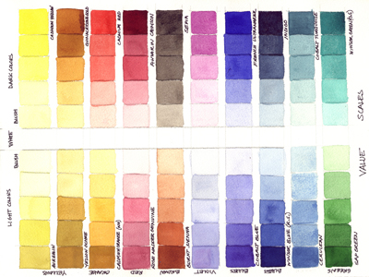
Value
Lightness or darkness of a color
Add white to lighten a color = tint
Pastels—light pink, mint green, baby blue
Add black to darken a color = shade
Navy blue, brown (shade of orange)

Slide 6
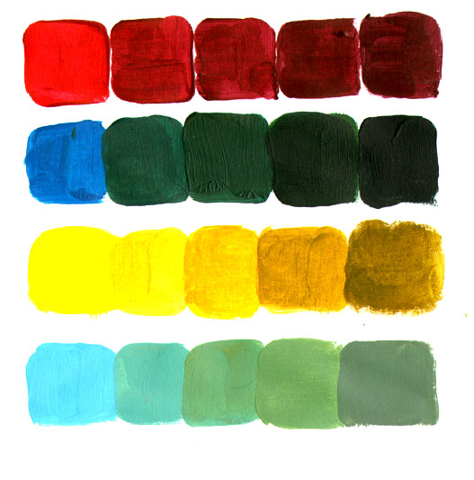
Intensity
Brightness or dullness of a color
Bright = jewel tones
Emerald green, ruby red
Dull colors (not necessarily boring or drab) = Softer, muted, subdued
Dusty rose, khaki green
Reduce intensity → dull =add gray

Slide 7
Neutrals
Black & White
NOT colors
Not on the color wheel
Gray
Combination of black and white
Beige and brown are sometimes considered neutrals, but are not true neutrals

Slide 8
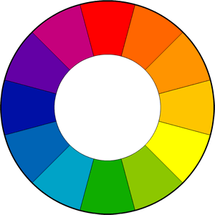
Color Schemes

Slide 9
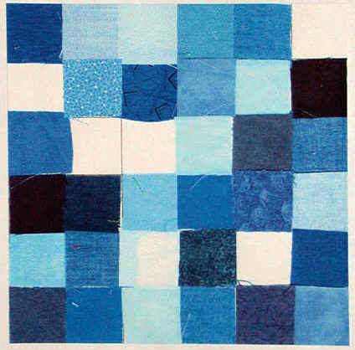
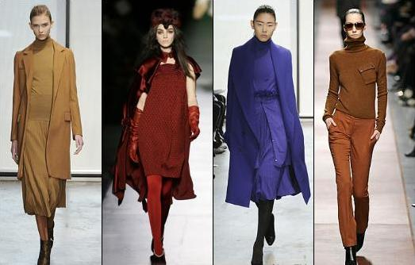
Monochromatic
One color
Different tints and shades
Example: Light blue, blue, dark blue

Slide 10
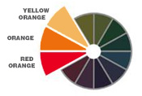
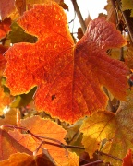
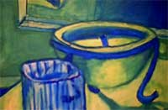
Analagous
3-4 colors next to each other on the color wheel
Examples:
Red, red-violet, violet
Blue, green, yellow

Slide 11
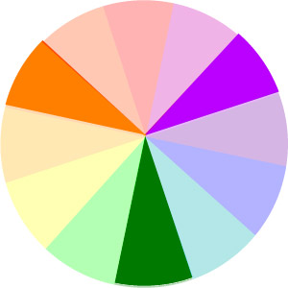
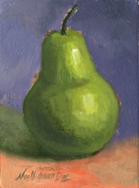
Triad
3 colors EVENLY spaced on the color wheel
Common examples/uses: Primary colors (red, blue, yellow) or secondary colors (green, orange, purple)

Slide 12
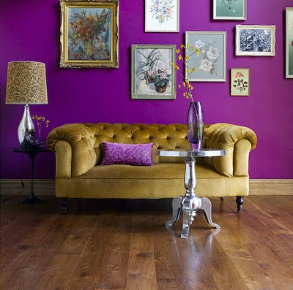
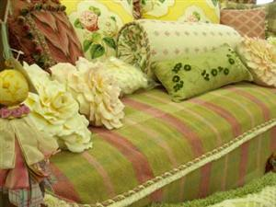
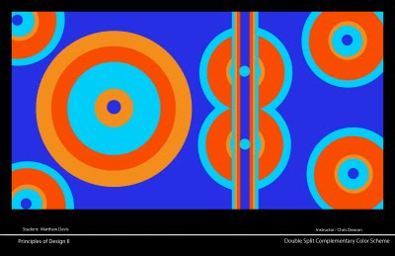
Complementary
2 colors opposite one another on the color wheel
Examples:
Red/green
Yellow/purple
Blue/orange

Slide 13
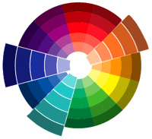
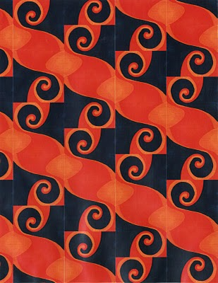
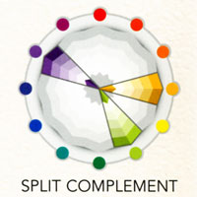
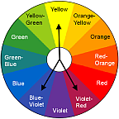
Split Complementary
One color + the two colors on either side of its complement
Example:
Red, Yellow-green, Blue-green
Blue-violet, Orange, Yellow

Slide 14
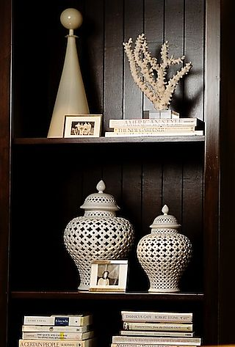
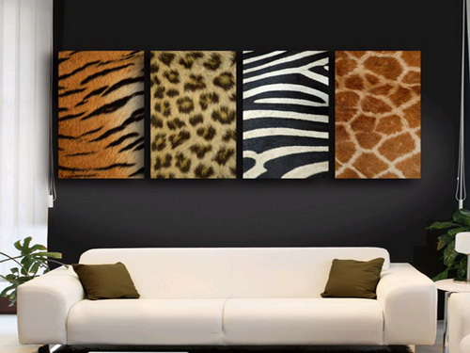
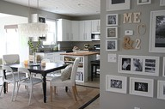
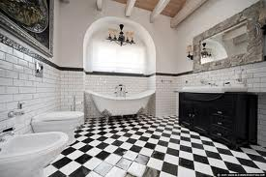
Neutral
Black, White, Gray—mix of black and white
In fashion, may also include brown and beige

Slide 15
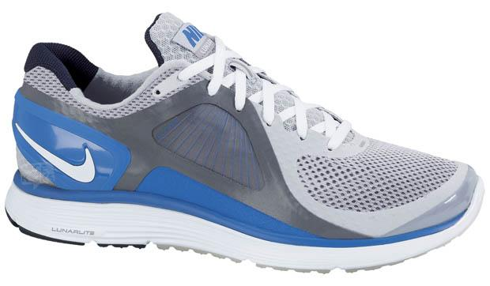
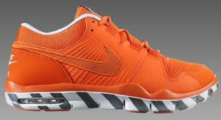
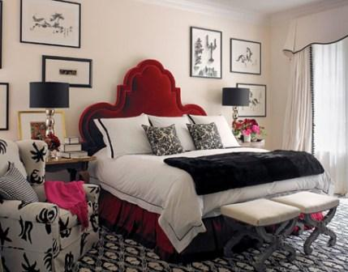
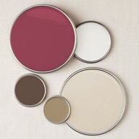
Neutral with an Accent
Any neutral + color
(usually only one, but may be more)

Slide 16
REVIEW!
Color Photo Hunt with a Partner

