Slide 1
Chocolate
ProStart Chapter 8

Slide 2
What’s Your Chocolate IQ?

Slide 3
Chocolate IQ continued

Slide 4
Chocolate IQ Continued

Slide 5
Chocolate IQ continued

Slide 6
Chocolate IQ continued

Slide 7
Chocolate IQ Answers- 1 point for each correct response

Slide 8
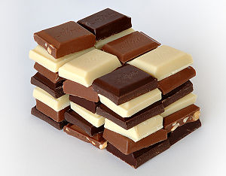
How did you do?

Slide 9
Chocolate History
Mayans believed it was a divine food from the gods.
French thought it to be a dangerous drug
Love, romance

Slide 10
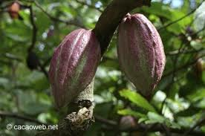
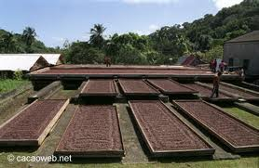
Chocolate preparation
Comes from cocoa beans from
cacao trees.
Roast cocoa beans – dry fermentation

Slide 11
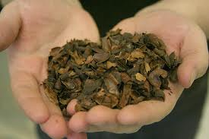
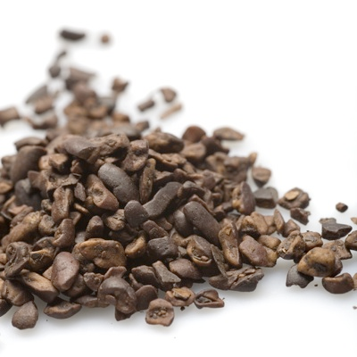
Continued
Loosen outer shell and crack bean
shown: shells, used in gardens
Beans are broken into small pieces
called nibs

Slide 12
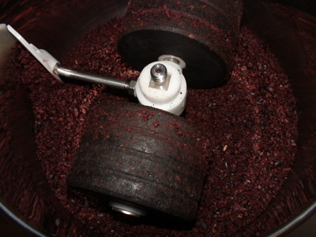
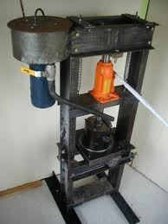
Continued
Crushed into paste – completely
unsweetened, called chocolate
liquour
Pressed to separate the liquid from
the solid. Liquid is cocoa butter.
This can be combined with chocolate
liquour to make eating chocolate.

Slide 13
Types of Chocolate
Type | Description | Form
Chocolate, bitter sweet | Solid chocolate 35-50% chocolate liquor, 15% cocoa butter and 35-50% sugar | Blocks, bars, chunks & chips
Chocolate liquor | Chocolate flavored portion of the chocolate | Blocks or bars
Chocolate semi-sweet | Solid chocolate about 45% chocolate liquor, 15% cocoa butter and 40% sugar | Blocks, bars, chunks & chips
Chocolate, unsweetened | 90% chocolate liquor, 5% cocoa butter, maybe 5% sugar | Blocks or bars
Cocoa | Only 10-25% of cocoa butter remains | Powdered
Cocoa butter | Vegetable fat portion of chocolate, added for chocolate | Wrapped in plastic at room temperature

Slide 14
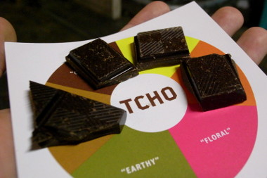
Tasting Chocolate
Cleanse your palate
Chocolate needs to be room temperature
Allow the chocolate to dissolve in your mouth – don’t bite or chew
Describe what you taste at the beginning, during and after

Slide 15
Storage
Cool, dry place.
Wrap carefully
Refrigeration causes moisture to condense. May need to refrigerate in hot humid weather.
Bloom – cocoa butter has melted and recrystallized on the surface. No change in flavor, but looks funny.
Should keep several months.

Slide 16
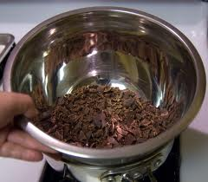
Tempering Chocolate
Why?
So it will harden evenly and have a good shine
Can be purchased already tempered
How?
Finely chop 1 pound of chocolate.
Combine ¾ of the chocolate and 2 tsp. shortening in a heat proof bowl set over a pan of simmering water. Don’t let the water near the chocolate.
Melt the chocolate to 105 degrees, stirring. Place the bowl in a larger bowl of cold water, stir in the remaining chocolate until melted. The temperature should drop to 87 degrees. Place back over simmering water. Heat back to 92 over hot water. Re-heat to 92 if it gets too thick.

Slide 17
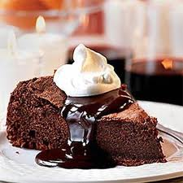
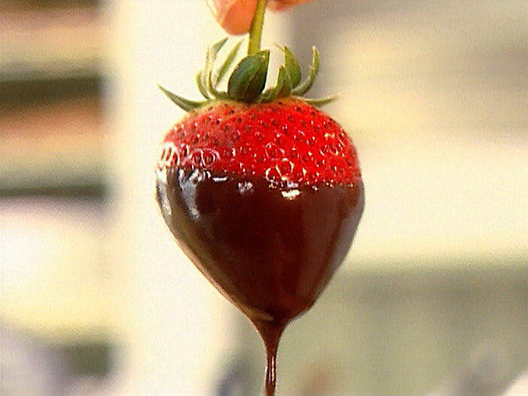
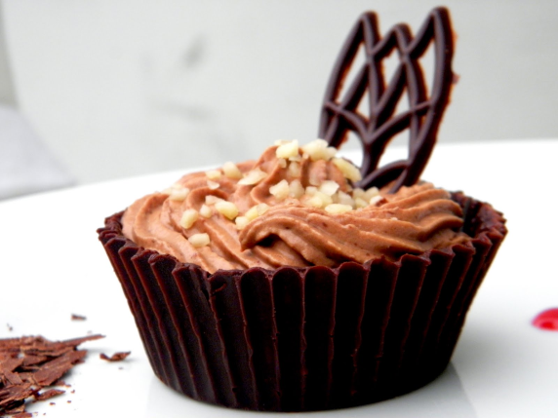
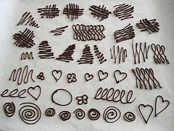
Chocolate uses
Sauces or icing (Ganache)
Dipping
Piping - garnish

