Slide 1
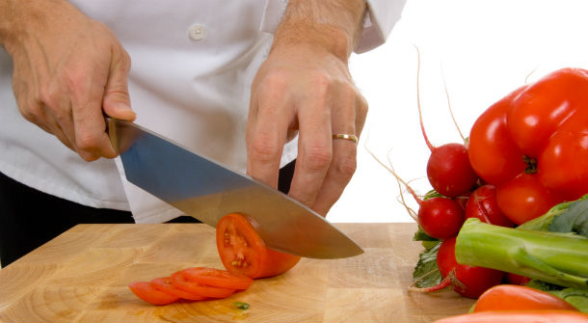
Chapter 4

Slide 2
As a manager, you can minimize the risk of foodborne illness by carrying out the following responsibilities:
Establishing specific personal hygiene policies
Training food handlers on those policies and retraining them regularly.
Modeling correct behavior for food handlers at all times.
Supervising food safety practices at all times.
Revising policies according to changes in law anf food safety science.

Slide 3
When they have a foodborne illness
When they have wounds that contain a pathogen
When sneezing or coughing
When they have contact with a person who is ill
When they touch anything that may contaminate their hands and then they don’t wash them
When they have symptoms such as diarrhea, vomiting or jaundice
When they don’t wash their hands after touching a contaminant

Slide 4
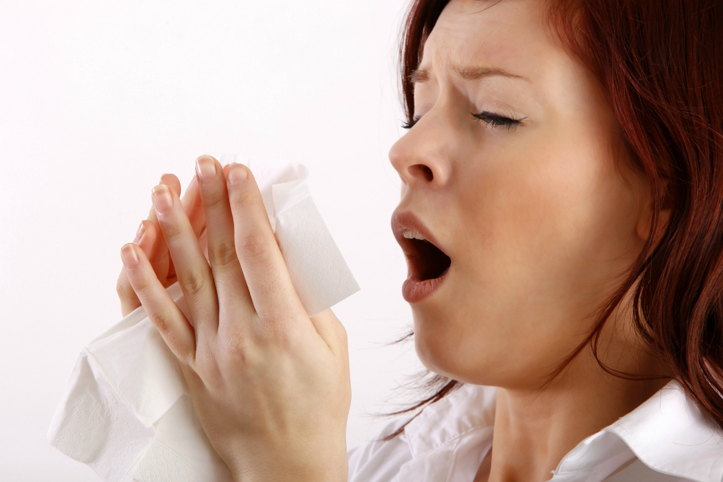
With some illnesses, a person may infect other people before showing any symptoms
With other illnesses, a person my infect other people for days or even months after symptoms are gone (Norovirus can be spread for days after symptoms have ended)

Slide 5
Carriers- people who carry pathogens and infect others without ever getting sick
Staphylococcus aureus is a pathogen carried in the nose of 30 to 50 percent of healthy adults, and about 20 to 35 percent carry it on their skin as well. Foodhandlers transfer this type of bacteria to food when they touch the infected areas of their bodies and then touch food without washing their hands.

Slide 6
WATCH WHAT YOU DO WITH YOUR HANDS!
Scratching the scalp
Running fingers through the hair
Wiping or touching the nose
Rubbing an ear
Touching a pimple or an infected wound
Wearing a dirty uniform
Coughing or sneezing into the hand
Spitting in the operation

Slide 7
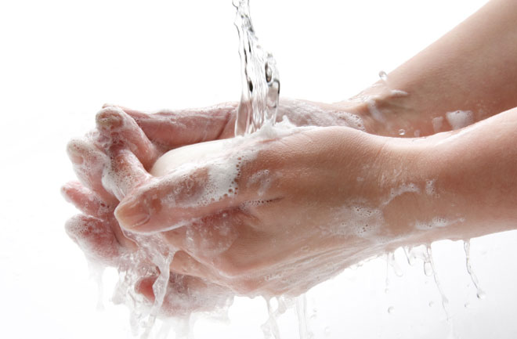
Hand practices
Handwashing
Hand care
Glove use
Preventing bare-hand contact with ready-to-eat food
Personal cleanliness
Wearing clean and appropriate clothing, restraining hair, and removing jewelry

Slide 8
Avoiding certain habits and actions
Maintaining good health
Covering wounds
Reporting health issues

Slide 9
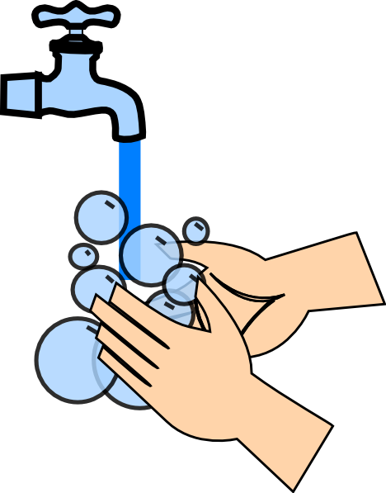
Most important part of personal hygiene
Many food handlers do not wash their hands the correct way or as often as they should
Hands must be washed in a sink designated for handwashing (NEVER in a food prep, dishwashing or utility services sink)
There are 5 steps in the proper handwashing routine, and the whole process should take AT LEAST 20 seconds

Slide 10
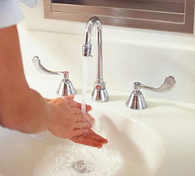
Wet hands and arms
Use running water as hot as you can comfortably stand
It should be at least 100F

Slide 11
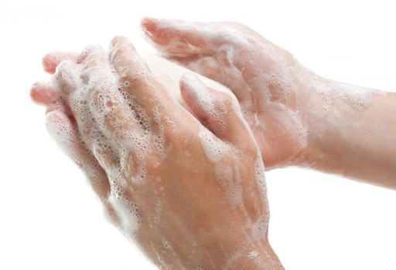
Apply soap
Apply enough to build up a good lather

Slide 12
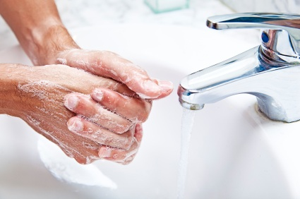
Scrub hands and arms vigorously
Scrub them for 10 to 15 seconds.
Clean under fingernails and between fingers.

Slide 13
Rinse hands and arms thoroughly
Using running warm water

Slide 14
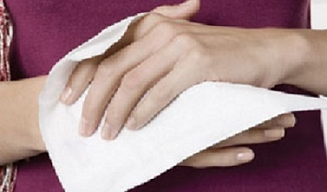
Dry hands and arms
Use a single-use paper towel or a hand dryer

Slide 15
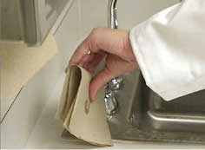
If you are not careful, you can contaminate your hands after washing them.
Consider using a paper towel to turn off the faucet and to open the door when leaving the restroom

Slide 16
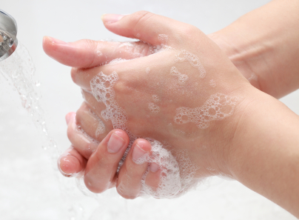
Before you start work
After using the restroom
After handling raw meat
After touching the hair, face or body
After sneezing, coughing, or using a tissue
After eating, drinking, smoking or chewing gum or tobacco
After handling chemicals that might affect food safety

Slide 17
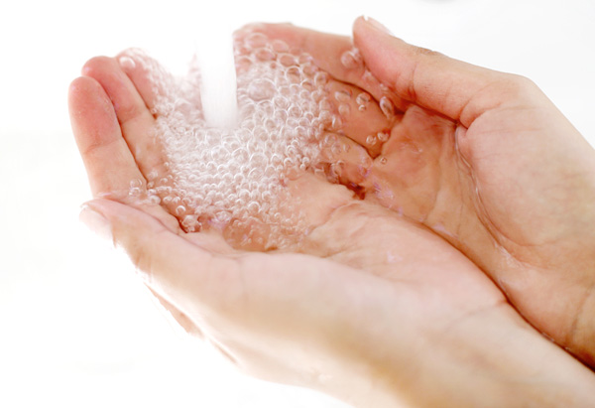
After taking out garbage
After clearing tables or busing dirty dishes
Touching clothing or aprons
After handling money
After leaving and returning to the kitchen/prep area
After touching anything else that may contaminate hands, such as dirty equipment, work surfaces, or cloths.

Slide 18
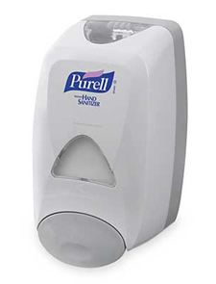
Hand antiseptics are liquids or gels that are used to lower the number of pathogens on skin.
If used they must comply with the Code of Federal Regulations (CFR) and Food and Drug Administration standards.
Only use hand antiseptics AFTER handwashing.
NEVER use in place of handwashing.
Wait for hand antiseptic to dry before touching food or equipment.

Slide 19
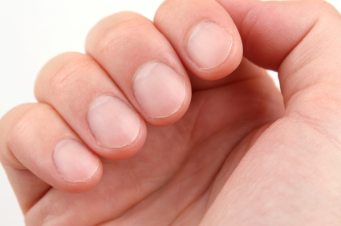
Fingernail length
Fingernails should be short and clean
Long fingernails can become physical contaminants if they break or chip
Fingernails should be trimmed and filed
Ragged nails can be hard to clean and hold pathogens

Slide 20
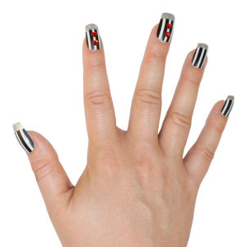
False fingernails
Do NOT wear false fingernails
They can be hard to keep clean
Can break off into food and become physical contaminants
Some local regulatory authorities allow false nails if single-use gloves are worn

Slide 21
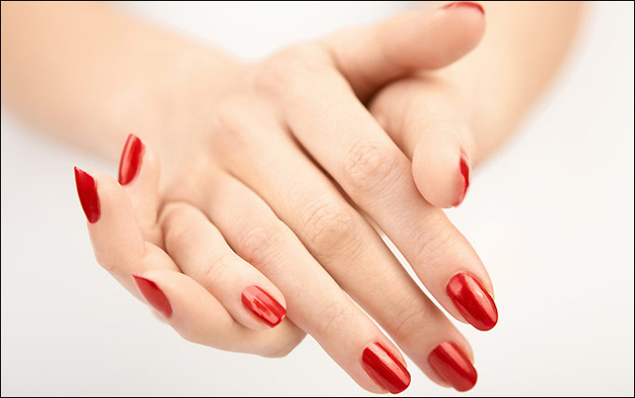
Nail Polish
Do NOT wear nail polish
It can disguise dirt under nails and may flake off into food
Some regulatory authorities allow polished nails if single-use gloves are worn

Slide 22
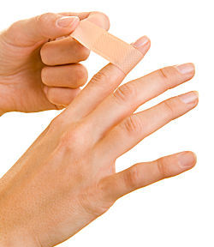
Infected wounds or cuts
Infected wounds, cuts or boils contain pus, and must be covered to prevent pathogens from contaminating food and food contact surfaces
Cover wounds with an impermeable cover (which means that liquid cannot pass through the cover) Ex. Bandages or finger cots IN ADDITION to a glove

Slide 23
Food can be contaminated when it has been handled with bare hands, especially with hands that have not been washed or hands that have cuts or wounds.
Do NOT handle ready-to-eat food with bare hands.
NEVER handle ready-to-eat food with bare hands if you primarily serve a high-risk population.

Slide 24
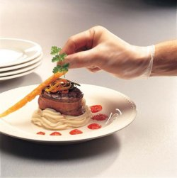
Single use gloves can help keep food safe by creating a barrier between hands and food.
Should be used when handling ready-to-eat food
The include when washing produce, or when handling ready-to-eat ingredients for a dish that will be cooked to the correct internal temperature.
Gloves should never be used in place of handwashing!

Slide 25
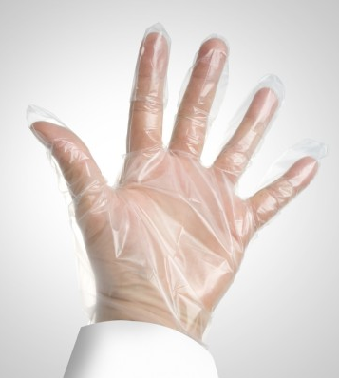
Approved Gloves
Only gloves approved for foodservice should be purchased
Disposable Gloves
Buy only single-use gloves for handling food.
NEVER wash and reuse gloves

Slide 26
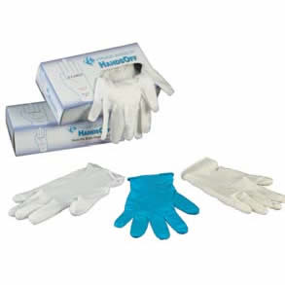
Multiple Sizes
Make sure your provide different size gloves
Gloves that are too big will not stay on
Gloves that are too small will tear or rip easily
Latex Alternatives
Some food handlers and customers may be sensitive to latex
Consider providing gloves made form other materials

Slide 27
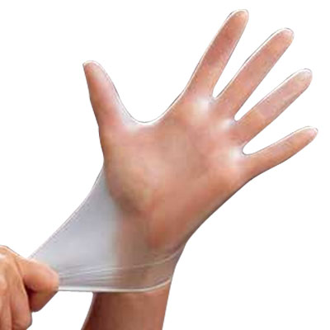
Wash and dry your hands before putting on gloves
Select the correct glove size
Hold gloves by the edge when putting them on. Avoid touching the glove as much as possible.

Slide 28
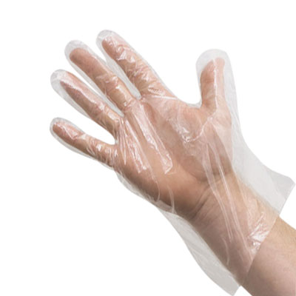
Once you’ve put them on, check the gloves for rips or tears.
NEVER blow into gloves
NEVER roll gloves to make them easier to put on

Slide 29
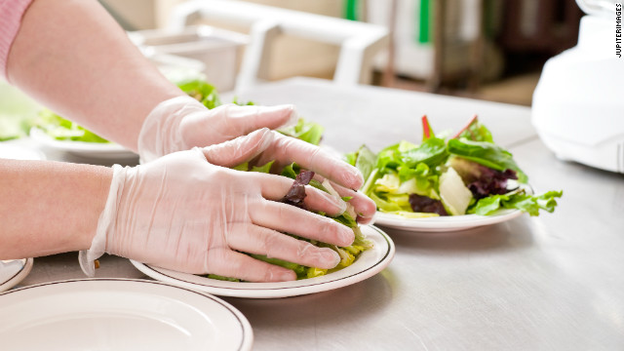
As soon as they become dirty or torn
Before beginning a different task
After an interruption, such as taking a phone call
After handling raw meat, seafood, or poultry, and before handling ready-to-eat food

Slide 30
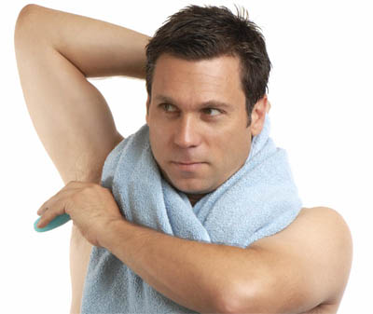
Pathogens can be found on hair and skin, and they can be transferred to food and food equipment if the food handler does not follow a personal hygiene program.
Make sure food handlers shower or bathe before work.

Slide 31
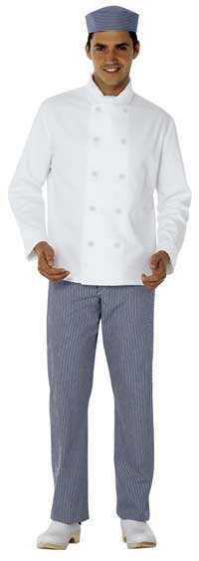
Pathogens can be transferred from dirty clothing to the hands and then to the food being prepared.
Make sure food handlers follow these guidelines

Slide 32
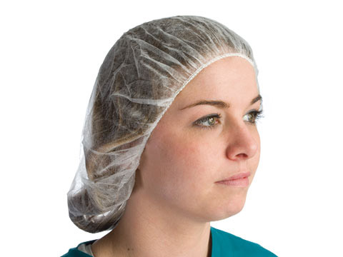
Hair Restraints
Wear a CLEAN hat or other hair restraint
Do NOT wear hair accessories that could become physical contaminants. They should be limited to hair accessories that keep your hands out of your hair and hair out of food.
False eyelashes can become a physical contaminant and should NOT be worn
Food handlers with facial hair should also wear a beard restraint

Slide 33
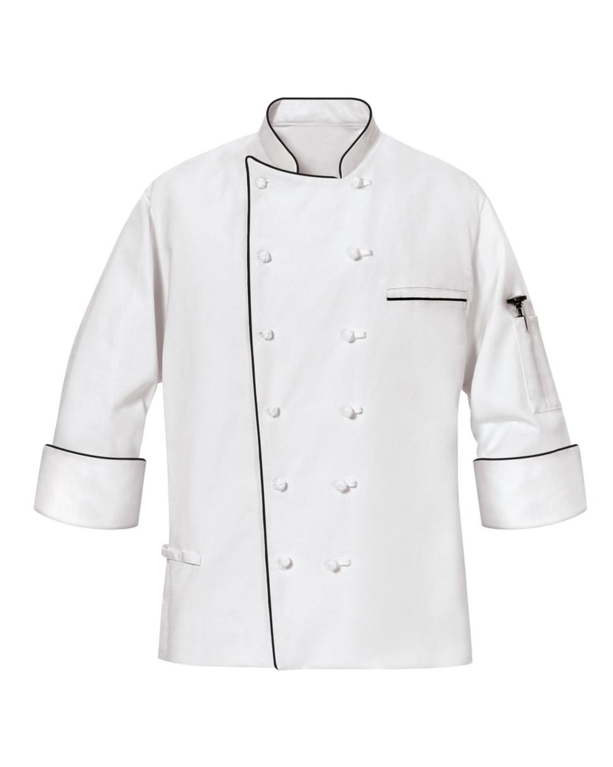
Clean Clothing
Wear clean clothing daily. If possible, change into work clothes at work.
Dirty clothing that is stored in the operation must be kept away from food and prep areas. This includes dirty aprons, chef coats, and other uniforms.

Slide 34
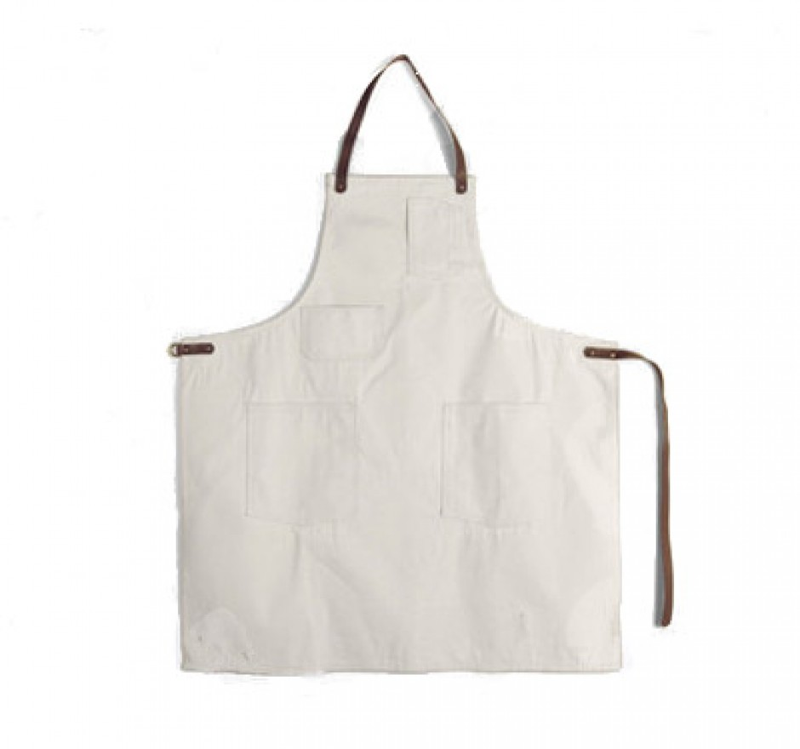
Aprons
Remove aprons when leaving prep areas.
For example, aprons should be removed and stored before taking out garbage or using the restroom.
NEVER WIPE YOUR HANDS ON YOUR APRON

Slide 35
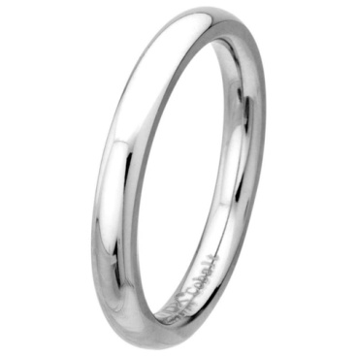
Jewelry
Remove jewelry from hands and arms before prepping food or when working around food preps.
Food handlers can not wear any of the following:
Rings, EXCEPT FOR A PLAIN BAND RING
Bracelets, including medical bracelets
Watches
Companies may require other jewelry to be removed, including earrings, necklaces, and facial jewelry.

Slide 36
Small droplets of saliva can contain thousands of pathogens.
In the process of eating, drinking, smoking or chewing gum or tobacco saliva can be transferred to hands or directly to the food being handled.
Do NOT eat, drink, smoke or chew gum or tobacco at these times:
When prepping or serving food
When working in prep areas
When working in areas used to clean utensils and equipment

Slide 37
Some regulatory authorities allow food handlers to drink froma covered container while in these areas.
If food must be tasted during prepping, it should be placed in a separate dish and tasted with a clean utensil. The dish and utensil should then be removed from the prep area or discarded.

Slide 38
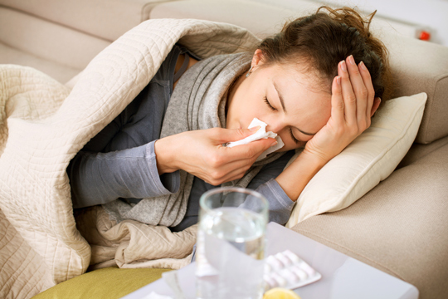
You must tell your staff to let you know when they are sick.
Staff must report illness before they come to work. They should also let you know immediately if they get sick while working.

Slide 39
If the food handler has a sore throat
Restrict the food handler from working with or around food. The food handler can work with or around food when he or she has a written release from a medical practitioner.
Exclude the food handler from the operation if you primarily serve a high-risk population. The food handler must be cleared by his or her medical practitioner before returning to work.

Slide 40
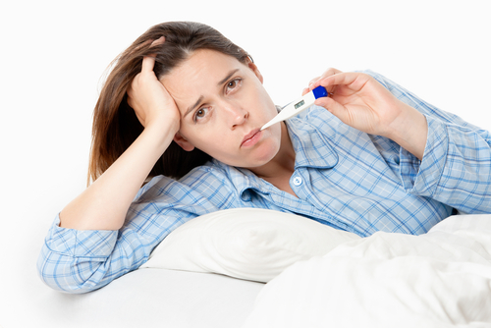
If the food handler is vomiting or has diarrhea
EXCLUDE the food handler from the operation
Food handlers must meet one of these requirements before they can return to work:
Have had no symptoms for at least 24 hours
Have a written release from a medical practitioner

Slide 41
If the food handlers has jaundice (yellowing of the skin or eyes)
Must be reported to the regulatory authority.
Food handlers who have jaundice for less than seven days must be EXCLUDED from the operation.
Food handlers must have a written release from a medical practitioner and approval from the regulatory authority before returning to work.

Slide 42
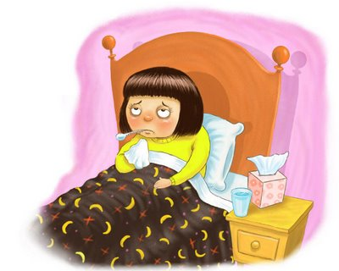
Food handlers who have been diagnosed with: Hepatitis A, Salmonella, E. Coli, Norovirus or Shigella
EXCLUDE food handler from the operation.
Work with the food handler’s medical practitioner and local regulatory authority to determine when the food handler can come back to work.

