Slide 1
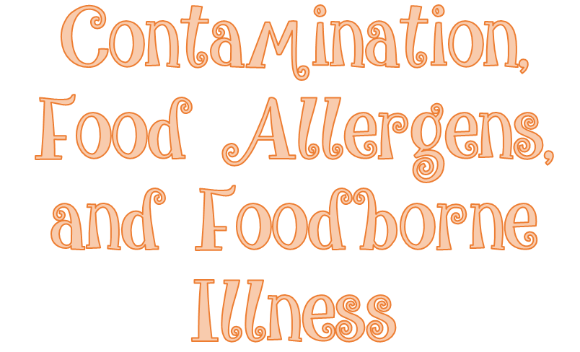

Slide 2
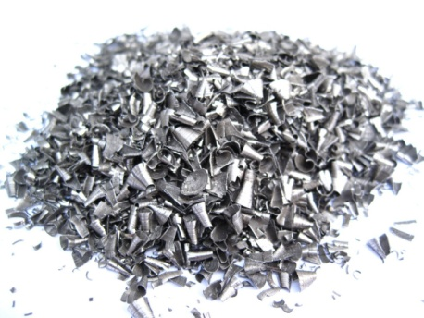
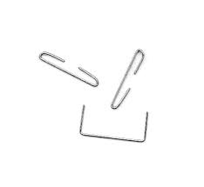
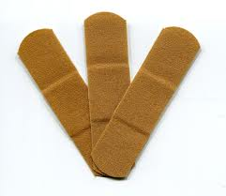
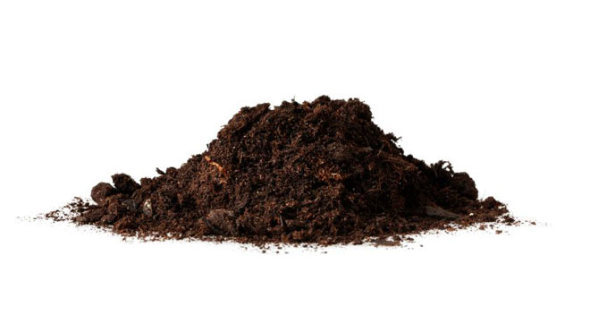
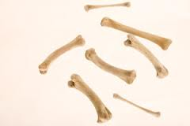
Sources
Metal shavings from cans
Wood
Fingernails
Staples
Bandages
Glass
Jewelry
Dirt
Naturally occurring objects such as fruit pits and bones

Slide 3
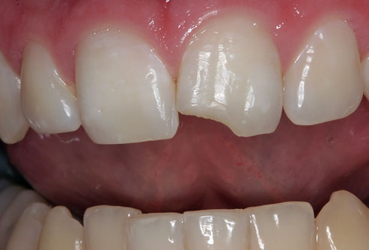
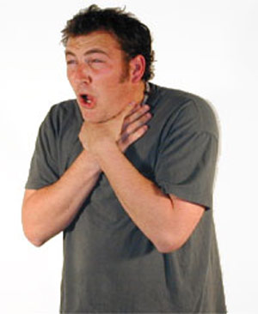
Symptoms
Mild to fatal injuries possible
Could include:
Dental damage
Cuts
Choking
Bleeding
pain

Slide 4
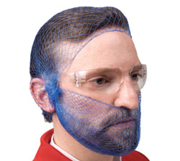
Prevention
Purchase food from approved reputable suppliers
Closely inspect food received
Take steps to make sure no physical contaminants can get into food
Make sure food handlers practice good personal hygiene

Slide 5
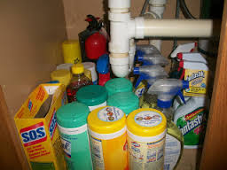
Sources
Cleaners
Sanitizers
Polishes
Machine lubricants
Pesticides
Deodorizers
First aid products
Health and beauty products

Slide 6
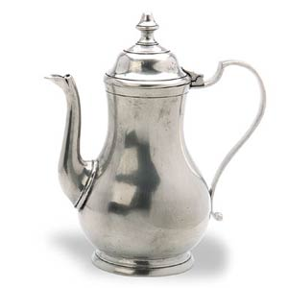
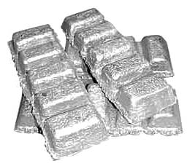
Sources
Toxic metals
Pewter
Copper
Zinc
Some types of painted pottery
NOT FOOD GRADE!!!!

Slide 7
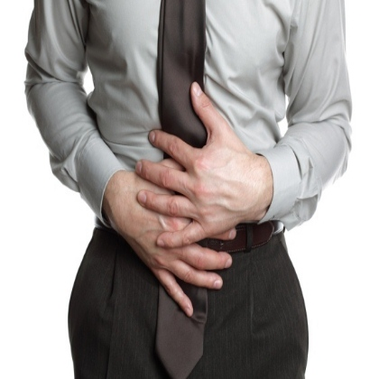
Symptoms
Vary depending on the chemical consumed
Most illnesses occur within minutes
Vomiting and diarrhea are typical
Call poison control of chemical contamination is suspected

Slide 8
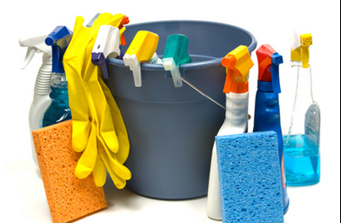
Prevention
Purchase chemicals from approved, reputable suppliers
Store chemicals away from prep areas, food storage areas and service areas
Use chemical for their intended use and follow the manufacturer’s directions
Only handle food with equipment and utensils approved for foodservice use

Slide 9
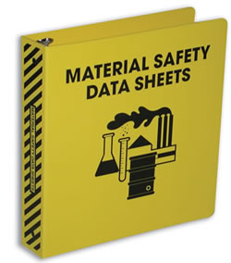
Prevention
Keep Material Safety Data Sheets (MSDS) current and make sure they are accessible to staff at all times
Follow the manufacturer’s directions and local regulatory requirements when throwing out chemicals

Slide 10
Who?
Terrorists or activists
Disgruntled current of former staff
Vendors
Competitors

Slide 11
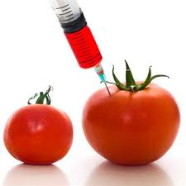
How?
Biological, chemical and physical contaminants
Radioactive materials
Attacks might occur anywhere in the food supply chain
Usually focused on a specific food item, process or business

Slide 12
The FDA created a tool that can be used to develop a food defense program against deliberate contamination of food

Slide 13
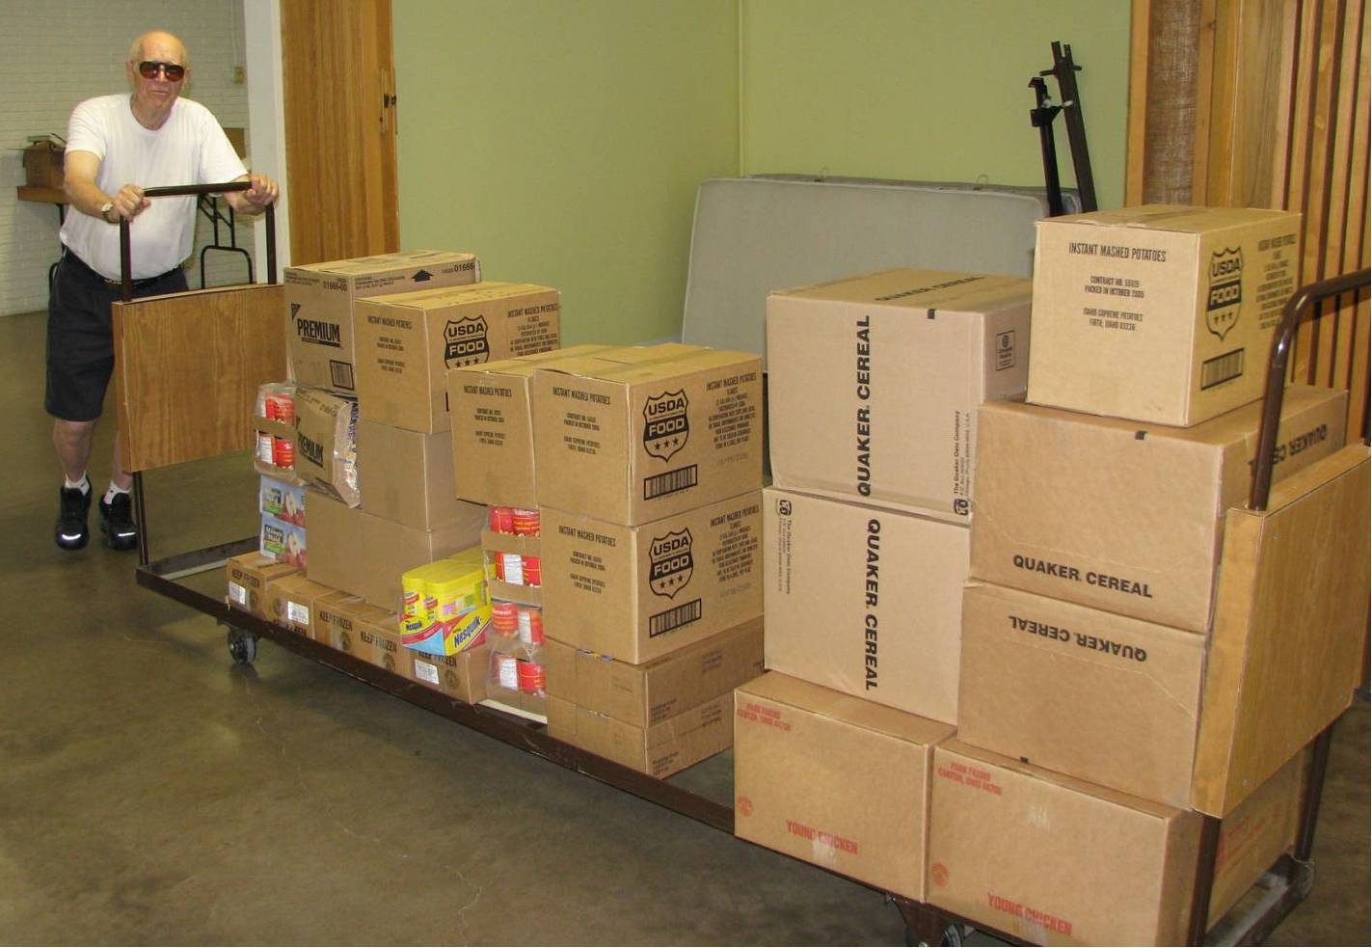
Make sure that products you receive are from safe sources.
Supervise product deliveries
Use approved suppliers who practice food defense
Request that delivery vehicles are locked or sealed

Slide 14
Monitor the security of products in the facility.
Limit access to prep and storage areas. Locking storage areas is one way to do this.
Create a system for handling damaged products.
Store chemicals in a secure location.
Train staff to spot food defense threats.

Slide 15
Know who is in your facility.
Limit access to prep and storage areas
Identify all visitors, and verify credentials
Conduct background checks on staff

Slide 16
Keep information related to food defense accessible
Receiving logs
Office files and documents
Staff files
Random food defense self inspections

Slide 17
Identify what you will do and who you will contact if there is suspicious activity or a threat at your operation.
Hold any product you suspect to be contaminated
Contact your regulatory authority immediately
Maintain an emergency contact list

Slide 18
Food allergen- a protein in a food or ingredient that some people are sensitive to
These proteins are naturally occurring
When enough of an allergen is eaten, an allergic reaction can occur

Slide 19
Depending on the person, an allergic reaction can happen just after the food is eaten or several hours later.
Nausea
Wheezing or shortness of breath
Hives or itchy rashes
Swelling of various parts of the body, including the face, eyes, hands or feet
Vomiting and/or diarrhea
Abdominal pain

Slide 20
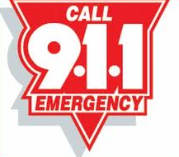
Initially symptoms may be mild, but they can become serious quickly.
In severe cases, anaphylaxis—a severe allergic reaction that can lead to
death—may result.
If someone is having an
allergic reaction, call 9-1-1

Slide 21
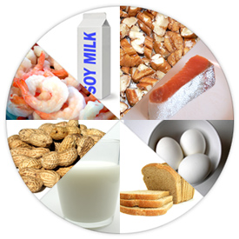
Milk
Eggs
Fish
Shellfish
Wheat
Soy
Peanuts
Tree nuts

Slide 22
Describe dishes
Identify ingredients
Suggest items
Deliver food- hand deliver food to guests with food allergens, separate from other food

Slide 23
Staff must make sure that allergens are not transferred from food containing an allergen to the food served to the customer (called cross contact) Ways it can happen:
Cooking different types of food in the same fryer oil
Putting food on surfaces that have touches allergens

Slide 24
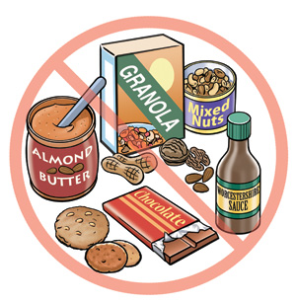
Wash, rinse and sanitize cookware, utensils and equipment after handling a food allergen
Wash your hands and change gloves before prepping food
Use separate fryers and cooking oils when frying food for customers with food allergies
Prep food for customers with food allergies in a separate area from other food
Label food packaged on site for retail sale. Name all major allergens on the label and follow any additional labeling requirements.

