Slide 1
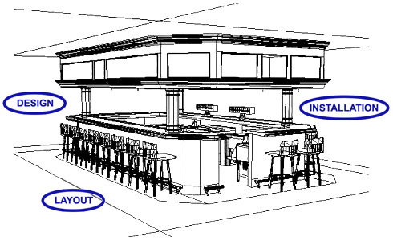
Notes:
Read story and “You CanP

Slide 2
Before starting any new construction or a large remodeling project, you must check with your regulatory authority.
You will need approval of your construction plans before construction begins.
You should also check with your local building department to see what is required.

Slide 3
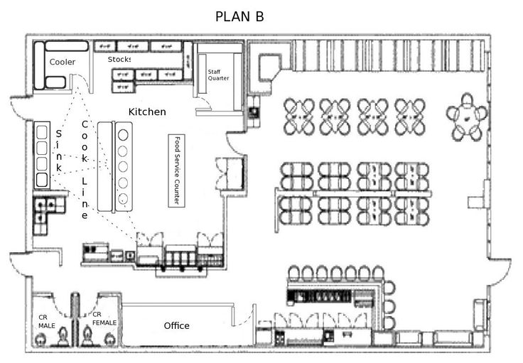
A well-designed kitchen will address the following factors:
Work flow
Establish a work flow that will minimize the time food spends in the temperature danger zone.
It should also minimize the number of times food is handled.
Locate storage areas near receiving areas
Locate prep tables near coolers and freezers

Slide 4
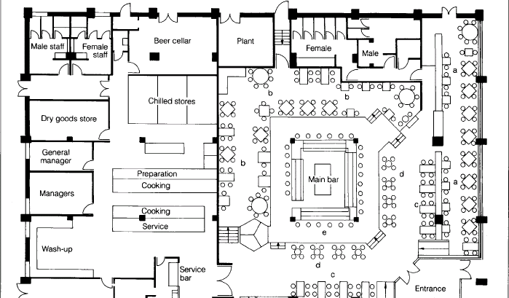
Contamination
Place equipment in a way that will prevent splashing or spilling from one piece of equipment onto another.
Equipment Accessibility
Hard-to-reach areas are less likely to be cleaned.
A well-planned layout will ensure that equipment is accessible for cleaning.

Slide 5
When selecting materials for interior construction, the most important consideration is how easy the operation will be to clean and maintain.
Sound-absorbent surfaces that resist grease and moisture and reflect light will probably create an environment acceptable to your regulatory authority.

Slide 6
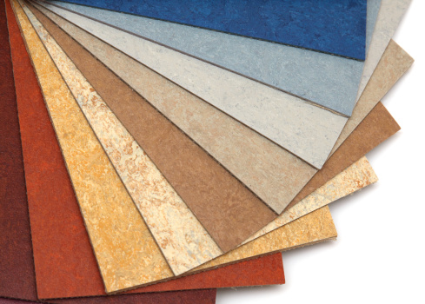
Flooring should be smooth, durable, nonabsorbent, and easy to clean.
It should resist wear and help prevent slips.
Once installed, flooring should be kept in good condition and be replaced if damaged or worn.

Slide 7
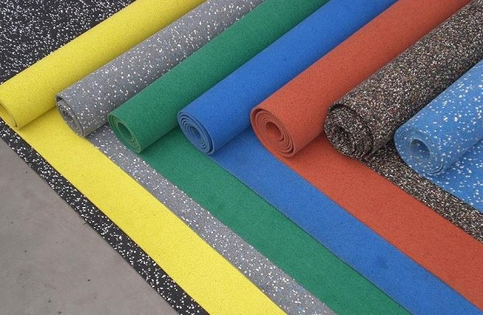
Porosity is the extent to which a material will absorb liquids. AVOID high-porosity flooring. Its absorbency often makes it ideal for pathogen growth and can also cause people to slip or fall.
Use non-absorbent flooring in: walk in coolers, prep and food storage areas, dishwashing areas, restrooms and dressing and locker rooms.

Slide 8
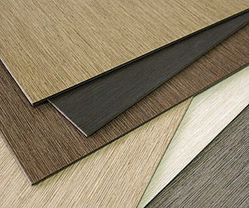
Resiliency means a material can react to a shock without breaking or cracking.
In most of the operation, nonporous, resilient flooring is the best choice.
Vinyl and rubber tiles are usually used.

Slide 9
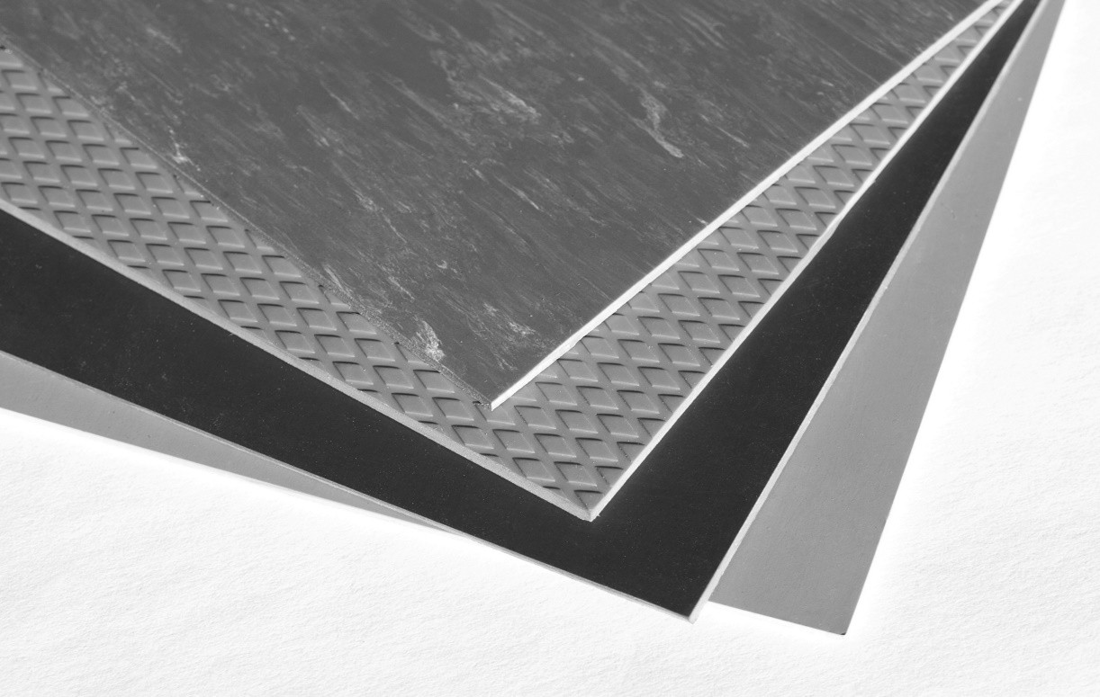
Advantages
Easy to clean and maintain
If a tile breaks, they can be easily replaced
Can handle heavy traffic
Resist grease and alkalis
Disadvantages
Sharp objects can easily damage it
Tends to be slippery when wet

Slide 10
Because it is durable and nonabsorbent, hard-surface flooring is often used in food-service operations.
Examples of hard-surface flooring: marble, quarry tile, wood
These types of flooring—especially quarry and ceramic tile—are excellent for public restrooms or high-dirt areas.

Slide 11
Disadvantages:
May crack or chip if heavy objects are dropped on them
They do not absorb sound, and they are expensive to install and maintain
Somewhat difficult to clean

Slide 12
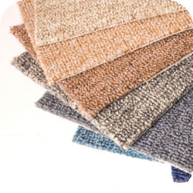
Carpeting is a popular choice for certain areas, such as dining rooms, because it absorbs sound.
Not recommended in high-dirt areas such as waitstaff service areas, tray and dish drop-off areas, beverage stations, and major traffic aisles.

Slide 13
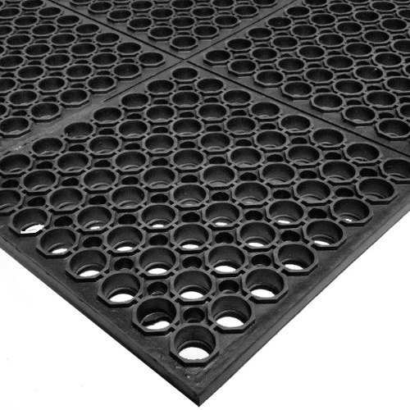
Use nonslip surfaces in traffic areas and the entire kitchen.
For safety reasons, rubber mats are allowed in areas where standing water may occur.

Slide 14
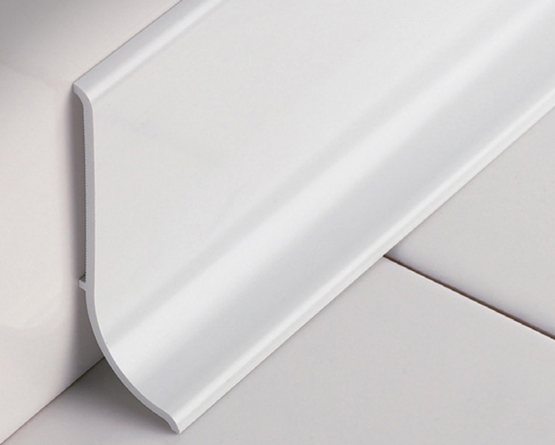
Coving- a curved, sealed edge placed between the floor and the wall to eliminate sharp corners or gaps that would be impossible to clean.
Coving is required in operations using resilient or hard-surface flooring materials.
Coving tile or strip should adhere tightly to the wall.
Coving helps eliminate hiding places for insets and also prevents moisture from deteriorating the wall.

Slide 15
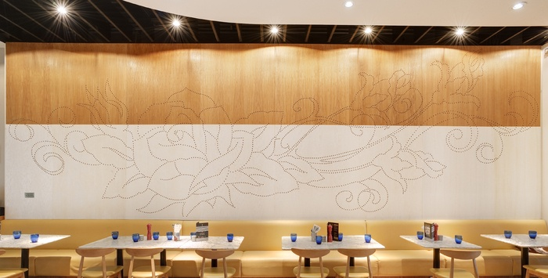
Interior finishes are the materials used on the surface of an operation’s walls and ceilings. They need to be smooth, nonabsorbent, durable and easy to clean.
Walls and ceilings in prep areas should be light in color to distribute light and to make it easier to spot dirty when cleaning.

Slide 16
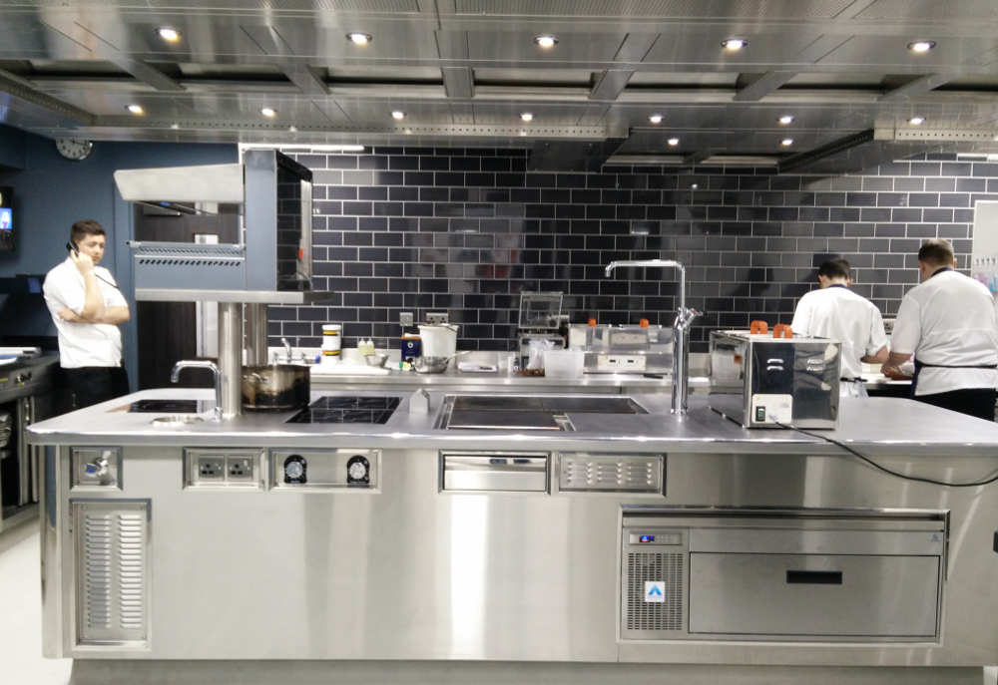
The best wall finish in cooking areas is ceramic tile.
It needs to be monitored for grout loss and regrouted when needed
Stainless steel is used occasionally because it is durable and moisture resistant.

Slide 17
The most common ceiling materials are acoustic tile, painted drywall, painted plaster, and exposed concrete.
Flexible materials such as paper, vinyl, and thin wood veneers are often used for walls and ceilings. Vinyl coverings are popular because they are attractive, relatively inexpensive, easy to clean, and durable.
Plaster or cinder-block walls that have been sealed and painted with oil-resistant, easy-to-wash, glossy paints are appropriate for dry areas of the facility.

Slide 18
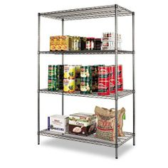
Construct with easy-to-clean materials that allow good air circulation.
Shelving, tabletops and bins for dry ingredients should be made of corrosion-resistant metal or food-grade plastic
Any windows should have frosted glass or shades. Sunlight can increase the area’s temperature and affect food quality.

Slide 19
Dripping condensation or leaks in overhead pipes can promote pathogen growth in normally stable items such as crackers, flour and baking powder.
Cracks and crevices in floors or walls should be filled to protect against insects and rodents.

Slide 20
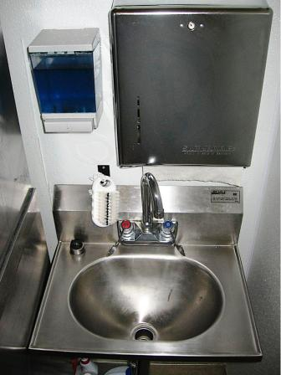
Handwashing stations should be put in areas that make it easy for staff to wash their hands often.
Stations are required in restrooms or directly next to them.
Stations are also required in areas used for food prep, service and dishwashing.
Handwashing sinks must be used ONLY for handwashing and not for other purposes.

Slide 21
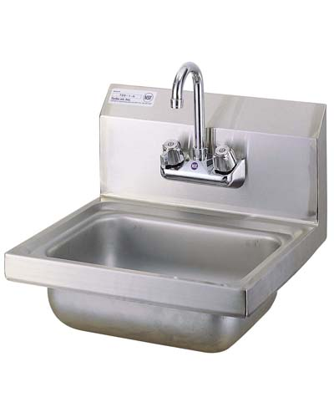
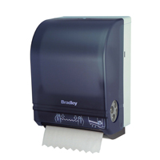
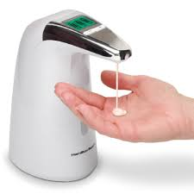
Hot & cold running water- water must be drinkable and meet temperature and pressure requirements
Soap-The soap can be liquid, bar or powder
A way to dry hands- Disposable paper towels or hand dryers using either warm air or room-temperature air delivery at high velocity

Slide 22
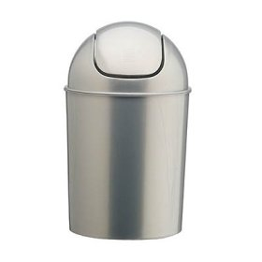
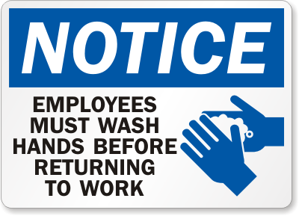
Garbage container- Garbage containers are required if disposable paper towels are used
Signage- A clearly visible sign or poster must tell staff to wash hands before returning to work.

Slide 23
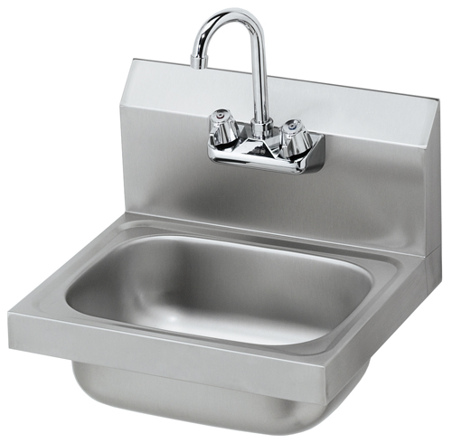
To prevent cross-contamination, staff must use each sink in an operation for its intended purpose.
Handwashing sinks are used for handwashing
Prep sinks are used for prepping food
Service sinks are used for cleaning mops and disposing of wastewater
At least one service sink or curbed drain area is required for disposing of dirty water

Slide 24
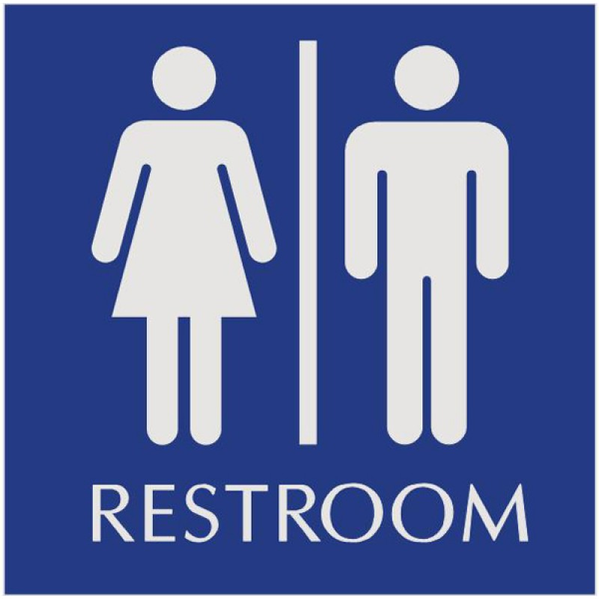
If possible, provide separate restrooms for staff and customers. If not possible, the operation must be designed so patrons do not pass through prep areas to reach the restroom.
Restrooms should be convenient, sanitary, and have self-closing doors.

Slide 25
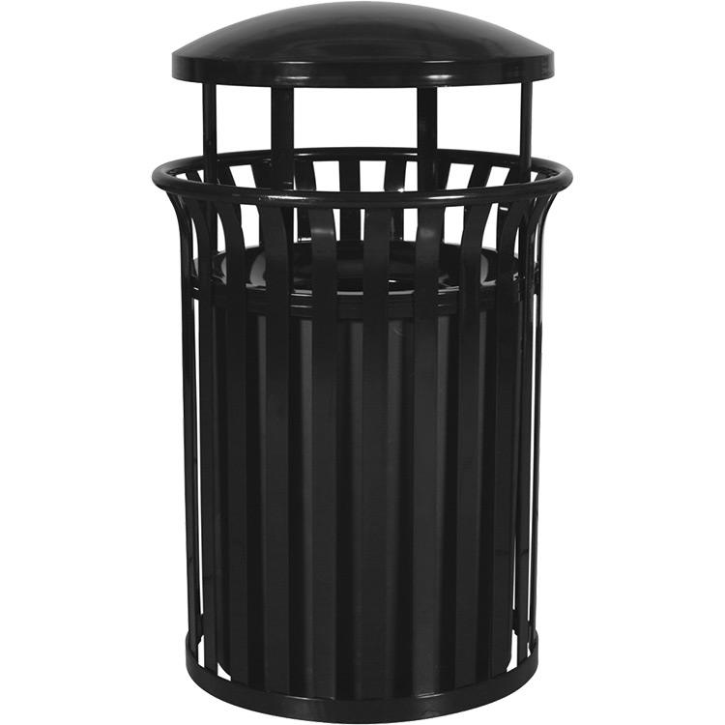
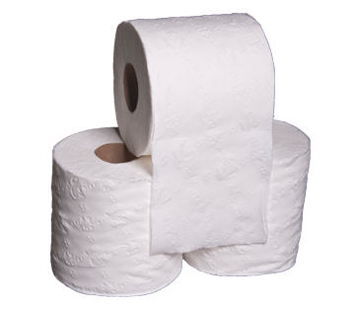
The must be adequately stocked with toilet paper.
Garbage containers must be provided if disposable paper towels are used.
Women’s restrooms also need covered garbage containers for disposing sanitary supplies.

Slide 26
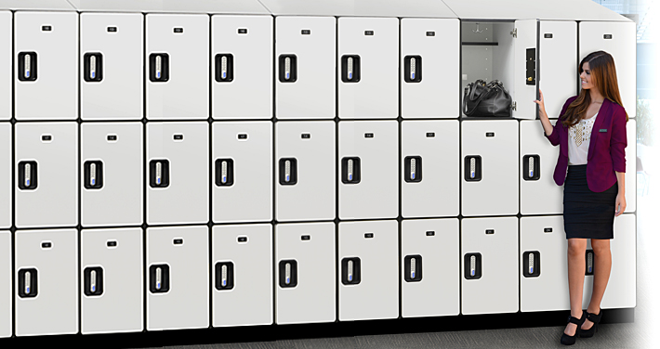
Dressing rooms are not required.
If available, they should not be used for prepping food, storage, or utensil washing.
Lockers should be located in a separate room or one where food, equipment, utensils, linens and single-service items cannot be contaminated.

Slide 27
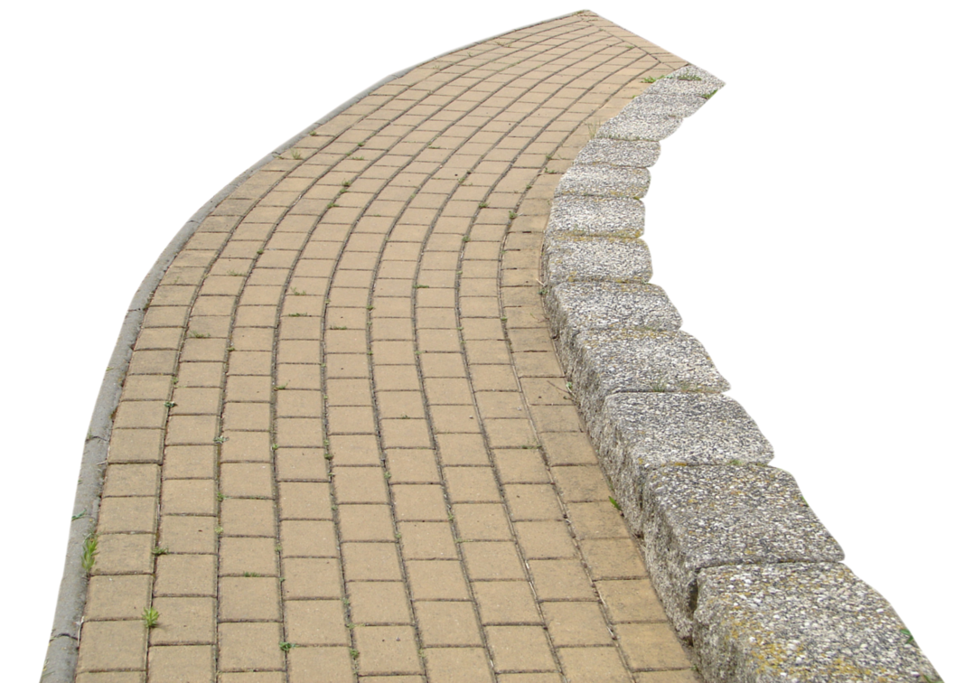
Grade the parking lot and walkways so standing pools of water do not form. They should also be surfaced to minimize dirt and blowing dust.
Concrete and asphalt are recommended for walkways and parking lots. Gravel, while acceptable, is not recommended.

Slide 28
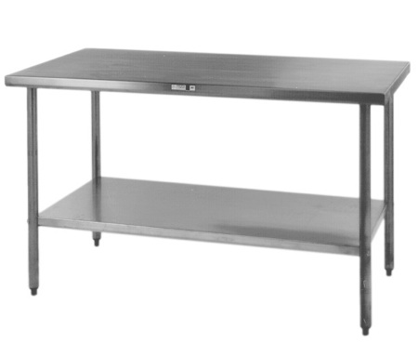
Foodservice equipment must meet certain standards if it will come in contact with food.
The NSF require that it be nonabsorbent, smooth, and corrosion resistant.
Must also be easy to clean, durable and resistant to damage.

Slide 29
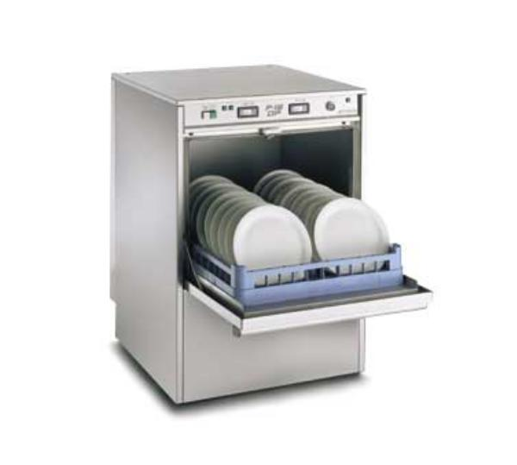
Vary by size, style and sanitizing method (some sanitize with very hot water, while others with chemicals)
Dishwashers must be installed so that they are reachable and conveniently located. The installation must also keep utensils, equipment, and other food-contact surfaces from becoming contaminated.

Slide 30
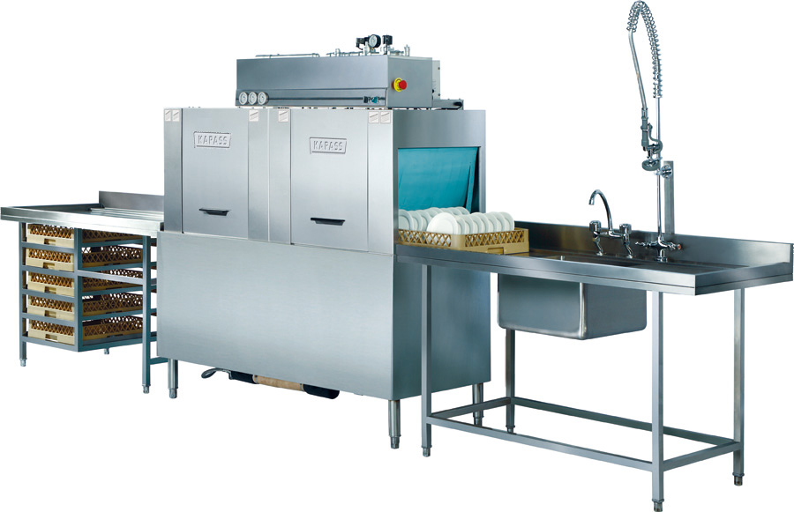
Types of Dishwashing Machines
Single-tank, stationary-rack machine, with doors- holds a stationary rack of tableware and utensils. Washed by detergent and water from below and sometimes above the rack. The wash cycle is followed by a hot-water or chemical-sanitizer final rinse.
Conveyor machine- A conveyor moves racks of items through the various cycles of washing, rinsing, and sanitizing

Slide 31
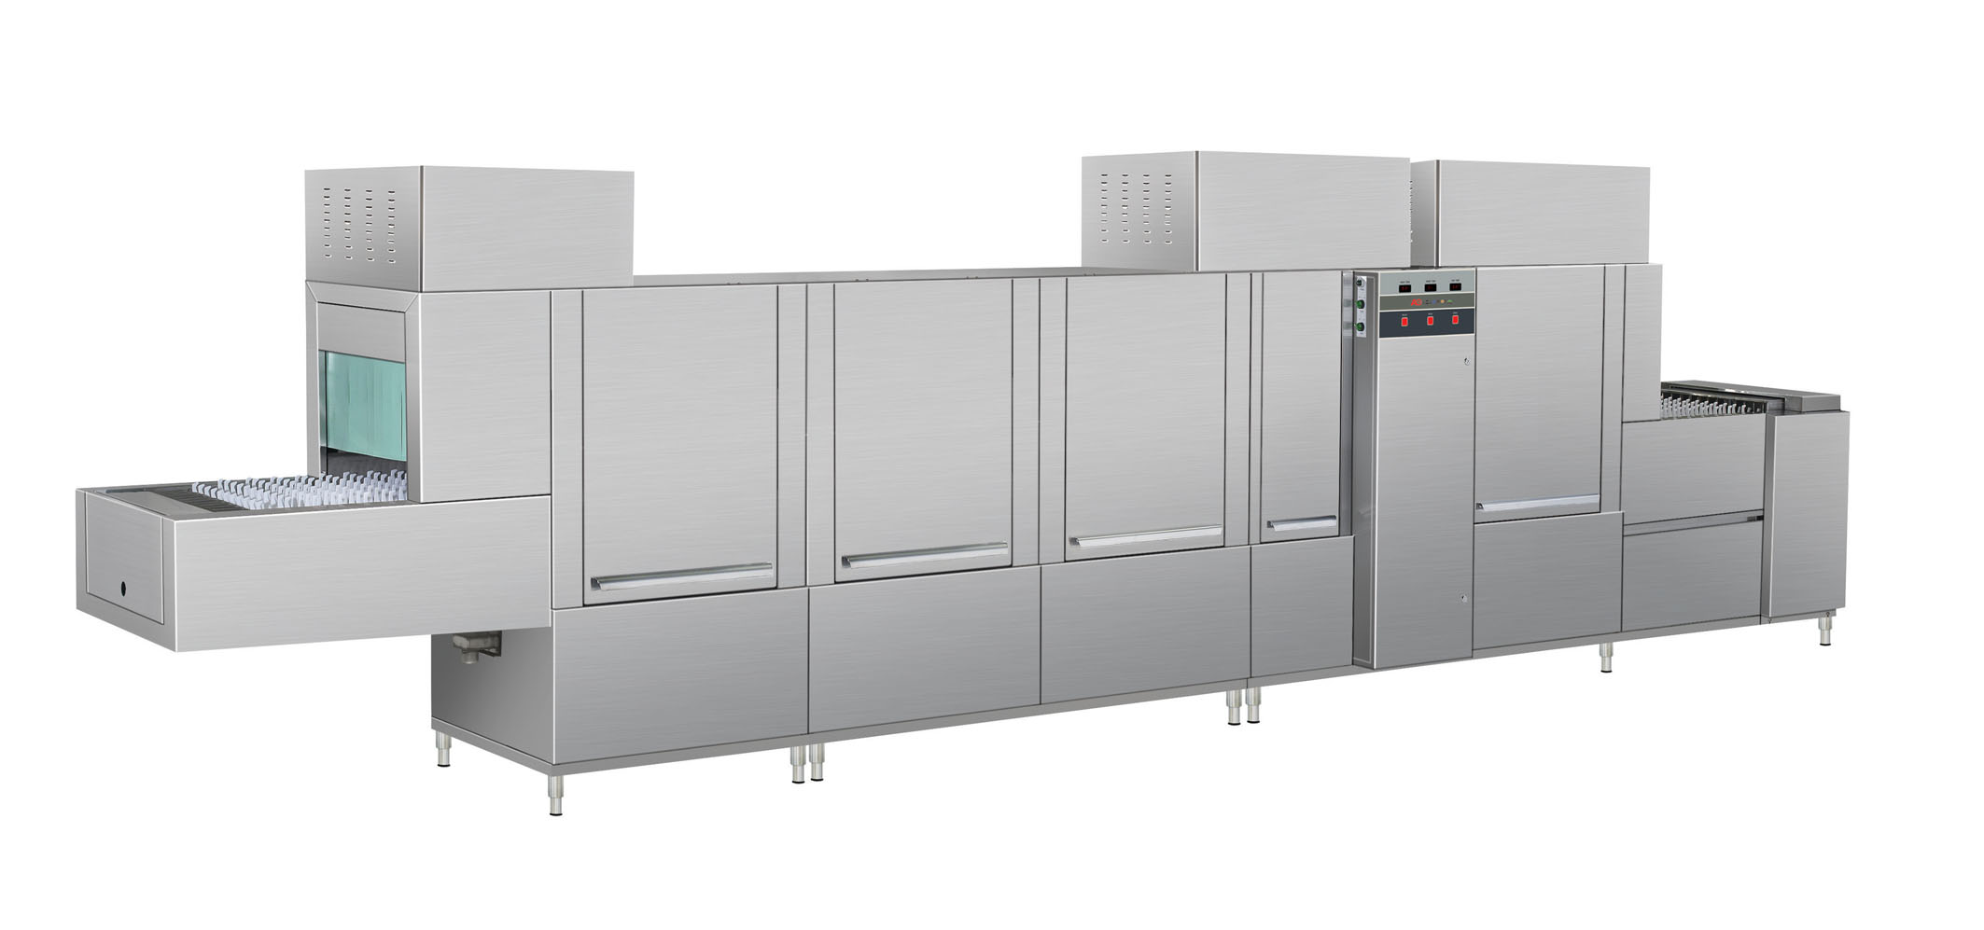
Carousel or circular-conveyor machine- This multiple-tank machine moves tableware and utensils on a peg-type conveyor or in racks
Flight type- This is a high-capacity, multiple-tank machine with a peg-type conveyor; may also have a built in dryer

Slide 32
Batch-type, dump- This stationary-rack machine combines the wash and rinse cycles in a single-tank. Each cycle is timed. The machine automatically dispenses both the detergent and the sanitizing chemical or hot water. Wash and rinse water are drained after each cycle
Recirculating, door-type, non-dump machine- This stationary-rack machine is not fully drained of water between cycles. The wash water is dilute with fresh water and reused from cycle to cyle

Slide 33
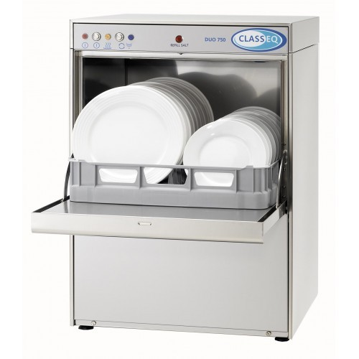
Installation
Must be installed so that they are reachable and conveniently located
Must keep utensils, equipment and other food contact surfaces from becoming contaminated
Must be 6 inches off the floor
Plumbing
Water pipes to the dishwashing machines should be as short as possible to prevent the loss of heat

Slide 34
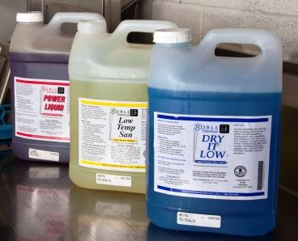
Chemicals
Use detergents and sanitizers approved by the regulatory authority
Settings
Purchase dishwashers that can measure water temperature, water pressure, cleaning and sanitizing chemical concentration
Information about the correct settings should be posted on the machine

Slide 35
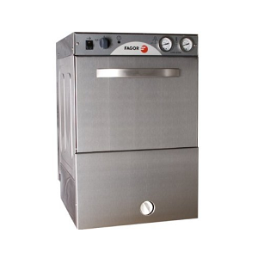
Thermometer
The machine’s thermometer should be located so it is readable with a scale in increments no greater than 2°F
Cleaning
Dishwashers should be easy to clean
They should be cleaned as often as necessary

Slide 36
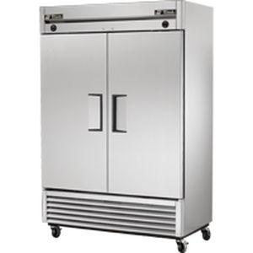
Two most common types
Walk-in
reach-in
Doors should withstand heavy use and close with a slight nudge
A drain must be provided and maintained for disposal of condensation and defrost water.

Slide 37
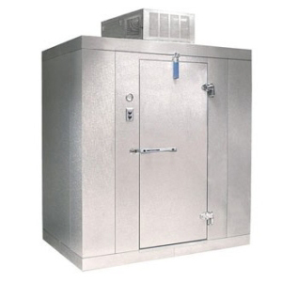
Installation
Walk-in units can be sealed to the floor and wall
Reach-ins
Purchase units with legs that elevate them 6 inches off the floor or mount and seal them on a masonry base.
Caster wheels are often preferred or required to make it easier to move for cleaning.
Temperature
Should have built-in thermometers that are accurate within +/-3°F

Slide 38
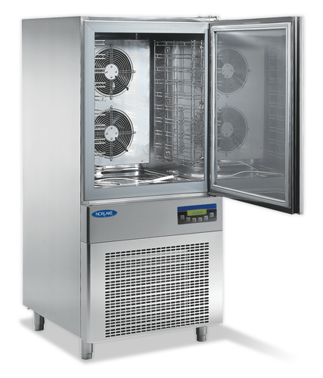
Blast chillers cool food quickly. Many can cool from 135°F to 37°F within 90 minutes.
Most units allow the operator to set target chill temperatures and monitor the temperature of food throughout the chill cycle.
To cool in a tumble chiller you put prepackaged hot food into a drum that rotates inside a reservoir of chilled water. The tumbling action increases the effectiveness of the chilled water in cooling the food.

Slide 39
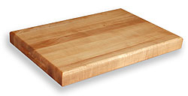
Many regulatory authorities allow the use of either wooden or synthetic cutting boards.
If the regulatory authority allows wooden cutting boards and baker’s tables, they need to be made from a nonabsorbent hardwood, such as maple or oak. They need to be nontoxic and free of cracks and seams.

Slide 40
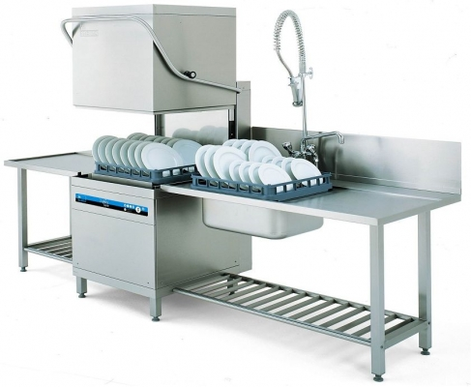
Stationary equipment should be easy to clean and easy to clean around.
Stationary equipment should be installed:
Floor mounted equipment- on legs at least 6 inches high. Another option is to seal it to a masonry base.
Tabletop equipment- on legs at least 4 inches high; or seal it to the countertop.

Slide 41
An operation uses many utilities and building systems.
Utilities include water, electricity, gas, sewage, and garbage disposal.
Building systems include plumbing, lighting and ventilation.
There must be enough utilities to meet the needs of the operation and they need to work correctly.

Slide 42
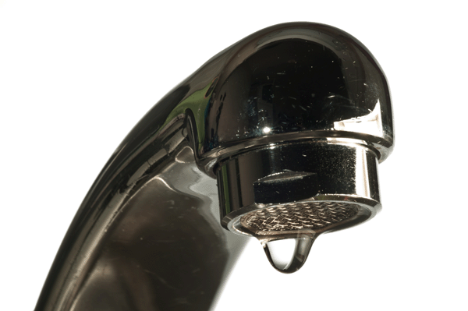
Only water that is drinkable can be used for the preparation of food and come in contact with food-contact surfaces.
This water can come from the following sources:
Approved public water mains
Private water sources that are regularly tested and maintained
Closed, portable water containers
Water transport vehicles

Slide 43
Providing a continuous supply of hot water can be a problem for many operations serving the public.
Most general-purpose water heaters will not heat water to temperatures required for hot-water sanitizing. A booster heater might be needed to maintain water temperatures.
Many dishwashing machines now come with booster heaters.

Slide 44
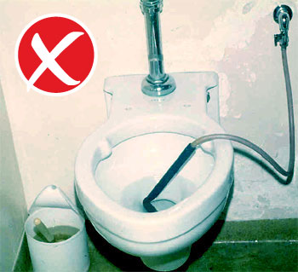
Cross-connections are the greatest risk to water safety.
A cross-connection is a physical link between safe water and dirty water, which can come from drains, sewers, or other wastewater sources.

Slide 45
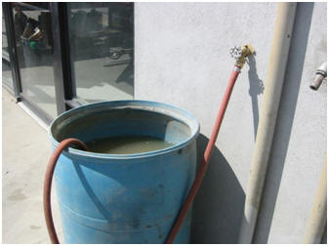
A Cross-connection is dangerous because it can let backflow occur.
Backflow is the reverse flow of containments through a cross-connection into a drinkable water supply.
Backflow can be the result of pressure pushing contaminants back into the water supply.

Slide 46
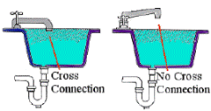
Backflow can also happen when high water use in one area of an operation creates a vacuum in the plumbing system that sucks contaminants back into the water supply. This is called backsiphonage.
A running faucet below the flood rim of a sink is an example of a cross-connection that can lead to backsiphonage.
A running hose in a mop bucket is another example.

Slide 47
The best way to prevent backflow is to avoid creating a cross-connection.
Do NOT attach a hose to a faucet unless a backflow prevention device is attached.
A vacuum breaker is a mechanical device that prevents backsiphonage. It does this by closing a check valve and sealing the water supply line shut when water flow is stopped.

Slide 48
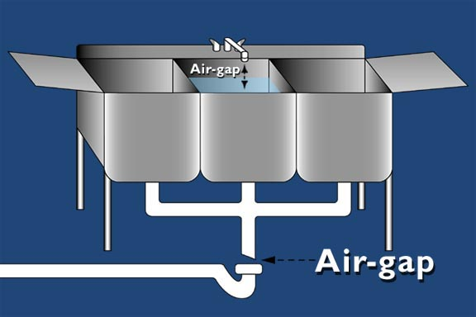
Other prevention devices include double check valves and reduced pressure zone backflow preventers.
The only sure way to prevent backflow is to create an air gap. An air gap is an air space that separates a water supply outlet from a potentially contaminated source.

Slide 49
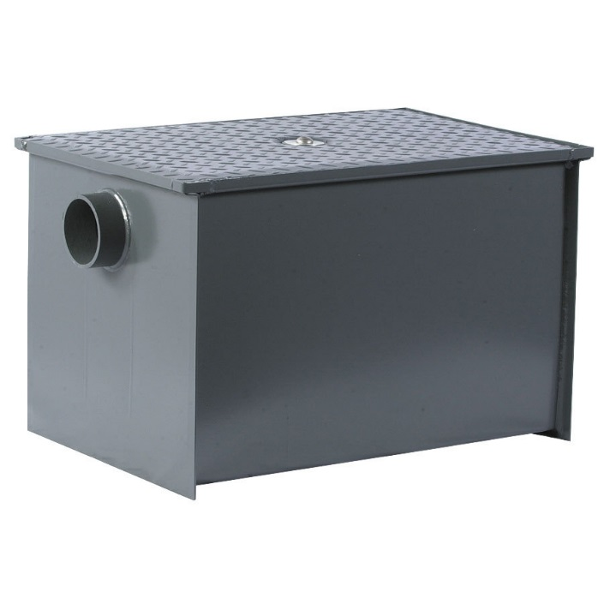
Grease condensation in pipes is another common problem in plumbing systems.
Grease traps are often installed to prevent the buildup of grease from creating a drain blockage. If used, grease traps need to be easily accessible, must be installed by a licensed plumber and cleaned periodically according to the manufacturer’s recommendations.

Slide 50
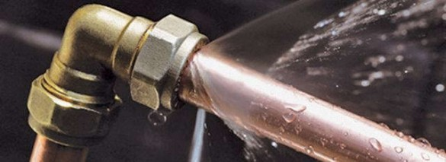
Overhead wastewater pipes, overhead drinkable water pipes or fire-safety sprinkler systems can also leak and become a source of contamination.
Water can condense on the pipes and drip onto food.
Check all pipes often to ensure they appear in good condition and do not leak.

Slide 51
Good lighting makes it easier to clean things in your operation and provides a safer environment.
Lighting intensity—how bright the lights are in the operation—is usually measured in units called foot- candles or lux.
Different areas of the facility have different lighting intensity requirements. Prep areas need to be brighter than other areas.

Slide 52
Minimum Lighting Intensity | Area
50 foot-candles (540 lux) | Prep areas
20 foot-candles (215 lux) | Handwashing or dishwashing areas Buffets and salad bars Displays for produce or packaged food Utensil-storage areas Wait stations Restrooms Inside some pieces of equipment (e.g. reach-in refrigerators
10 foot-candles (108 lux) | Inside walk- in coolers and freezer units Dry-storage areas Dining rooms (for cleaning)

Slide 53
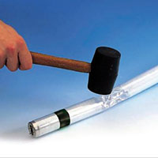
Replace any bulbs that have burned out, and make sure they are the correct size.
All lights should have shatter-resistant light bulbs or protective covers. These products prevent broken glass from contaminating food or food-contact surfaces.

Slide 54
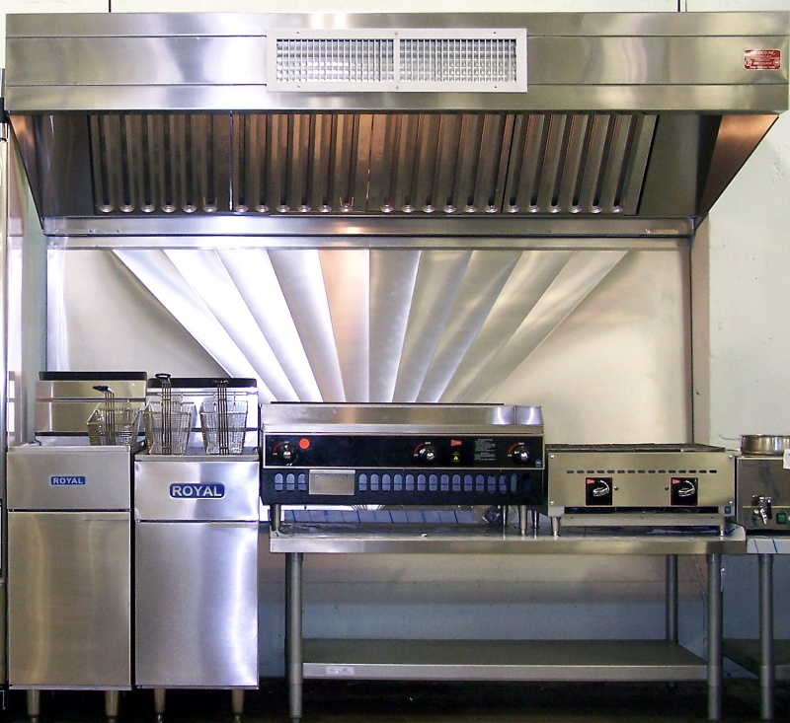
Ventilation improves the air inside an operation.
It removes heat, steam, and smoke from cooking lines. It also eliminates fumes and odors.
If ventilation systems are not working correctly, grease and condensation will build up on walls and ceilings. To prevent this, get ventilation systems cleaned and maintained regularly.

Slide 55
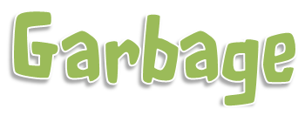
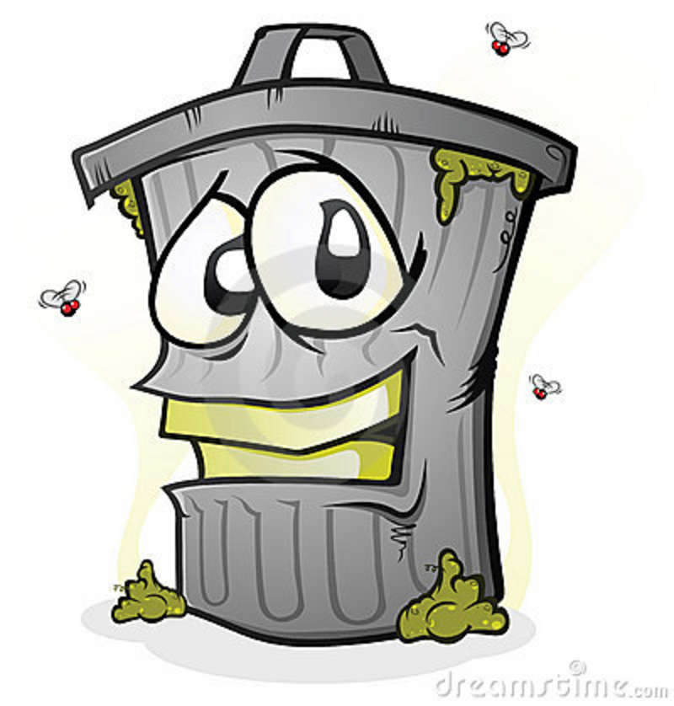
Garbage can attract pests and contaminate food, equipment and utensils if not handled correctly.
Garbage should be removed from prep areas as quickly as possible to prevent odors, pests and possible contamination.
Clean the inside and outside of garbage container frequently. This will help prevent the contamination of food and food contact surfaces.

Slide 56
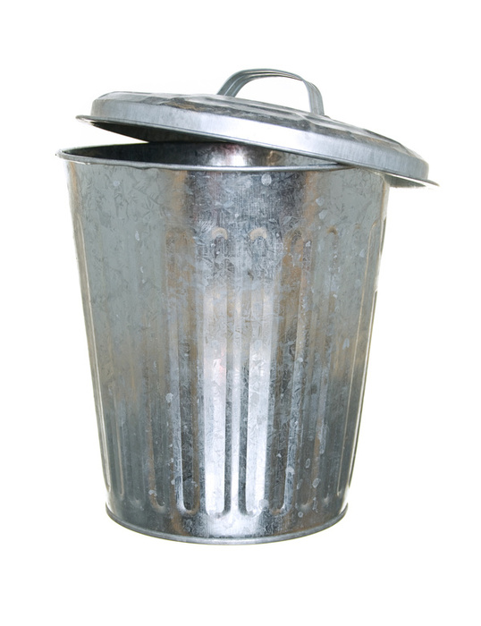
Containers must be leak proof, waterproof and pest proof. They also should be easy to clean. Containers must be covered when not in use.
Waste and recyclables must be stored separately from food and food-contact surfaces. The storage of these items must not create a nuisance or public health hazard.
Place outdoor garbage containers on a surface that is smooth, durable and nonabsorbent. Make sure the containers have tight-fitting lids and are kept covered at all times. Keep their drain plugs in place.

