Slide 1
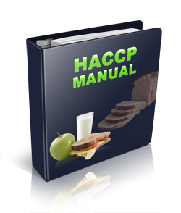

Slide 2
A food safety management system is a group of practices and procedures intended to prevent foodborne illness.
It does this by actively controlling risks and hazards throughout the flow of food.
Having some food safety programs already in place gives you the program are the basis of these programs.

Slide 3
Personal Hygiene program
Supplier selection and specification program
Facility design and equipment maintenance program
Food safety training program
Quality control and assurance programs
Cleaning and sanitation program
Standard operating procedures (SOPs)
Pest-control program

Slide 4
It is a manager’s responsibility to actively control the following risk factors for foodborne illness:
Purchasing food from unsafe sources
Failing to cook food correctly
Holding food at incorrect temperatures
Using contaminated equipment
Practicing poor personal hygiene

Slide 5
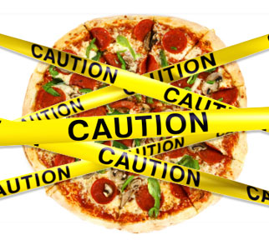
Is proactive NOT reactive
Risks are anticipated and planned for.
The FDA says you can have active managerial control by using simple tools like training programs, manager supervision and the incorporation of SOPs, but also by more complex solutions such as a HACCP program.
Notes:
Read the “Something to Think About…” story on page 8.3

Slide 6
The FDA provides specific recommendations for controlling the common risk factors for foodborne illness, these are known as public health interventions.
The following are designed to protect public health

Slide 7
Demonstration of knowledge- you can show that you know what to do to keep food safe
Staff health controls- procedures are in place to make sure staff are practicing personal hygiene
Controlling hands as a vehicle of contamination- controls must be put in place to prevent bare-hand contact with ready-to-eat food

Slide 8
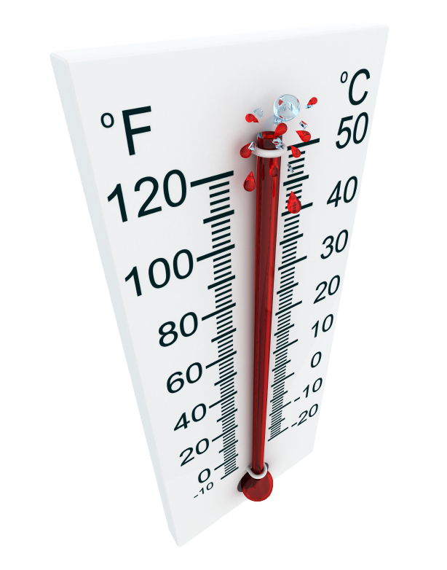
Time and temperature parameters for controlling pathogens- procedures must be put in place to limit the time food spends in the temperature danger zone
Consumer advisories- notices must be provided to customers if you serve raw or undercooking menu items

Slide 9
Hazard Analysis Critical Control Point (HACCP) is based on identifying significant biological, chemical, or physical hazards at specific points within a product’s flow.
Once identified, the hazards can be prevented, eliminated, or reduced to safe levels.
An effective HACCP system must be based on a written plan, which must be specific to each facility’s menu, customers, equipment, processes and operations.

Slide 10
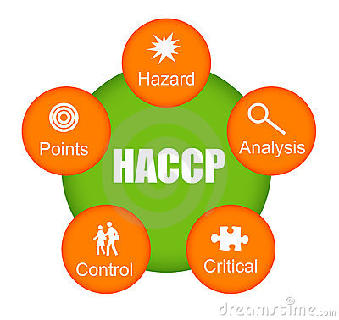
Each HACCP principle builds on the information gained from the previous principle. So you must consider all seven principles, in order, when developing your plan.
Conduct a hazard analysis
Determine critical control points (CCPs)
Establish critical limits.
Establish monitoring procedures.
Identify corrective actions.
Verify that the system works.
Establish procedures for record keeping and documentation.

Slide 11
In general terms, the principles break into three groups.
Principles 1 and 2 help you identify and evaluate your hazards.
Principles 3, 4 and 5 help you establish ways for controlling those hazards.
Principles 6 and 7 help you maintain the HACCP plan and system, and verify its effectiveness.

Slide 12
First, identify and assess potential hazards in the food you serve. Start by looking at how food is processed in your operation. Here are some common processes you need to assess:
Prepping and serving without cooking (salads, cold sandwiches, etc.)
Prepping and cooking for same-day service (grilled chicken sandwiches, hamburgers, etc.)
Prepping, cooking, holding, cooling, reheating, and serving (chili, soup, pasta sauce with meat, etc.)
Notes:
Read principle 1 example on page 8.6

Slide 13
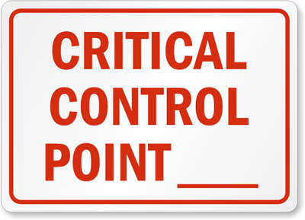
Find the points in the process where the identified hazard(s) can be prevented, eliminated, or reduced to safe levels. These are the critical control points (CCPs). Depending on the process, there may be more than one CCP.
Notes:
Read Principle 2 Example on page 8.6

Slide 14
For each CCP, establish minimum or maximum limits. These limits must be met to prevent or eliminate the hazard, or to reduce it to a safe level.
Notes:
Read Principle 3 Example on page 8.6

Slide 15
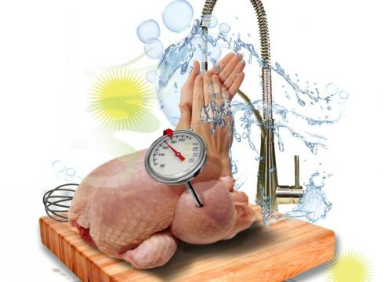
Once critical limits have been created, determine the best way for your operation to check them. Make sure the limits are consistently met. Identify who will monitor them and how often.
Notes:
Read Principle 4 Example on page 8.7

Slide 16
Identify steps that must be taken when a critical limit is not met. These steps should be determined in advance.
Notes:
Read Principle 5 Example on page 8.7

Slide 17
Determine if the plan is working as intended. Evaluate it on a regular basis. Use your monitoring charts, records, hazard analysis, etc.; and determine if your plan prevents, reduces or eliminates identified hazards.
Notes:
Read Principle 6 Example on Page 8.8

Slide 18
Maintain your HACCP plan and keep all documentation created when developing it. Keep records for the following actions.
Monitoring activities
Taking corrective action
Validating equipment (checking for good working condition)
Working with suppliers (i.e., shelf-life studies, invoices, specifications, challenge studies, etc.)
Notes:
Read Principle 7 Example on page 8.8

Slide 19
Some food processes are highly specialized and can be a serious health risk if specific procedures are not followed. Typically these processes are carried out at processing plants.
Smoking food as a method to preserve it (but not to enhance flavor)
Using food additives or adding components such as vinegar to preserve or alter it so it no longer requires time and temperature control for safety.

Slide 20
Curing food
Custom-processing animals.
Packaging food using reduced-oxygen packaging (ROP) methods. This includes MAP, vacuum-packed and sous vide food.
Treating (e.g. pasteurizing) juice on-site, and packaging it for later sale.
Sprouting seeds or beans.

Slide 21
A variance is required from the regulatory authority will be required before processing food in any of those ways.
A HACCP plan may also be required if the processing method carries a higher risk of causing a foodborne illness.

Slide 22
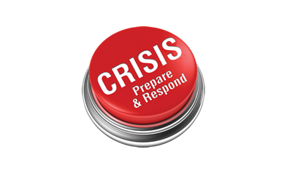
Putting the food safety principles you have learned into action can help keep food safe in you operation, but despite your best efforts, a foodborne illness outbreak or another crises affecting food safety can still occur.
To handle these crises, you will need a crisis-management program.

Slide 23
This program needs to have a written plan that focuses on three phases
Preparation
Response
Recovery
For each phase, the plan should identify resources needed and procedures to be followed

Slide 24
The time to prepare for a crisis is before one happens.
The crisis management plan needs to be tested to ensure it works.
You can test it yourself
Hire a consulting firm with crisis management experience

Slide 25
To begin, create a crisis-management the size based on the size of the operation.
Bigger operations could include representatives from several departments (like senior management, risk management, public relations, etc)
Smaller operations may include the chef, general manager and owner/operator.

Slide 26
The crisis management team should
Create an emergency contact list
Post by all phones the names and umbers of all crisis management team members, the media spokesperson, management or headquarters personnel, and outside resources (like police & fire department, testing labs, regulatory authority)

Slide 27
Develop a crisis-communication plan, it should include
List of media responses
Sample press releases that can be tailored to each incident
List of media contact to call for press conferences or news briefings
Plan for communicating with staff during the crisis
Assemble a crisis kit
It can be a three-ring notebook or binder enclosing the plan’s materials.
Keep the kit in an accessible place, such as the manager’s or chef’s office

Slide 28
In the event of an outbreak, it will be critical to gather accurate information.
Develop an incident report form and include all the following critical information:
What and when the customer ate at the operation
When the customer first got sick, what the symptoms were, and how long the customer experienced them
When and where the customer sought medical attention, what the diagnosis was, and what treatment was received
What other food was eaten by the customer

Slide 29
The crisis-management plan should include response procedures to help manage a crisis more effectively. Consider the following to keep the situation under control
Media relations: work with the media; make sure the spokesperson is fully informed; stick to the facts and be honest; the easiest way to worsen a crisis is to deny, lie, misinform, or change your story

Slide 30
Direct communication: communicate information directly to your key audiences; do not depend on the media to relay all of the fact; tell your side of the story to staff, customers, stockholders, and the community
Solution: fix the problem; then communicate to both the media and your customers what you have done; take control rather than simply responding to questions

Slide 31
The final step in a crisis-management plan is developing procedures for recovering from a crisis.
This is critical for getting your operation running again

Slide 32
Foodborne illness outbreak:
Work with the local regulatory authority to resolve issues
Clean and sanitize all areas of the operation
Throw out all suspect food
Investigate to fine the cause of the outbreak
Review food handling procedures to identify if standards are not being met or procedures are not working
Develop a plan to reassure customers that the food you serve is safe

Slide 33
An imminent health hazard is a significant threat or danger to health that requires immediate correction or closure to prevent injury.
If there is a significant risk to the safety or the security of your food, service must be stopped. The local regulatory authority must be notified and spoiled or contaminated food must thrown away along with food in packaging that is not intact.

Slide 34
Power failures and refrigeration breakdowns can threated your ability to control the temperature of TCS food. In case the event of a power outage
Arrange access to an electrical generator and a refrigerated truck that can be used in the event of an emergency
Prepare a menu with items that do not require cooking to use in the event of an emergency
Develop a policy that addresses when cooler doors should be opened

Slide 35
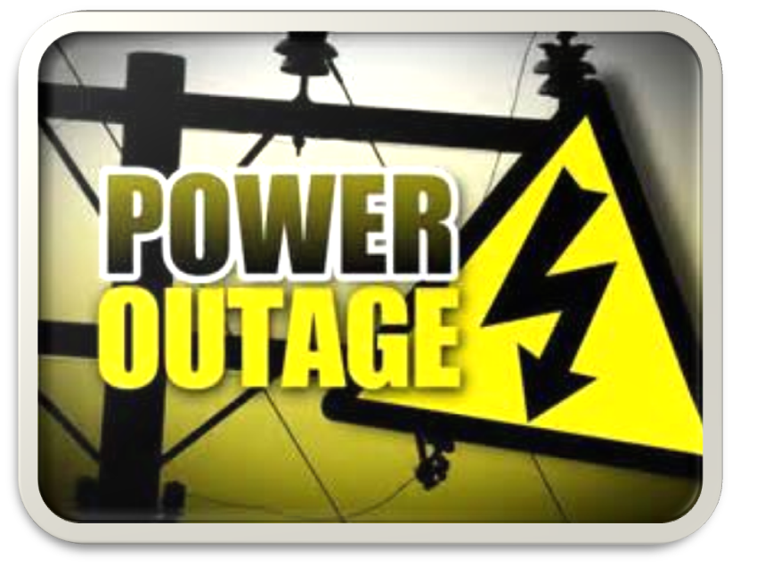
Plan for the recovery of a power outage
Refrigeration units will need to be checked often after the power has been restored to ensure the equipment can maintain product temperatures
TCS food will also have to be thrown out if it has been in the temperature danger zone for more than four hours

Slide 36
Broken water mains and breakdowns at water treatment facilities are a risk to the safety of food. In the event of a water service operation, plan for the following:
Prepare a menu items that require little or not water to be used
Keep a supply of single-use items
Keep a supply of bottled water, also have a supplier who can provide bottled water at the time of crisis

Slide 37
Have emergency-contact information for your regulatory authority, plumber and water department
Develop procedures that minimize water use during the emergency
Work with your regulatory authority to develop an emergency handwashing procedure for use during water service interruptions

Slide 38
When water is restored, plan on taking these actions
Clean and sanitize equipment with water line connections such as spray misters, coffee or tea urns, ice machines, and others. Follow manufactures' instructions
Flush water lines as required by the regulatory authority
Work with your regulatory authority to resume normal operations

Slide 39
Consider the following when planning for a fire:
Have emergency-contact information for the fire and police departments, the regulatory authority and management or headquarters personnel
Post the fire department phone number by each phone so its easy to see.

Slide 40
If a fire occurs you must stop operating if you cannot prep food safely. Block off areas, equipment, utensils, and other items affected by the fire. To recover from a fire:
Throw out all food affected
Throw out all damaged utensils linens or items that cannot be cleaned and sanitized
Clean and sanitize the operation
If needed, hire a janitorial service that specialize in areas exposed to fires
Check water lines. The use of fire hoses may have lowered water pressure in the area.

Slide 41
Consider the following when planning for a flood:
Have a plan to monitor and maintain flood-control equipment: plumbing, storm drains, sump pumps, etc.
Have emergency-contact information for the regulatory authority, the plumber, utility companies
Keep a supply of bottled water

Slide 42
To recover from a flood:
Throw out all damaged utensils, linens, or items that cannot be cleaned and sanitized.
Throw out any food or food packaging that made contact with the water.
Clean and sanitize the facility, utensils, equipment surfaces, floors or other affected areas.
If needed, hire a janitorial service that specializes in areas exposed to floods.

