Slide 1
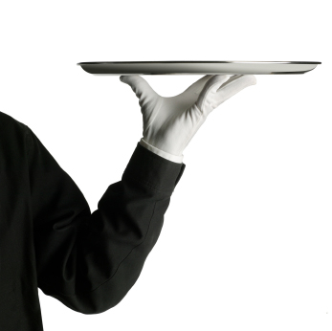
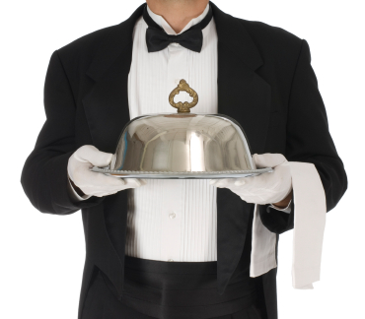
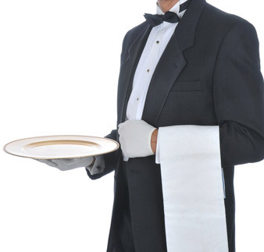
Chapter 9

Slide 2
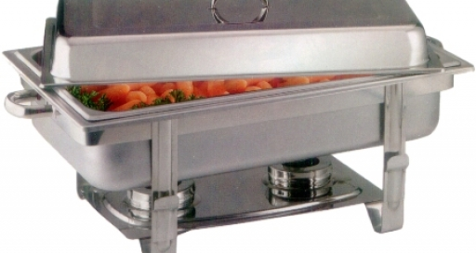
Food that is being held for service is at risk for time-temperature abuse and cross-contamination.
Operations must create policies for how they will hold food.
Policies should consider the following:

Slide 3
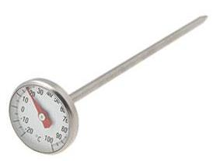
Hold TCS food at the correct internal temperature.
Hold hot food at 135°F or higher.
Hold cold food at 41°F or lower.

Slide 4
Use a thermometer to check a food’s internal temperature.
NEVER use the temperature gauge on a holding unit to do it. The gauge does not check the internal temperature of the food.

Slide 5
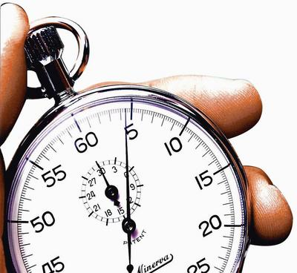
Check food temperature at least every four hours.
Throw out food that is not 41°F or lower, or 135°F or higher.
You can also check the temperature every two hours. This will leave time for corrective action.

Slide 6
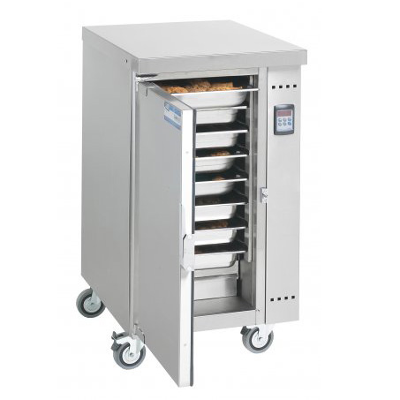
NEVER use hot-holding equipment to reheat food unless it is built to do so. Most hot-holding equipment does not pass food through the temperature danger zone quickly enough.
Reheat food correctly. Then move it to the holding unit.

Slide 7
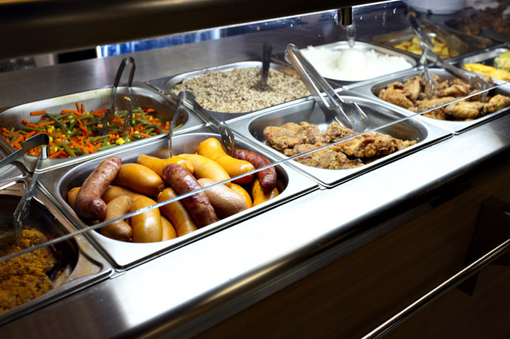
Cover food and install sneeze guards to protect food from contaminants.
Covers also help maintain a food’s internal temperature

Slide 8
An operation might want to hold food without temperature control like these situations:
Displaying food for a short time, such as at an off-site catered event
When electricity is not available to power holding equipment
Note that the conditions for holding cold food are different from those for holding hot food.

Slide 9
You can hold food without temperature control for up to six hours if you meet these conditions:
Hold the food at 41°F or lower before removing it from refrigeration.
Label the food with the time you removed it from refrigeration and the time you must throw it out. This discard time on the label must be six hours from the time you removed the food from refrigeration.

Slide 10
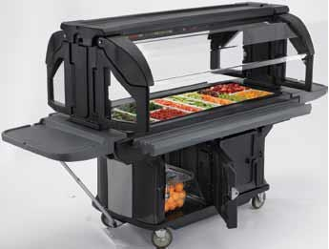
Make sure the food temperature does not exceed 70°F while it is being served. Throw out any food that exceeds 70°F.
Sell, serve, or throw out the food within six hours.

Slide 11
You can hold hot food without temperature control for up to four hours if you meet these conditions:
Hold the food at 135°F or higher before removing it from temperature control
Label the food with the time you must throw it out. The discard time on the label must be four hours form the time you removed the food from temperature control
Sell, serve or throw out the food within four hours

Slide 12
Hold dishes by the bottom or edge.
Hold glasses by the middle, bottom, or stem.
Do NOT touch the food- contact areas of dishes or glassware.

Slide 13
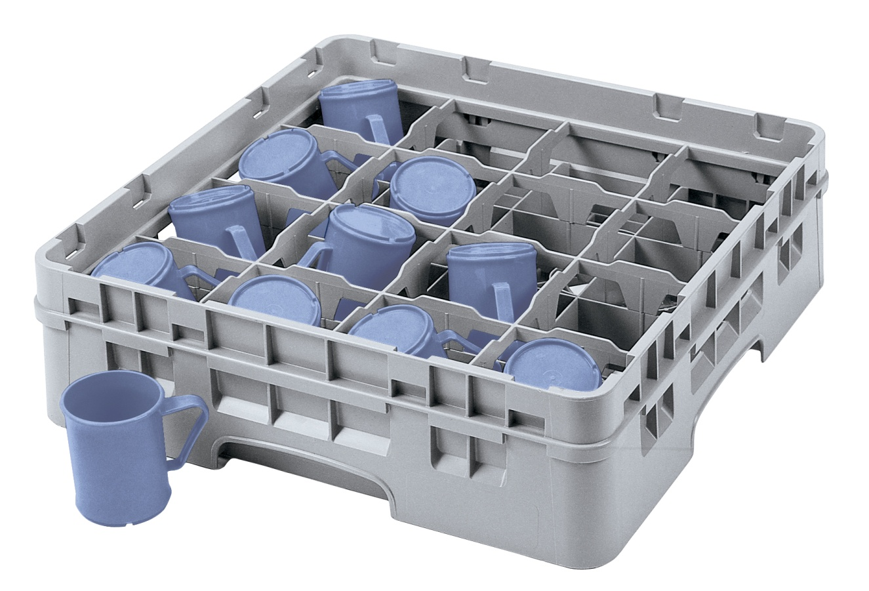
Carry glasses in a rack or on a tray to avoid touching the food-contact surfaces.
Do NOT stack glasses when carrying them.

Slide 14
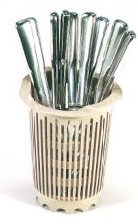
Hold flatware by the handle.
Do NOT hold flatware by food- contact surfaces.
Store flatware so that servers grasp handles, not food-contact surfaces.

Slide 15
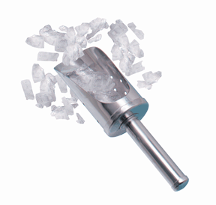
Avoid bare-hand contact with food that is ready to eat.
Use ice scoops or tongs to get ice.
NEVER scoop ice with your bare hands or a glass. A glass may chip or break.

Slide 16
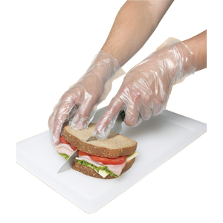
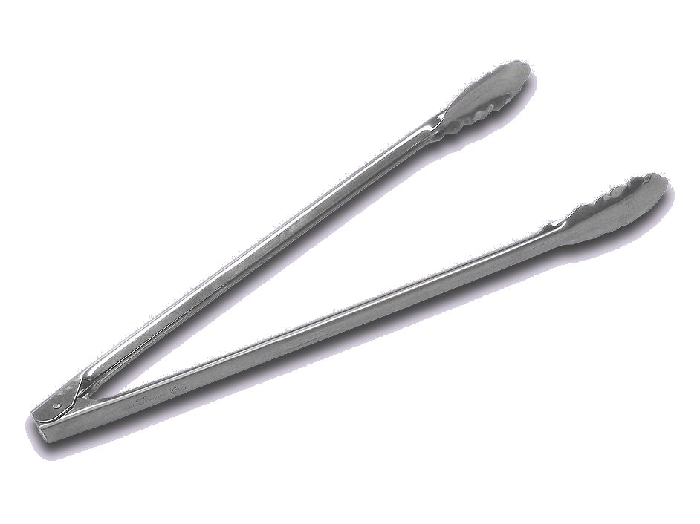
Bare-hand contact with food
Food handlers must wear single-use gloves whenever handling ready-to-eat food.
As an alternative, food can be handled with spatulas, tongs, deli sheets, or other utensils.

Slide 17
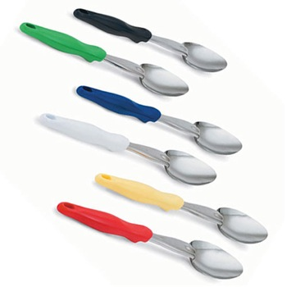
Clean and sanitized utensils
Use separate utensils for each food item.
Clean and sanitize them after each serving task.
If using utensils continuously, clean and sanitize them at least once every four hours.

Slide 18
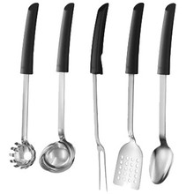
Serving utensils
Store serving utensils in the food with the handle extended above the rim of the container.
You can also place them on a clean and sanitized food-contact surface.
Spoons or scoops used to serve food such as ice cream or mashed potatoes can be stored under running water that is 135°F.

Slide 19
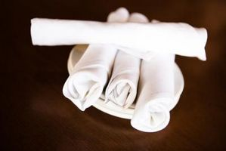
If an operation presets tableware on dining tables, you must take steps to prevent it from becoming contaminated. This could include wrapping or covering them.
Table settings do not need to be wrapped or covered if extra, or unused settings meet these requirements:
They are removed when guests are seated.
If they remain on the table, they are cleaned and sanitized after guests have left.

Slide 20
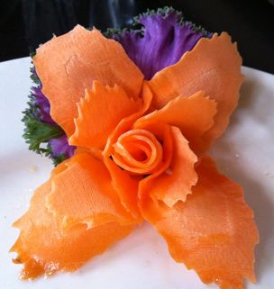
Do NOT re-serve food returned by one customer to another customer.
Do NOT re-serve uneaten bread to other customers. Change linens used in bread baskets after each customer.
NEVER re-serve plate garnishes, such as fruit or pickles, to another customer. Throw out served but unused garnishes.

Slide 21
Condiments
You must protect condiments from contamination. Serve them in their original containers or in containers designed to prevent contamination.
Offering condiments in individual packets or portions can also help keep them safe. NEVER re-serve uncovered condiments.
Do NOT combine leftover condiments with fresh ones.
Throw away opened portions or dishes of condiments after serving them to customers.
Salsa, butter, mayo and ketchup are examples.

Slide 22
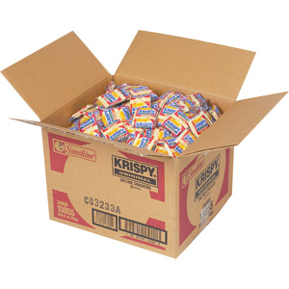
Prepackaged food
In general, you may re-serve only unopened, prepackaged food in good condition.
These include condiment packets and wrapped crackers.
You may re-serve bottles of ketchup, mustard, and other condiments.
The containers must remain closed between uses.

Slide 23
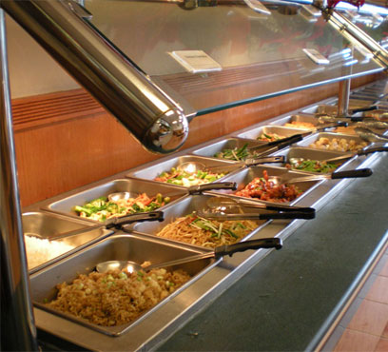
Protection
Food on display can be protected from contamination using sneeze guards.
They should be located 14 inches above the counter and should extend 7 inches beyond the food.
Food can also be protected by placing it in a display cases or by packaging it in a way that will protect it from contamination.
Whole, raw fruits and vegetables and nuts in the shell that require peeling or hulling before eating do not require the protection measures discussed above.

Slide 24
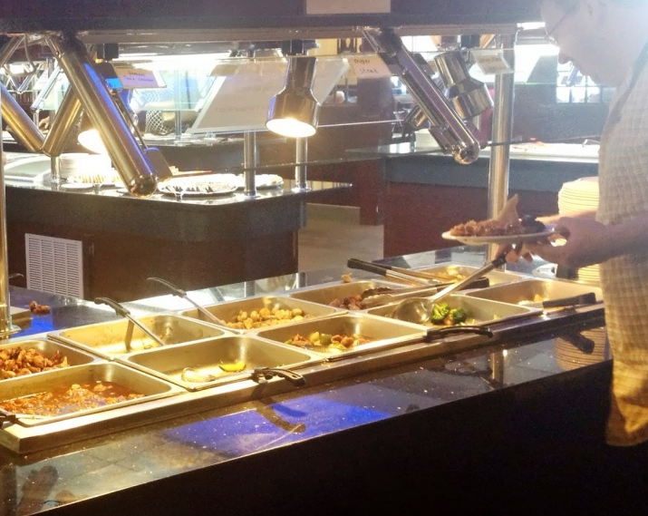
Labels
Label food located in self-service areas.
For example, place the name of the food, such as types of salad dressings, on ladle handles.
Temperature
Keep hot food hot, 135°F or higher.
Keep cold food cold, 41°F or lower.

Slide 25
Raw and Ready-to-Eat Food
Typically, raw, unpackaged meat, poultry, and seafood cannot be offered for self-service. However these items are an exception:
Ready-to-eat food at buffets or salad bars that serve food such as sushi or raw shellfish
Ready-to-cook portions that will be cooked and eaten immediately on the premises, such as at Mongolian barbeques.
Raw, frozen, shell-on shrimp or lobster.

Slide 26
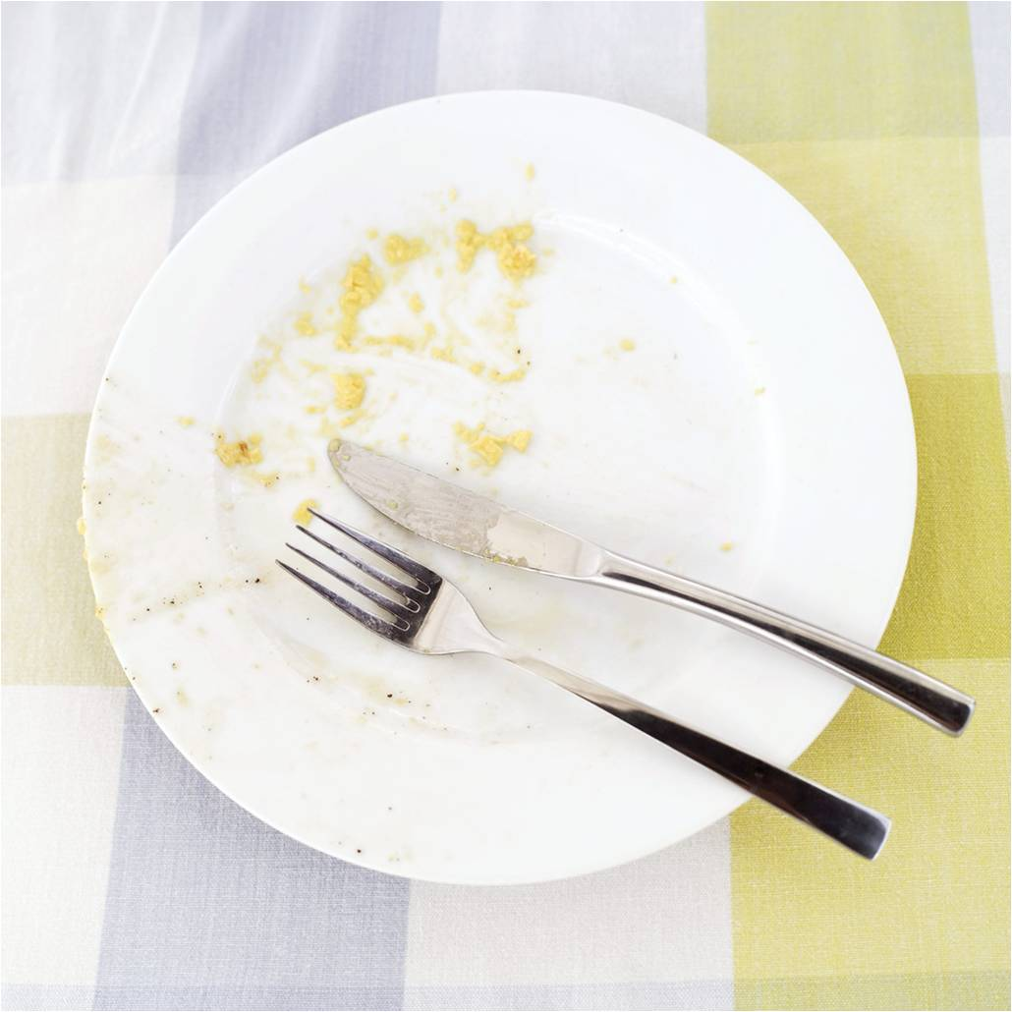
Refills
Do NOT let customers refill dirty plates or use dirty utensils at self-service areas.
Pathogens such as Norovirus can easily be transferred by reused plates and utensils.
Assign a staff member to monitor guests.
Post signs reminding customers not to reuse plates and utensils.

Slide 27
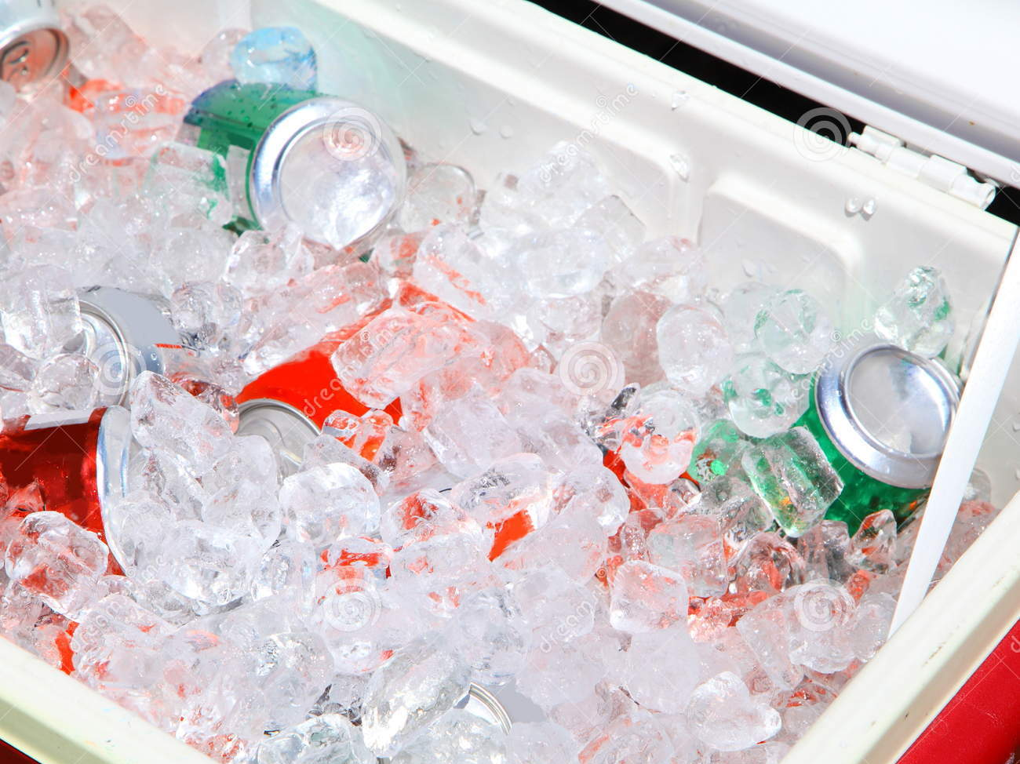
Utensils
Stock food displays with the correct utensils for dispensing food.
This might include tongs, ladles, or deli sheets.
Ice
Ice used to keep food or beverages cold should NEVER be used as an ingredient.

Slide 28
Bulk food in self-service areas must be labeled. The label must be in plain view of the customer.
When labeling food, you can include the manufacturer or processor label provided with the food.
As an alternative, you can provide the information using a card, sign or other labeling method.

Slide 29
Bulk unpackaged food, such as bakery products and unpackaged food portioned for customers, does not need to be labeled if it meets these conditions:
The product makes not claim regarding health or nutrient content
There are not laws requiring labeling
The food is manufactured or prepared on the premises
The food is manufactured or prepared at another food operation or processing plant owned by the same person. The operation must be regulated.

Slide 30
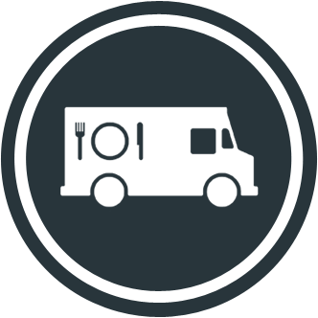
Off-site service such as delivery, mobile/temporary kitchens, and vending machines can present special challenges.
Those who operate these services need to follow the same food safety rules as permanent operations.

Slide 31
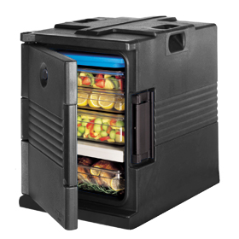
Many operations prep food at one location and then deliver it to remote sites. The longer the time between preparation and consumption, the greater the risk that food will be exposed to contamination or time-temperature abuse. So follow these procedures:
Food containers
Pack food in insulated food containers.
Use only food-grade containers.
They should be designed so food cannot mix, leak or spill.

Slide 32
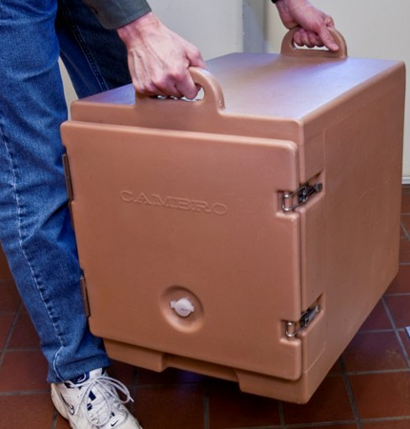
Delivery vehicles
Clean the inside of delivery vehicles regularly.
Internal temperatures
Check the internal food temperatures.
If containers or delivery vehicles are not holding food at the correct temperature, reevaluate the length of the delivery route or the efficiency of the equipment being used.

Slide 33
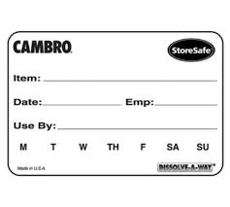
Personal Hygiene
Practice good personal hygiene when distributing food
Labels
Label food with a use-by date and time, and reheating and service instructions for staff at off-site locations.
Storage
Store raw meat, poultry and seafood and ready-to-eat items separately.

Slide 34
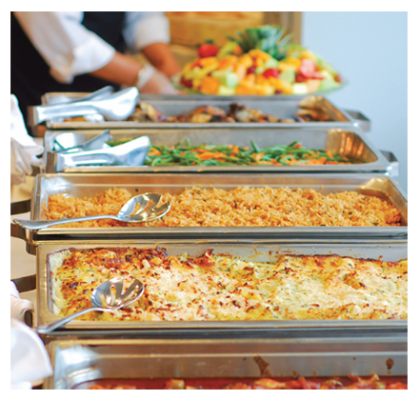
Caterers must follow the same food safety rules as permanent operations.
Food must be protected from contamination and time-temperature abuse.
Facilities must be clean and sanitary.
Food must be prepared and served correctly
Staff must follow good personal hygiene practices
In addition, the following guidelines need to be met

Slide 35
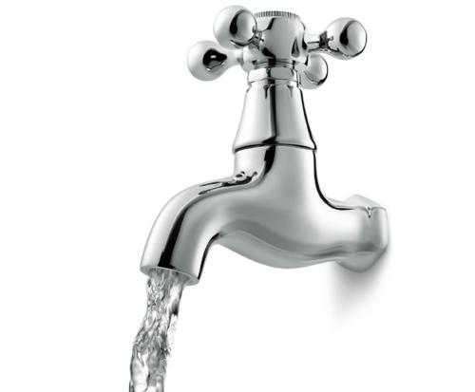
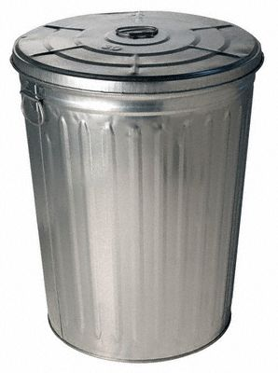
Utilities
Make sure the service site has the correct utilities.
Safe water for cooking, dishwashing, and handwashing.
Garbage containers stored away from food-prep, storage, and serving areas.

Slide 36
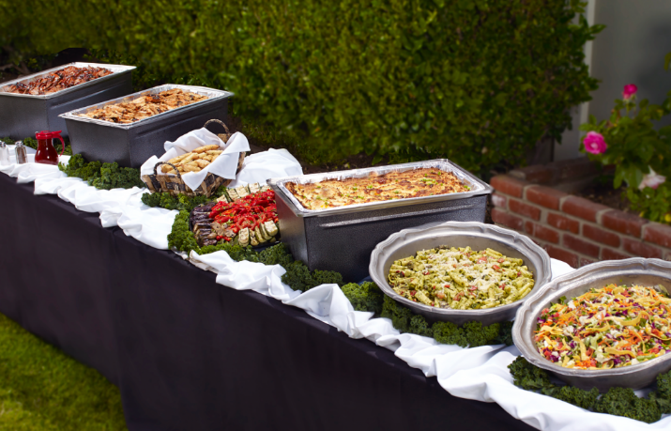
Insulated containers
Use insulated containers to hold TCS food.
Raw meat should be wrapped and stored on ice.
Deliver milk an dairy products in a refrigerated vehicle or on ice.
Cold food
Serve cold food in containers on ice or in chilled, gel-filled containers. If not desired, the rules for serving cold foot without temperature control need to be followed.

Slide 37
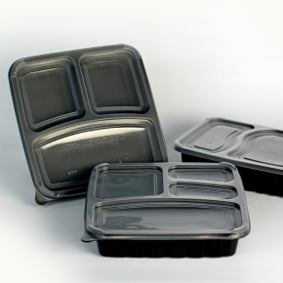
Ready-to-eat food
Store ready-to-eat food separately from raw food.
Leftovers
If leftovers are given to customers, provide instructions on how they should be handled.
Information such as a discard date and the food’s storage and reheating instructions should be clearly labeled on the container.

Slide 38
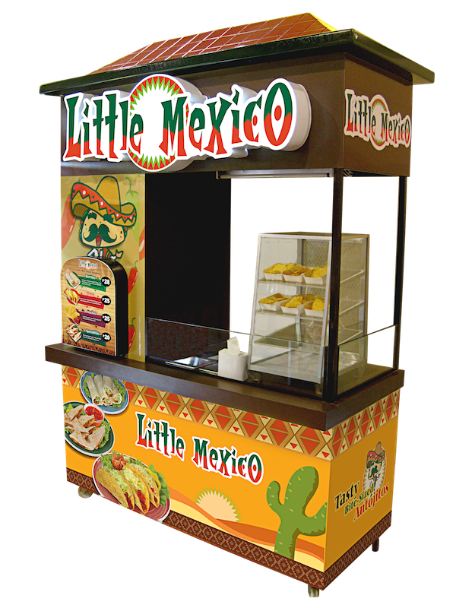
Temporary units typically operate in one location for less than 14 days. Foodservice tents or kiosks set up for food fairs, special celebrations, or sporting events may be temporary units.
Temporary units usually serve packaged food or food requiring limited prepping, such as hot dogs. It is best to keep the menu simple to limit the amount of on-site food prep.

Slide 39
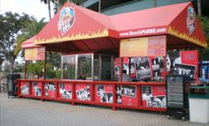
Temporary units also need to follow these guidelines:
Should be constructed to keep dirt and pests out.
If floors are made of dirt or gravel, cover them with mats or platforms to control dust and mud.
Construct walls and the ceiling with materials that will protect food from weather and windblown dust.

Slide 40
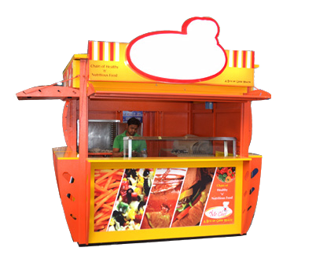
The safe-handling rules discussed through out Servsafe apply to food prep in temporary units.
Safe drinking water also needs to be available for cleaning, sanitizing, and handwashing.
Since dishwashing facilities will likely be limited too, it is best to use disposable single-use items.

Slide 41
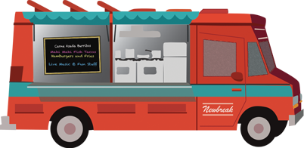
Mobile units are portable facilities ranging from concession vans to elaborate field kitchens.
Those only serving frozen novelties, candy, packaged snacks, and soft drinks need meet basic sanitation requirements.
However, mobile kitchens prepping and serving TCS food need to follow the same rules required of permanent foodservice kitchens.
Both might be required to apply for a special permit or license from the regulatory authority.

Slide 42
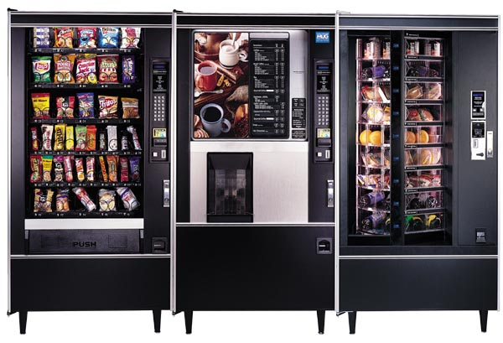
Handle food prepped and packaged for vending machines with the same care as any other food served to customers.
Vending operators should protect food from contamination and time-temperature abuse during transport, delivery and service.

Slide 43
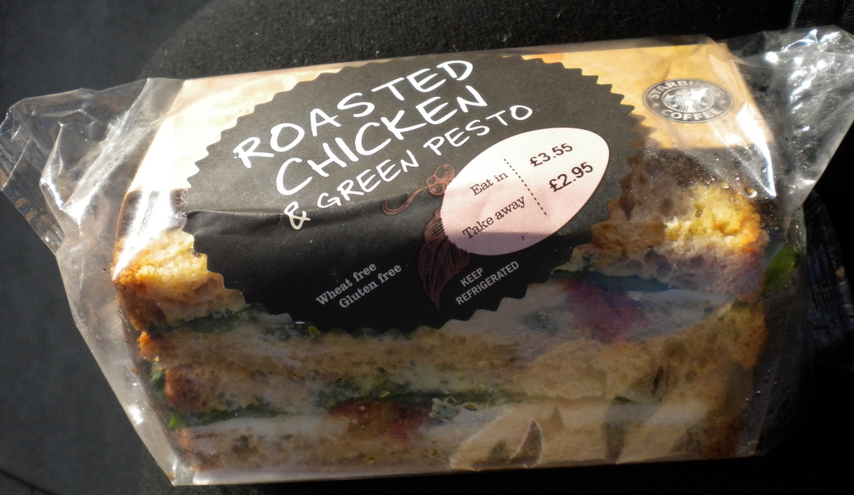
Check product shelf life daily. Products often have a code date, such as an expiration or use-by date. If the date has expired, throw out the food immediately. Throw out refrigerated food prepped on-site if not sold within seven days of preparation.

Slide 44
Keep TCS food at the correct temperature. It should be held at 41°F or lower or at 135°F or higher. These machines must have controls that prevent TCS food from being dispensed if the temperature stays I the danger zone for a specified amount of time. This food must be thrown out.

Slide 45
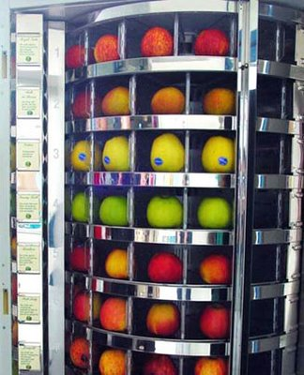
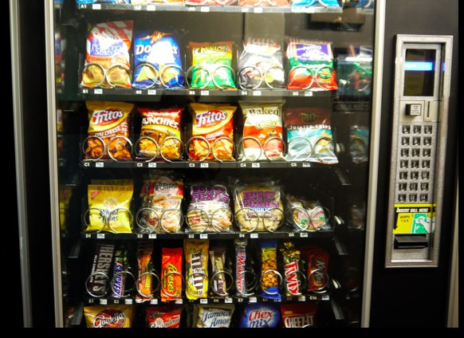
Dispense TCS food in its original container.
Wash and wrap fresh fruit with edible peels before putting it in a machine.

