Slide 1
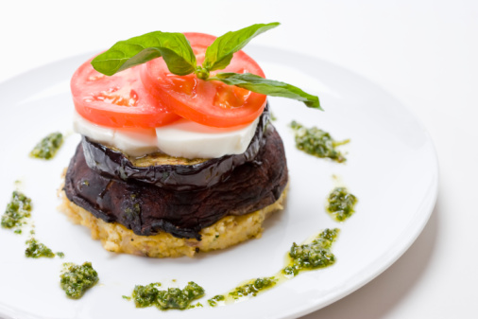
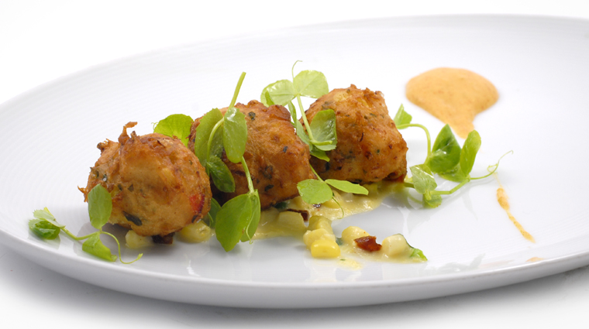
Chapter 8

Slide 2
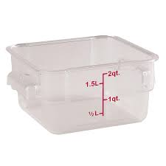
Equipment
Make sure workstations, cutting boards, and utensils are clean and sanitized
Quantity
Only remove as much food from the cooler as you can prep in a short period of time
Storage
Return prepped food to the cooler, or cook it as quickly as possible

Slide 3
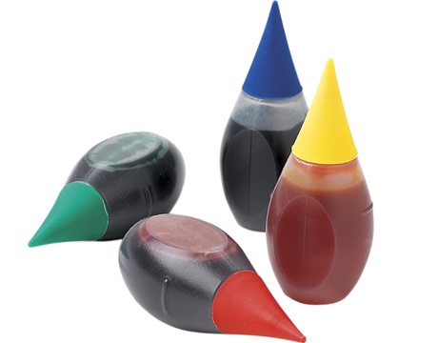
Additives
If you food or color additives:
Only use additives that have been
approved by your local regulatory authority
NEVER use more than is allowed by law
NEVER use additives to alter the appearance of the food
Do NOT sell produce that was treated with sulfites before it was received in the operation
NEVER add sulfites to produce that will be eaten raw

Slide 4
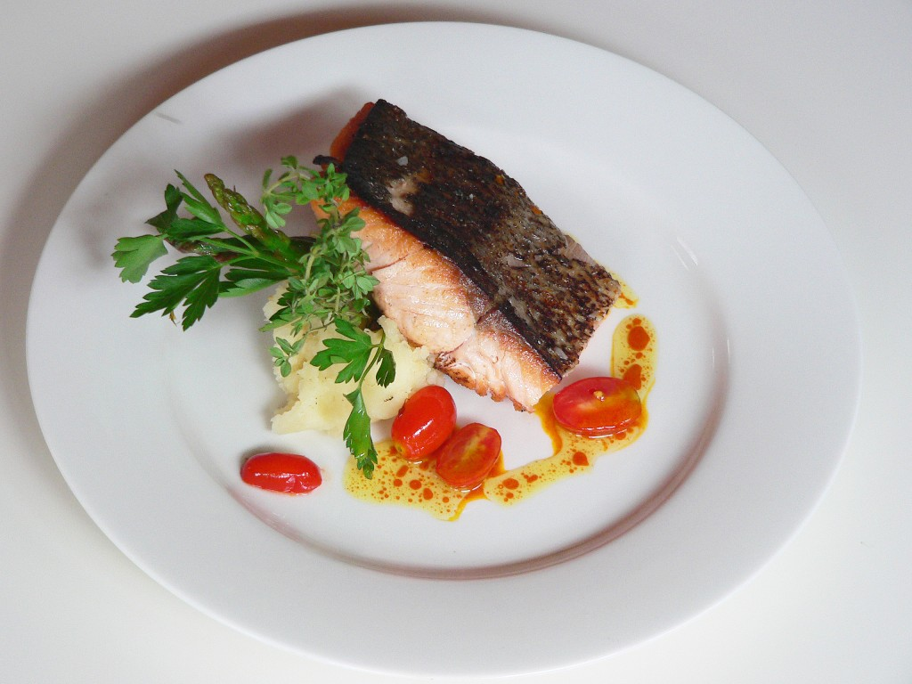
Presentation
Food must be offered to customers in a way that does not mislead or misinform them.
Customers must be able to judge the true appearance, color and quality of food.

Slide 5
Corrective Actions
Food that has become unsafe must be thrown out unless it can be safely reconditioned. All food—especially ready-to-eat food—must be thrown out in the following situations:
When it is handled by staff who have been restricted or excluded from the operation due to illness
When it is contaminated by hands or bodily fluids from the nose or mouth
When it has exceeded the time and temperature requirements designed to keep food safe

Slide 6
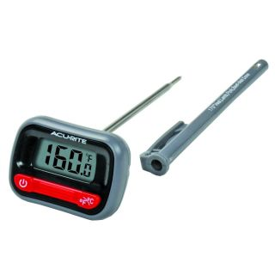
Sometimes food can be restored to a safe condition, which is called reconditioning.
Example: A hot food has not be held at the correct temperature may be reheated if it has not been in the temperature danger zone for more than two hours. This can return food to a safe condition.

Slide 7
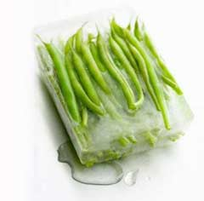
When frozen food is thawed and exposed to the temperature danger zone, pathogens in the food begin to grow.
To reduce this growth, NEVER thaw food at room temperature.
There are 4 acceptable thawing methods.

Slide 8
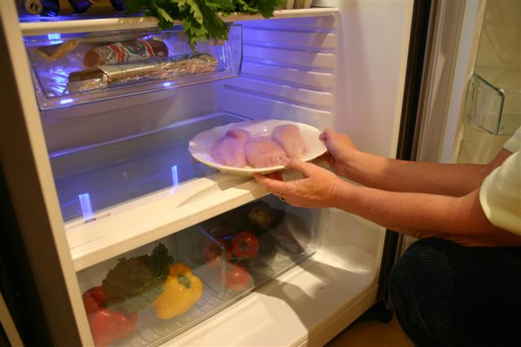
Refrigeration
Thaw food in a cooler, keeping its temperature at 41°F or lower

Slide 9
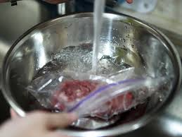
Running Water
Submerge food under running, drinkable water at 70°F or lower. The flow of the water must be strong enough to wash loose food bits into the drain.
Always use a clean sanitized food-prep sink when thawing food
NEVER let the temperature of the food go above 41°F longer than four hours. This includes the time it takes to thaw the food plus the time it takes to prep or cool it.

Slide 10
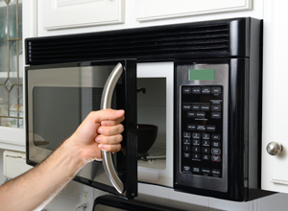
Microwave
Thaw food in a microwave oven if it will be cooked immediately after thawing.
The food must be cooked in conventional cooking equipment, such as an oven, once it’s thawed

Slide 11
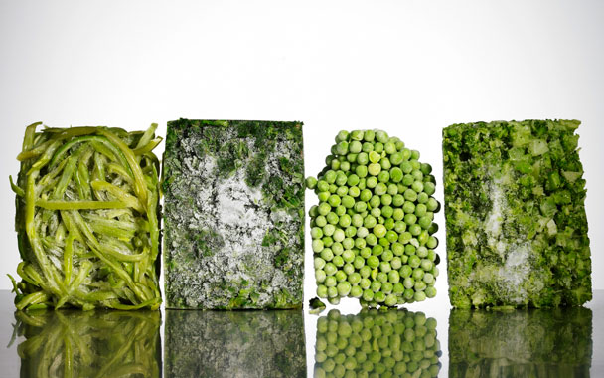
Cooking
Thaw food as part of the cooking process

Slide 12
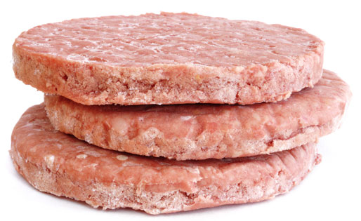
Some frozen food may also be slacked before cooking; Slacking is the gradual thawing of frozen food to prep it for deep-frying.
This allows even heating during cooking.
Slack food just before you cook it. DO not let it get any warmer than 41°F.

Slide 13
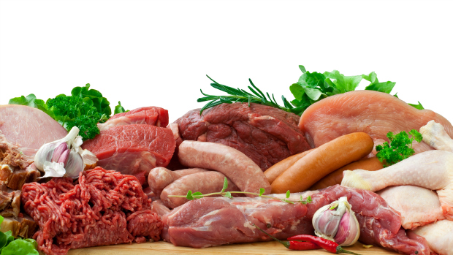
Meat, Seafood & Poultry
Prep raw meat, poultry, and seafood separately or at different times from fresh produce.
Remove from refrigerated storage only as much of an item as can be prepped at one time.
Return raw, prepped meat directly to the cooler, or cook it as quickly as possible. Store these items correct to prevent cross-contamination.

Slide 14
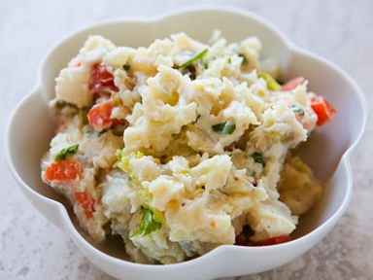
Salads Containing TCS Food
Chicken, tuna, egg, pasta and potato salads have all been involved in foodborne-illness outbreaks. These salads are not usually cooked after preparation. This means you do not have a chance to reduce pathogens (like Staph) that may have gotten into the salads. Follow these guidelines:
Using leftovers: TCS food such as pasta, chicken and potatoes can be used only if it has been cooked, held, and cooled correctly
Storing leftovers: Throw out leftover food held at 41°F or lower after seven days. Check the use-by date before suing stored food items.

Slide 15
Eggs & Egg Mixtures
Pooled Eggs
Handle pooled eggs (if allowed by your local regulatory authority) carefully. Pooled eggs are cracked open and combined in a container.
Cook them promptly after mixing, or store them at 41°F or lower.
Clean and sanitize the containers used to hold them before making a new batch.

Slide 16
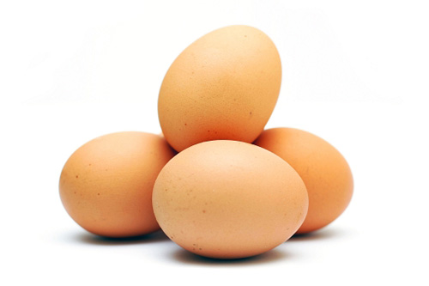
Eggs & Egg Mixtures
Pasteurized eggs
Consider using pasteurized shell eggs or egg products when prepping egg dishes that need little or no cooking (like caesar salad dressing, hollandaise sauce, tiramisu and mousse)
High-risk Populations
If you mainly serve high-risk populations use pasteurized eggs or egg produces when serving dishes that are raw or undercooked. Shell eggs that are pooled must also be pasteurized. You may use unpasteurized shell eggs if the dish will be cooked all the way through

Slide 17
Batters & Breading
Batters and breadings prepped with eggs or milk should be handled carefully since they run the risk of time-temperature abuse and cross-contamination.
Prep in small batches to prevent time-temperature abuse of both the batter and the food being coated.
Set a plan to throw out unused batter or breading after a set time.
The coating of battered and breaded food acts as an insulator that can prevent food from being thoroughly cooked.
Don’t overload the fryer; overloading slows cooking time.

Slide 18
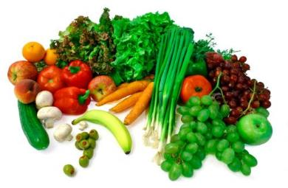
Produce
Cross contamination
Make sure fruit and vegetables do NOT touch surfaces exposed to raw meat, seafood or poultry
Washing
Wash produce under running water. This is especially important before cutting, cooking, or combining it with other ingredients.
The water should be a little warmer than the produce.
Certain chemicals may be used to wash fruits and vegetables.

Slide 19
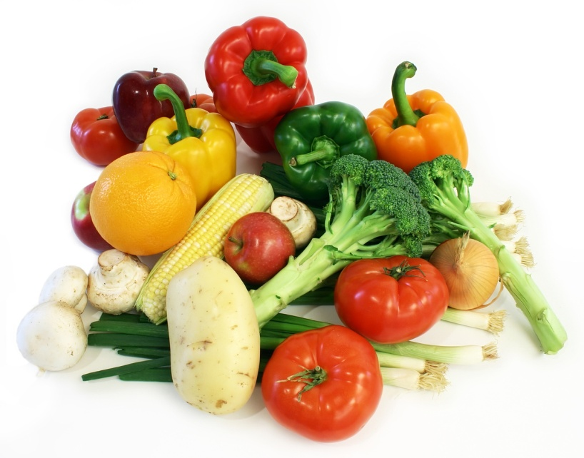
Produce
Soaking or Storing
When soaking or storing produce in standing water or an ice-water slurry, do NOT mix different items or multiple batches of them some time.
Fresh-cut produce
Refrigerate and hold sliced melons, cut tomatoes and cut leafy greens at 41°F or lower. Many operations hold other fresh-cut produce at this temperature as well.
Raw seed sprouts
If your operation primarily serves high-risk populations, do NOT serve raw seed sprouts

Slide 20
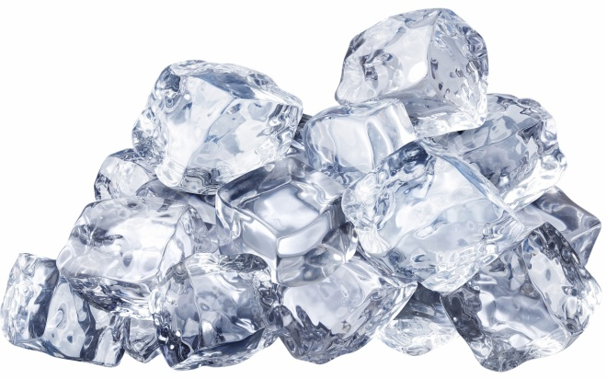
Ice
Consumption: Make ice from water that is safe to drink
Cooling food: NEVER use ice as an ingredient if it was used to keep food cold
Containers and scoops: Use clean and sanitized containers and ice scoops to transfer ice from a machine to other containers.
Store ice scoops outside of the ice machine in a clean, protected location
NEVER hold or carry ice in containers that have held raw meat, seafood, or poultry; or chemicals
NEVER touch ice with hands or use a glass to scoop ice

Slide 21
You will need a variance when prepping food in certain ways. A variance is a document issued by your regulatory authority that allows a regulatory requirement to be waived or changed.
When applying for a variance, your regulatory authority may require you to submit a HACCP plan (explained in ch 8). The plan must account for any food safety risks related to the way you plan to prep the food item.

Slide 22
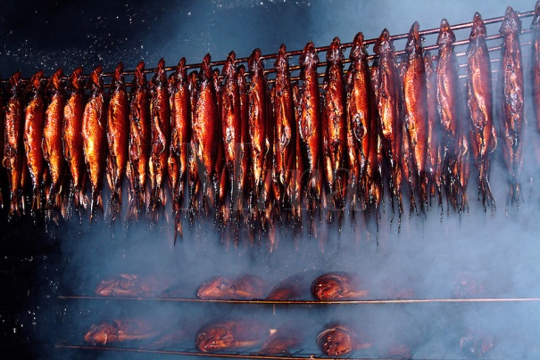
You will need a variance if your operation plans to prep food in any of the following ways.
Packaging fresh juice on-site for sale at a later time, unless the juice has a warning label.
Smoking food as a way to preserve it (but not to enhance flavor)
Using food additives or adding components such as vinegar to preserve or alter the food so that it no longer needs time and temperature control for safety

Slide 23
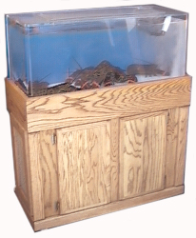
Curing food
Custom-processing animals for personal use. For example, a hunter brings a deer to a restaurant for dressing and takes the meat home for later use.
Packaging food using a reduced-oxygen packaging (ROP) method. This includes MAP, vacuum-packed, and sous vide food.
Sprouting seeds or beans.
Offering live shellfish from a display tank.

Slide 24
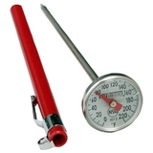
The only way to reduce pathogens in food to safe levels is to cook it to its minimum internal temperature. The temperature is different for each food.
Once correct temperature is reached, you must hold the food at this temperature for a specific amount of time.
While cooking reduces pathogens in food, it does not destroy spores or toxins they may have produced.

Slide 25
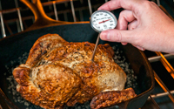
Monitor the temperature of cooked food to make sure it has reached the correct temperature.
Minimum temperatures have been developed for TCS food.

Slide 26
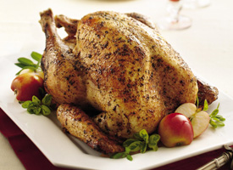
Poultry—including whole or ground chicken, turkey or duck
Stuffing made with fish, meat or poultry
Stuffed meat, seafood, poultry, or pasta
Dishes that include previously cooked TCS ingredients (raw ingredients should be cooked to their minimum internal temperatures)

Slide 27
Ground meat—including beef, pork, and other meat
Injected meat—including brined ham and flavor-injected roasts
Mechanically tenderized meat
Ratites—including ostrich and emu
Ground seafood—including chopped or minced seafood
Shell eggs that will be hot-held for service

Slide 28
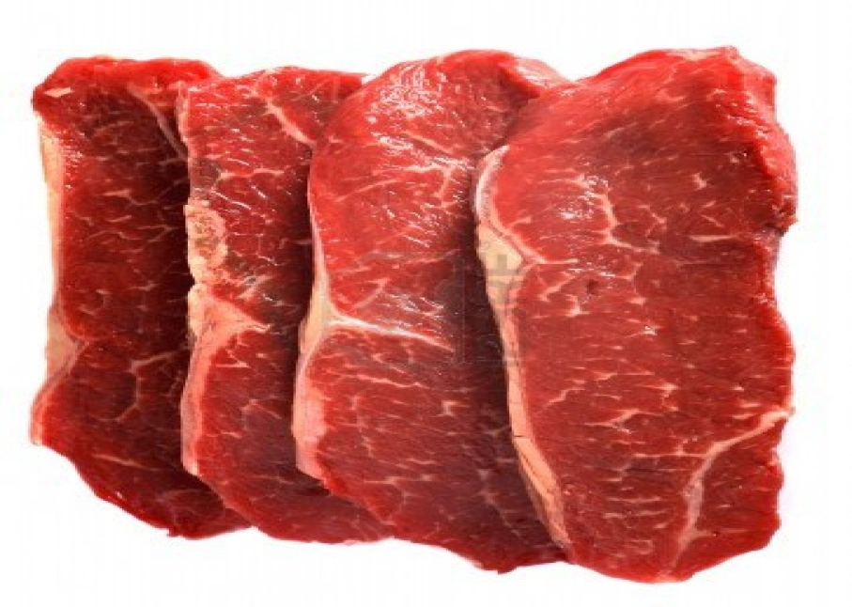
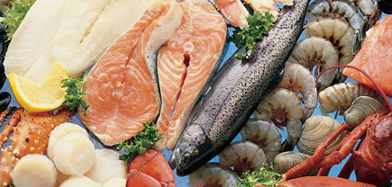
Seafood—including fish, shellfish, and crustaceans
Steaks/chops of pork, beef, veal and lamb
Commercially raised game
Shell eggs that will be served immediately

Slide 29
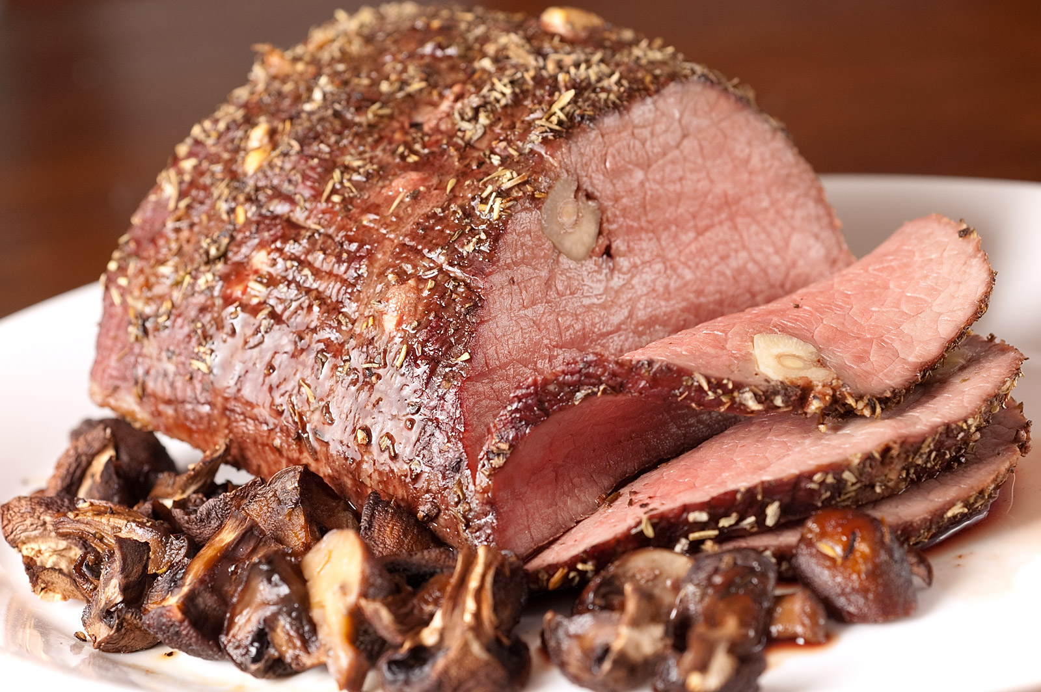
Roasts of pork, beef, veal and lamb

Slide 30
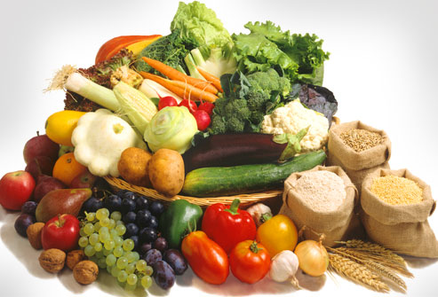
The following that will be hot-held for service:
Fruits & vegetables
Grains (rice, pasta)
Legumes (beans, refried beans)

Slide 31
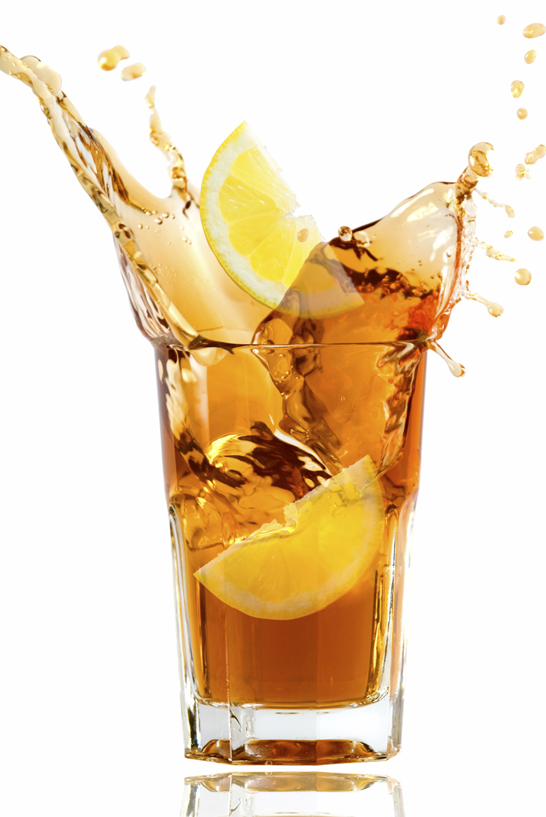
Tea
Automatic iced tea and automatic coffee machine equipment: tea leaves should remain in contact with the water for a minimum of 1 minute.
Traditional steeping method: tea leaves should be exposed to the water for about five minutes

Slide 32
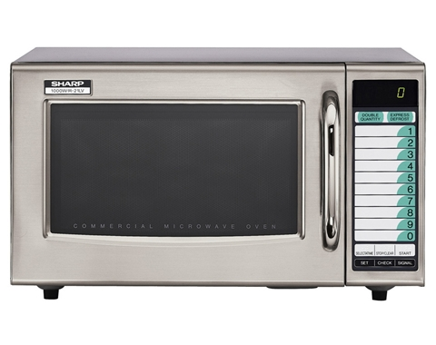
Meat, seafood, poultry and eggs that you cook in a microwave must be cooked to 165°F. In addition, you must follow these guidelines:
Cover the food to prevent its surface from drying out.
Rotate or stir it halfway through the cooking process so that the heat reaches the food more evenly
Let the covered food stand for at least two minutes after cooking to let the food temperature even out
Check the temperature in at least two places to make sure that the food is cooked through

Slide 33
Time and temperature
Specify the cooking time and minimum internal temperature in all recipes.
Correct thermometer
Use a thermometer with a probe that is the correct size for the food. Check the temperature in the thickest part of the food. Take at least two readings in different locations.

Slide 34
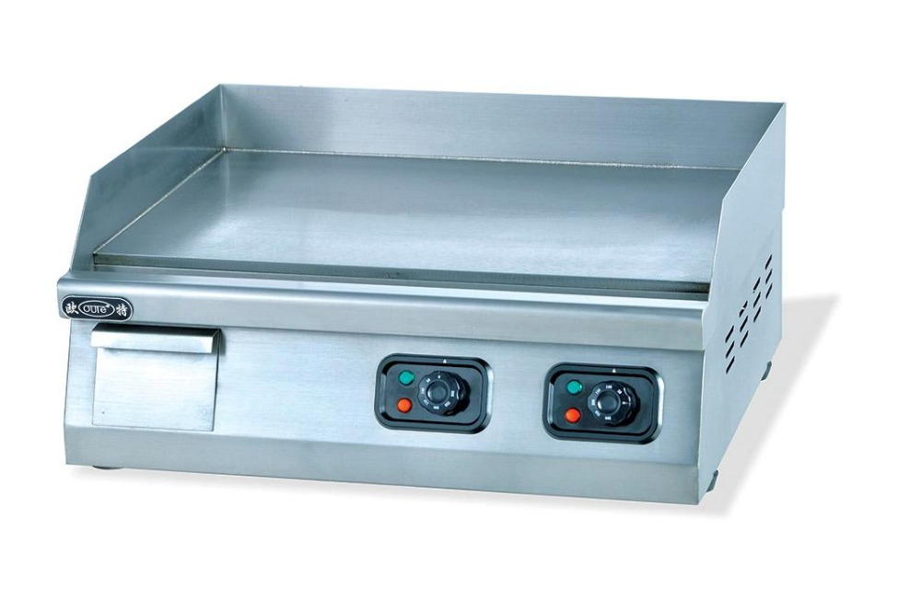
Overloading
Avoid overloading ovens, fryers, and other cooking equipment. Overloading may lower the equipment or oil temperature and the food might not cook fully.
Equipment temperature
Let the cooking equipment’s temperature recover between batches.

Slide 35
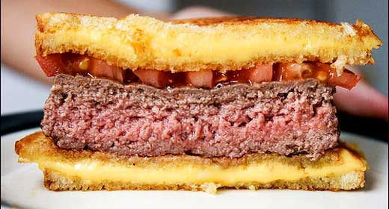
You must cook TCS food to the minimum internal temperatures listed previously unless a customer requests otherwise. This might happen often in your operation, particularly if you serve meat, eggs, or seafood.

Slide 36
If your menu includes TCS items that are raw or undercooked, you must note it on the menu next to those items.
This can be done by placing an asterisk next to the item that points customers to a footnote at the bottom of the menu. The footnote must include a statement that indicated the item is raw or undercooked, or contains raw or undercooked ingredients.

Slide 37
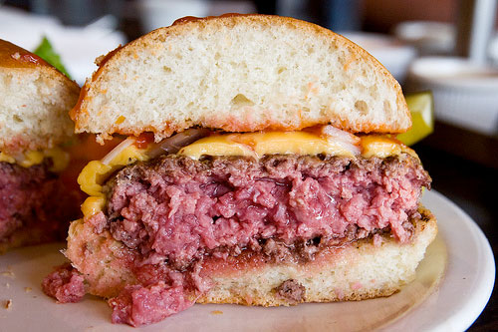
You must advise customers who order food that is raw or undercooked of the increased risk of food-borne illness.
You can do this by posting a notice in your menu.
You can also provide this information using brochures, table tents, signs or other written methods.

Slide 38
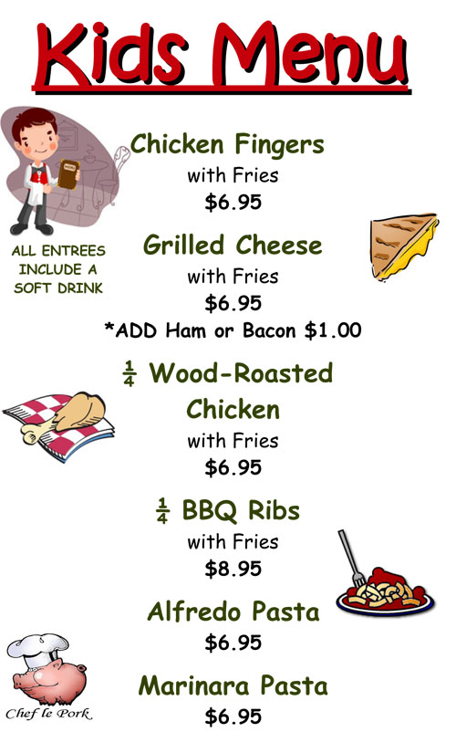
The Food and Drug Administration advises against offering raw or undercooked meat, poultry, seafood, or eggs on a children’s menu.
This is especially true for undercooked ground beef, which may be contaminated with e coli.

Slide 39
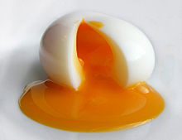
Operations that mainly serve a high-risk population, such as nursing homes or day-care centers, cannot serve certain items.
NEVER serve raw seed sprouts or raw or undercooked eggs, meat or seafood.
Examples include over-easy eggs, raw oysters on the half shell, and rare hamburgers.

Slide 40
Some operations partially cook food during prep and then finish cooking it just before service, the following steps must be followed if your operation is going to do this:
Do not cook the food for longer than 60 minutes during initial cooking.
Cool the food immediately after initial cooking.
Freeze or refrigerate the food after cooling it. If refrigerating the food, make sure it is held at 41°F or lower.
Heat the food to at least 165°F for 15 seconds before selling or serving it.
Cool the food if it will not be served immediately or held for service.

Slide 41
Pathogens grow extremely fast between 125°F and 70°F, so its important that food passes through this temperature range quickly to reduce this growth
Food must be cooled from 135°F to 41°F or lower within six hours

Slide 42
135°F to
70°F
Cool food from 135°F to 70°F within TWO HOURS
Then cool it from 70°F to 41°F or lower in the next FOUR HOURS.
70°F to
41°F

Slide 43
If food has not reached 70°F within two hours, it must be reheated and then cooled again.
If you can cool the food from 135°F to 70°F in less than two hours, you can use the remaining time to cool it to 41°F or lower.
The total cooling time cannot be longer than six hours.
6
Notes:
For example: If you cool food from 135°F to 70°F in one hour, you have the remaining five hours to get the food to 41°F or lower.

Slide 44
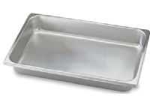
Thickness or density of the food
The denser the food, the more slowly it will cool
Size of the food
Large food items cool more slowly than smaller items
Reduce the side of the product to cool quicker
Storage container
Stainless steel transfers heat away from food faster than plastic.
Shallow pans let the heat from food disperse faster than deep pans

Slide 45
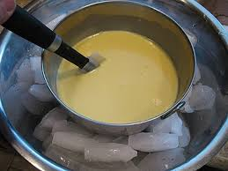
NEVER cool large amounts of hot food in a cooler. Most coolers are not designed to cool large amounts of hot food quickly.
Ice- Water Bath
After dividing food into smaller containers, place them in a clean prep sink or large pot filled with ice water.

Slide 46
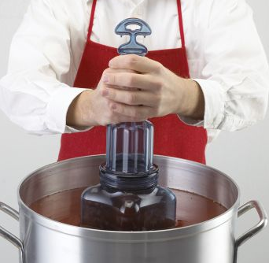
Stir the food frequently to cool it faster and more evenly
Blast chiller
Blast chillers blast cold air across food at high speeds to remove heat. They are typically used to cool large amounts of food.
Ice paddle
Plastic paddles are available that can be filled with ice or with water and then frozen. Food stirred with these paddles will cool quickly.

Slide 47
Cool food even faster when placed in an ice-water bath and stirred with an ice paddle.
Ice or cold water as an ingredient
When cooling soups or stews, the recipe is made with less water than required. Cold water or ice is then added after cooking to cool the food and provide the remaining water.

Slide 48
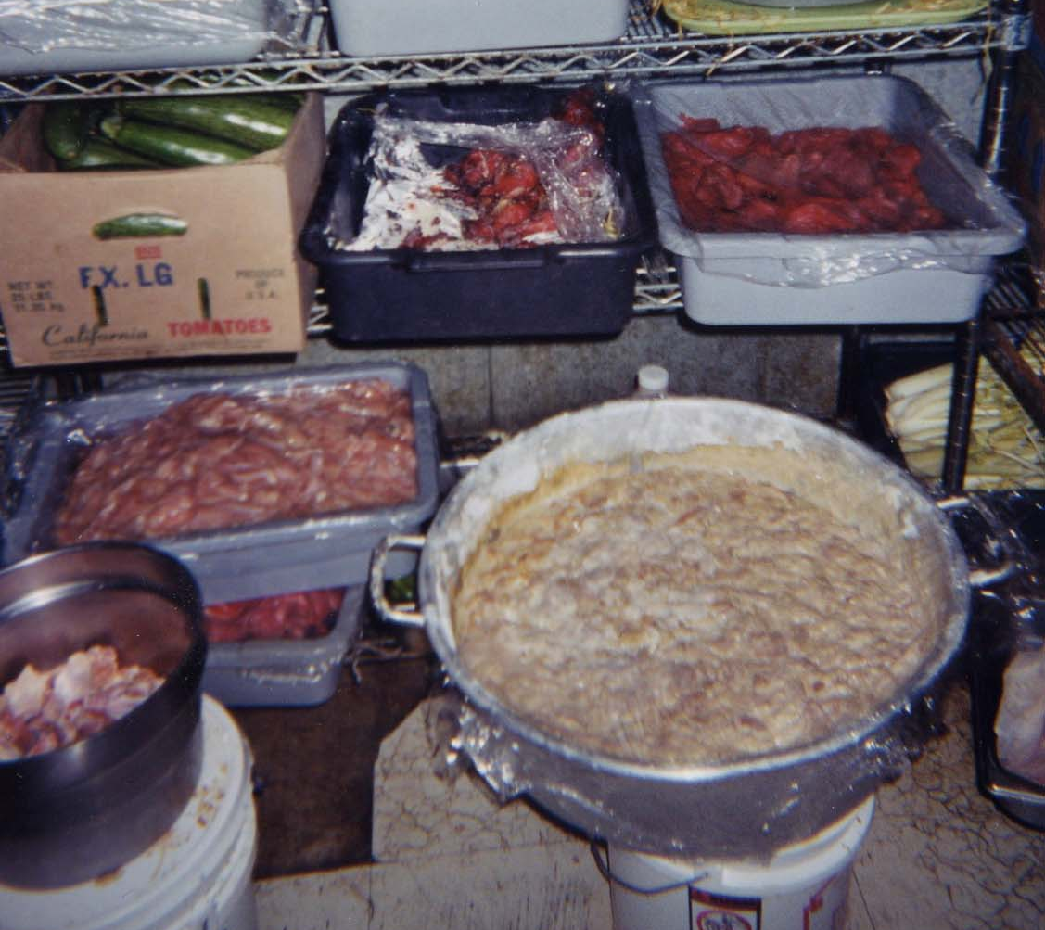
Loosely cover food containers before storing them.
Food can be left uncovered if stored in a way that prevents contaminants from getting into it.
Storing uncovered containers above other food, especially raw seafood, meat, and poultry, will help prevent cross-contamination.

Slide 49
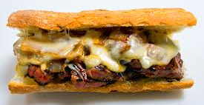
Food reheated for immediate service
You can reheat food that will be served immediately, such as beef for a beef sandwich, to any temperature. However, you must make sure the food was cooked and cooled correctly.

Slide 50
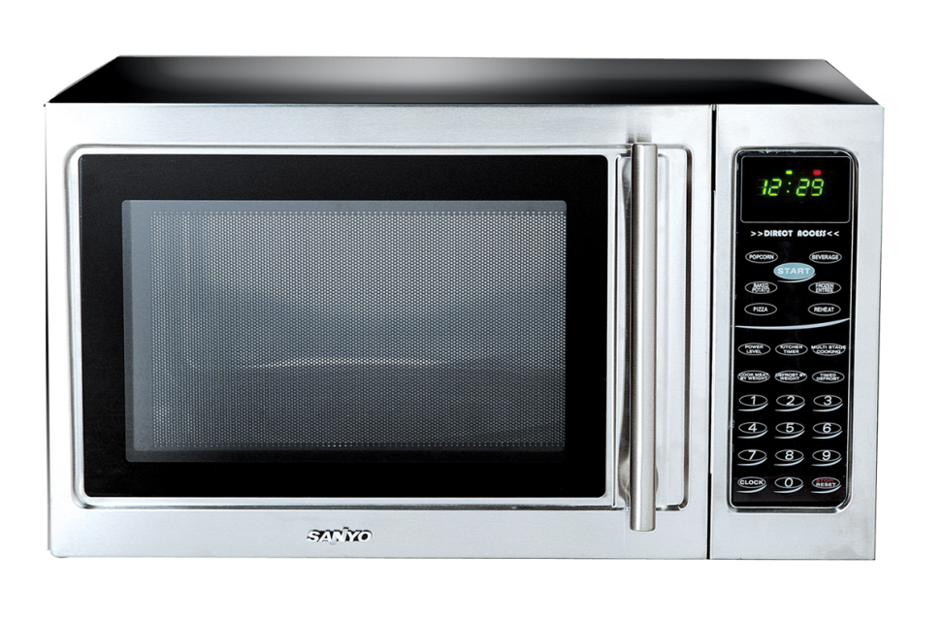
Food reheated for hot-holding
You must heat TCS food for hot-holding to an internal temperature of 165°F for 15 seconds. Make sure the food reaches this temperature within two hours from start to finish. These guidelines apply to all reheating methods, such as ovens and microwaves.

Slide 51
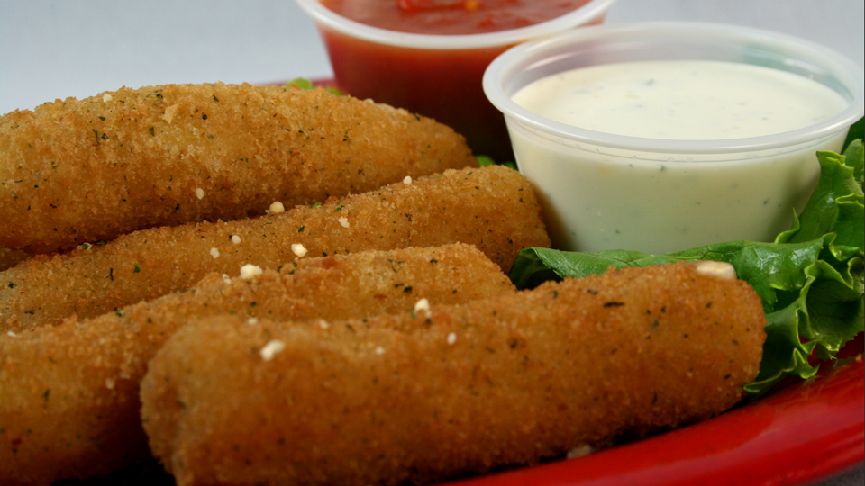
Reheat commercially processed and packaged ready-to-eat food to an internal temperature of at least 135°F. This includes items such as cheese sticks and deep-fried vegetables.

