Slide 1
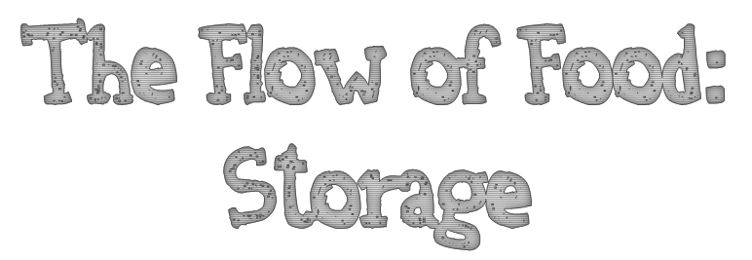
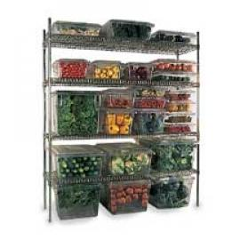
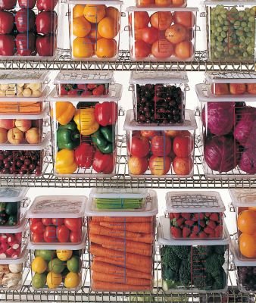
Chapter 7

Slide 2
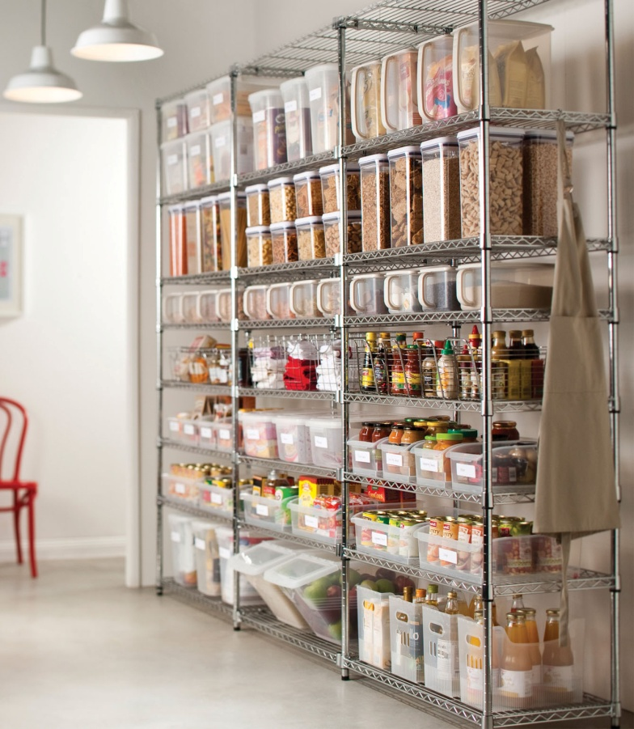
Following good storage guidelines for food and nonfood items will help keep these items safe and preserve their quality.
You must:
label and date mark your food correctly
rotate food and store it at the correct temperature
store items in a way that prevents cross-contamination

Slide 3
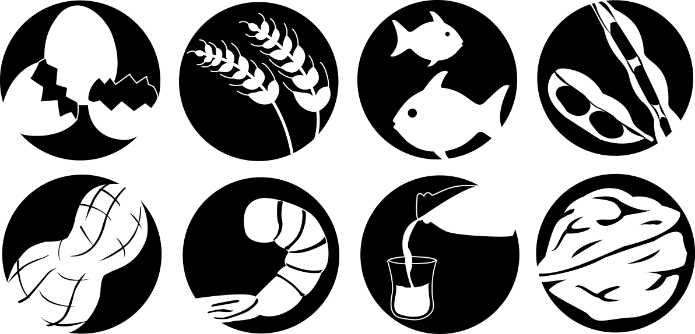
Illnesses have occurred when unlabeled chemicals were mistaken for food such as flour, sugar, and baking powder.
Customers have also suffered allergic reactions when food was unknowingly prepped with a food allergen that was not labeled.

Slide 4
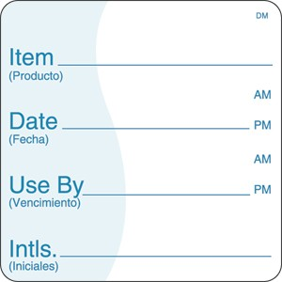
All items that are not in their original containers must be labeled
Food labels should include the common name of the food or a statement that clearly and accurately indentifies it
It is not necessary to label food if it clearly will not be mistaken for another item. The food must be easily identified by sight.

Slide 5
Food packaged for customer use at home must be labeled with:
Common name of the food or statement that clearly identifies it
Quantity of food
List of ingredients in descending order by weight
List of artificial colors, flavors and chemical preservatives must be listed
Name and place of business of the manufacturer, packer or distributer
Source of each major food allergen contained in the food

Slide 6
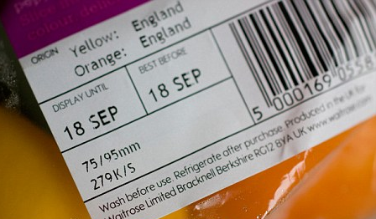
Ready-to-eat TCS food must be marked if held for longer than 24 hours. (Listeria grows well at refrigeration temperatures)
Must indicate when the food must be sold, eaten or thrown out.

Slide 7
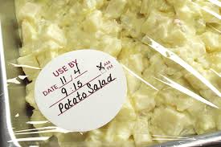
Ready-to-eat TCS food can be stored for only SEVEN days if it is held at 41°F or lower.
The count begins on the day that the food was prepared or a commercial container was opened.
When combining food in a dish with different use-by dates, the discard date of the dish should be based on the earliest prepared food.

Slide 8
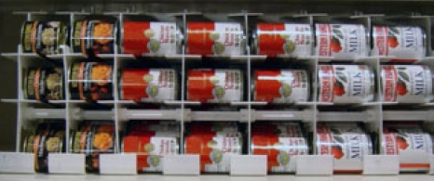
Food must be rotated in storage to maintain quality and limit the growth of pathogens.
Food items must be rotated so that those with the earliest use-by or expiration dates are used before items with later dates.
Many operations use the first-in, first-out (FIFO) method to rotate their refrigerated, frozen and dry food during storage.

Slide 9
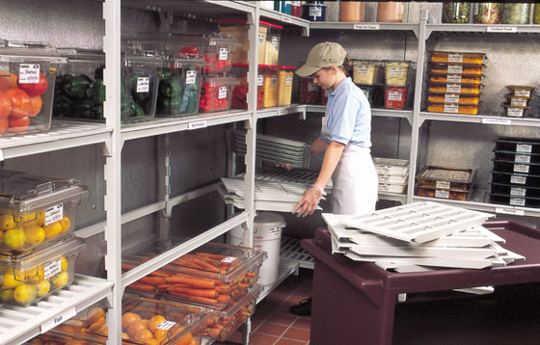
Here is one way to use the FIFO method:
Identify the food item’s use-by or expiration date.
Store items with the earliest use-by or expiration dates in front of items with later dates.
Once shelved, use those items stored in front first.
Throw out food that has passed its manufacturer’s use-by or expiration date.

Slide 10
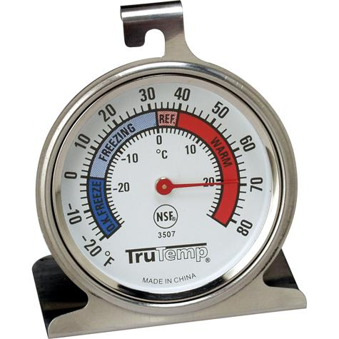
Pathogens can grow when food is not stored at the correct temperature. Follow these guidelines to keep food safe.
Store TCS food at an internal temperature of 41°F or lower or 135°F or higher
Store frozen food at temperatures that keep it frozen
Make sure storage units have at least one air temperature measuring device. It must be accurate to +/- 3°F. Needs to be located in the warmest part of refrigerated units, and the coldest part of hot-holding units.

Slide 11
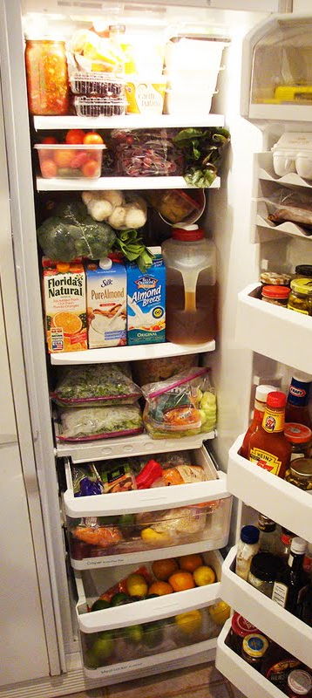
Store meat, poultry, seafood, and dairy items in the coldest part of the unit, away from the door
Consider using cold curtains in walk-in coolers and freezers to help maintain temperatures
Defrost freezers regularly. They are more efficient when free of frost. Move food to another freezer while defrosting.

Slide 12
Do not overload coolers or freezers. Storing too many food items prevents good airflow and makes the units work harder to stay cold. Be aware the frequent opening of the cooler lets warm air inside, which can affect food safety.
Use open shelving. Do not line shelves with aluminum foil, sheet pans, or paper. This restricts circulation of cold air in the unit.
Monitor food temperatures regularly. Randomly sample the temperature of stored food to verify that the cooler is working.

Slide 13
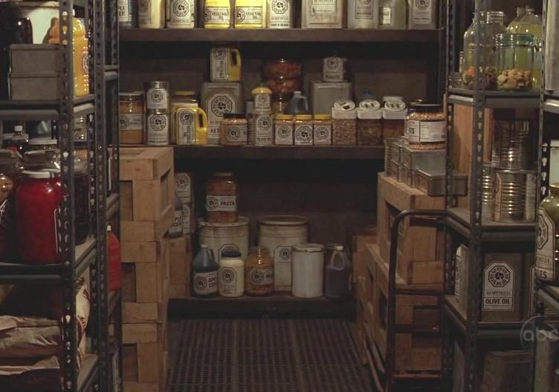
Food should be stored in a clean, dry location away from dust and other contaminants.
Never store food in these areas to prevent contamination:
Locker rooms or dressing rooms
Restroom or garbage rooms
Mechanical rooms
Under unshielded sewer lines or leaking water lines
Under stairwells

Slide 14
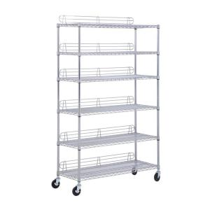
Supplies
Store all items in designated storage areas
Store items away from walls and at least six inches off the floor
Store single-use items (single use gloves) in original packaging

Slide 15
Containers
Store food in containers intended for food
Use containers that are durable, leak proof, and able to be sealed or covered
Never use empty food containers to store chemicals
Never put food in empty chemical containers

Slide 16
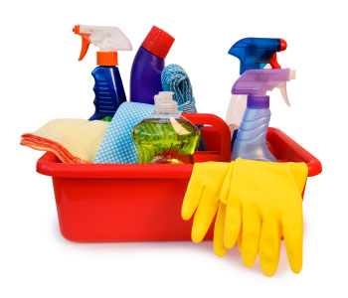
Cleaning
Keep all storage areas clean and dry. Clean floors, walls and shelving in coolers, freezers, dry-storage areas, and heated holding cabinets on a regular basis.
Clean dollies, carts, transports and trays often
Store food in containers that have been cleaned sanitized
Store dirty linens away from food. Store them in clean, nonabsorbent containers. They can also be stored in washable laundry bags.

Slide 17
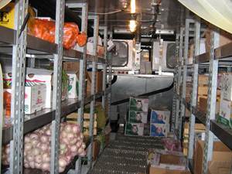
Wrap or cover food. Store raw meat, poultry and seafood separately from ready-to-eat food.
If can not be stored separately, store ready to eat food ABOVE raw meat, poultry and seafood. This prevents juices from raw food dripping onto ready to eat food.

Slide 18
Ready To Eat Food
Seafood
Whole cuts of beef and pork
Ground meat and ground fish
Whole and ground poultry

Slide 19
Meat
Store meat in its own storage unit or in the coldest part of the cooler.
Fresh meat should be held at internal temperature of 41°F or lower. Frozen meat should be held at a temperature that will keep it frozen.
It removed from its original packaging, wrap in airtight moisture-proof material or place it in clean and sanitized containers.
Primal cuts, quarters, sides of raw meat, and slab bacon can be hung on clean sanitized hooks or placed on sanitized racks.

Slide 20
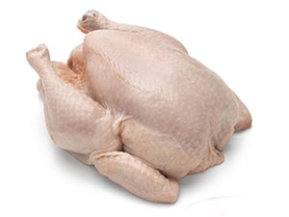
Poultry:
Store at an internal temperature of 41°F or lower. Store frozen poultry at temperatures that will keep it frozen.
If removed from original packaging, place it in airtight containers or wrap it in airtight material.
Ice-packed poultry can be stored in a cooler as is. Use self-draining containers. Change the ice and sanitize the container often.

Slide 21
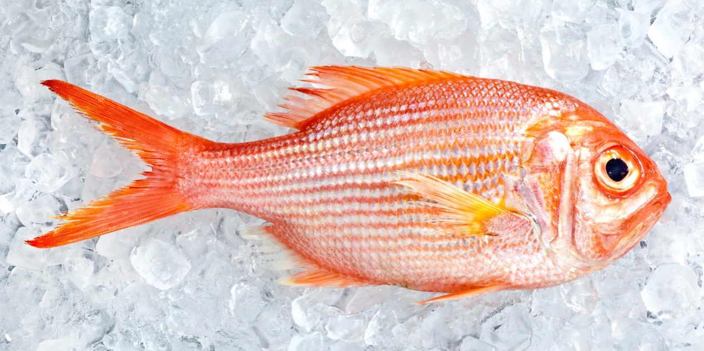
Fish
Store fresh fish at internal temperature of 41°F or lower
Keep fillets and steaks in original packaging, or tightly wrap them in moisture-proof materials.
Fresh, whole fish can be packed in flaked or crushed ice. Ice beds should be self-draining.
Store frozen fish at temperatures that will keep it frozen.

Slide 22
Shellfish
Store shucked shellfish at an internal temperature of 41°F or lower.
Store live shellfish in its original container at an air temperature of 41°F or lower.
You can store live shellfish, such as clams, oysters, mussels, and scallops in a display tank under one of two conditions:
The tank has a sign state that the shellfish are for display only
For shellfish served to customers, a variance has been obtained from the local regulatory authority that allows shellfish to eb served to customers.

Slide 23
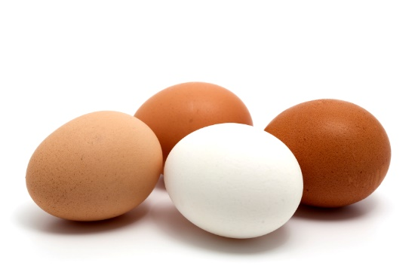
Eggs
Store shell eggs at an air temperature of 45°F or lower. Maintain constant temperature and humidity levels in coolers.
Do not wash shell eggs before storing them. They are washed and sanitized at the packing facility.
Plan to use all shell eggs within four to five weeks of the packing date.
Keep shell eggs in cold storage until the time they are used. Only take out as many as needed for immediate use.
Store frozen egg items at temperatures that will keep them frozen.
Store liquid eggs according to the manufacturer’s recommendations
Dried egg items can be stored in a cool storage area. Once reconstituted, store them in the cooler at 41°F or lower. Do not reconstitute more egf item that was is needed for immediate use.

Slide 24
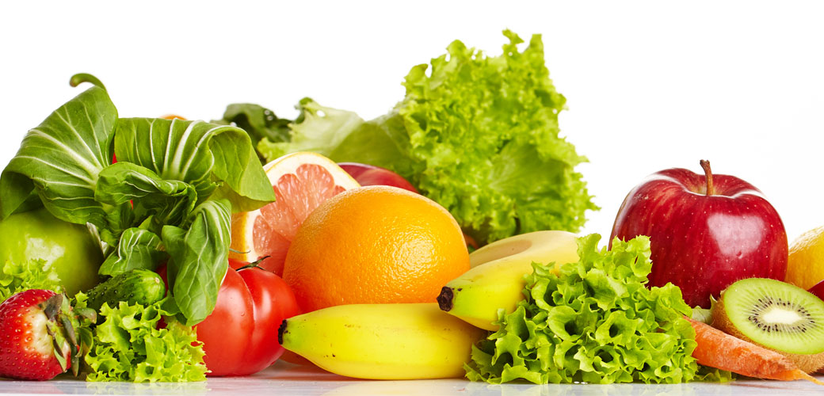
Fresh Produce
Cut melons, cut tomatoes and cut leafy greens are TCS food and need to be stored at 41°F or lower.
Other fruit and vegetables have various temperature requirements for storage. While many raw, whole fruit and vegetables can be stored at 41°F or lower, not all can be stored at this temperature. Work with your produce supplier to determine best storage methods for the items you purchase.

Slide 25
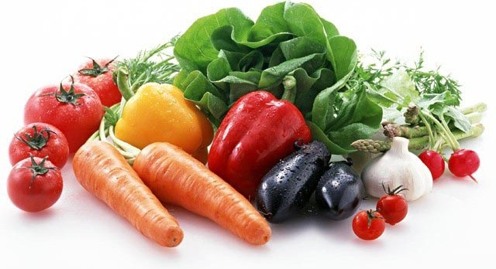
Fresh Produce
Fruit and vegetables kept in the cooler can dry out quickly. Keep the relative humidity at 85 to 95 percent.
Although most produce can be stored in the cooler, avocados, bananas, pears and tomatoes ripen best at room temperature.
Most produce should not be washed before storage. Moisture often promotes the growth o mold. Instead, wash produce before prepping or serving it.
When soaking or storing produce in standing water or an ice-water slurry, do no mix different items or multiple batches at the same time.
Store whole citrus fruit, hard-rind squash, eggplant and root vegetables—such as potatoes, sweet potatoes, rutabagas and onion—in a cool dry-storage area. Temperatures of 60°F to 70°F are best. Store onions away from other vegetables as other vegetables might absorb odor.

Slide 26
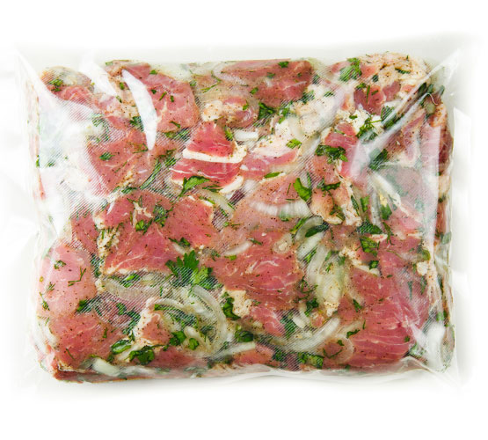
Reduce-Oxygen Packaged (ROP) food
Store at temperatures recommended by the manufacturer or at 41°F or lower. Frozen items should be stored at temperatures that will keep it frozen.
ROP items are especially susceptible to the growth of Clostridium botulinum. Throw away the package if it is torn or slimy, contain excessive liquid, or if the food item bubbles (which indicates the possible growth of clostridium botulinum).

Slide 27
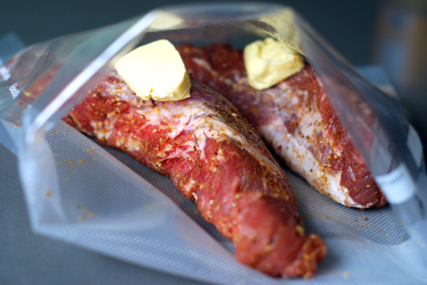
Reduce-Oxygen Packaged (ROP) food
Always check the expiration date before using ROP items.
Operators who package food in-hours using a ROP process need to follow specific rules for packaging and labeling.

Slide 28
UHT and Aseptically Packaged Food
Food that has been pasteurized at ultra-high temperatures (UHT) and aseptically packaged can be stored at room temperature.
Once opened, store food in the cooler at 41°F or lower.
Store UHT items that are not aseptically packaged at an internal temperature of 41°F or lower.

Slide 29
Canned Goods
Even canned food spoil over time. Higher storage temperatures may shorten shelf life.
Acidic food, like canned tomatoes, do no last as long as food that is low in acid. The acid can also form pinholes in the metal over time.
Discard damaged cans
Keep dry-storage areas dry. Too much moisture will cause cans to rust.
Wipe cans clean with a sanitized cloth before opening them. This will help prevent dirt from falling into the contents of the can.

Slide 30
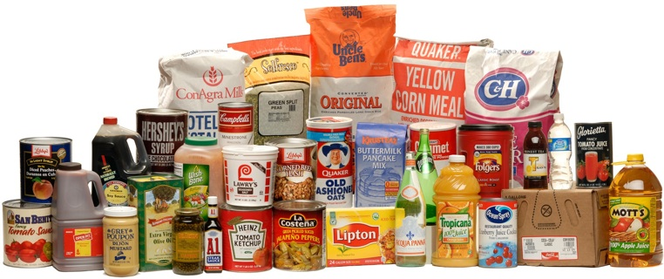
Dry Food
Keep flour, cereal, and grain items, such as pasta or crackers, in airtight containers.
They can quickly become stale in a humid room. They can also become moldy with too much moisture.
If stored in the correct conditions, salt and sugar can he held almost indefinitely.

