Slide 1
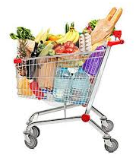
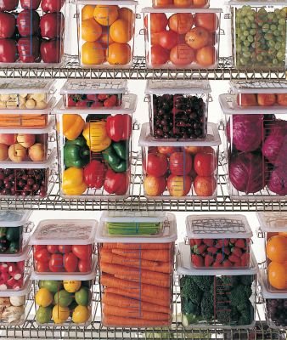
Chapter 6

Slide 2
Food must be purchased from an approved reputable supplier. For suppliers to be considered so, they must meet the following criteria:
Have been inspected and can show you an inspection report.
Must meet all applicable local, state and federal laws

Slide 3
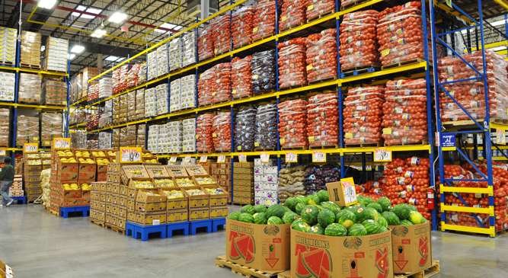
Your suppliers can include the following from the supply chain: growers, shippers, packers, manufacturers, distributors and local markets.
You need to develop a relationship with the suppliers, get to know their food safety practices and consider reviewing their most recent inspection report.

Slide 4
The inspection reports can be from the USDA, FDA or a third party inspector.
The inspection report should be based on Good Manufacturing Practices (GMP) or Good Agricultural Practices (GAP) and review the following areas:
Receiving and storage
Processing
Shipping
Cleaning & Sanitizing
Personal hygiene
Staff training
HACCP program or other food safety system

Slide 5
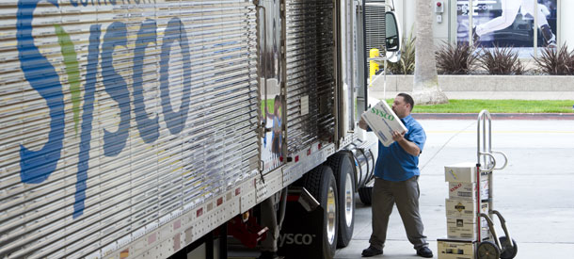
Suppliers must deliver food when staff has enough time to do inspections
Schedule deliveries at a time when they can be correctly received

Slide 6
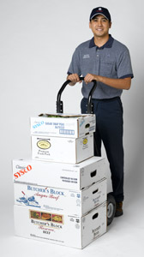
Make specific staff responsible for receiving. Train them to follow food safety guidelines, which include checking items for:
Correct temperatures
Expired code dates
Signs of thawing and refreezing
Pest damage

Slide 7
Provide staff with the tools they need, including purchase orders, thermometers, and scales.
Make sure enough trained staff are available to receive and inspect food items promptly.

Slide 8
Start by visually inspecting delivery trucks for signs of contamination
Then visually inspecting the food items and checking to make sure they have been received at the correct temperature.
Once inspected, food items must be stored as quickly as possible in the correct area, especially refrigerated and frozen items.

Slide 9
Some foodservice operations receive food after-hours when they are closed business, known as a key drop delivery
The supplier is given a key or other access to the operation to make the delivery, and they put the product in the coolers, freezers and dry storage areas

Slide 10
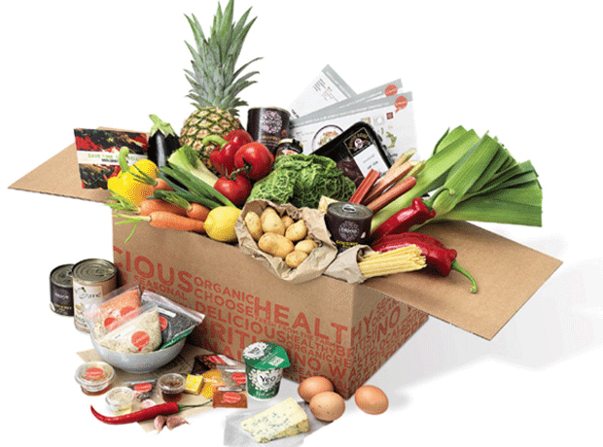
If you must reject an item, set it aside from the items you are accepting and tell the delivery person exactly what’s wrong it.
Make sure you get a signed adjustment or credit slip before giving the a item back to the delivery person. Log the incident on the invoice or the receiving document.

Slide 11
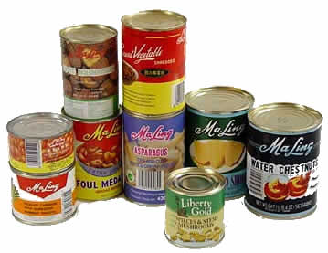
Occasionally you may be able to recondition and use items that would have been rejected.
Example: a shipment of cans with contaminated surfaces may be cleaned and sanitized, allowing them to be used. HOWEVER, the same cans could not be reconditioned if the contamination was the result of damage to the cans (i.e. the can is bulging or dented)

Slide 12
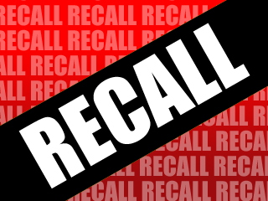
Food items you have received may sometimes be recalled by the manufacturer. This may happen when food contamination is confirmed or suspected. It can also occur when items have been mislabeled or misbranded.
Often food is recalled when food allergens have not been identified on the label.
Most vendors will notify you of the recall. However, you should also monitor recall notifications made by the FDA and the USDA.

Slide 13
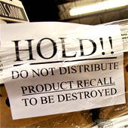
Identify the recalled food item by matching information from the recall notice.
Remove the item from inventory, and place it in a secure and appropriate location.
Label the item in a way that will prevent it from being placed back in inventory.
Refer to the vendor’s notification or recall notice for what to do with the item.

Slide 14
Use thermometers to check food temperatures during receiving
Meat poultry, and fish: Insert the thermometer stem or probe directly into the thickest part of the food.
ROP Food (Vacuum packed and sous vide food)- Insert thermometer stem or probe between two packages. If the package can be folded, fold around the thermometer stem or probe.
Other packaged food: Open the package and insert the thermometer stem or probe into the food.

Slide 15
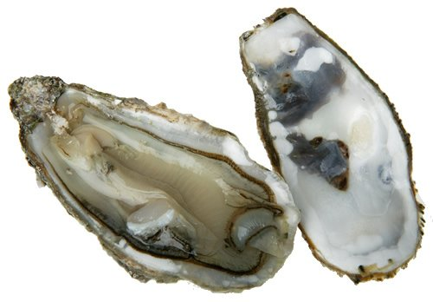
Deliveries should also meet the following temperature criteria:
Cold food: Receive at 41°F or lower
Live shellfish: Receive at air temperature of 45°F and an internal temperature no greater than 50°F. Must be cooled to 41°F or lower in four hours.
Shucked Shellfish: Receive at 45°F or lower. Cool the shellfish to 41°F or lower in four hours.

Slide 16
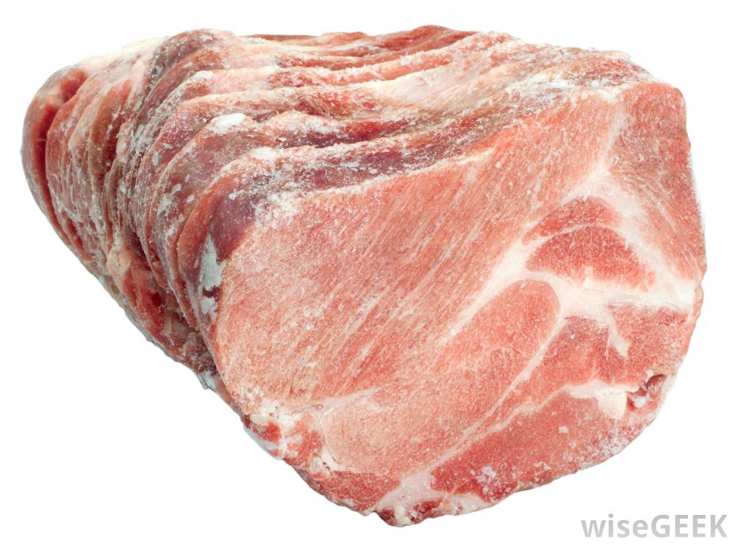
Shell eggs: Receive at an air temperature of 45°F or lower
Milk: Receive at 45 F then cooled to 41 F or lower in four hours
Hot food: Receive hot TCS food at 135°F or higher
Frozen food: Should be frozen solid when received
Reject frozen food for the following reasons:
Fluids or water stains appear in case bottoms or on packaging
There are ice crystals or frozen liquids on the food or the packaging. This may be evidence of thawing and refreezing, which shows the food has been time-temperature abused.

Slide 17
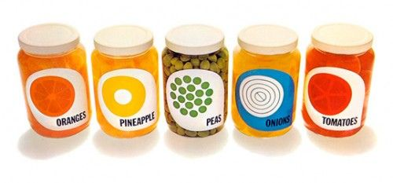
Both food items and nonfood items must be packaged correctly when you receive them.
Items should be delivered with their original packaging and manufacturer label.
The packaging should be intact, clean and protect food and food-contact surfaces.
Reject food and nonfood items if packaging has any of the following problems:

Slide 18
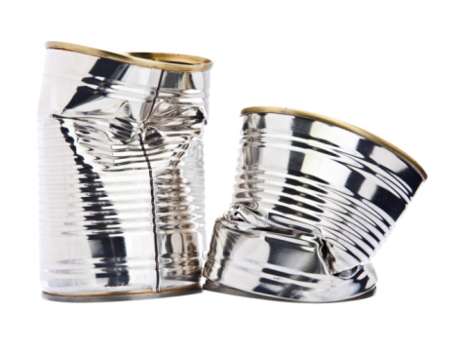
Damage
Reject items with tears, holes, or punctures in their packaging; reject cans with severe dents in the can seams, deep dents in the can body, missing labels, swollen or bulging ends, holes and visible signs of leaking or rust.
Items with broken cartons or seals, or items with dirty and discolored packaging should be rejected
Don’t accept cases or packages that appear to have been tampered with

Slide 19
Liquid
Reject items with leaks, dampness or water stains
Pests
Reject items with signs of pest or pest damage
Dates
Don’t accept food that is missing use-by or expiration dates from the manufacturer
Reject items that have passed their use-by or expiration dates

Slide 20
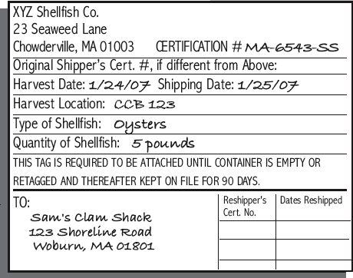
Food items must be delivered with the correct documents
Shellfish must be received with a shellstock identification tags. These tags
indicate when and where
the shellfish were harvested. They must be kept on file for 90 days from the date
the last shellfish was used from
its delivery container.

Slide 21
Fish that will be eaten raw or partially cooked must also be received with the correct documentation.
These documents must indicate the fish was correctly frozen before you received it. Keep these documents for 90 days from the sale of the fish.
If the fish was farm raised, it must have documentation that states the fish was raised to FDA standards. Documents must be kept for 90 days from sale of the fish.
90

Slide 22
Meat must be purchased from plants inspected by the USDA or a state department of agriculture.
“Inspected” does not mean that the product is free of pathogens. It means that the product and processing plant have met defined standards.
Carcasses and packages of meat that have been inspected will have an inspection stamp with abbreviations for “inspected and passed” by the inspecting agency, along with a number identifying the processing plant.

Slide 23
Poultry
Inspected by the USDA or the state department of agriculture in much the same way as meat
Liquid, frozen and dehydrated eggs
Must also have a USDA inspection mark. These types of eggs are required by law to be pasteurized.
Grading stamps might also appear on packages of eggs, meat and poultry. Grading of these types of products is voluntary and paid for by the processors and packers

Slide 24
Reject food that is moldy or has abnormal color.
Reject food that is received moist when it should be dry.
Reject meat, fish, or poultry that is slimy, sticky or dry. Also reject it if it has soft flesh that leaves an imprint when you touch it.
Reject food with an abnormal or unpleasant odor.

Slide 25
Certain types of food have specific criteria for accepting or rejecting it.

Slide 26
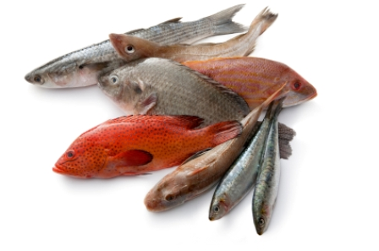
Accept Criteria
Reject Criteria
Color: bright red gills; bright shiny skin
Texture: firm flesh that springs back when touched
Odor: mild ocean or seaweed smell
Eyes: bright, clear, full
Packaging: product surrounded by crushed, self-draining ice
Color: dull gray gills; dull dry skin
Texture: soft flesh that leaves an imprint when touched
Odor: strong fishy or ammonia smell
Eyes: cloudy, red-rimmed, sunken
Product: tumors, abscesses, or cysts on the skin

Slide 27
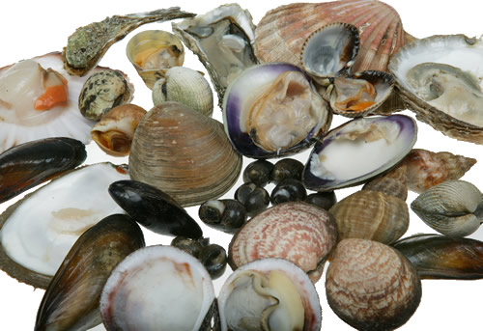
Accept Criteria
Reject Criteria
Odor: mild ocean or seaweed smell
Shells: closed and unbroken, indicating that the shellfish are alive
Condition: if fresh, they must be received alive
Texture: slimy, sticky or dry
Odor: strong fishy smell
Shells: excessively muddy or broken shells
Condition: dead on arrival (open shells that do not close when tapped)

Slide 28
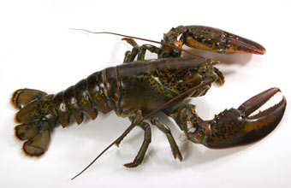
Accept Criteria
Reject Criteria
Odor: mild ocean or seaweed smell
Condition: shipped alive, packed in seaweed, and kept moist
Odor: strong fishy smell
Condition: dead on arrival

Slide 29
Accept Criteria
Reject Criteria
Color:
Beef: bright, cherry red; aged beef may be darker; vacuum-packed beef will appear purplish
Lamb: light red
Pork: light pink meat; firm, white fat
Texture: firm flesh that springs back when touched
Odor: no odor
Packaging: intact and clean
Color:
Beef: brown or green
Lamb: brown, whitish surface covering the lean meat
Pork: excessively dark color; soft or rancid fat
Texture: slimy, sticky, or dry
Odor: sour odor
Packaging: broken cartons; dirty wrappers; torn packaging; broken seals

Slide 30
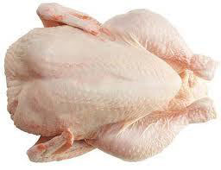
Accept Criteria
Reject Criteria
Color: no discoloration
Texture: firm flesh that springs back when touched
Odor: no odor
Packaging: should be surrounded by crushed, self-draining ice
Color: purple or green discoloration around the neck; dark wing tips (red are acceptable)
Texture: stickiness under the wings and around joints
Odor: abnormal, unpleasant odor

Slide 31
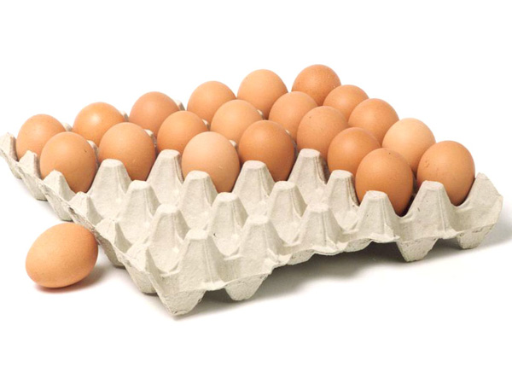
Accept Criteria
Reject Criteria
Odor: no odor
Shells: clean and unbroken
Odor: sulfur smell or off odor
Shells: dirty or cracked

Slide 32
Accept Criteria
Reject Criteria
Milk: sweetish flavor
Butter: sweet flavor; uniform color; firm texture
Cheese: typical flavor and texture; uniform color; clean and unbroken rind
Milk: sour, bitter, or moldy taste; off odor; expired sell-by date
Butter: sour, bitter, or moldy taste; uneven color; soft texture; contains foreign matter
Cheese: abnormal flavor or texture; uneven color; unnatural mold; unclean or broken rind

Slide 33
Accept Criteria
Reject Criteria
Temperature: varies according to product
Condition: varies according to product
Condition: evidence of mishandling or insects (including insect eggs and egg cases)
Spoilage: mold, cuts, wilting, unpleasant odors, discoloration, etc. (will depend on produce involved)

