Slide 1
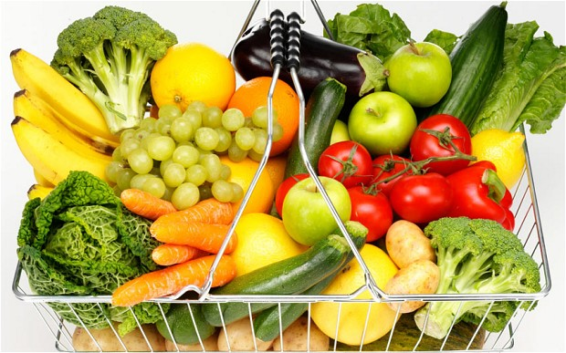
Chapter 5

Slide 2
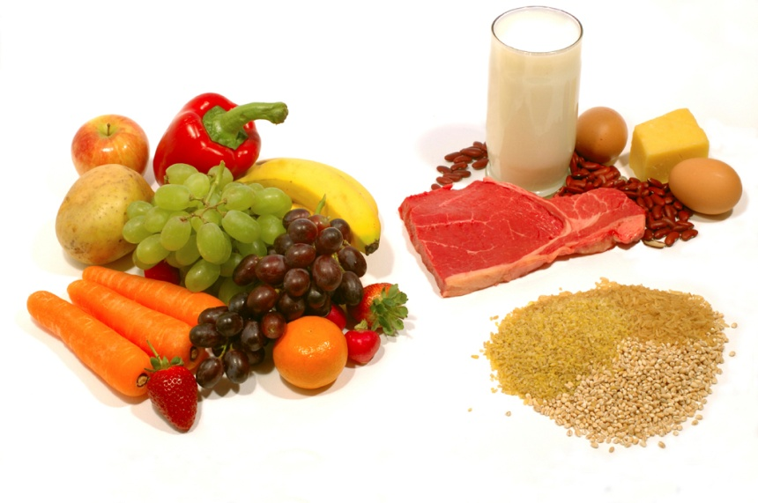
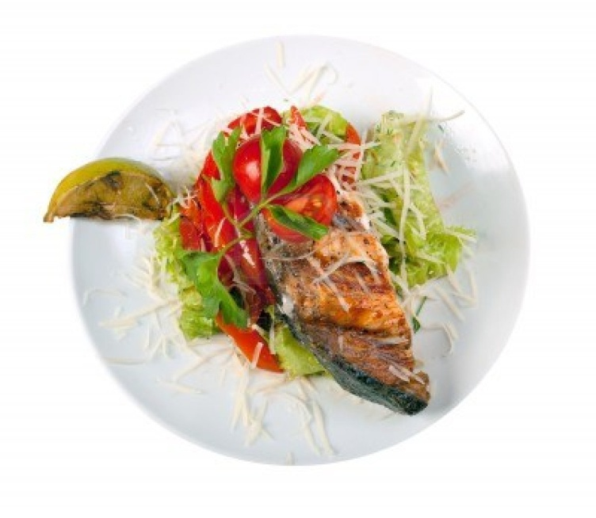
In the following four chapters (6-9), the flow of food will be looked at in depth.
Purchasing
Receiving
Storing
Preparation
Cooking
Holding
Cooling
Reheating
Serving

Slide 3
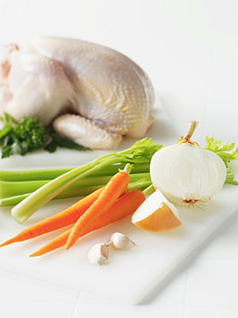
Cross contamination can happen at almost any point in the flow of food.
When you know how and where it can happen, it is fairly easy to prevent.
The most basic way is to keep raw and ready-to-eat food away from each other.
The following are guidelines to help prevent cross contamination.

Slide 4
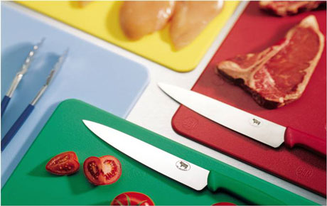
Each type of food should have separate equipment.
Colored cutting boards and utensil handles can help keep equipment separate.

Slide 5
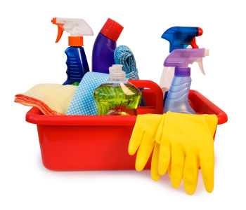
Clean and sanitize all work surfaces, equipment and utensils after each task.

Slide 6
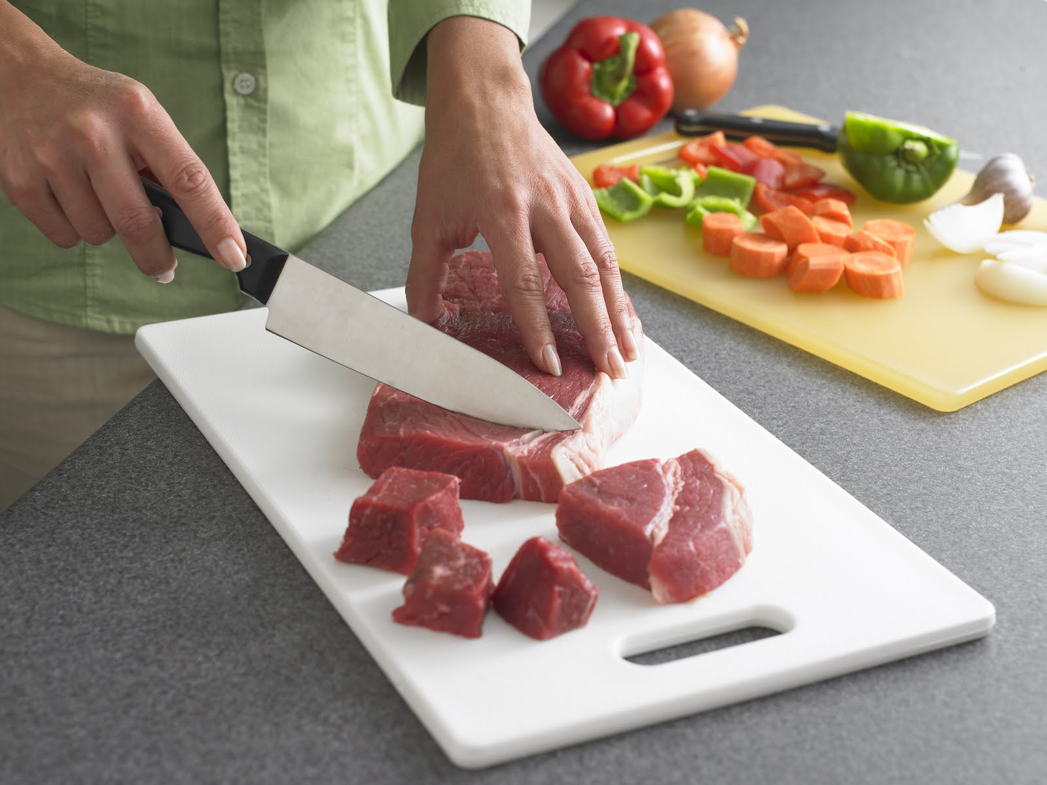
If you need to use the same table to prep different types of food, prep raw meat, fish and poultry; and ready-to-eat food at different times.
You must clean and sanitize work surfaces and utensils between each type of food.

Slide 7
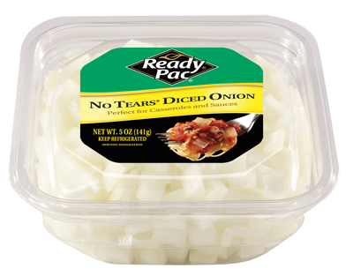
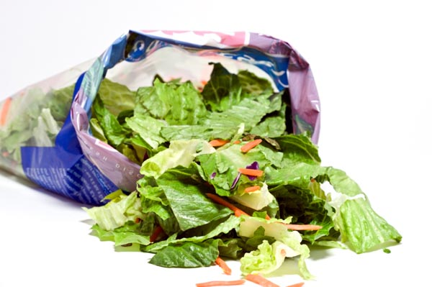
Buy food that doesn’t require much prepping or handling.
Ex. Chopped lettuce

Slide 8
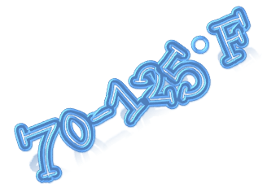
Pathogens grow well in the temperature danger zone: 41-135°F
Pathogens grow BEST in the range of 70-125°F
The longer food stays in the temperature danger zone, the more time pathogens have to grow.
If food is held in this range for more than 4 hours it must be thrown out.

Slide 9
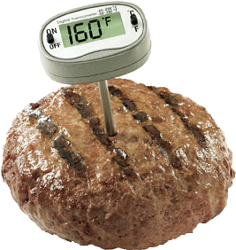
Food is being temperature abused whenever it is handled in the following ways
Cooked to the wrong internal temperature
Held at the wrong temperature
Cooled or reheated incorrectly

Slide 10
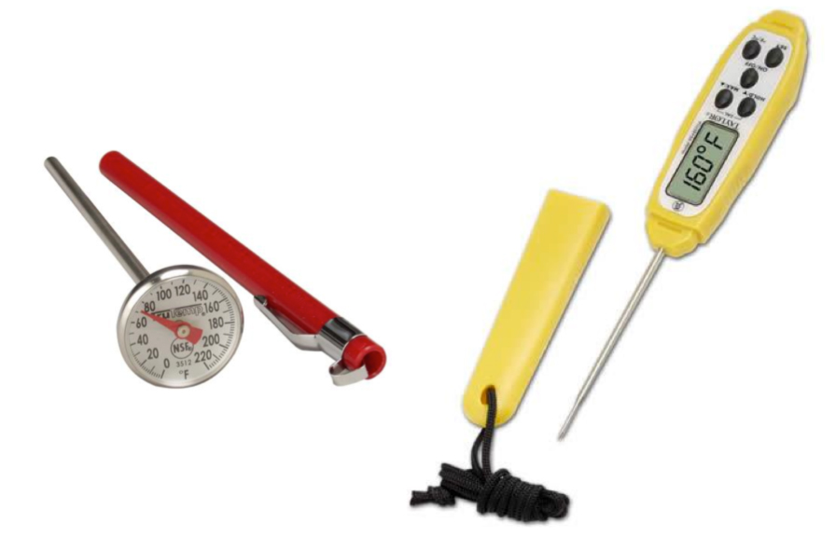
The most important tool you have to monitor temperature is the thermometer.
Three types are commonly used in operations
Bimetallic stemmed thermometer
Thermocouples
Thermistors

Slide 11
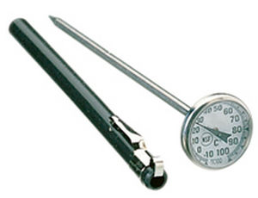
Can check temps 0°F-220°F
This makes it useful to check the temperature during the flow of food; receiving and cooking temps of food
Takes the temperature
through the metal stem

Slide 12
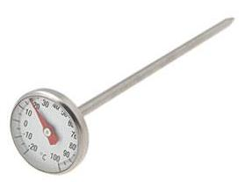
The sensing area of thermometer is from the tip to the dimple
Insert stem into the food up to the dimple
Good for thick or large food; not practical for thin food (like hamburger patties)

Slide 13
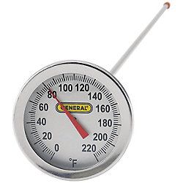
Must Have Features:
Calibration nut: You can adjust the thermometer to make it accurate by using its calibration nut
Easy-to-read markings: Clear markings reduce the chance that someone will misread the thermometer. The thermometer must be scaled in at least two-degree increments.
Dimple: The dimple is the mark on the stem that shows the end of the temperature sensing area

Slide 14
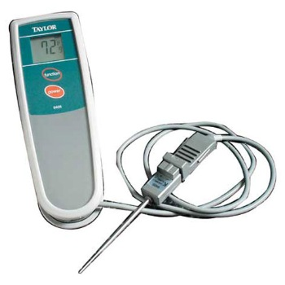
Measures temperatures through a metal probe
Temperatures are displayed digitally
Sensing area is on the tip of the probe; this means you don’t have to insert them into the food as far as bimetallic stemmed thermometers to get a correct reading.
Good for both thick & thin foods
Come in several styles and sizes; also comes with different probes

Slide 15
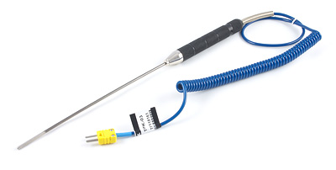
Immersion probe
Use these to check the temperature of liquids. This could include soups, sauces and frying oil

Slide 16
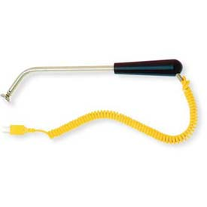
Surface probe
Use these to check the temperature of flat cooking equipment, such as griddles

Slide 17
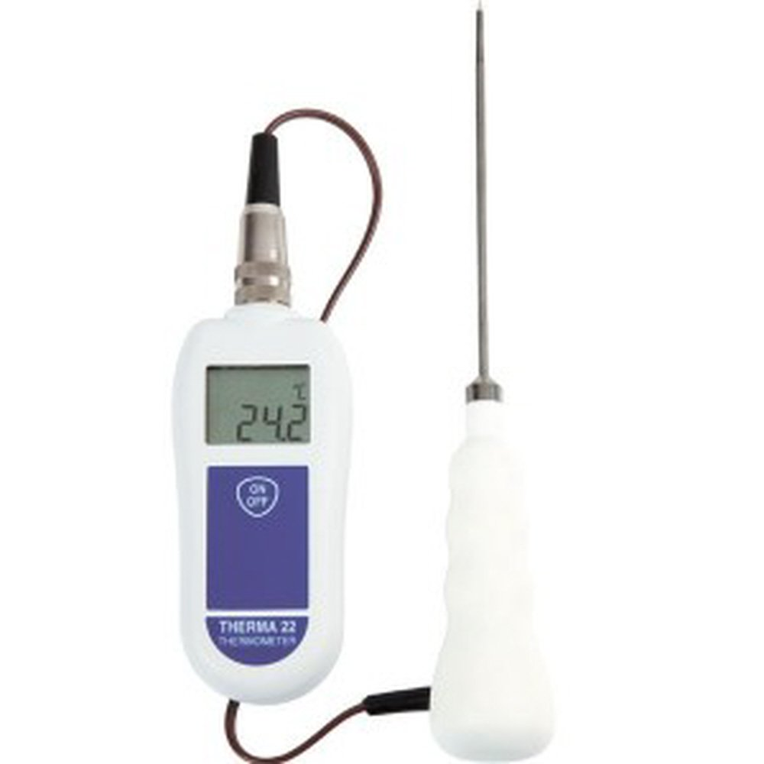
Penetration probe
Use these to check the internal temperature of food. They are especially useful for check the temperatures of thin food, such as hamburger patties or fish fillets

Slide 18
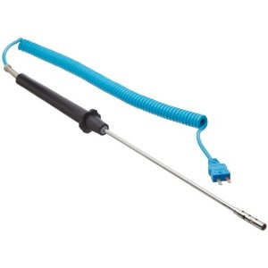
Air probe
Use these to check the temperature inside coolers and ovens

Slide 19
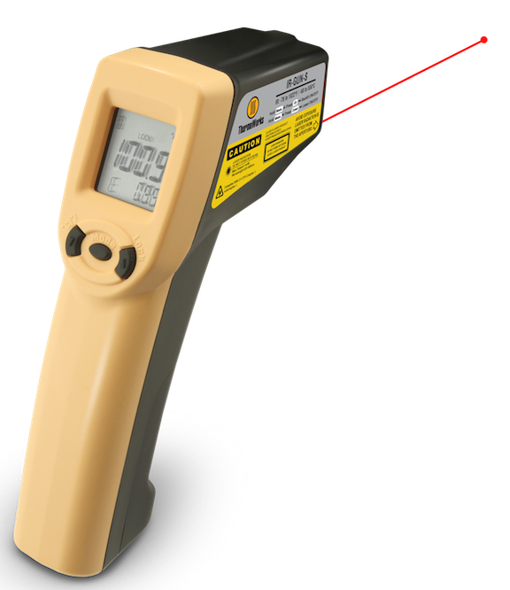
Infrared thermometers measure the temperatures of food and equipment surfaces
Quick & easy to use
Does not need to touch a surface to check its temperature; means less chance for cross contamination and damage to food
CAN NOT measure air temperature or internal temperatures of food

Slide 20
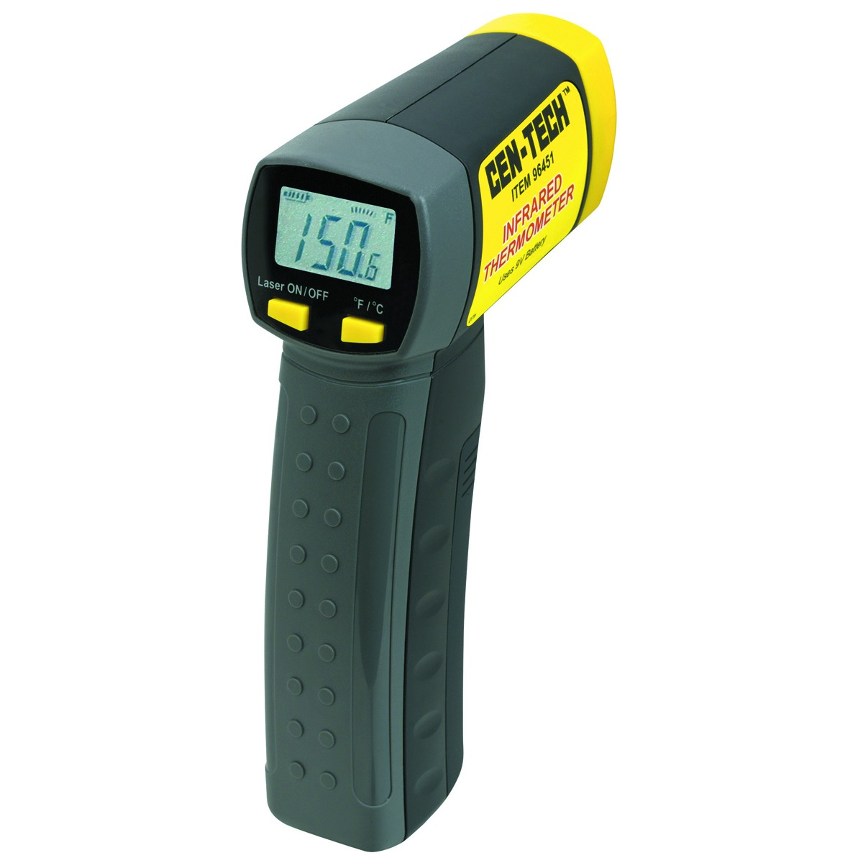
Guidelines to follow when using:
Hold the thermometer as close to the food or equipment as you can without touching it
Remove anything between the thermometer and the food, food package or equipment.
Do NOT take readings through metal, such as stainless steel or aluminum
Do NOT take readings through glass

Slide 21
Maximum Registering Thermometer
This thermometer indicates the highest temperature reached during use and is used where temperature readings cannot be continuously observed.
It works well for checking final rinse temperatures of dishwashing machines.

Slide 22
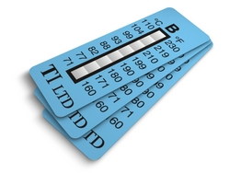
Time Temperature Indicator (TTI)
These tags are attached to packaging by the supplier.
A color change appears in the window if the food has been time-temperature abused during shipment or storage.
This color change is not reversible, so you know if the food has been abused.

Slide 23
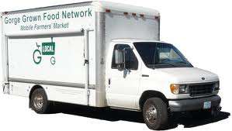
Some suppliers place temperature-recording devices inside their delivery trucks.
These devices constantly check and record temperatures.
You can check the device during receiving to make sure the food was at safe temperatures while it was being shipped.

Slide 24
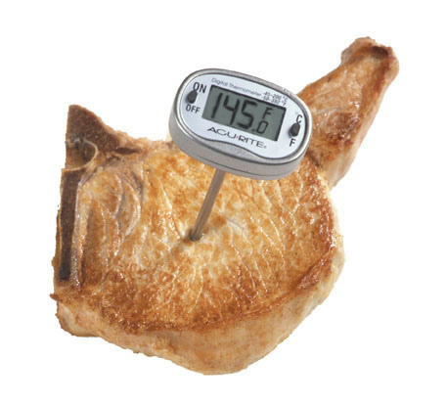
Cleaning & Sanitizing
Thermometers must be washed, rinsed, sanitized and air dried
Keep storage cases cleaned too
Do these things before and after using thermometers to prevent cross contamination

Slide 25
Calibration
Thermometers can lose their accuracy when they are bumped or dropped. It can also happen when they go through severe temperature change.
When this happens, the thermometer must be calibrated, or adjusted, to give a correct reading.
Calibrate regularly; before each shift; before the first delivery arrives
Some thermometers can not be calibrated and must be replaced, while others have to be sent back to the manufacturer for calibration

Slide 26
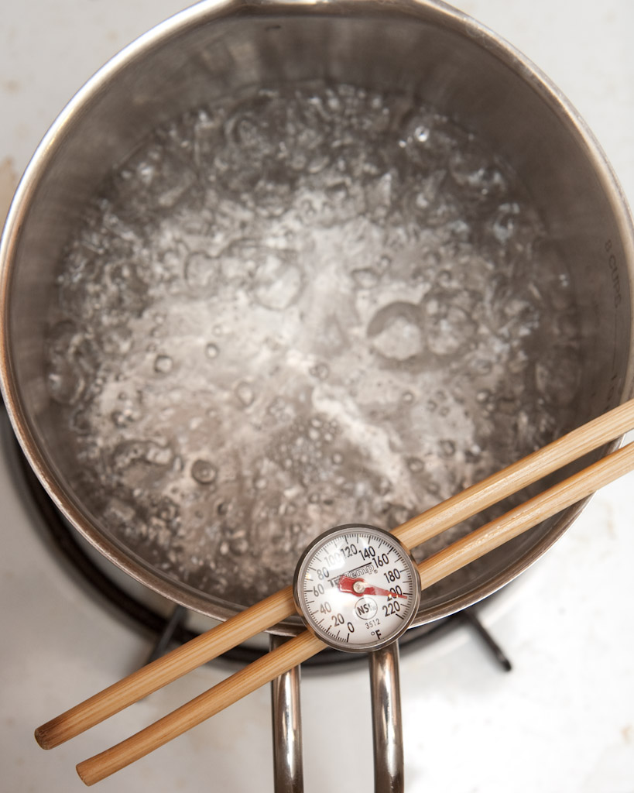
Boiling Point Method
Ice Point Method

Slide 27
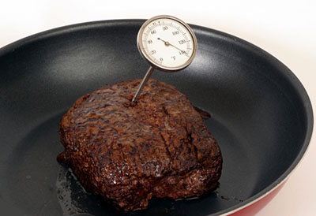
Accuracy
Thermometers that measure the temperature of food must be accurate to + or - 2°F
Thermometers that measure the temperature of air must be accurate to + or - 3°F

Slide 28
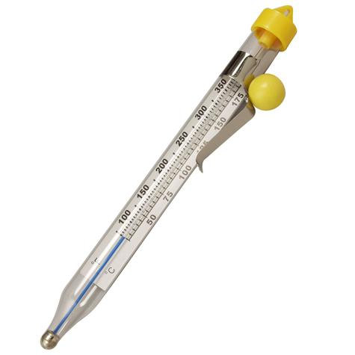
Glass thermometers
Glass thermometers, such as candy thermometers, can be a physical contaminant if they break.
They can only be used when enclosed in a shatterproof casing.

Slide 29
Checking temperatures
Insert the probe into the thickest part of the food, which is usually center.
Take a second reading in a different spot. The temperature my vary in different areas.
Before recording a temperature, wait for the thermometer reading to steady. Digital thermometers will display the temperature instantly while bimetallic stemmed thermometers need at least 15 seconds to get to the temperature of the food

