Slide 1
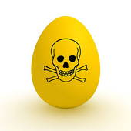
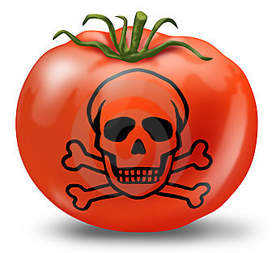
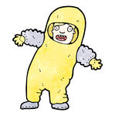

Slide 2
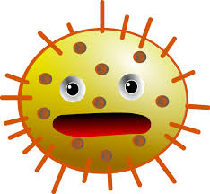
Microorganisms- small, living organisms that can be seen only through a microscope. Many are harmless, but some can cause illness.
Pathogens= Harmful microorganisms
Some pathogens make you sick when you eat them, while others produce poisons—or toxins—that make you sick

Slide 3
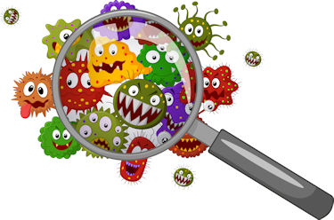
The four types of pathogens that can contaminate food are:
Viruses
Bacteria
Parasites
Fungi

Slide 4
Contamination- the presence of harmful substances (biological, chemical or physical) in food
Can be contaminated on purpose, but most cases are accidents.

Slide 5
Most pathogens get into food and onto food-contact surfaces because of the way people handle them.
Food handlers can also pass on pathogens when they are in contact with a person who is sick. Some pathogens are passed very easily in these ways:
From person to person
Through sneezing or vomiting onto food or food-contact surfaces
From touching dirty food-contact surfaces and equipment and then touch food

Slide 6
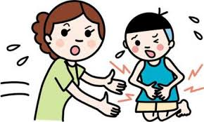
Diarrhea
Vomiting
Fever
Nausea
Abdominal cramps
Jaundice- yellowing of the skin and eyes

Slide 7
Not every person will have all of the symptoms listed.
Nor are the symptoms of a foodborne illness limited to this list
Onset times (how quickly symptoms appear in a person) depend on the type of foodborne illness. Range 30 min- 6 weeks
Severity can vary from diarrhea to death

Slide 8
The Big Six
According to the Food and Drug Administration, there are over 40 kinds of bacteria, viruses, parasites and molds that can occur in food and cause a foodborne illness.
Of these, five have been singled out by the FDA and been dubbed “the big 6” because they are highly infectious.

Slide 9
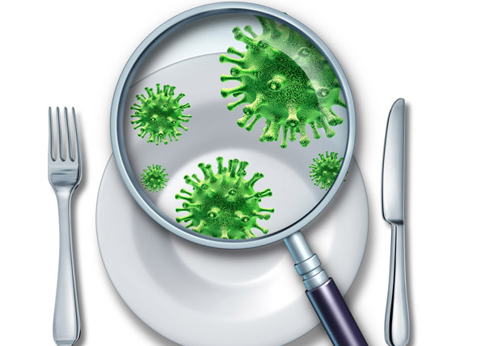
The Big Six
Shigella spp.
Salmonella Typhi
Nontyphoidal Salmonella
Enterohemorrhagic and shiga toxin E.coli
Hepatitis A
Norovirus

Slide 10
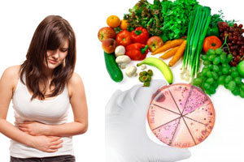
The Big Six
These pathogens are often found in very high numbers in an infected person’s feces and can be transferred to food easily.
Food handlers diagnosed with illnesses from these big five pathogens cannot work in a foodservice operation while they are sick.

Slide 11
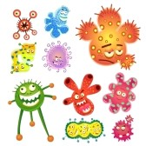
Location
Can be found almost anywhere
Live in our bodies
Some keep us healthy, while others cause illness

Slide 12
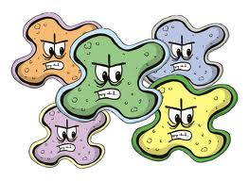
Detection
Can’t be seen
Can’t be smelled
Can’t be tasted

Slide 13
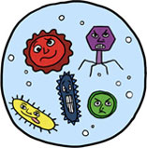
Growth
Grows rapidly if FAT TOM conditions are right (as described on the next few slides)

Slide 14
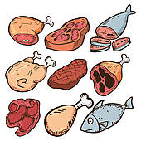
Most bacteria need nutrients such as carbohydrates or proteins to survive.
TCS food supports the growth of bacteria better than other types of food. This includes meat, poultry, dairy products and eggs.

Slide 15
Bacteria grow best in food that contains little or no acid.
They grow best in pH range neutral to slightly acidic, scale of 7.5-4.6
Examples of foods with an ideal pH reading for bacteria growth:
Bread: 5.0-6.0
Raw chicken: 5.5-6.0
Cantaloupe: 6.1-6.5
Milk: 6.4-6.8
Cooked corn: 7.3-7.6

Slide 16
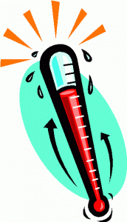
Bacteria grow rapidly between 41°F-135°F, which is also known as the temperature danger zone
Bacteria grow even more rapidly from 70°F-125°F.
Bacteria growth is limited when food is held above or below the temperature danger zone.

Slide 17
Bacteria need time to grow.
The more time bacteria spend in the temperature danger zone, the more opportunity they have to grow to unsafe levels.

Slide 18
Some bacteria need oxygen to grow.
Others grown when oxygen is not there.
Bacteria that grow without oxygen can occur in cooked rice, untreated garlic-and-oil mixtures, and temperature-abused baked potatoes

Slide 19
Bacteria grow well in food with high levels of moisture.
The amount of moisture available in food for this grown is called water activity. The scale ranges from 0.0 to 1.0 (water itself being 1.0).
Food with a water activity of .85 or higher is ideal for the growth of bacteria.

Slide 20
Toxin Production:
Some bacteria produce toxins in food as they grow and die.
People who eat the toxins can get sick.
Cooking may not destroy these toxins.

Slide 21
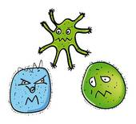
Prevention
CONTROL TIME AND TEMPERATURE

Slide 22
Bacterial growth can be broken into four progressive stages or phases:
Lag
Log
Stationary
Death

Slide 23
Bacteria that are introduced to food go through an adjustment period called the lag phase.
Their number is stable as they get ready to grow.
To prevent food from becoming unsafe, prolong the lag phase by controlling the conditions for growth: temperature, time, oxygen, moisture and pH. You have the most control over time and temperature.

Slide 24
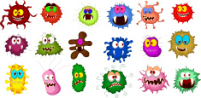
Bacteria reproduce by splitting in two.
Under the correct conditions, they can double as often as every 20 minutes.

Slide 25
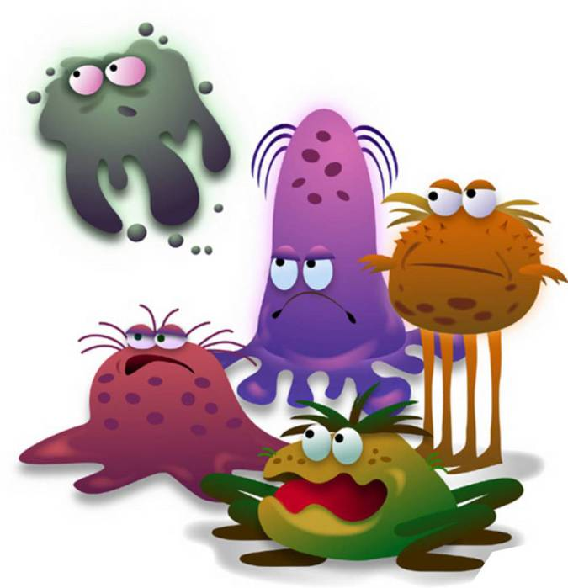
Bacteria can continue to grow until conditions become unfavorable.
Eventually the grow and die at the same rate.

Slide 26
When dying bacteria outnumber growing bacteria, the population declines.

Slide 27
To keep from dying when they lack nutrients, certain bacteria can change into a form called a spore.
Spores are often found in dirt and can contaminate food grown there, such as potatoes, other vegetables and rice.
They can also contaminate meat, poultry, fish, and other food exposed to dirt or dust.

Slide 28
Spores can resist heat and survive cooking temperatures.
They can also change back into a form that grows.
You can prevent this by storing food at the correct temperature. You also need to hold and cool food correctly.

Slide 29
The FDA has identified 3 types of bacteria that are highly contagious and can cause severe illness.
Food handlers diagnosed with illnesses from these bacteria can NEVER work in a food service operation while sick.

Slide 30
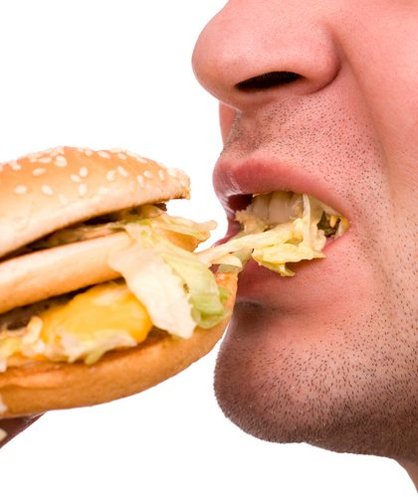
Only lives in humans
Eating only a small amount can make a person sick.
Severity of symptoms depends on the health of a person
Can live in a person’s feces for weeks after symptoms have ended

Slide 31
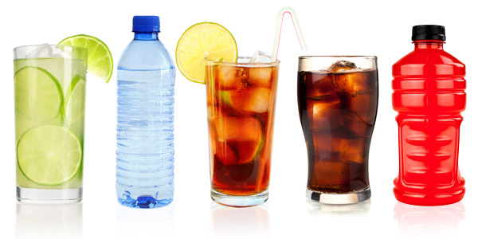
Food linked with bacteria
Ready-to-eat food
beverages
Prevention Measures
Exclude food handlers who have been diagnosed
Wash hands
Cook food to minimum internal temperatures

Slide 32
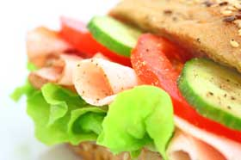
Found in the feces of humans with the illness
Flies can transfer the bacteria from feces to food
Eating only a small amount can make a person sick
High levels of the bacteria are often in a person’s feces for weeks after symptoms have ended

Slide 33
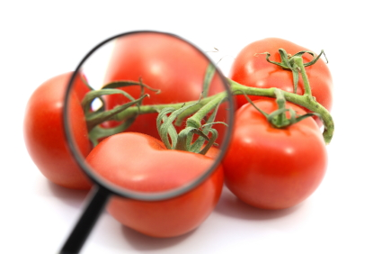
Food linked with bacteria
Foods that is easily contaminated by hands
Food that has made contact with contaminated water, such as produce
Prevention Measures
Exclude food handlers who have been diagnosed
Exclude food handlers who have diarrhea
Wash hands
Control flies inside and outside of the operation

Slide 34
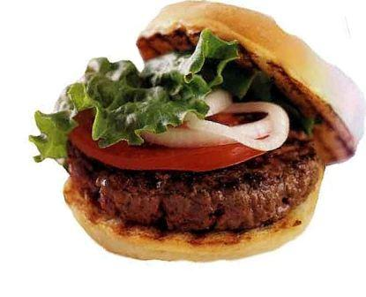
Can be found in the intestines of cattle
Also found in infected people
Can contaminate meat during slaughtering
Eating only a small amount can get you sick
Once eaten, produces toxins in the intestines, which causes the illness.
Bacteria often found in a person’s feces for weeks after symptoms have ended

Slide 35
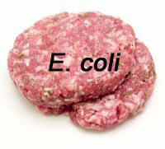
Food linked with bacteria
Ground beef (raw and undercooked)
Contaminated produce
Prevention Measures
Exclude food handlers who have been diagnosed
Cook food to minimum internal temperatures
Purchase produce from approved, reputable suppliers
Prevent cross-contamination between raw meat and ready-to-eat food

Slide 36
The following slides are other bacteria that can cause foodborne illnesses.

Slide 37
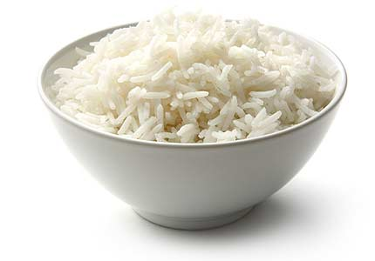
A spore-forming bacteria found in dirt.
Can produce two different toxins when allowed to grow to high levels.
Prevention Measures: Cook food to minimum internal temperatures, hold and cool food correctly
Food commonly linked to: cooked vegetables, meat products, milk and cooked rice dishes

Slide 38
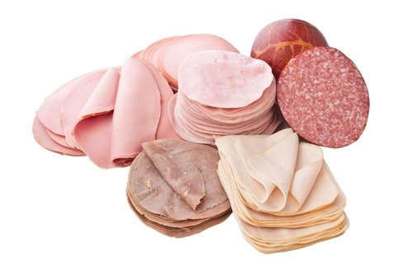
Found in dirt, water, and plants.
Grows in cool, moist environments.
Illness is uncommon in healthy people, but high-risk populations are especially vulnerable- particularly pregnant women (causes miscarriage).
Prevention measures: Throw out any product passed its used-by date or expiration date, cook raw meat to minimum internal temperatures, prevent cross contamination, avoid using unpasteurized dairy products.
Food linked to: raw meat, unpasteurized dairy products, ready to eat food such as deli meat, hot dogs and soft cheeses.

Slide 39
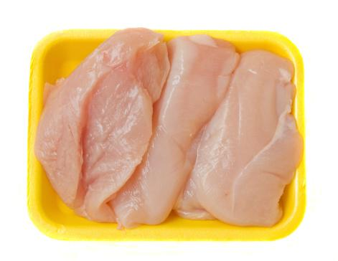
Prevention Measures: cook food, particularly poultry, to required minimum internal temperatures; prevent cross-contamination between raw poultry and ready-to-eat food
Food commonly linked to: poultry, contaminated water, meats, stews/gravies

Slide 40
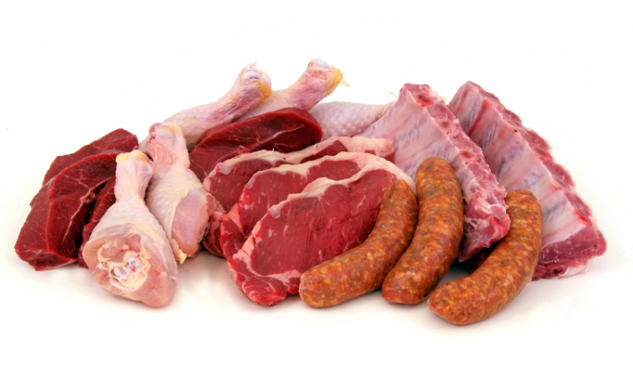
Found in dirt, where it forms spores that allow it to survive.
Carried in the intestines of both animals and humans.
Prevention Measures: Cool and reheat food correctly, hold food at correct temperatures
Food commonly linked to: meat, poultry, dishes made with meat and poultry such as stews and gravies

Slide 41
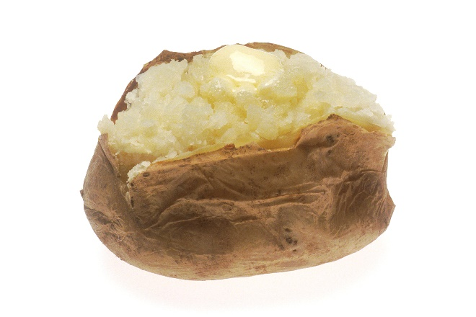
Illness: Botulism
Grows without oxygen and can produce a lethal toxin when food is time-temperature abused. Without medical treatment, death is likely
Prevention measures: hold, cool and reheat food correctly; inspect canned food for damage
Food commonly linked to: incorrectly canned food, reduced-oxygen packed food, temperature abused vegetables (like baked potatoes), untreated garlic-and-oil mixtures

Slide 42
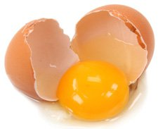
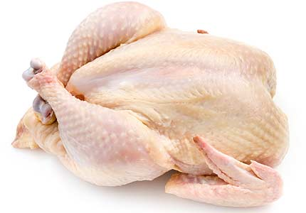
Many farm animals carry Salmonella spp. naturally.
The bacteria is often in a person’s feces for weeks after symptoms have ended.
Prevention Measures: cook poultry and eggs to a minimum internal temperatures; prevent cross contamination; keep food handlers who have been diagnosed out of the operation
Food commonly linked to: poultry, eggs, dairy products and produce

Slide 43
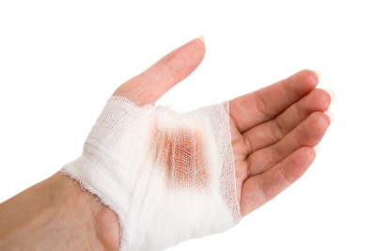
Can be found in humans—particularly in the hair, nose, and throat; and in infected cuts
Often transferred to food when people carrying it touch these areas on their bodies and then handle food without washing their hands
Cooking cannot destroy these toxins, so preventing bacterial growth is critical
Prevention measures: wash hands, particularly after touching the hair, face or body; cover wounds on hands and arms; hold, cool and reheat food correctly
Food Commonly linked to: salads contained TCS food, deli meat

Slide 44
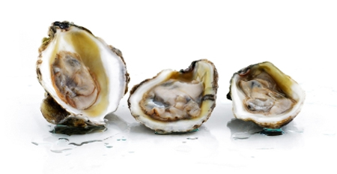
Found in waters where shellfish are harvested
Can grow rapidly at temperatures in the middle of the temperature danger zone
Prevention measures: cook oysters to minimum internal temperatures
Food Commonly linked to: oysters from contaminated water

Slide 45
Location
Carried by humans and animals
Require a living host to grow
While they do not grow in food, viruses can be transferred through food and remain infectious in food

Slide 46
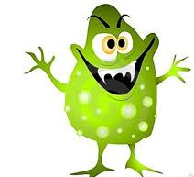
Sources
You can get a virus from food, water or any contaminated surface
Foodborne illnesses caused by viruses typically occur through fecal-oral routes

Slide 47
Transfer
Can be transferred from person to person, from people to food and from people to food-contact surfaces
When a customer gets a virus it usually because their food was handled by an infected person, which that person could be:
Food handler at the operation
Staff member of the food manufacturer
Anyone else who has the virus
People carry viruses in their feces and transfer them to their hands after using the restroom.

Slide 48
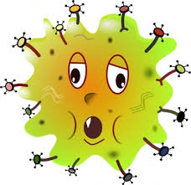
Prevention Measures
Viruses are not destroyed by normal cooking temps
Important to practice good personal hygiene when handling food and food-contact surfaces
Quick removal of vomit is also important

Slide 49
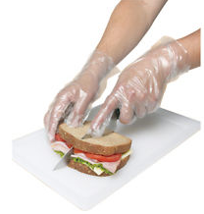
Prevention Measures
Best ways to prevent the spread of viruses:
Prohibit food handlers who are vomiting or who have diarrhea or jaundice from working
Make sure food handlers wash their hands regularly and correctly
Avoid bare-hand contact with ready-to-eat food

Slide 50
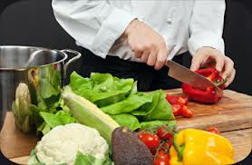
Mainly found in the feces of people infected with it
Can contaminate water and many types of food
The virus is often transferred to food when infected food handlers touch food or food equipment with fingers that have feces on them
Cooking does not destroy

Slide 51
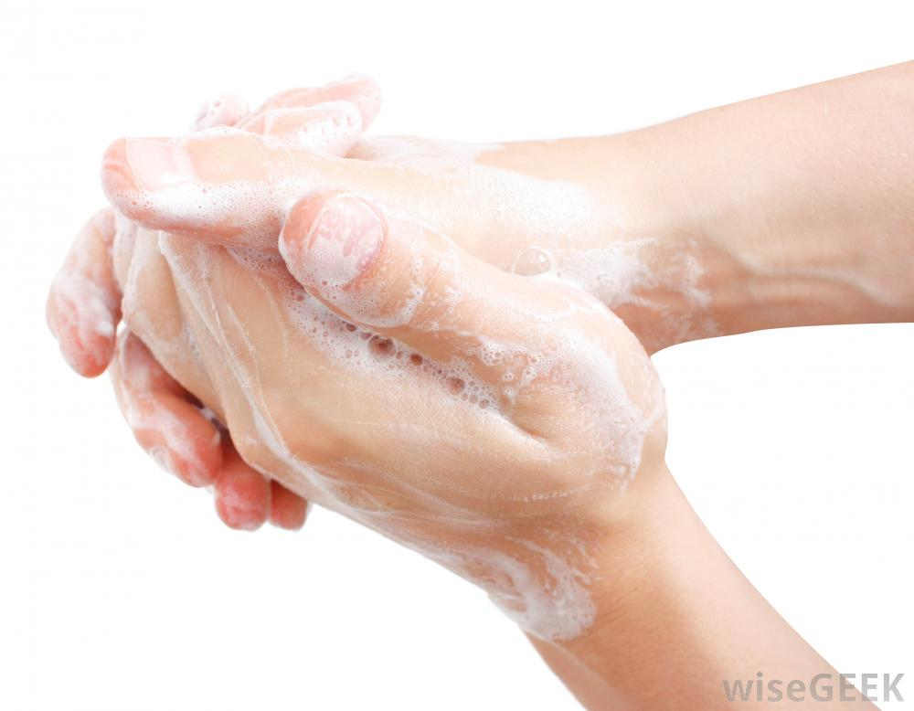
Food Linked with the Virus
Ready-to-eat food
Shellfish form contaminated water
Prevention Measures
Exclude staff who have been diagnosed
Exclude staff who have jaundice
Wash hands
Avoid bare-hand contact with ready-to-eat food
Purchase shellfish from approved, reputable suppliers

Slide 52
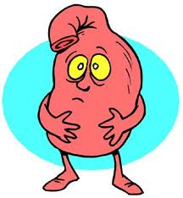
Often transferred to food when infected food handlers touch food or equipment with fingers that have feces on them
Eating only a small amount can make you sick
People become contagious within a few hours after eating it
The virus is often in a person’s feces for days after symptoms have ended.

Slide 53
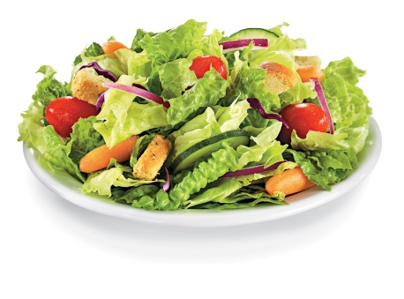
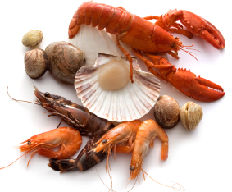
Food linked with the Virus
Ready-to-eat food
Shellfish from contaminated water
Prevention Measures
Exclude staff who have been diagnosed
Exclude staff with diarrhea and vomiting from the operation
Wash hands
Avoid bare-hand contact with ready to eat food
Purchase shellfish from approved, reputable suppliers

Slide 54
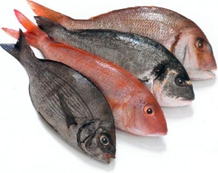
Location
Require a host to live and reproduce
CAN NOT GROW IN FOOD
Sources
Commonly associated
Seafood
Wild game
Food processed with contaminated water, such as produce

Slide 55
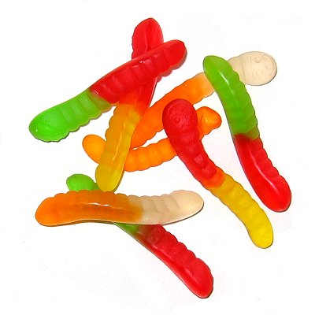
Prevention
Most important way to prevent a foodborne illness by a parasite is to purchase food from approved, reputable suppliers.
Cooking food to required minimum internal temperatures is also important.
Make sure that fish that will be served raw or undercooked has been correctly frozen by the manufacturer

Slide 56
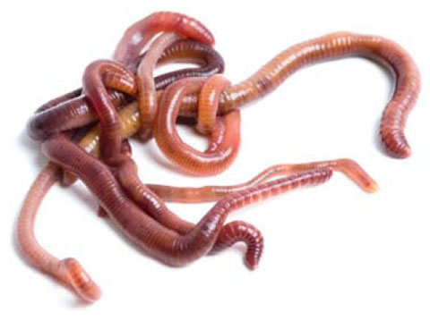
Food commonly linked to: Raw and undercooked fish, cod, herring, halibut, mackerel, pacific salmon
Most common symptoms: Tingling in throat, coughing up worms
Prevention measures: cook fish to minimum internal temperatures, if serving raw or undercooked fish, purchase sushi grade fish that has been frozen to the correct time-temperature requirements.

Slide 57
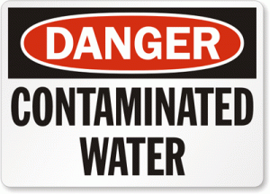
Can be found in feces of infected people
Daycare and medical communities have been frequent locations of person-to-person spread of this parasite
Food commonly linked to: contaminated water, produce
Prevention measures: use correctly treated water, keep food handlers with diarrhea out of the operation, wash hands

Slide 58
Can be found in the feces of infected people
Food commonly linked: incorrectly treated water, produce
Prevention measures: use correctly treated water, keep food handlers with diarrhea out of the operation, wash hands

Slide 59
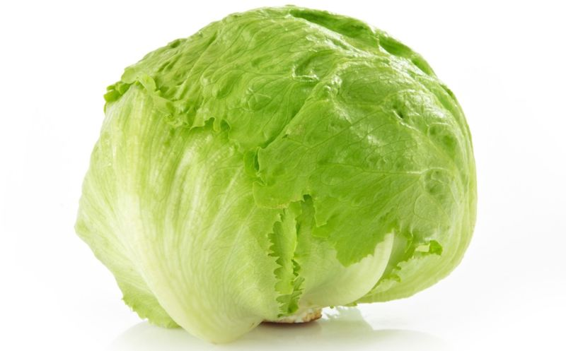
Found in contaminated water and has been associated with produce irrigated or washed with contaminated water. Can also be found in the feces of infected people.
Food commonly linked: incorrectly treated water, produce such as berries, lettuce or basil
Prevention measures: Purchase produce from approved reputable suppliers, keep food handlers with diarrhea out of the operation, wash hands

Slide 60
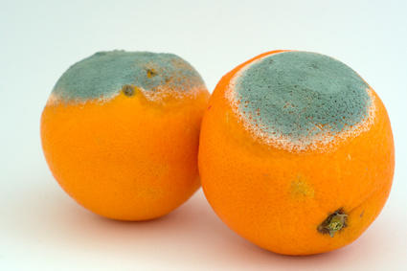
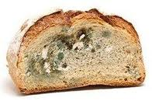
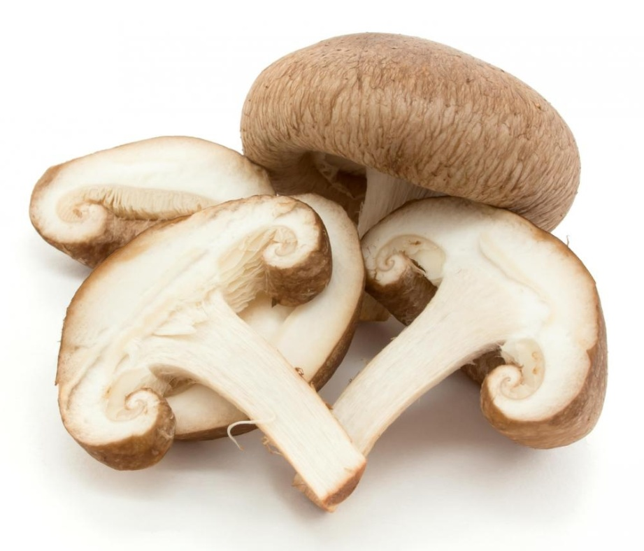
Fungi includes yeasts, molds, and mushrooms
Throw out all moldy food, unless the mold is a natural part of the food
Because mushrooms are difficult to recognize, you must purchase all mushrooms from approved, reputable suppliers.

Slide 61
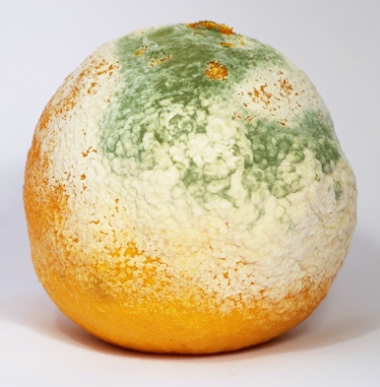
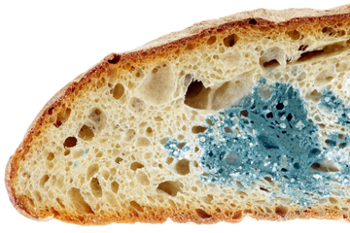
Molds spoil food and sometimes cause illness
Some molds produce toxins, such as aflatoxins
Molds grow under almost any condition. They grow particularly well in acidic food with low water activities like jams, jellies and cured, salty meat.
Cooler or freezer temperatures may slow the growth of molds, but they do not kill them
Some molds produce toxins that can cause allergic reactions, nervous system disorders and kidney and liver damage.

Slide 62
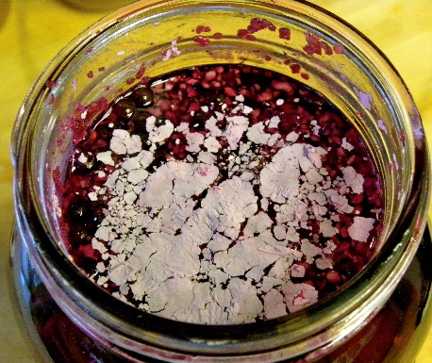
Yeasts can spoil food quickly.
Signs of spoilage can include a smell or taste of alcohol. They yeast itself may look a white or pink discoloration or slime and may bubble
Grow well in acidic food with little moisture, such as jellies, jams, syrup, honey and fruit or fruit juice

Slide 63
Origin
Natural part of some fish (called systemic toxins)
Some fish become contaminated when they eat smaller fish with a toxin. Shellfish (like oysters) can be contaminated when they eat marine algae that have a toxin

Slide 64
Prevention
Toxins cannot be destroyed by cooking or freezing
Purchase seafood from approved, reputable suppliers
Control time and temperature when handling raw fish

Slide 65
Illness can occur when high levels of histamine in scombroid and other species of fish are eaten.
When the fish are time-temperature abused, bacteria on the fish make the toxin
Food Commonly Linked: tuna, bonito, mackerel, mahimahi
Common symptoms: Reddening of the face and neck, sweating, headache, burning or tingling in the mouth or throat
Prevention measures: prevent time-temperature abuse during storage and prepping.

Slide 66
Found in some marine algae.
Builds up in certain fish when they eat smaller fish that have eaten the toxic algae
Symptoms may last months or years depending on how severe the illness is
Food commonly linked: Predatory tropical fish from the Pacific Ocean, the western part of the Indian Ocean and the Caribbean Sea- Barracuda, Grouper, Jacks, Snapper
Common Symptoms: reversal of hot/cold sensations, nausea, vomiting, tingling in fingers, lips or toes, joint and muscle pain
Purchase predatory tropical reef fish from approved reputable suppliers

Slide 67
Illness: Paralytic shellfish poisoning
Food commonly linked: shellfish found in colder waters, such as those of the Pacific and New England coasts- clams, mussels, oysters, scallops
Most Common Symptoms: numbness, tingling of the mouth, face, arms and legs, dizziness, nausea, vomiting, diarrhea
Prevention Measures: Purchase shellfish from approved, reputable suppliers

Slide 68
Illness: Neurotoxic shellfish poisoning
Food commonly linked: Shellfish found in the warmer waters of the west coast of Florida, the Gulf of Mexico, and the Caribbean Sea- Clams, Mussels, Oysters
Most Common Symptoms: Tingling and numbness of the lips, tongue, and throat, dizziness, reversal of hot/cold sensations, vomiting, diarrhea
Prevention Measures: Purchase shellfish from approved, reputable suppliers

Slide 69
Illness: Amnesic shellfish poisoning
Food commonly linked: Shellfish found in the coastal waters of the Pacific Northwest and the east coast of Canada- clams, oysters, mussels, scallops
Most common symptoms: vomiting, diarrhea, abdominal pain, confusion, memory loss, disorientation, seizure, coma
Prevention Measures: Purchase shellfish from approved, reputable suppliers

Slide 70
Foodborne illnesses linked with mushrooms are almost always caused by eating toxic wild mushrooms collected by amateur hunters.
Most cases happen because toxic mushrooms are mistaken for edible ones.
Mushroom toxins are not destroyed by cooking and freezing.
Use only mushrooms and mushroom products purchased from approved, reputable suppliers

Slide 71
Illnesses from plant toxins usually happen because an operation has purchased plants from an unapproved source.
Some illnesses are caused by plants that have not been cooked correctly.
Examples of items that have made people sick:
Toxic plants, like fool’s parsley or wild turnips, mistaken for the edible version
Honey from bees allowed to harvest nectar from toxic plants
Undercooked kidney beans
Purchase plants and items made with plants only from approved, reputable suppliers. Then cook and hold dishes made from these items correctly.

