Slide 1
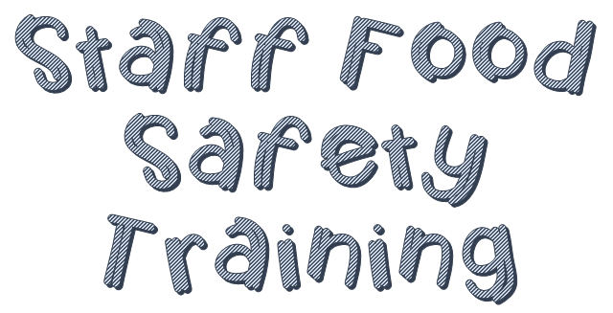
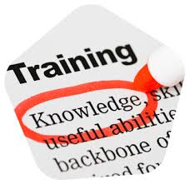

Slide 2
Whether they have been on the job for one day or five years, they need to understand that food safety is important.
To make sure you are serving safe food, train your staff when they are first hired and then continue training them.

Slide 3
Training need- is a gap between what staff should know to do their jobs and what they actually know
For new hires, the need might be obvious.
For experienced staff, the need is not always clear.

Slide 4
Identifying food safety training needs will require some effort. You can achieve this in several ways:
Observe performance on the job
Test food safety knowledge
Identify areas of weakness
All staff need general food safety knowledge.
Other knowledge will be specific to tasks

Slide 5
You CANNOT assume new hires will understand your operation’s food safety procedures without training.
They should begin learning about the importance of food safety on their first day.
Once staff are trained, monitor them to make sure they are following procedures.
The following slides are the critical areas for training

Slide 6
Good Personal Hygiene
How and when to wash hands
Where to wash hands
Other hand-care guidelines including fingernail length, nail polish, covering wounds
Proper work attire
Reporting illness

Slide 7
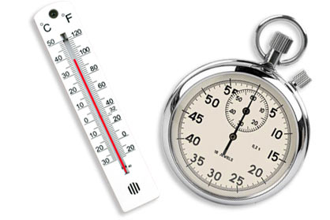
Controlling Time and Temperature
TCS food
How to measure the temperature of food
Holding and storing TCS food
How to label food for storage
Temperature requirements when thawing, cooking, cooling and reheating food

Slide 8
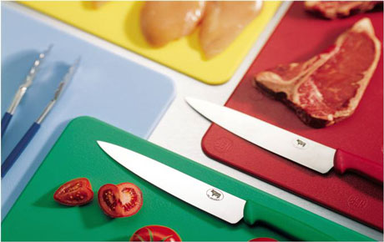
Preventing Cross Contamination
Preventing cross-contamination of food during storage, preparation, and service
Preventing cross-contamination when storing utensils and equipment
What to do if cross- contamination happens
What to do for people who have food allergies

Slide 9
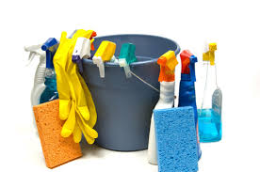
Cleaning and Sanitizing
How and when to clean and sanitize
The correct way to wash dishes in a three-compartment sink and in a dishwasher
How to handle cleaning tools and supplies
Handling garbage
Spotting pests

Slide 10
Staff need to be periodically retrained in food safety.
You can do this by scheduling short training sessions, planning meetings to update them on new procedures, or holding motivational sessions that reinforce food safety practices.

Slide 11
Keep records of all food safety training at your operation.
For legal reasons, be sure to document this training when a staff member completes it.

Slide 12
On-the-Job Training
Many operations assign experienced staff to train learners while on the job. Learners perform tasks while the trainers tell them how they are doing.
Teaches skills that require thinking and doing
Good for training staff members one at a time, but can also work for small groups
Success depends on the skill of the person doing the training. Choose the trainer carefully

Slide 13
Classroom Training
People learn by doing rather than just by being told what to do. So your training should include activities that require staff to do something.
Staff should also take part in learning activities. Encourage them to ask questions and allow them to make mistakes.

Slide 14
Classroom training
You can use a range of activity-based training to teach food safety to your staff:
Information search: Some people are curious and like to explore things on their own. Make use of their interest by having them discover food safety information themselves.
Guided discussion: Ask staff questions that draw on their knowledge and experience. Encourage them to think and this discuss their thoughts. Each time learners answer a question, follow with another question.
Games: A game can help make difficult or boring information seem more exciting. You can also use games to practice information that has already been taught.

Slide 15
Role-Play: Many trainers use role-play to teach concepts. However, some learners do not like role-playing because it puts them on the spot.
Demonstrations: You will often teach specific food safety tasks by showing them to a person or group. Demonstrations are most effective when you follow the Tell/Show/Practice model
Tell the learner how to do the task. Explain what you are doing and why
Show the learner how to do the task
Let the learner do the task.

Slide 16
Jigsaw Design: Put learners in small groups, assign a specific food safety topic to each group and have that group read about their topic, discuss it, and decide how to teach it to other groups, take one person from each group and form new groups, have each member in the new group teach their topic to the other group members.
Training Videos & DVD’s: Learners retain information from their training session in the following ways:
10 percent of what they read
20 percent of what they hear
30 percent of what they see
50 percent of what they see and hear
Videos and DVDs will help your staff see and hear food safety information which will make them more likely to remember it.

Slide 17
Technology-Based Training
Many operations use technology-based training, such as online learning, to teach food safety.
Technology-based training lets you deliver training when and where your staff needs it.
It is most appropriate in the following situations:
Staff work in different locations and/or need the same training at different times.
When it is too costly to bring staff to the same place.
Staff need retraining.
Staff have different levels of knowledge about a topic.
Staff have different learning skills.
Staff need to learn at their own pace.
You want to collect specific information, such as test scores, time spent on different topics, and/or problem areas.

