Slide 1
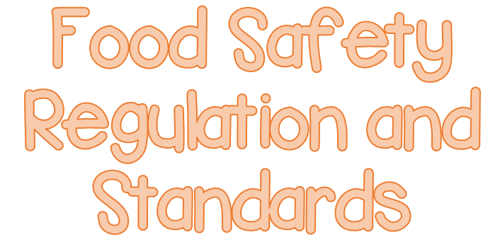

Slide 2
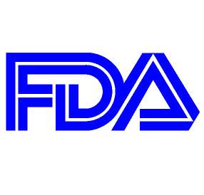
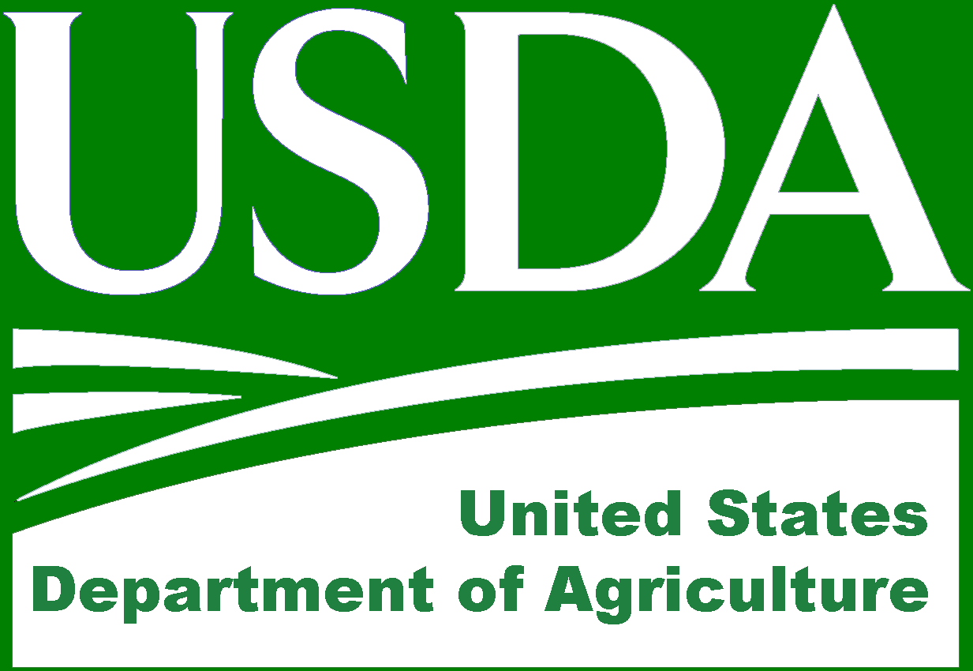
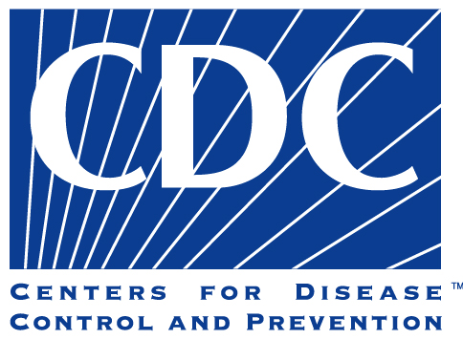
Several government agencies take leading roles in the prevention of foodborne illness in the U.S.

Slide 3
The FDA inspects all food except meat, poultry and eggs.
The agency also regulates food transported across state lines.
In addition, the FDA issues a Model Food Code. This science-based code provides recommendations for food safety regulations.

Slide 4
The Model Food Code was created for city, country, state and tribal agencies. These agencies regulate foodservice for the following groups:
Restaurants and retail food stores
Vending operations
Schools and day care centers
Hospital and nursing homes
Although the FDA recommends that states adopt the Model Food Code, it cannot require it. The FDA also provides technical support and training. This is available for industry and regulatory agencies.

Slide 5
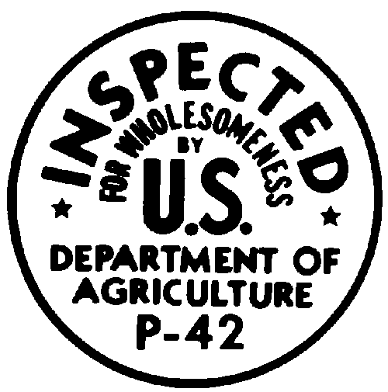
The USDA regulates and inspects meat, poultry, and eggs.
The USDA also regulates food that crosses state boundaries or involves more than one state.

Slide 6
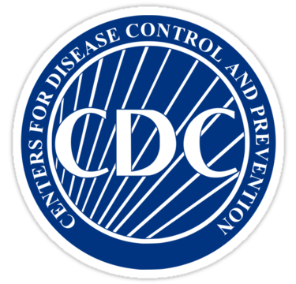
Centers for Disease Control and Prevention is an agency of the U.S. Department of Health Services.
They assist the FDA, and state and local regulatory authorities by providing the following services:
Investigate outbreaks of foodborne illness
Study the causes and control of disease
Publish statiscal data and case studies in the Morbidity and Morality Weekly Report
Provide educational services in the field of sanitation
Conduct the Vessel Sanitation Program— an inspection program for cruise ships

Slide 7
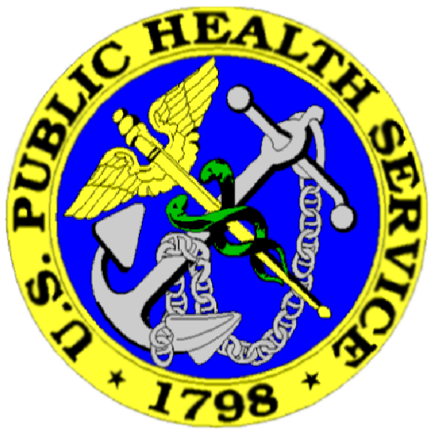
The Public Health Service also assists the FDA, USDA and state and local regulatory authorities.
They conduct research into the causes of foodborne-illness outbreaks.
They also assist in investigating the outbreaks.

Slide 8
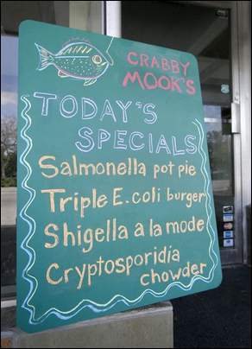
Regulatory authorities have many responsibilities. Here are some of the responsibilities related to food safety:
Inspecting operations
Enforcing regulations
Investigating complaints and illnesses
Issuing licenses and permits
Approving construction
Reviewing and approving HACCP plans

Slide 9
Regulatory authorities writes or adapts code that regulates retail and foodservice operations.
Codes may differ from the FDA Model Food Code, because these agencies are not required to adopt it.

Slide 10
In a large city, the local regulatory authority will probably be responsible for enforcing regulatory requirements.
In smaller cities or in rural areas, a county or state regulatory authority may be responsible for enforcement.
State and local health inspectors (can also be called sanitarians, health officials, or environmental health specialists) conduct restaurant and foodservice inspections in most states.

Slide 11
All operations that serve food to the public are subject to inspection.
An inspection measures whether an operation is meeting minimum food safety standards. It also produces a written report that notes deficiencies.
Regulatory requirements guide the inspection. So keep a current copy of your local or state regulations and be familiar with them.

Slide 12
The FDA recommends that regulatory authorities use the following three risk designations when evaluating operations:
Priority items
Priority foundation items
Core items

Slide 13
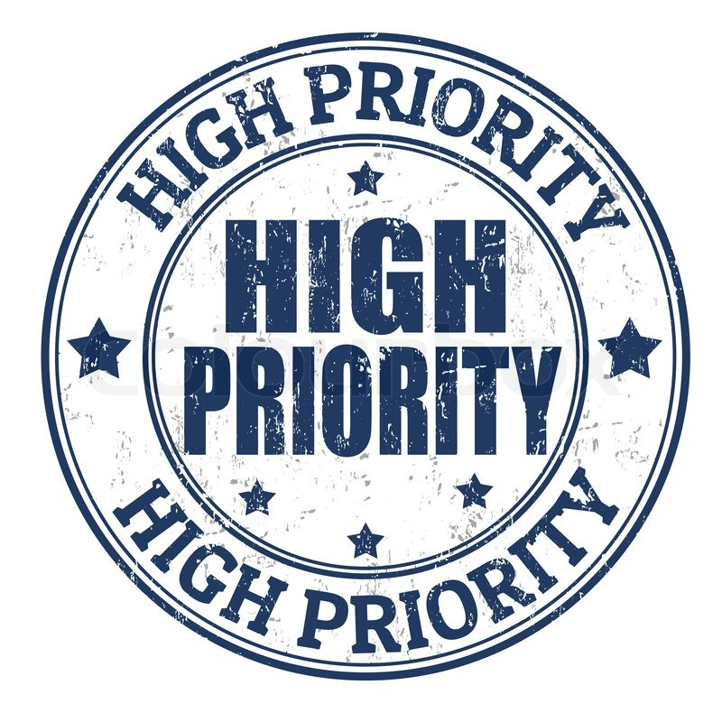
Priority items are the most critical.
These are actions and procedures that prevent, eliminate, or reduce hazards associated with foodborne illness to an acceptable level.
Correct handwashing would be considered a priority item.

Slide 14
Priority foundation items are those that support a priority item.
Having soap at a handwashing sink is an example.

Slide 15
Core items relate to general sanitation, the facility, equipment design, and general maintenance.
Keeping equipment in good repair is an example.

Slide 16
State and local regulatory authorities differ in the frequency of their inspections.
Some require inspections for operations at least every six months. Others schedule inspections more, or less, often.
The frequency will vary depending on the area, type of operation, or food served.

Slide 17
Many authorities use a risk-based approach to decide how often they will inspect. Factors include:
Size and complexity: Larger operations offering many TCS food items might be inspected more often
Inspection history: Operations with a history of low sanitation scores or consecutive violations might be inspected more often
At-risk populations: Nursing homes, schools, day-care centers, and hospitals might receive more inspections
Resources: The regulatory authority’s workload and number of available inspectors may determine how often it inspects operations

Slide 18
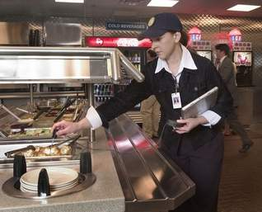
In most cases, inspectors will arrive without warning.
They will usually ask for the person in charge
The following slides will have guidelines that can help a food safety manager get the most out of food safety inspections.

Slide 19
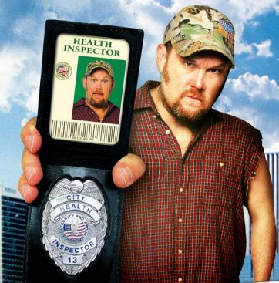
Always ask for identification of the person who is inspecting.
Also prohibit entry through the back of the operation without the correct ID.
Inspectors will volunteer their credentials.
Make sure you know the reason for the inspection. It could be a routine visit or the result of a customer complaint.
Do NOT refuse entry to an inspector. They have the authority to gain access to the operation and authority to revoke the operation’s permit for refusing entry.

Slide 20
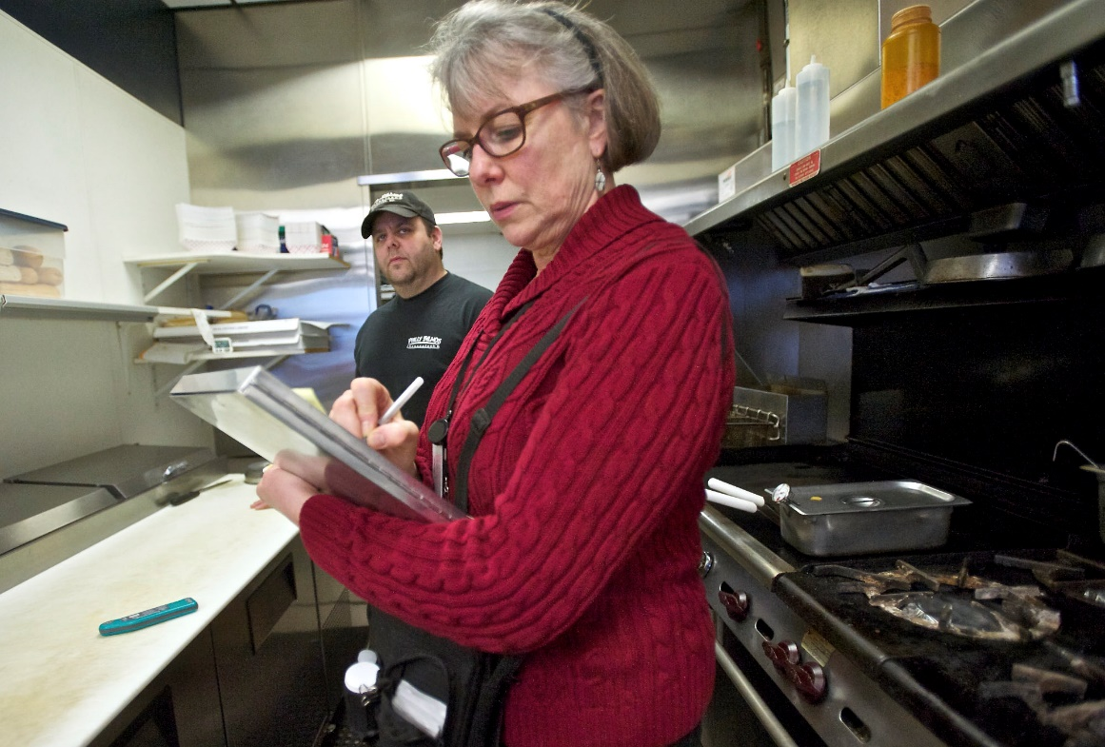
Answer all of the inspector’s questions as well as you can, and tell your staff to do the same.
You should go with the inspector during the inspection. By doing so you can answer any questions and possibly correct problems right away.
Tell the inspector when something can be fixed if it cannot be fixed immediately.

Slide 21
As you walk with the inspector, make note of any problems pointed out.
Make it clear you are willing to fix any problems.
If you believe the inspector is incorrect about something, ask for clarification and note what was mentioned. Then contact the regulatory authority if you are still unsure about something.

Slide 22
Be polite and friendly, and treat inspectors with respect.
Be careful about offering food, drink or anything else that could be perceived as trying to influence the report.

Slide 23
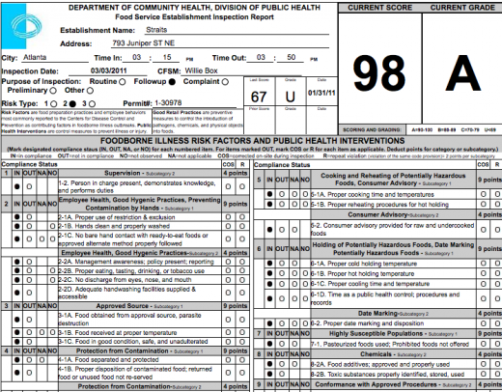
Be prepared to provide the following records an inspector might request:
Purchasing records to make sure that food has been received from an approved source
PCO treatment plan
Proof of food safety knowledge, such as a food protection manager certificate
HACCP records in some cases
You can ask the inspector why these records are needed. If a request seems inappropriate, check with the inspector’s supervisor.
Remember that any records you provide will become part of the public record.

Slide 24
After the inspection, the inspector will explain the results and score, if one is given.
Study the report and discuss any violations and time frames for correction with the inspector.
You will be asked to sign the inspection report. Signing it acknowledges you have received it.
A copy of the report will then be given to you or the person in charge at the time. Keep copies on file. They are public documents that may be available to anyone upon request.

Slide 25
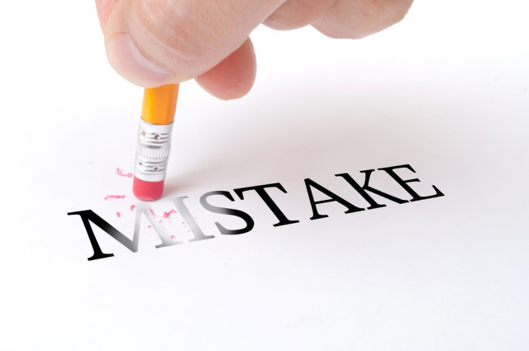
Act on deficiencies noted in the inspection report in the time frame given by the inspector.
Violations of priority items usually must be corrected within 72 hours.
Violations of priority foundation items typically must be corrected within 10 calendar days.

Slide 26
Determine their cause by reviewing standard operating procedures.
Also review the master cleaning schedule, staff training, and food handling practices.
Revise current procedures or set up new ones to resolve any problems.
Inform staff of the deficiencies and retrain them if needed.

Slide 27
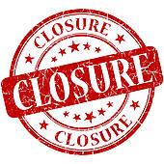
After careful review, an inspector might determine an operation poses an imminent health hazard to the public.
In some states, he or she may ask for a voluntary closure or issue an immediate suspension of the permit to operate.

Slide 28
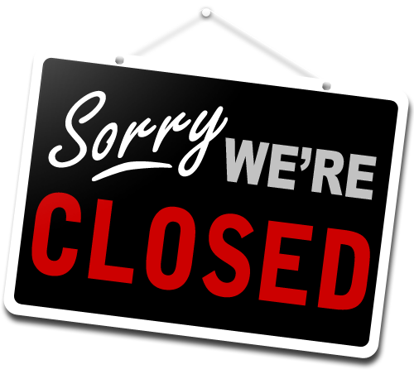
Examples of hazards calling for closure include:
Significant lack of refrigeration
Backup of sewage into the operation or its water supply
Emergency, such as a building fire or flood
Significant infestation of insects or rodents
Long interruption of electrical or water service
Clear evidence of a foodborne-illness outbreak related to the operation

Slide 29
If an operation receives a suspension, it must cease operations right away.
The owner can request a hearing if he or she believes the suspension was unjustified.
The suspension order may be posted at a public entrance to the operation. This is not required if the operation closes voluntarily.
To reinstate a permit to operate, the operation must eliminate the hazards causing the suspension. Then it needs to pass a reinspection and receive written approval to reopen.

Slide 30
Well-managed operations perform frequent self-inspections to keep food safe.
Consider these guidelines when conducting a self-inspection:
Use the same type of checklist that the regulatory authority uses
Identify all risks to food safety
After the inspection, meet with staff to review any problems

