Slide 1
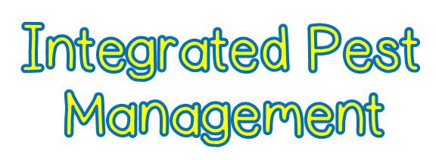
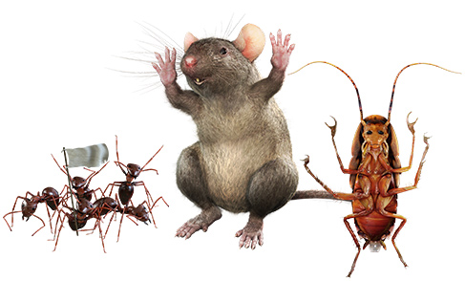

Slide 2
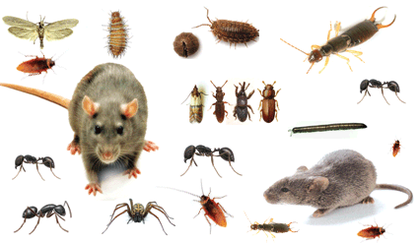
Rodents, insects, and other pests are more than just unsightly to customers.
They can damage food, supplies, and facilities.
But the greatest danger comes from their ability to spread diseases, including foodborne illness.

Slide 3
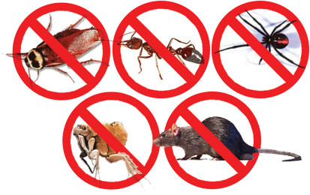
Once pests have entered the operation in large numbers—an infestation—they can be difficult to eliminate
Developing and implementing an integrated pest management (IPM) program is the key
An IPM program uses prevention measures to keep pests from entering the operation and control measures to eliminate those that do get inside.

Slide 4
The best way to ensure your IPM program succeeds is to work closely with a licensed pest control operator (PCO).
These professionals use safe, current ways of preventing and controlling pests

Slide 5
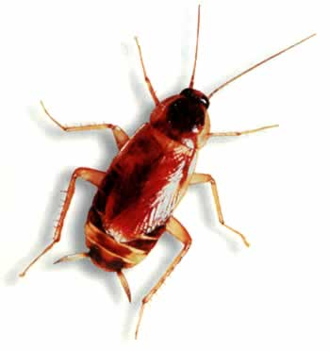
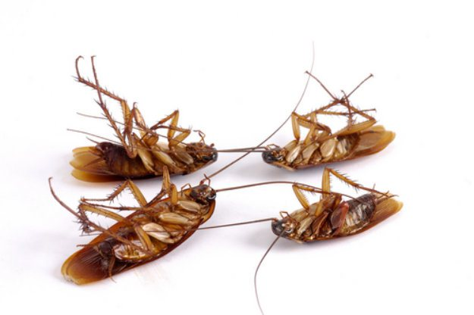
Prevention is critical in pest control. If you wait until there is evidence of pests in your operation, they may already be there in large numbers. An IPM program has three basic rules:
Deny pests access to the operation.
Deny pests food, water and shelter.
Work with a licensed pest control operator (PCO).

Slide 6
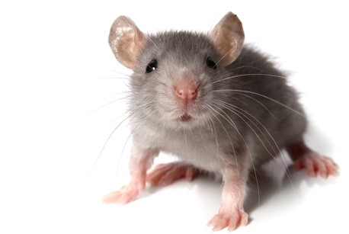
Pests can be brought inside with deliveries or through building openings. Follow these guidelines to prevent it:
Deliveries:
Use approved, reputable suppliers
Check all deliveries before they enter your operation
Refuse shipments that have pests or signs of pests, such as egg cases and body parts (legs, wings, etc.)

Slide 7
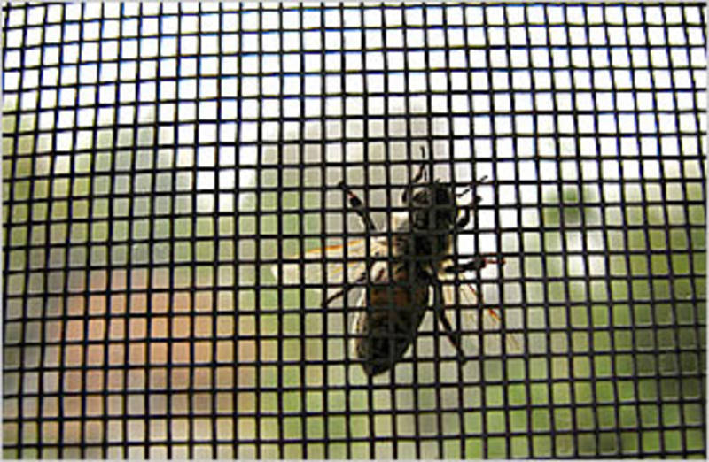
Doors, Windows, and Vents
Screens: Screen all windows and vents with at least 16 mesh per square inch screening. Anything larger might let in mosquitoes or flies. Check screens often. Clean, patch or replace them as needed.
Self-closing devices and door sweeps: Install self-closing devices and door sweeps on all doors. Repair gaps and cracks in door frames and thresholds, such as the one in the photo at left. Use weather stripping on the bottoms of doors with no threshold.

Slide 8
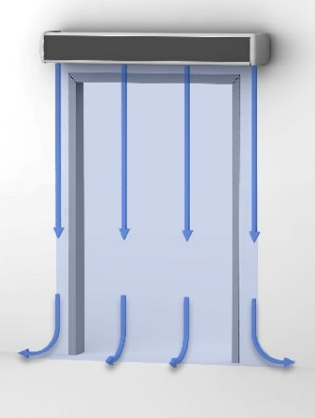
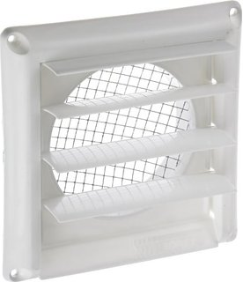
Doors, Windows, and Vents
Air curtains: Install air curtains (also called air doors or fly fans) above or alongside doors. These devices blow a steady stream of air across the entryway. This creates an air shield around doors left open.
Exterior openings: Keep all exterior openings tightly closed. Close drive-through windows when not in use.
Pipes
Concrete: Use concrete to fill holes or sheet metal to cover openings around pipes.
Screens: Install screens over ventilation pipes and ducts on the roof.
Grates: Cover floor drains with hinged grates to keep rodents out. Rats are good swimmers. They can enter buildings through drainpipes.

Slide 9
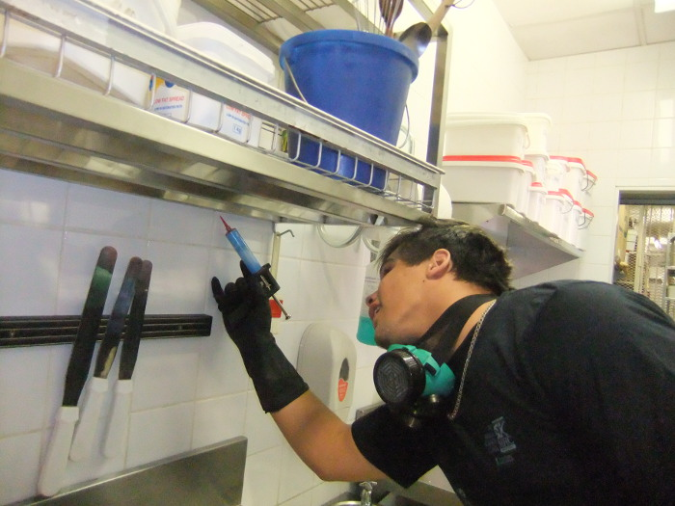
Floors and Walls
Rodents often burrow into buildings through decaying masonry or cracks in foundations. They move through floors and walls the same way.
Seal all cracks in floors and walls. Use a permanent sealant recommended by your PCO or regulatory authority.
Seal spaces or cracks where stationary equipment is fitted to the floor. Use an approved sealant or concrete, depending on the size of the space.

Slide 10
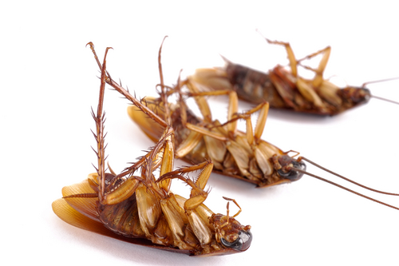
Pests are attracted to damp, dark, dirty places.
A clean operation offers them no food or shelter. The stray pest that might get in cannot thrive or multiply in a clean kitchen.

Slide 11
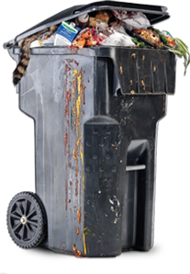
Follow these guidelines
Garbage: Dispose of garbage quickly and correctly. Garbage attracts pests and provides them with a breeding ground. Keep garbage containers clean. Make sure outdoor containers are tightly covered. Clean spills around garbage containers right away. Wash and rinse containers often.

Slide 12
Recyclables: Store recyclables in clean, pest-proof containers as far from your building as regulatory requirements allow. Bottles, cans, paper and packaging material provide shelter and food for pests.
Storage: Keep food and supplies away from walls and at least six inches off the floor. Rotate food items so pests do not have time to settle into them and breed.

Slide 13
Cleaning: Careful cleaning eliminates the pests’ food supply and destroys insect eggs. It also reduces the places pests can take shelter. Follow these guidelines to deny pests food and shelter:
Clean food and beverage spills right away, including crumbs and scraps
Clean toilets and restrooms as often as needed
Train staff to keep lockers and break areas clean
Keep cleaning tools and supplies clean and dry. Store wet mops on hooks rather than on the floor; otherwise roaches can hide in them.
Empty water from buckets to keep from attracting rodents.

Slide 14
Grounds & Outdoor Dining Areas
Birds, flies, and wasps can be both annoying and dangerous to your customers. As with indoor pests, the key to controlling them is to deny them food and shelter.
Follow these guidelines
Mow the grass, pull weeds, get rid of standing water, and pick up litter
Cover all outdoor garbage containers
Remove uneaten food and dirty dishes from tables. Clean dishes as quickly as possible.
Clean spills as quickly as possible.
Do not allow staff or customers to feed birds or wildlife on the grounds.
Locate electronic insect eliminators, or zappers, away from food, customers, staff and serving areas.
Call your PCO to remove hives and nests

Slide 15
Pests may still get into your operation even if you try to prevent them.
It is important to spot signs of pests and determine which type you are dealing with. When you detect pests, record the date, time, and location. Then inform your PCO. Early detection allows the PCO to start treatment as soon as possible.

Slide 16
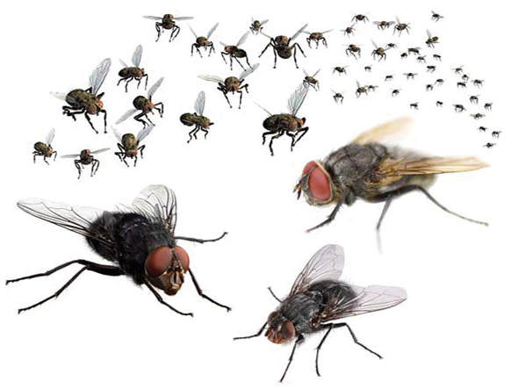
Flies are a threat to human health because they feed on garbage and animal waste.
For this reason, flies can spread pathogens such as Shigella.

Slide 17
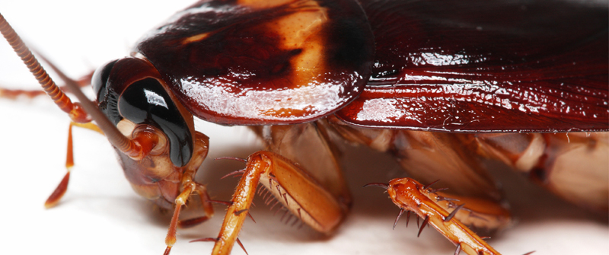
Often carry disease-causing pathogens such as Salmonella, fungi, parasite eggs, and viruses.
They reproduce quickly and can adapt to certain pesticides. This makes them difficult to control.
Many people are also allergic to residue that roaches leave on food and surfaces.
There are several types of roaches. Most live and breed in dark, warm, moist, hard-to-clean places.

Slide 18
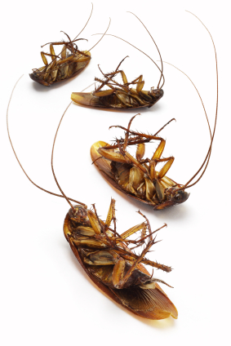
You will often find them in the following areas:
Behind coolers, freezers, and stoves
In sink and floor drains
In spaces around hot-water pipes
Inside equipment, often near motors and other electrical devices
Under shelf liners and wallpaper
Underneath rubber mats
In delivery bats and boxes
Behind unsealed coving (especially rubber-based)

Slide 19
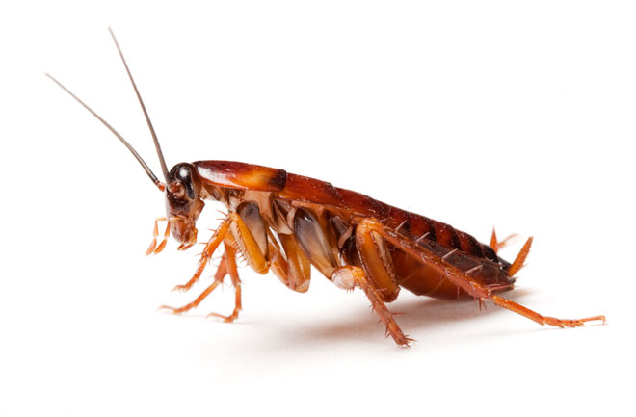
Roaches generally feed in the dark.
If you see a cockroach in daylight, you may have a major infestation, because only the weakest roaches come out during the day.
If you suspect you have a roach problem, check for the following signs:
Strong, oily odor
Droppings (feces) that look like grains of black pepper
Capsule-shaped egg cases that are brown, dark red, or black and possibly leathery, smooth or shiny in appearance

Slide 20
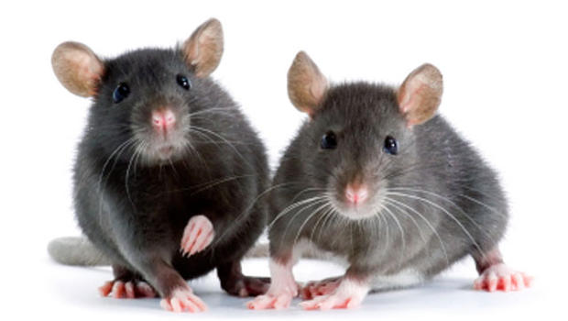
Rodents are serious health hazard as they eat and ruin food, damage property and can spread disease.
Most rodents have a simple digestive system. They urinate and defecate as they move around a facility.
Their waste can both fall into food and contaminate surfaces.
Rats and mice are the most common types of rodent.
Rodents hide during the day and search for food at night. Like other pests, they reproduce often.

Slide 21
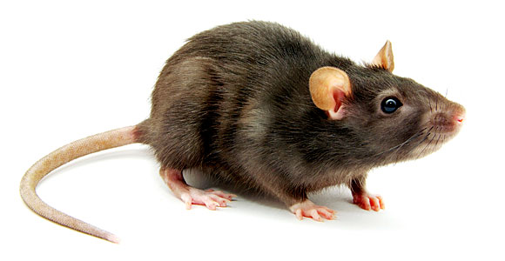
Typically, they don’t move far from their nests. Rats travel only 100 to 150 feet away. Mice travel only 10 to 30 feet.
Mice can squeeze through a nickel-sized hole to enter a facility.
Rats can slip through holes the size of a half dollar.
Rats can also stretch to reach an item as far as high as 18 inches, jump three feet in the air, and even climb straight up brick walls.

Slide 22
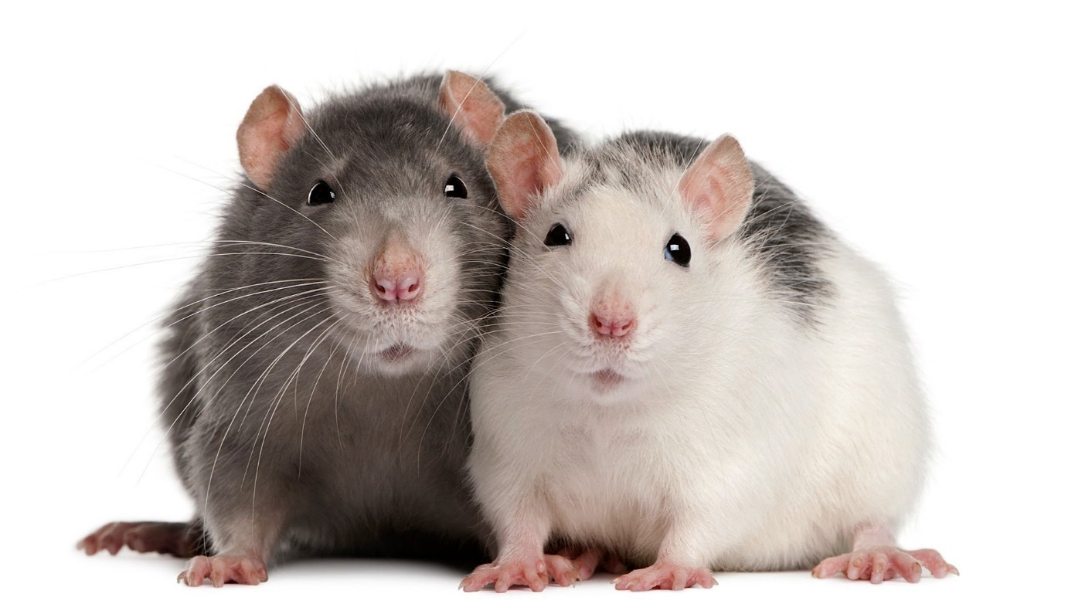
Rats and mice have keen senses of hearing, touch, and smell. Plus, they are smart enough to avoid poison bait and poorly laid traps.
Effective control of these rodents requires professional knowledge and experience.

Slide 23
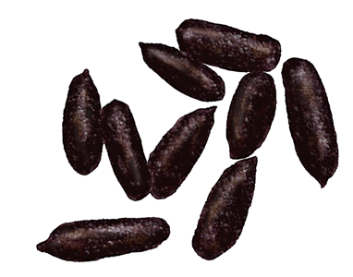
A building can be infested with both rats and mice at the same time. Look for the following signs:
Gnawing: Rats and mice gnaw to reach food and to wear down their teeth, which are always growing. Rats’ teeth can gnaw through pipes, concrete and wood.
Dropping and urine stains: Fresh droppings are shiny and black. Older droppings are gray. Rodent urine will glow under black (ultraviolet) light.

Slide 24
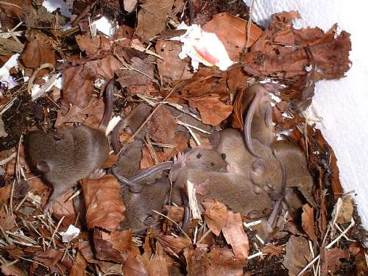
Tracks: Rodents tend to use the same pathways through your operation. If rodents are a problem, you may see dirt tracks along light- colored walls.
Nesting materials: Rats and mice build their nests with soft materials such as cloth, hair, feathers, grass, and scraps of paper.
Holes: Rats usually nest in holes in quiet places, often near food and water. Their nests may also be found next to buildings.

Slide 25
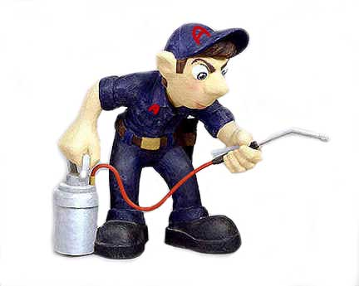
Few pest problems are solved simply by spraying pesticides (chemical agents used to destroy pests).
While you can reduce the risk of infestation, most pest control should be carried out by professionals.

Slide 26
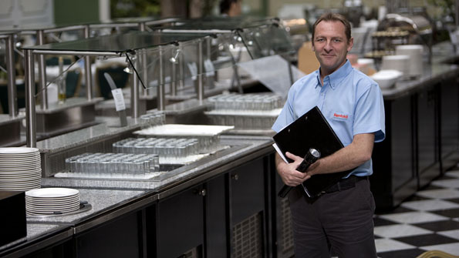
You can rely on your PCO to do the following:
Develop an integrated approach to pest management. This may include a combination of chemical and nonchemical treatments to solve and prevent problems.
Stay current on new equipment and products.
Provide prompt service to address problems as they occur. Contacts should include regular visits as well as immediate service when pests are spotted.
Keep records of all steps taken to prevent and control pests.

Slide 27
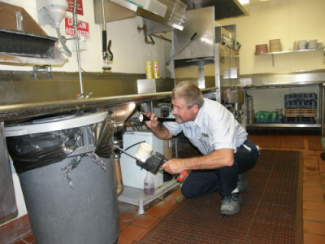
Check references when hiring a PCO and make sure they are licensed.
Always require a written service contact that outlines the work to be performed. It clarifies what is expected from both you are the PCO.

Slide 28
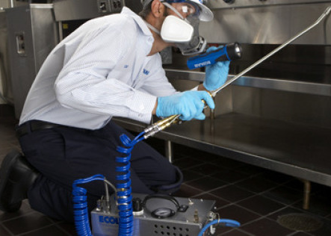
Effective treatment starts with a thorough inspections of your facility and grounds.
Give the PCO complete access to the building which will give the PCO a clearer picture of the situation.
After the initial inspection, your PCO should provide a treatment plan in writing. In addition to price the plan should address the following:
Exactly what treatments will be used
Dates and times of each treatment
Steps you can take to control pests
Any building defects that may be a barrier to prevention and control measures
Timing of follow up visits

Slide 29
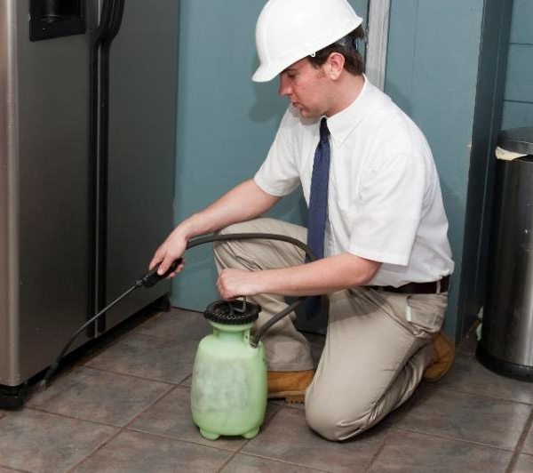
PCOs use pest-control methods that are environmentally sound and safe for operations.
They also know which techniques will work best to control the types of pests in your area.
New technologies are always being developed. Work with your PCO to determine which pest-control methods are best for your operation.

Slide 30
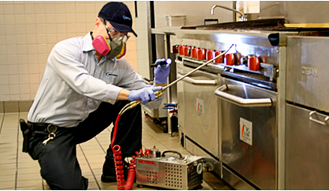
Sometimes, purchasing and applying pesticides on your own might seem more cost effective. There are many reasons not to do so:
Applied incorrectly, they may be ineffective or harmful
Pests can develop resistance and immunity to pesticides
Each region has its own pest-control problems. Control measures may vary.
Pesticides are regulated by federal, state, and local laws. Some are not approved for use in restaurants or foodservice operations.

Slide 31
Here are other considerations when pesticides will be used:
Timing: To minimize the hazard to people, have your PCO use pesticides only when you are closed for business and staff are not on-site.
Preparation: When pesticides will be applied, prepare the area to be sprayed by removing all food and movable food-contact surfaces. Cover equipment and food-contact surfaces that cannot be moved.
Post application: Wash, rinse, and sanitize food-contact surfaces after the areas has been sprayed.

Slide 32
MSDS: Pesticides are hazardous materials. You should have a corresponding MSDS any time one will be used or stored on the premises
Storage: All pesticides used in your facility should also be stored by your PO. If they are stored on the premises, follow these guidelines:
Keep pesticides in their original containers
Store pesticides in a secure location away from where food, utensils, and food equipment and stored.
Disposal: Pesticides should be disposed of by the PCO. Check regulatory requirements before disposing of pesticides yourself. Many are considered hazardous waste. Dispose of empty containers according to manufacturer’s directions and your regulatory requirements.

