Slide 1
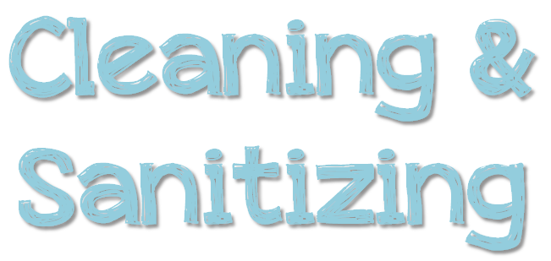
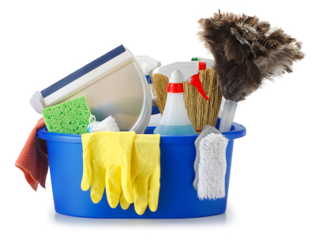

Slide 2
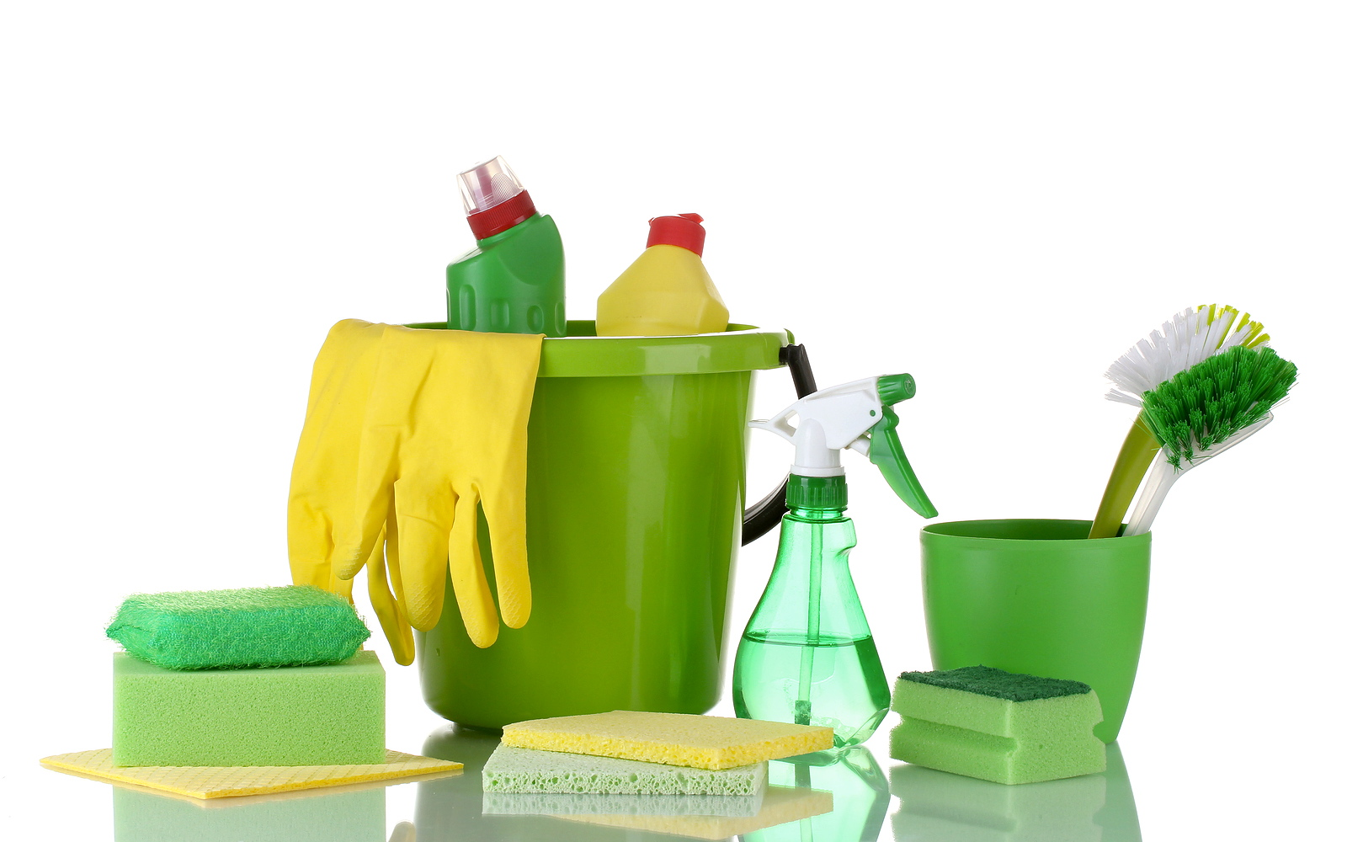
Cleaning removes food and other dirt from a surface.
Sanitizing reduces pathogens on a surface to safe levels.

Slide 3
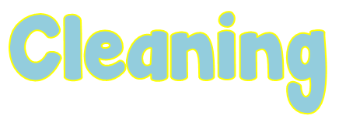
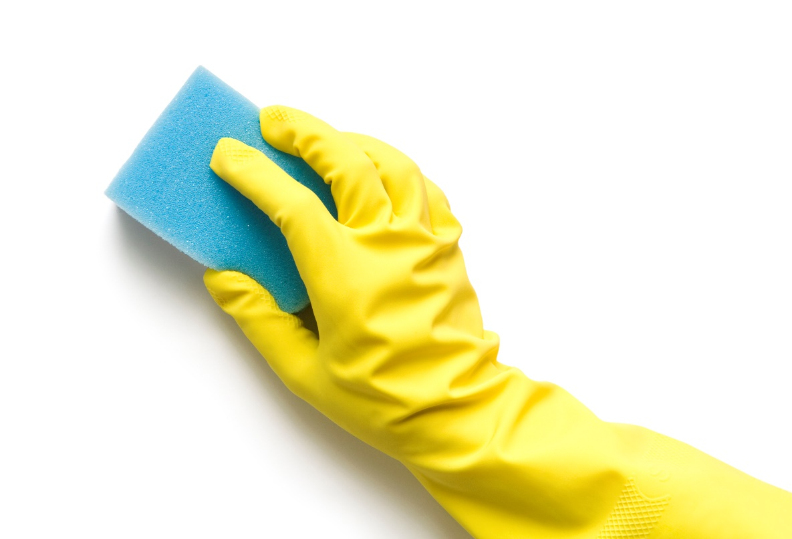
Factors that Affect Cleaning
Type and condition of dirt
Certain types of dirty require special cleaning methods.
The condition of the dirt also affects how easily it can be removed.
Water hardness
Cleaning is more difficult in hard water. Minerals react with the detergent and decrease how effective it is.

Slide 4
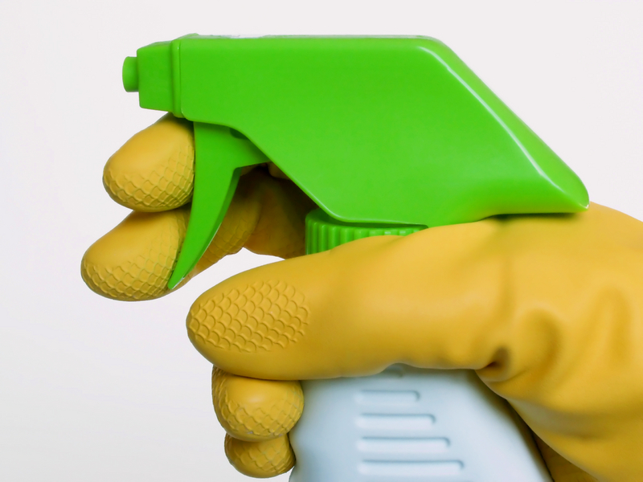
Water temperature
In general, the higher the water temperature, the better a detergent will dissolve and better it will loosen dirt.
Surface
Different surfaces call for different cleaners.
Some cleaners work well in one situation but not in another. The wrong cleaner might even damage equipment.

Slide 5
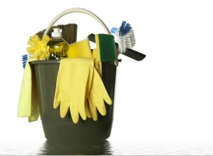
Agitation or pressure
Scouring or scrubbing helps remove the outer layer of dirt.
Length of treatment
The longer dirty on a surface is exposed to a cleaner, the easier it is to remove.

Slide 6
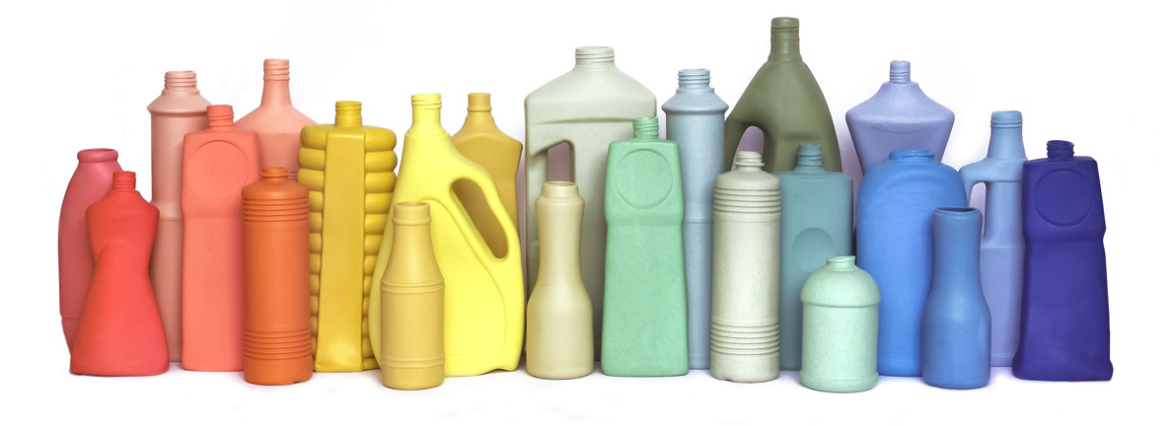
Cleaners are chemicals that remove food, dirt, rust, stains, minerals, or other deposits.
They must be stable, noncorrosive, and safe to use.
NEVER use one type of cleaner in place of another.
The following slides will have types of cleaners.

Slide 7
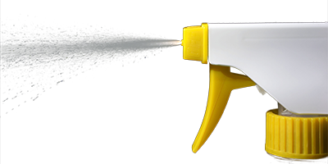
Different detergents are used for different cleaning tasks, but all have surfactants (surface acting agents) that reduce surface tension between the dirt and the surface.
General purpose detergents- mildly alkaline cleaners that remove fresh dirt
Heavy-duty detergents- highly alkaline that remove wax, aged or dried dirt and baked on grease.

Slide 8
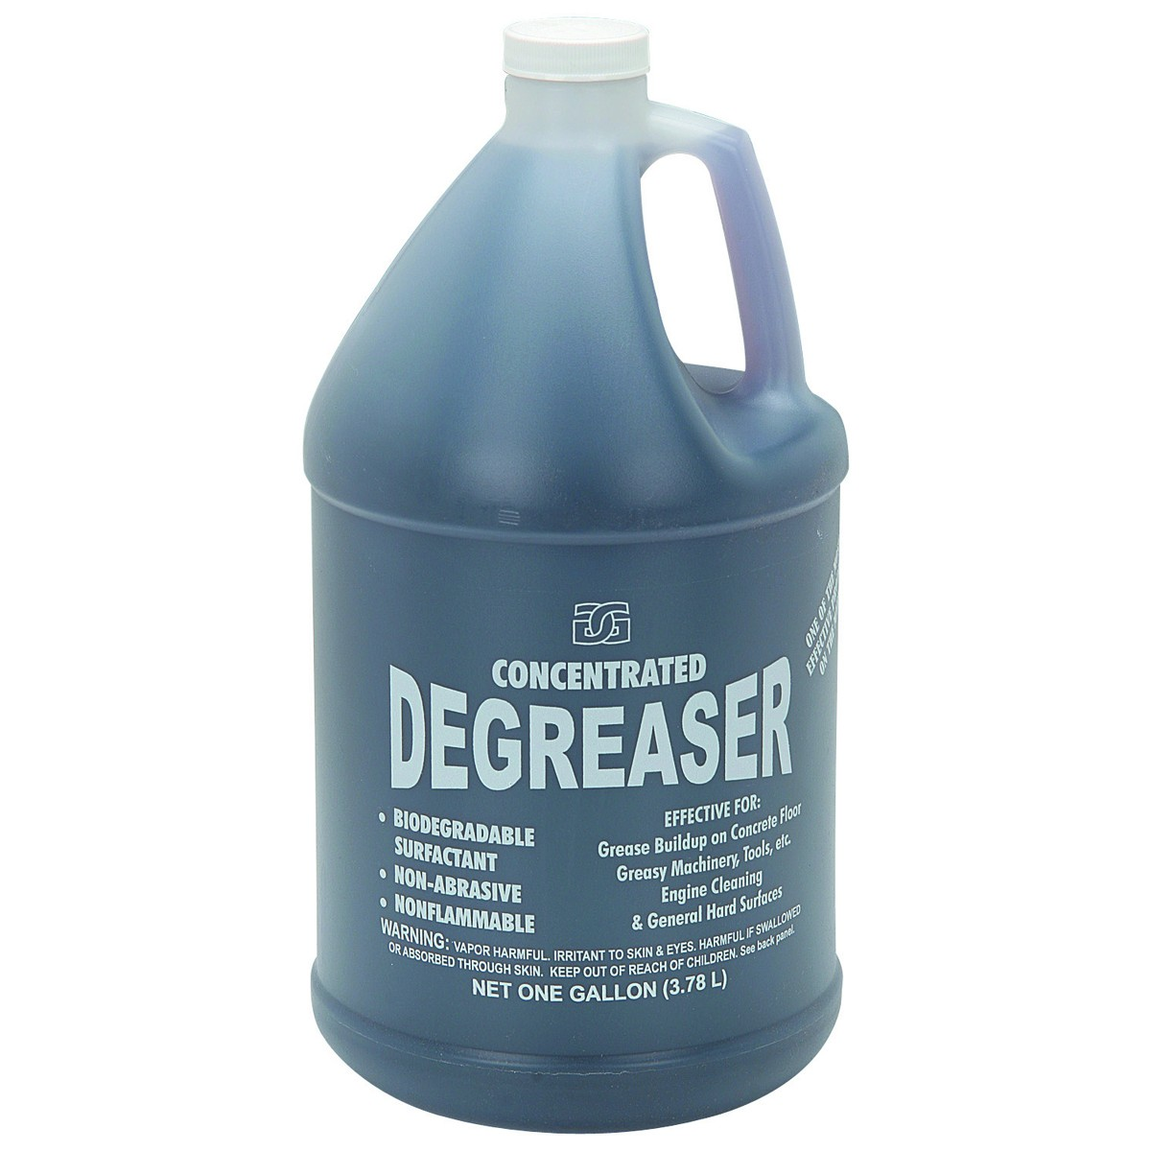
Degreasers are detergents that contain a grease-dissolving agent.
They work well in areas where grease has been burned on, such as grill backsplashes, oven doors and range hoods.

Slide 9
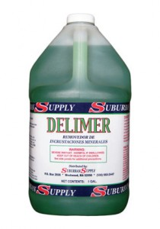
Delimers are used on mineral deposits and other dirt that other cleaners can’t remove.
They are often used to remove scale in dishwashing machines and on steam tables.

Slide 10
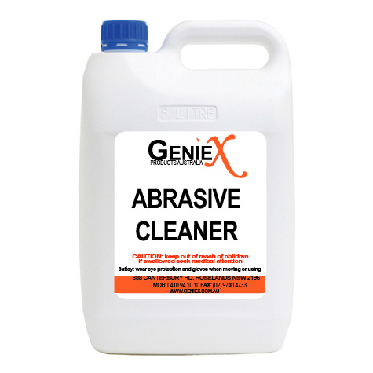
Abrasive cleaners contain a scouring agent that helps scrub hard-to-remove dirt.
These cleaners are often used to remove baked-on food in pots and pans.
Use abrasives with caution because they can scratch surfaces.

Slide 11
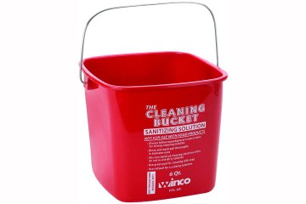
Food contact surfaces must be sanitized after they have been cleaned and rinsed.
This can be done by using:
Heat
Chemicals

Slide 12
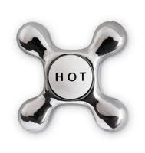
One way to sanitize items is to soak them in hot water.
For this method to work, the water must be at least 171°F.
The items must be soaked for at least 30 seconds.
Another way to sanitize items is to run them through a high-temperature dishwasher.

Slide 13
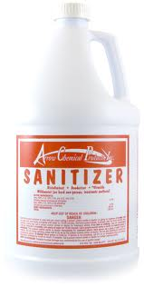
Tableware, utensils, and equipment can be sanitized by soaking them in a chemical sanitizing solution.
Or you can rinse, swab, or spray them with sanitizing solution.

Slide 14
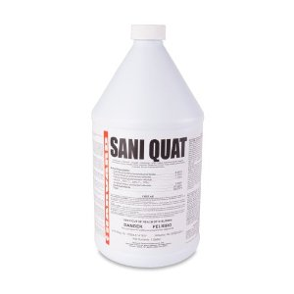
Three common types of chemical sanitizers are chlorine, iodine, and quaternary ammonium compounds (quats)
Chemical sanitizers are regulated by state and federal environmental protection agencies.

Slide 15
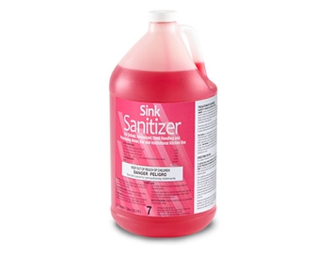
In some cases, you can use detergent-sanitizer blends to sanitize. Operations that have two-compartment sinks often use these.
If you use a detergent-sanitizer blend, use it once to clean. Then use it a second time to sanitize.

Slide 16
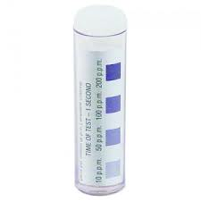
Several factors influence the effectiveness of chemical sanitizer. The most critical are:
Concentration
Temperature
Contact time
Water hardness
pH

Slide 17
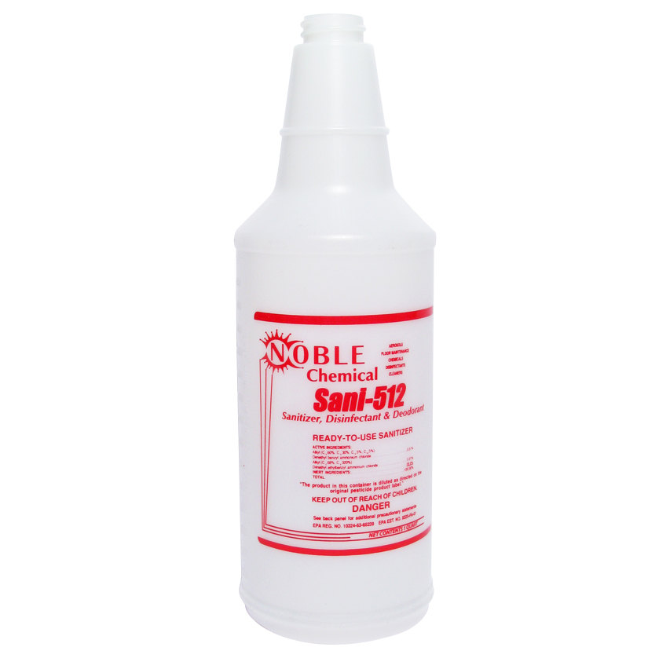
Sanitizer solution is a mix of chemical sanitizer and water.
Too little sanitizer may make the solution weak and useless.
Too much sanitizer may make the solution too strong and unsafe.
It can also leave a bad taste on items or corrode metal.

Slide 18
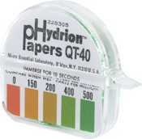
Concentration is measured in parts per million (ppm).
To check the concentration of a sanitizer solution, use a test kit.
Hard water, food bits, and leftover detergent can reduce the solution’s effectiveness.
Change the solution when it looks dirty or its concentration is too low. Check concentration often.

Slide 19
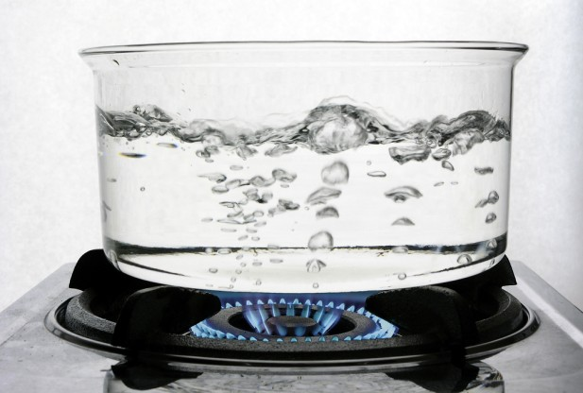
The water in sanitizing solutions must be the correct temperature.
Follow manufacturers’ recommendations.

Slide 20
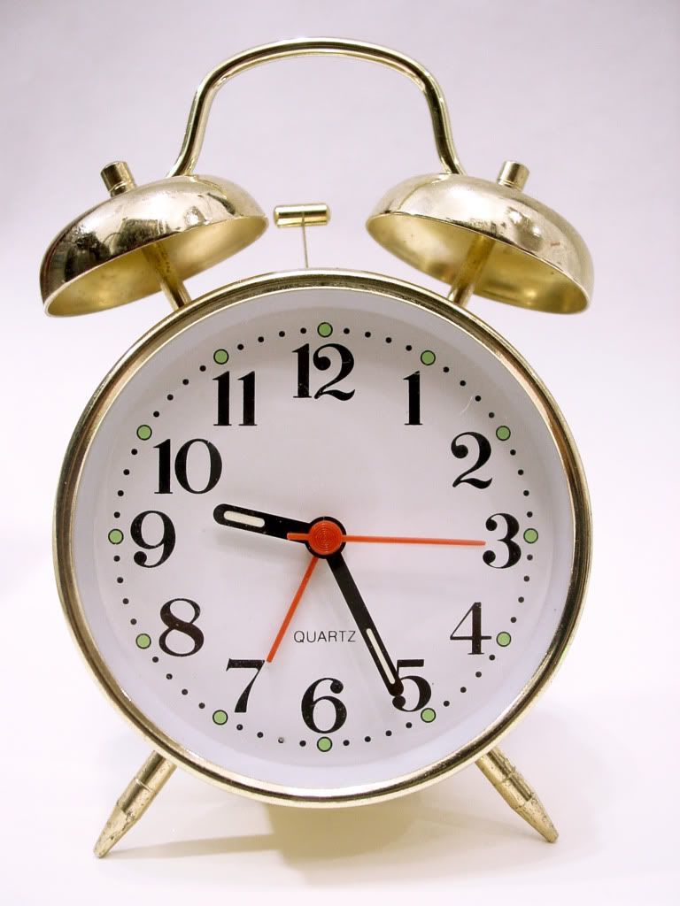
For a sanitizer solution to kill pathogens, it must make contact with the object being sanitized for a specific amount of time.
Most sanitizers must make contact for at least 30 seconds, some are for as little as 7 seconds.

Slide 21
Water hardness is the amount of minerals in your water.
Find out what the water hardness is from the municipality. Then work with the supplier to identify the correct amount of sanitizer to use for your water.

Slide 22
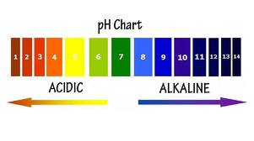
Find out what the pH of the water is from the municipality. Then work with the supplier to find out the correct amount of sanitizer to use for the water.

Slide 23
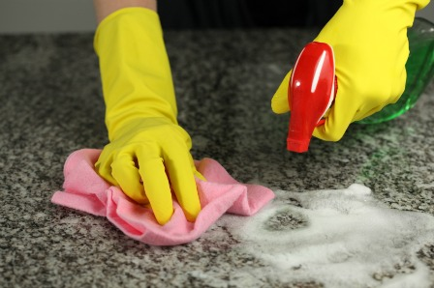
Scrape or remove food bits from the surface.
Use the correct cleaning tool, such as a nylon brush or pad, or a cloth towel.
Wash the surface
Prepare the cleaning solution with an approved cleaner.
Wash the surface with the correct cleaning tool, such as a cloth towel.

Slide 24
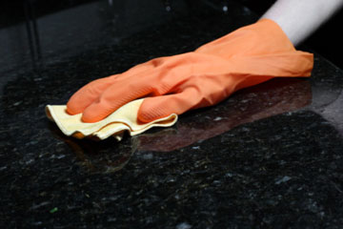
Rinse the surface
Use clean water.
Rinse the surface with the correct cleaning tool, such as a cloth towel.

Slide 25
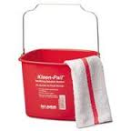
Sanitize the surface.
Use the correct sanitizing solution.
Prepare the concentration per manufacturer requirements.
Use the correct tool, such as a cloth towel, to sanitize the surface.
Make sure the entire surface has come in contact with the sanitizing solution.
Allow the surface to air-dry.

Slide 26
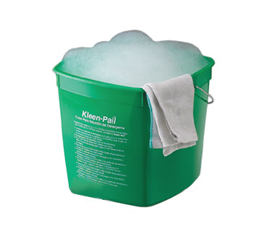
All food-contact surfaces need to be cleaned and sanitized at these times:
After they are used
Before food handlers start working with a different type of food
Any time food handlers are interrupted during a task and the items being used may have been contaminated
After four hours if items are in constant use

Slide 27
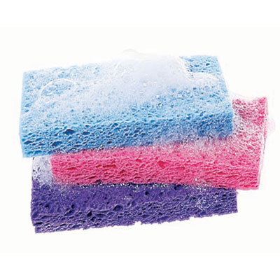
Unplug the equipment
Take the removable parts off the equipment. Wash, rinse, and sanitize them by hand. You can also run the parts through a dishwasher if allowed.
Scrape or remove food from the equipment surfaces.

Slide 28
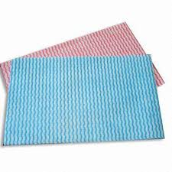
Wash the equipment surfaces. Use a cleaning solution prepared with an approved cleaner. Wash the equipment with the correct cleaning tool, such as a nylon brush or pad, or a cloth towel.
Rinse the equipment surfaces with clean water. Use a cloth towel or other correct tool.

Slide 29
Sanitize the equipment surfaces by making sure the sanitizer comes in contact with each surface. The concentration of the sanitizer must meet requirements.
Allow all surfaces to air- dry. Put the unit back together.

Slide 30
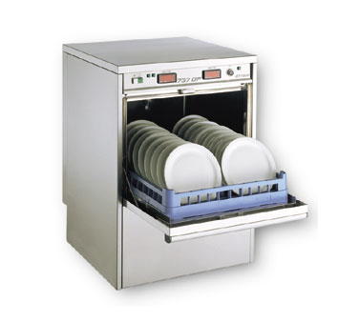
Tableware and utensils are often cleaned and sanitized in a dishwashing machine.
Larger items such as pots and pans are often cleaned by hand in a three-compartment sink.
Whichever method chosen, specific practices must be followed so items are cleaned and sanitized.

Slide 31
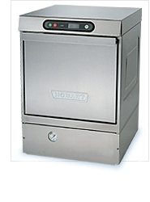
High-temperature machines use hot water to clean and sanitize.
If the water is not hot enough, items will not be sanitized.
Extremely hot water can bake food onto the items.

Slide 32
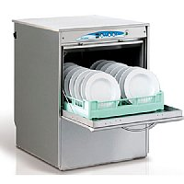
The temperature of the final sanitizing rinse must be at least 180°F.
For stationary rack, single- temperature machines, it must be at least 165°F.
The dishwasher must have a built-in thermometer that checks water temperature at the manifold (where the water sprays into the tank)

Slide 33
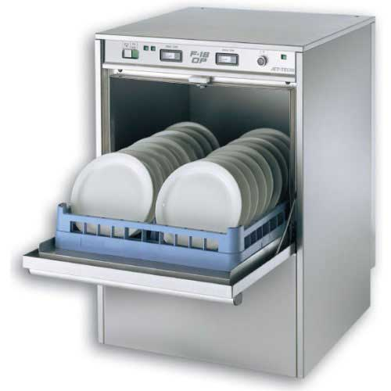
Chemical-sanitizing machines can clean and sanitize items at much lower temperatures with chemicals.
Follow the dishwasher manufacturer’s guidelines.

Slide 34
Operate the dishwasher according to the manufacturer's recommendations, and keep it in good repair.
Keep the machine clean.
Clean the machine as often as needed, checking it at least once a day.
Clear spray nozzles of food and foreign objects.
Remove mineral deposits when needed.

Slide 35
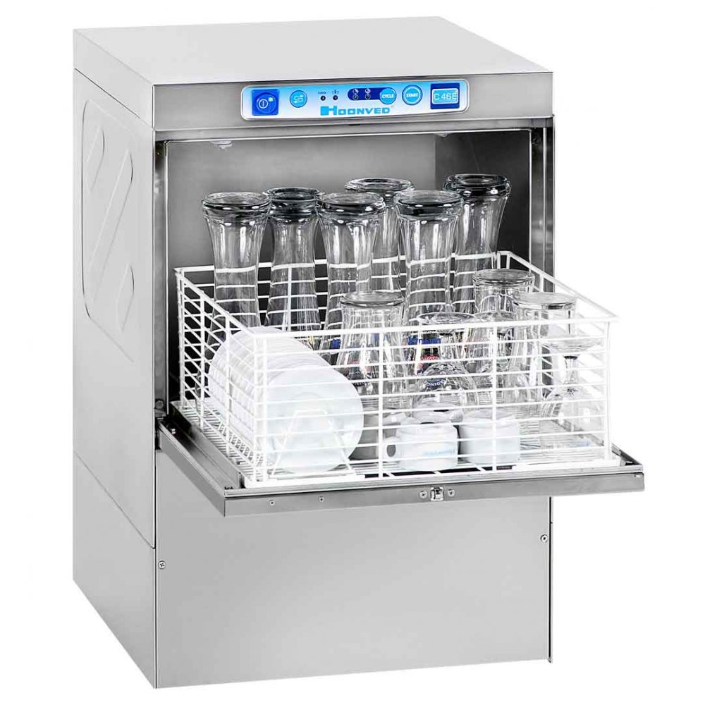
Preparing items for cleaning
Scrape, rinse, or soak items before washing.
Presoak items with dried-on food.
Loading dish racks
Use the correct dish racks.
Load them so the water spray will reach all surfaces.
NEVER overload dish racks.

Slide 36
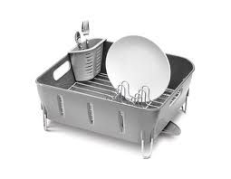
Drying items
Air dry all items.
NEVER use a towel to dry items. You could recontaminate them.
Monitoring
Check water temperature, pressure, and sanitizing levels.
Use heat tape or test strips to monitor the temperature of the sanitizing rinse. Another option is a maximum registering thermometer.

Slide 37
Operations often use a three-compartment sink to clean and sanitize large items.
Clean and sanitize each sink and drain board.
Fill the first sink with detergent and water. The water temperature must be at least 110°F.
Fill the second sink with clean water. This is not necessary if items will be spray rinsed instead of being dipped.

Slide 38
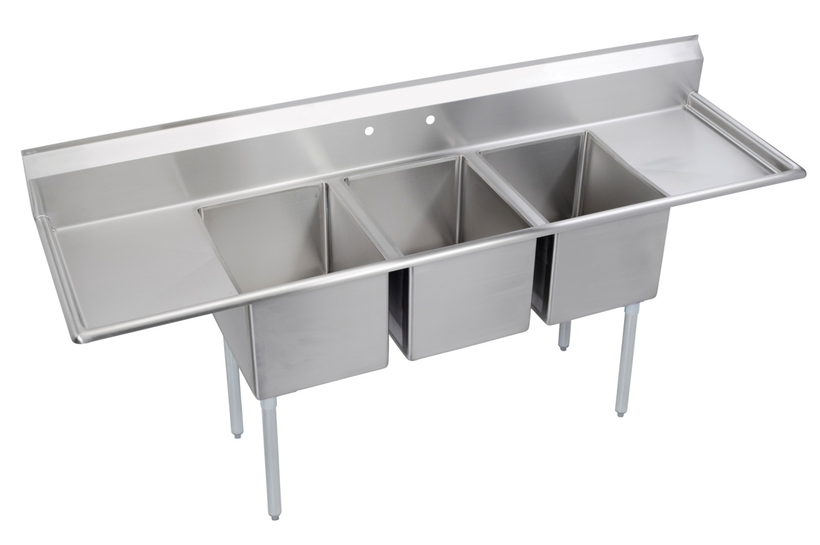
Fill the third sink with water and sanitizer to the correct concentration. Hot water can be used as an alternative.
Provide a clock with a second hand. This will let food handlers time how long items have been in the sanitizer.

Slide 39
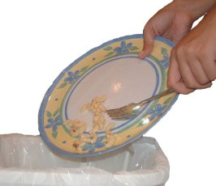
Rinse scrape or soak items before washing them.
If items are being soaked in the first sink, change the solution when food bits start to build up or the suds are gone.

Slide 40
Wash items in the first sink.
Use a brush, cloth towel, or nylon scrub pad to loosen dirt. Change the water and detergent when the suds are gone or the water is dirty.

Slide 41
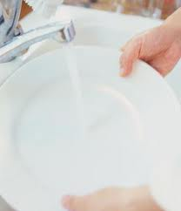
Rinse items in the second sink.
Spray the items with water or dip them in it. Make sure to remove all traces of food and detergent from the items being rinsed. If dipping the items change the rinse water when it becomes dirty or full of suds.

Slide 42
Sanitize items in the third sink.
Change the sanitizing solution when the temperature of the water or the sanitizer concentration fall below the requirements. NEVER rinse items after sanitizing them. This could contaminate their surfaces. The only exception to this rule is when you are washing items in a dishwasher that can safely rinse items after they have been sanitized.

Slide 43
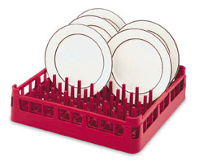
Air-dry items on a clean and sanitized surface.
Place items upside down so they will drain.

Slide 44
Once utensils, tableware, and equipment have been cleaned and sanitized, they must be stored in a way that will protect them from contamination. Follow these guidelines:
Storage
Store tableware and utensils at least six inches off the floor. Protect them from dirt and moisture.
6”

Slide 45
Storage surfaces
Clean and sanitize drawers and shelves before storing clean items
Glasses and flatware
Store glasses and cups upside down on a clean and sanitized shelf or rack. Store flatware and utensils with handles up. Staff can then pick them up without touching food-contact surfaces.

Slide 46
Trays and carts
Clean and sanitize trays and carts used to carry clean tableware and utensils. Check them daily, and clean as often as needed.
Stationary equipment
Keep the food-contact surfaces of stationary equipment covered until ready for use.

Slide 47
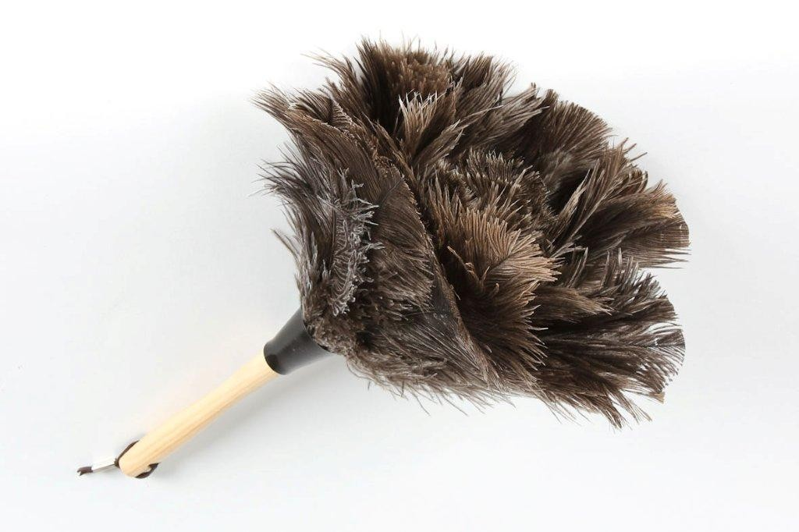
Nonfood-contact surfaces must be cleaned regularly.
Examples include floors, ceilings, equipment exteriors, restrooms, and walls.
Regular cleaning prevents dust, dirt, and food residue from building up.

Slide 48
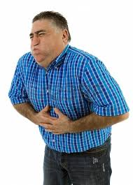
How you will contain liquid and airborne substances, and remove them from the operation.
How you will clean, sanitize, and disinfect surfaces
When to throw away food that may have been contaminated

Slide 49
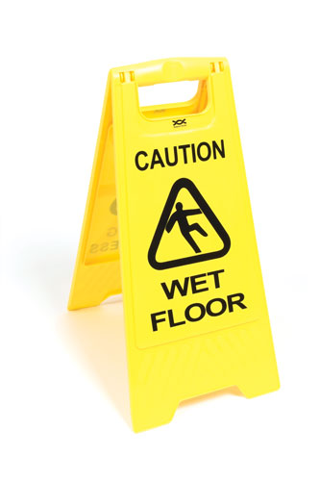
What equipment is needed to clean up these substances, and how it will be cleaned and disinfected after use
When a food handler must wear personal protective equipment
How staff will be notified of the correct procedures for containing, cleaning, and disinfecting these substances

Slide 50
How to segregate contaminated areas from other areas
When staff must be restricted from working with or around food or excluded from working in the operation
How sick customers will be quickly removed from the operation
How the cleaning plan will be implemented

Slide 51
Cleaning tools and chemicals must be stored in a separate area away from food and prep areas. The storage area should have the following:
Good lighting so staff can see chemicals easily
Hooks for hanging mops, brooms, and other cleaning tools
Floor drain for dumping dirty water

Slide 52
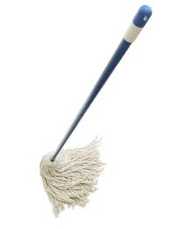
To prevent contamination, NEVER clean mops, brushes or other tools in sinks used for handwashing, food prep, or dishwashing.
Additionally, NEVER dump mop water or other liquid waste into toilets or urinals.

Slide 53
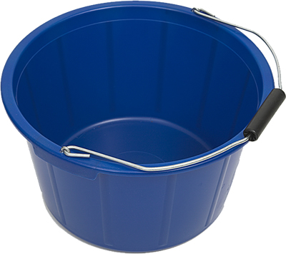
When storing cleaning tools, consider the following:
Air-dry towels overnight.
Hang mops, brooms, and brushes on hooks to air-dry.
Clean and rinse buckets. Let them air-dry, and then store them with other tools.

Slide 54
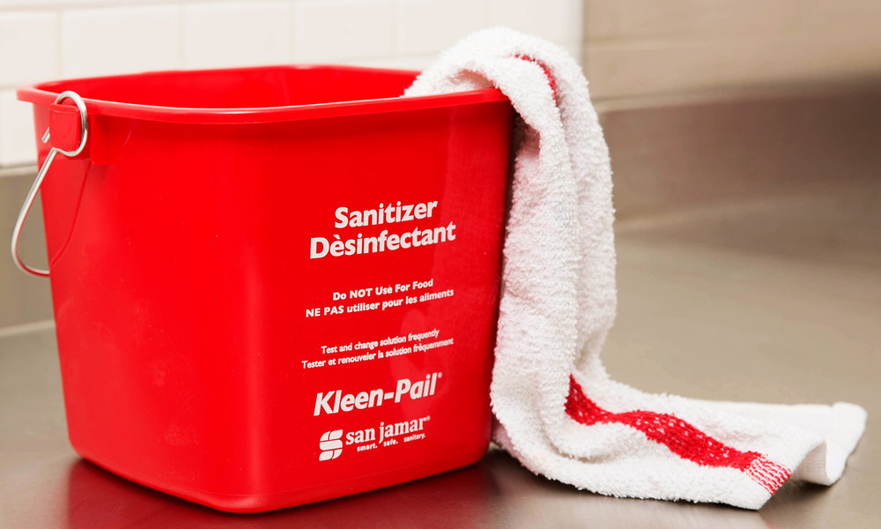
Never use towels meant for wiping up food spills for any other purpose.
Store wiping towels in a sanitizer solution between uses.
Keep towels that come in contact with raw meat, fish, or poultry separate from other cleaning towels.

Slide 55
Storage and Labeling
Store chemicals in their original containers away from food and prep areas. Separate by spacing or partitioning. If chemicals are transferred to a new container, the label on that container must list the common name of the chemical.
Disposal
When throwing out chemicals, follow the instructions on the label and any requirements from your local regulatory authority.

Slide 56
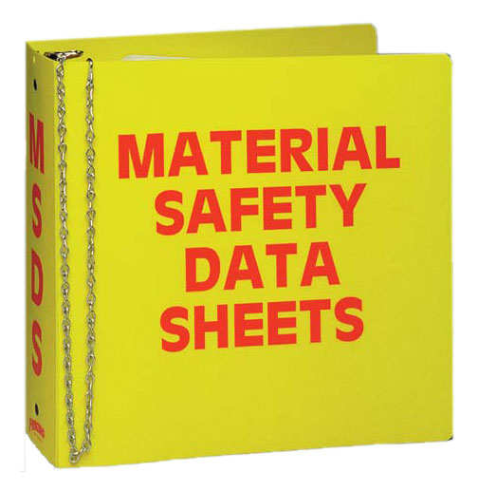
The Occupational Safety and Health Administration (OSHA) has requirements for using chemicals.
OSHA requires chemical manufacturers and suppliers to provide a Material Safety Data Sheet (MSDS) for each hazardous chemical they sell.

Slide 57
An MSDS contains the following information about the chemical:
Safe use and handling
Physical, health, fire and reactivity hazards
Precautions
Appropriate personal protective equipment (PPE) to wear when using the chemical

Slide 58
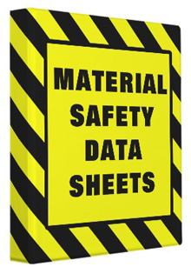
First-aid information and steps to take in an emergency
Manufacturer’s name, address, and phone number
Preparation date of MSDS
Hazardous ingredients and identity information

Slide 59
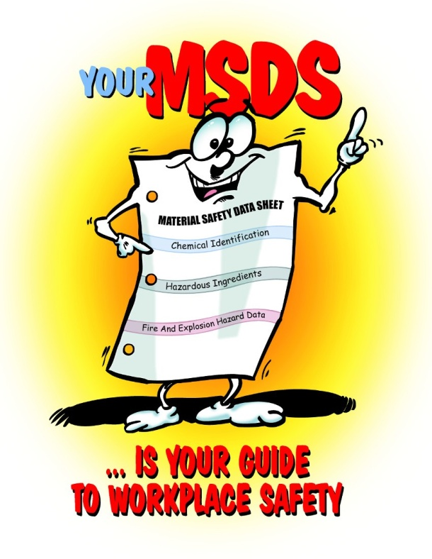
MSDS are often sent with the chemical shipment. You can also request them from your supplier or the manufacturer.
Staff have a right to see an MSDS for any hazardous chemical they work with. Therefore, you must keep these sheets where they can be accessed.

Slide 60
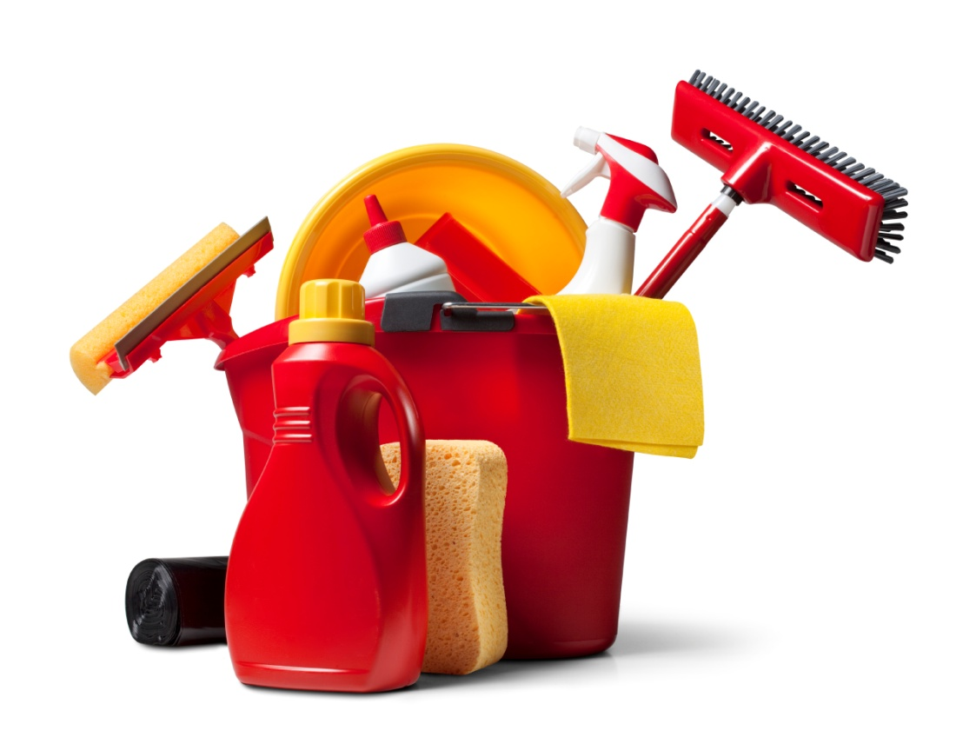
To develop an effective cleaning program for your operation, you must focus on three things
Creating a master cleaning schedule
Training your staff to follow it
Monitoring the program to make sure it works

Slide 61
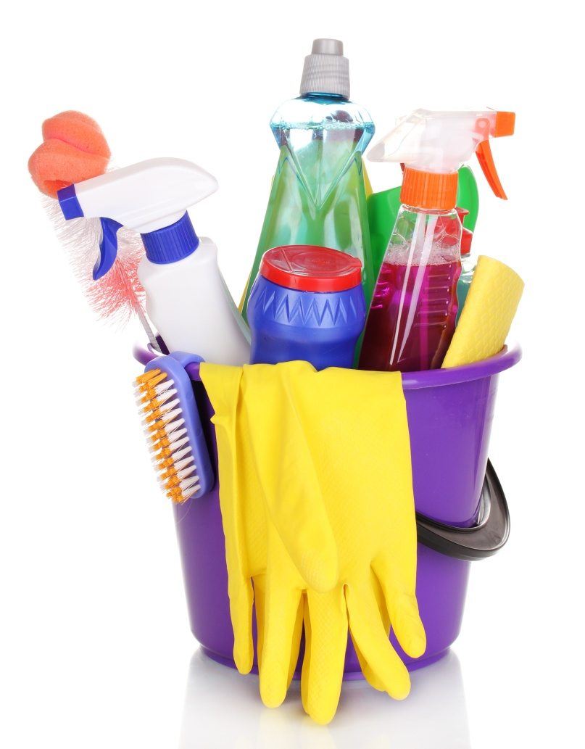
What should be cleaned
List all the cleaning jobs in one area. Or list jobs in the order they should be performed.
Who should clean it
Assign each task to a specific individual

Slide 62
When it should be cleaned
Staff should clean and sanitize as needed. Schedule major cleaning when food will not be contaminated or service will not be affected. Schedule work shifts to allow enough time.
How it should be cleaned
Have clear, written procedures for cleaning. List cleaning tools and chemicals by name. Post cleaning instructions near the item. Always follow manufacturers’ instructions when cleaning equipment.

Slide 63
Schedule time for training.
Work with small groups or conduct training by area.

Slide 64
Make sure the cleaning program is working.
Supervise daily cleaning routines
Check all cleaning tasks against the master schedule every day.
Change the master schedule as needed for any changes in menu, procedures, or equipment.
Ask staff during meetings for input on the program.

